Slide 1
AUTHENTICATION
SINGLE_ SIGN_ON, TWO FACTOR AUTHENTICATION & BIOMETRICS

Slide 2
SINGLE_SIGN_ON (SSO) Overview
What is SSO?
How SSO operates
Implications of SSO
SSO products and authentication systems

Slide 3
Why SSO?
Multiple systems typically require multiple sign-on dialogues
  Eg. Desktop logon, email, Virtual Learning Environment VLE, library systems, external resources …
  Multiple sets of credentials
  Presenting credentials multiple times
Headache for administration and users
The more security domains, the more sign-ons required

Slide 4
Simple SSO operation
Authentication Domain
Secondary domain
1. Access application
Application/resource
2. Refer for authn.
3. Ask for
credentials
SSO Application
4. Transfer to application
Application/resource
SSO
Session
(Ticket Granting Ticket)
Transfer/Service ticket
Secondary domain

Slide 5
Security implications
Credentials never leave the authentication domain
Secondary (affiliated) domains have to trust the authentication domain
  Credentials must be asserted correctly
  Protect from unauthorised use
Authentication transfer has to be protected
  Replay prevention
  Interception/masquerade attacks

Slide 6
SSO Components
Sign-on (verification)
App (enforcement)
HTTP server
SSO Application
Application
Enforcement agent
Authorisation
LDAP
Kerberos
RDBMS
…
Authentication server

Slide 7
SSO dependencies
SSO system relies on other infrastructure
  Authentication system
  Requires interface with web server
  Identity management/registration
Need to provide for authorisation
  Applications often need more than just authentication information
  Attribute information
  Shibboleth or other architectures

Slide 8
Other considerations
Most SSO systems are HTTP based
  Browser cookies (restricted to the authentication domain)
  HTTP redirects
  Placement of tokens in querystring
May require integration with application
  Agent-based architecture
  SSO protocol
Needs to interface with authentication system
Needs protocol between authentication domain and target application
  Token/ticket-based
  SAML POST/artifact profiles

Slide 9
Session management
The SSO application maintains a session (TGT) for the user
The target application usually maintains a session
Logging out of the target application may not log you out of the SSO application
Single Sign-On ⇒ Single Sign-Out!
  Application specific

Slide 10
Two-Factor Authentication Overview
Two-factor authentication requires the use of two of the three authentication factors:
  Something only the user:
  Knows (e.g. password, PIN, secret answer)
  Has (e.g. ATM card, mobile phone, hard token)
  Is (e.g. biometric – iris, fingerprint, etc.)

Slide 11







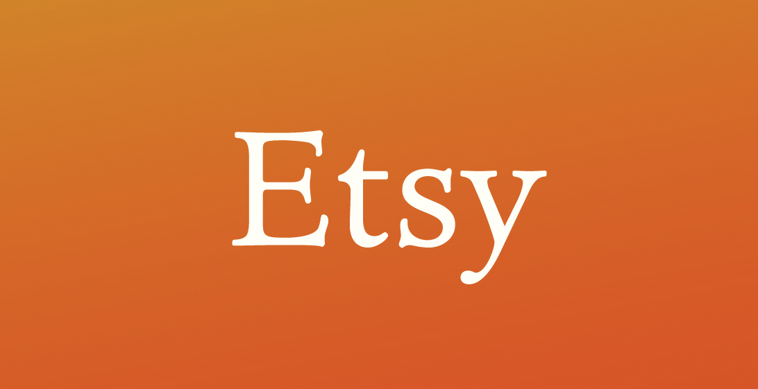





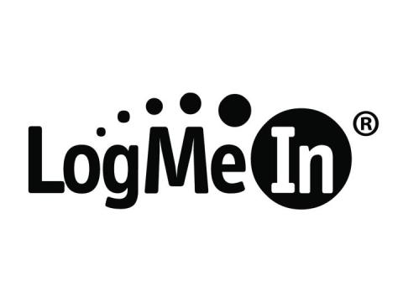



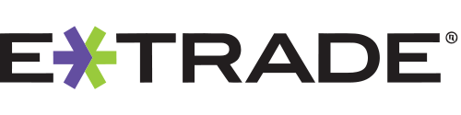




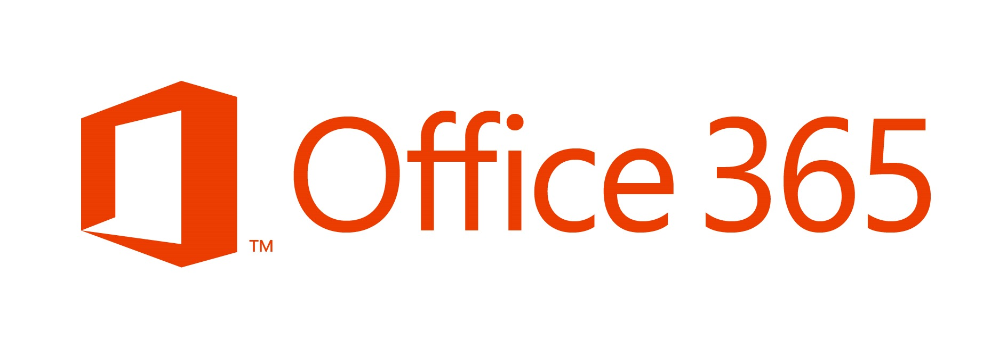








Who Uses Two-Factor?

Slide 12
How Two-Factor Authentication Helps
Credentials are commonly stolen through:
  Phishing attacks targeted at MSU
  Third-party sites compromised and same username/password used for MSU applications
    Adobe, Yahoo, LinkedIn, Forbes, Zappos, and eHarmony were breached in past year, 32 million usernames and passwords stolen
      15,000+ users registered with MSU email addresses, unknown how many used MSU password to register with these sites
Two-factor authentication prevents attackers from accessing your account even if they obtain your username and password.

Slide 13
Two-Factor Strategy at MSU
Second Factor will be a“soft” Token
Identify an Industry Leader for the Two-Factor Components
Enhance MSU’s single sign-on solution (Sentinel) to integrate with Industry Leaders Solution to provide Two-Factor
Enable Two-Factor for EBS applications (portal, HR, Payroll, Finance, BI) for all current employees.

Slide 14
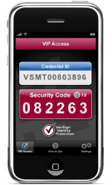
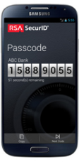
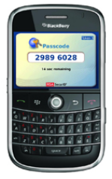
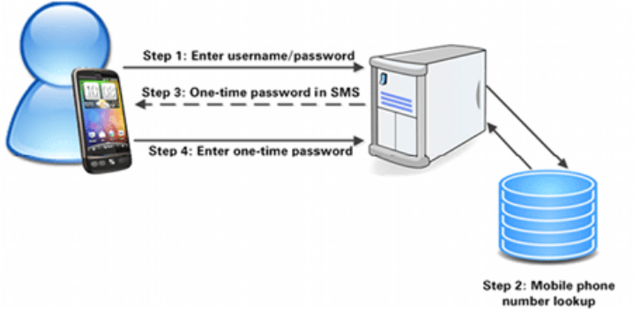
Two-Factor Authentication Deployment Options
Multiple deployment options available for MSU users:
  Mobile application
  SMS text message
  Voice call made to desk, mobile, or home phone

Slide 15
Biometrics
Biometrics measure innate characteristics
  “something you are”, hence hard to impersonate
Can be Physiological:
  Fingerprints
  Retinal or Iris scanning
  Face recognition
  Hand geometry recognition
Or behavioral
  Voice recognition (both physiological and behavioral)
  Handwriting/signature recognition
  Typing dynamics

Slide 16
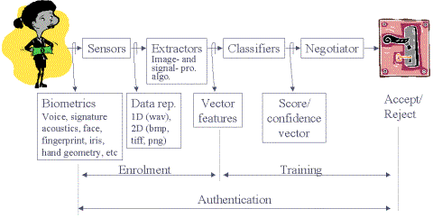
Biometrics-based Authentication
Usually uses a pattern recognition approach
  A “profile” is constructed for the true person
  A matching score is computed in each authentication attempt
Processes

Slide 17
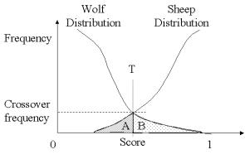
Threshold-based Decision
Real-time matching score is thresholded (T)
Error types
  (A) False alarms (False Positive, Type 2 error)
  (B) Misidentification (False Negative, Type 1 Error)

Slide 18
Two Generic Applications
Easier: Verification
  One-to-One: given a real-time authentication attempt, try to match to a specific profile
  Requires a second form of identification, e.g., login, token.
Harder: Identification
  Many-to-One: given a real-time authentication attempt, try to match to one of several profiles in a database
  Difficulty stems from birthday paradox unless a high separation can be attained between candidates
  Usually not attempted except in applications where two-factor authentication is not feasible

Slide 19


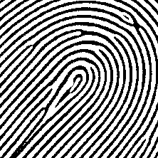





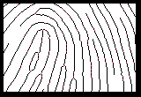
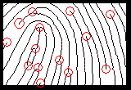
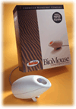
Fingerprints Analysis
Shapes:
ARCH
WHORL
LOOP
Minutiae:
END
BIFURCATION
ISLAND
LAKE
DOT
unique arrangement of
minutiae for different
people
Non-intrusive, Reliable, Inexpensive
Semiconductor or Optical
Useful mostly for verification and less for identification

Slide 20
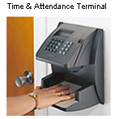
Hand Geometry
One of the first practically implemented techniques
  physical access control: airports, secured corporate areas, etc.
  time and attendance monitoring
Reader uses CCD camera and a number of mirrors to measure the shape of the hand perimeter, in <1 sec
  Length, width, thickness, surface areas
Used for verification, in conjunction with another identifier
  E.g., magnetic card
Non-intrusive

Slide 21
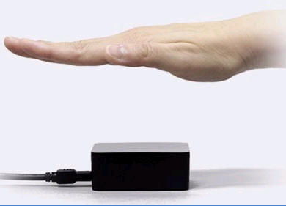
Palm Vein Authentication
Vein patterns are unique to an individual (even twins)
Scanned with infrared rays, using reflective photography
False rejection rate <0.01
PalmSecure (Fujitsu, CES 2006)

Slide 22
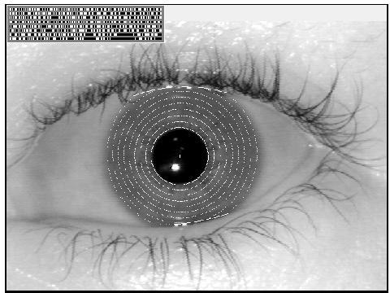
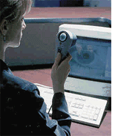
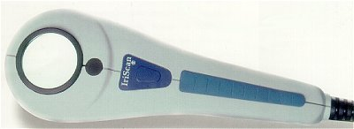
Iris Scanning
Human eye encodes 3.4bits/sqmm
Extremely accurate: chance of duplication (including twins) < 10^{–72}
Fast comparison: Identification takes 2sec per 100,000 people in DB
Sub-$1000 systems are available, but expensive to enroll many
Considered a little intrusive / dangerous by some people
Growing in market share vs. other solutions (patents expired)

Slide 23
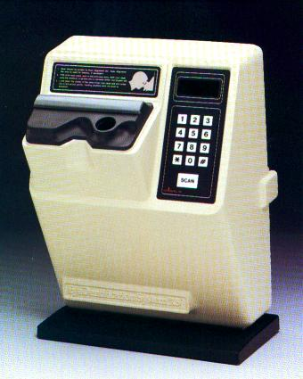
Retinal Scanning
Works by identifying patterns in retinal blood vessels
Uses light source to take 400 measurements, which are then reduced to a signature of 96 bytes
Preceded Iris scanning, but is less prevalent
  considered more intrusive
  requires precise positioning of the eye
  requires removal of glasses

Slide 24

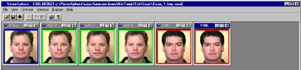
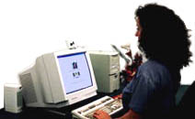
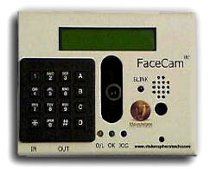
Face Recognition
Controlled scene – access control
  Frontal view, similar distance, reasonable lighting
  Compare live image to an original, captured in similar environment
  Usually for verification purposes, with another ID
Algorithms extract features, and compare relative positions of eyes, nose, and mouth, nose width, and other factors
Relatively user-friendly
Not very accurate, and requires frequent updates
Very difficult in a random scene – street, airports
  Much more difficult
  Law enforcement applications
  Privacy issues: a bill that makes this unlawful was shelved in March 2002
Notes:
Logan airport experiment with Visionics
Compute faceprint, a score that represents a face

Slide 25
Voice Verification
Principle: speech dynamics are affected by physical structure of mouth, vocal chords, sinus, etc.
A voice signature can typically be formed from speech features, with relatively high accuracy
  Each syllable typically has few dominant frequencies (formants)
  More accurate when user repeats a previously recorded sentence
Weaknesses: taped replay, environmental noise, illness, richness of spoken language
Applications: access control, call centers
Example: www.verivoice.com
  User is requested to spell a random string of digits
Notes:
Israeli company, persay, acquired by Comverse

Slide 26
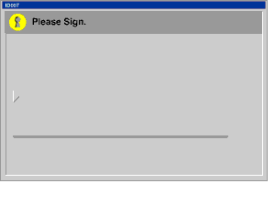
Signature Verification
Static verification
Dynamic verification
  Curvature, changes in x-y sign, acceleration, pen up time

Slide 27
Weaknesses of Biometrics
Possibility of false positives, and sometimes unacceptable FP rate
In identification applications: misidentification
Replay attack, e.g., tape replay, cut finger…
Health concerns
Privacy concerns

Slide 28
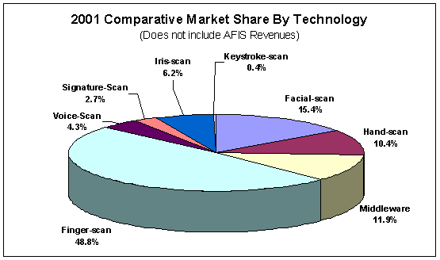
Biometric Market
Int’l Biometric Group

Slide 29
The 5th Factor: How you behave
Idea: a user’s behavior may help identify, or at least authenticate her
For example
  What time of the day you access a certain application?
  At what frequency do you perform a certain operation
  What type of access to which information you require?
  Did you login from home or work?
Premise for authentication: a user’s behavioral pattern changes only slowly over time.
Advantage: relatively cheap (software)
Typically shall be used in conjunction with another factor
  e.g., use behavior profiling to supplement password authentication
I believe that acceptance to this new form will grow, especially in areas like intrusion detection and access control
It also plays into the general trend of combining physical security and IT security
Notes:
Authentor application to password verification uses the speed of typing a password as another indication

