Slide 1
Web Service Security Standards Overview
Richard Jacob

Slide 2
What HTTPS/ SSL offers
(at the protocol level)
identification: who are you?
authentication: how do I know your identity is true?
authorization: are you allowed to perform this transaction?
integrity: is the data you sent the same as the data I received?
confidentiality: are we sure that nobody read the data you sent me?
auditing: record of all transactions so we can look for security problems after the fact
non- repudiation: both sender and receiver can provide legal proof to a third party that the sender did send the transaction, and the receiver received the identical transaction

Slide 3

Why Isn’t HTTP/S Adequate for Web Services?
Limitation #1: End-to-End
  authorization, auditing, non- repudiation
Limitation #2: Protocol Translation
  identification, authentication, confidentiality stop at HTTPS end point
Limitation #3: Signature and non- repudiation
  Transaction requirements dictate that integrity needs to persist... all the way to a database used for audit trail
  prove message has not been modified
  HTTPS has no signature (that can be used for non-repudiation)
Limitation #4: Element-wise encryption
  decryption is necessary to route the message
    HTTPS encrypts everything...
    so you have to decrypt everything to route it
  we may need certain data (credit card #) to remain encrypted all the way to endpoint

Slide 4
Web Service Security Framework
Broad set of specifications that cover
  Authentication
  Authorization
  Privacy
  Trust
  Integrity
  Confidentiality
  Secure communication channels
  Federation
  Delegation
  Auditing
Framework builds upon
  Soap
  WSDL
  XML Digital Signatures
  XML Encryption
  SSL/TLS
  …

Slide 5
Web Service Security Framework / Roadmap
WS-SecureConversation
WS-Federation
WS-Authorization
Federation
Layer
WS-Policy
WS-Trust
WS-Privacy
Policy
Layer
WS-PolicyFramework
WS-PolicyAttachments
WS-PolicyAssertions
WS-Security
Today
SOAP Foundation
Time

Slide 6
Transport/SOAP/XML Foundations
SSL/TLS
  Current means to exchange messages at various levels of security
  Point-to-Point
XML Digital Signatures
  Sign portions of an document
    relative to authentication and non-repudiation
  W3C recommendation, 12 February 2002
XML Encryption
  Using ciphers to make portions of a document unavailable to 3rd parties
  W3C recommendation, 10 December 2002
XML Key Management Services
  XML-based trust web services for the processing and management of PKI-based cryptographic keys
  2.0 Working Draft W3C, 18 March 2002

Slide 7
Transport/SOAP/XML Foundations
Security Assertions Markup Language
  Markup language for exchanging security related assertions about a document, its source and recipients.
  V1.1 OASIS specification, 2 September 2003
  V2.0 Committee Draft review shall begin July 2004
eXtensible Access Control Language
  policy language
    Describe general access control requirements
  access control decision request/response language
    form a query to ask whether or not a given action should be allowed (Policy Enforcement Point <-> Policy Decision Point)
  V1.0 OASIS standard, 18 February 2003
XrML
  Rights markup language
XML Common Biometric Format TC (XCBF)

Slide 8
WS-Security
Describes SOAP header enhancements to provide message integrity and confidentiality
  By leveraging XML Signature and XML Encryption
Provides general purpose mechanism to attach security tokens to messages
  No specific type of security token mandated
  Support for multiple security token formats
  Provides token profiles for
    Plain text tokens (Username, Username/Password) (standardized)
    Binary tokens
      X.509 certificates (standardized)
      Kerberos tickets (working draft)
    XML tokens
      SAML assertions (working draft)
      XrML
V1.0 OASIS Standard, 6th April 2004

Slide 9
WS-Security Model
Today’s technologies offer network and transport layer security
  IPsec, SSL, TLS
SOAP message model operates on logical endpoints, often via multi-hop with intermediaries
Need for SOAP message-level end-to-end security
Security Context
Requestor
Intermediary
Web Service

Slide 10
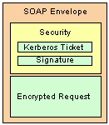
WS-Security
The <Security> header block provides a mechanism for attaching security-related information targeted at a specific receiver (SOAP actor). This may be either the ultimate receiver of the message or an intermediary.
Defines sub-elements to provide information about message integrity, confidentiality and credentials
Security Header
License Location
Integrity Element
Confidentiality Element
Credentials Element
Sequence
Sequence
Sequence
<S:Envelope>
<S:Header>
...
<Security S:actor="..." S:mustUnderstand="...">
...
</Security>
...
</S:Header>
...
</S:Envelope>
Signature Element
Any Element
Encrypted Attachments Element
Any Element
Any Element

Slide 11
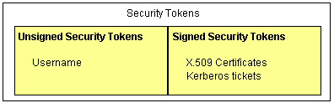
WS-Security – Security Token
Claim - is a declaration made by an entity (e.g. name, identity, key, group, privilege, capability, etc).
Claim Confirmation –is the process of verifying that a claim applies to an entity
SecurityToken – represents a collection of claims
Signature - is a value computed with a cryptographic algorithm and bound to data in such a way that intended recipients of the data can use the signature to verify that the data has not been altered since it was signed by the signer.
Signed SecurityToken – A signed security token is a security token that is asserted and cryptographically signed by a specific authority (e.g. an X.509 certificate or a Kerberos ticket).

Slide 12
WS-Security - UsernameToken
The <wsse:UsernameToken> element is introduced as a way of providing a username and optionally a password (plain text or digest)
Example:
<S:Envelope xmlns:S="http://www.w3.org/2001/12/soap-envelope"
xmlns:wsse="http://schemas.xmlsoap.org/ws/2002/xx/secext">
<S:Header>
...
<wsse:Security>
<wsse:UsernameToken>
<wsse:Username>JohnDoe</wsse:Username>
<wsse:Password>secret</wsse:Password>
</wsse:UsernameToken>
</wsse:Security>
...
</S:Header>
...
</S:Envelope>

Slide 13
WS-Security - BinarySecurityToken Element
Binary security tokens (e.g., X.509 certificates and Kerberos tickets) or other non-XML formats require a special encoding format for inclusion.
<S:Envelope xmlns:S="...">
<S:Header> 97
<wsse:Security xmlns:wsse="...">
<wsse:BinarySecurityToken
xmlns:wsse="http://schemas.xmlsoap.org/ws/2002/04/secext"
Id="myToken"
ValueType="wsse:X509v3"
EncodingType="wsse:Base64Binary"> MIIEZzCCA9CgAwIBAgIQEmtJZc0...
</wsse:BinarySecurityToken>
...
</wsse:Security>
</S:Header>
<S:Body>
...
</S:Body>

Slide 14
WS-Security – XML Tokens
Describes the basic principles and framework for using XML-based security tokens.
Subsequent specifications describe rules and processes for specific XML-based security token formats.
<S:Envelope xmlns:S="...">
<S:Header>
<wsse:Security xmlns:wsse="...">
<saml:Assertion
    MajorVersion="1"
    MinorVersion="0"
    AssertionID="SecurityToken-ef375268“ Issuer="elliotw1"
    IssueInstant="2002-07-23T11:32:05.6228146-07:00"
    xmlns:saml="urn:oasis:names:tc:SAML:1.0:assertion">
    ...
</saml:Assertion>
<wsse:SecurityTokenReference
<wsse:KeyIdentifier wsu:id=”…” ValueType=”saml:Assertion”
SecurityToken-ef375268
</wsse:KeyIdentifier>
</wsse:SecurityTokenReference>
</wsse:Security>
</S:Header>
<S:Body>
...
</S:Body>
</S:Envelope>

Slide 15
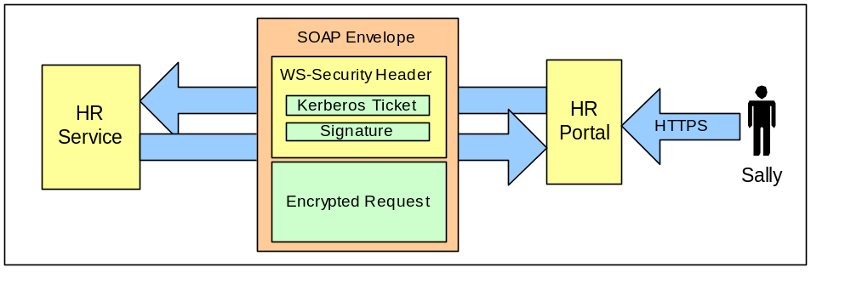
Message security using SSL and WS-Security
Secure the communication between the Sally, the HR Portal and the We-R-HR.com Web services.
Requires that Sally access the portal using a secure HTTP connection through her web browser.
WS-Security is used to add encryption and integrity information to SOAP messages regardless of destination.

Slide 16
WS-Policy*
Common to all
  V1.1 public draft, 28 May 2003
  Not at a Standards Body yet, but assumed to happen soon
  Finalization: ???
WS-Policy
  Grammar for Web service provides to communicate their requirements and capabilities so a Web service requester can discover the information they need to access the service.
WS-PolicyAttachment
  Mechanisms to attach these policy statements to a web service.
    WSDL
    UDDI
    Arbitrary resources independent of their definition
Policy Languages
  WS-PolicyAssertions
    General policies that can be associated with a service (text encoding, language, specVersion, messagePredicate)
  WS-SecurityPolicy
    General security policies that can be associated with a service

Slide 17
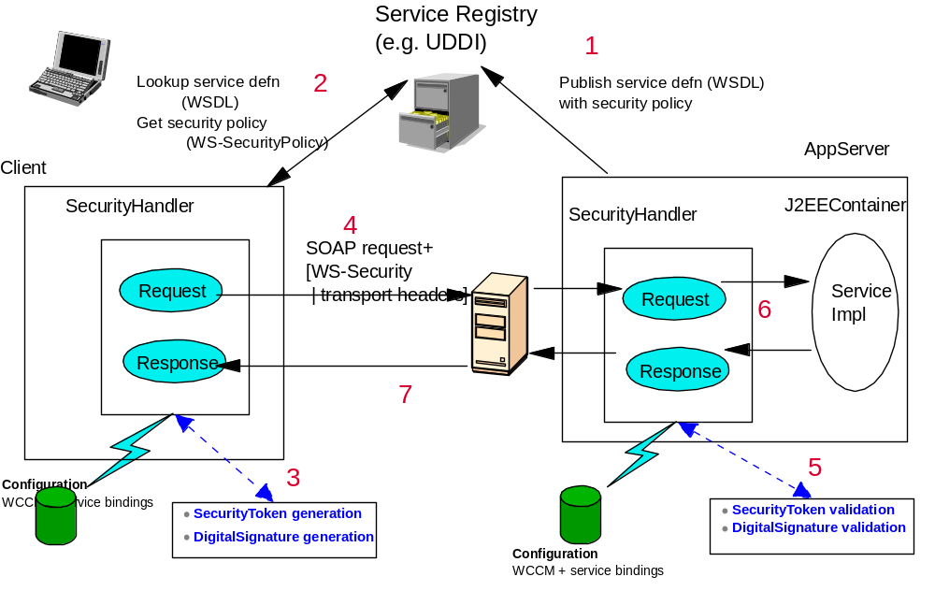
WS-Policy* - Usage Scenario

Slide 18
WS-Policy
General mechanism for expressing policy and metadata (assertions) about arbitrary subjects
Such information can be organized into groups of assertions using QNames or URIs
Possibility to reference both external and intra-document groups
Extensible to any kind of statements
WS Policy is the Grammar for assertions
  A Policy element contains assertions
  Assertions can be named and referenced
  Assertions can have operators to group in arbitrary combinations
    All
    OneOrMore
    ExactlyOne
  Assertions can be typed by their usage
    Required
    Optional
    Supported
    Rejected
    Ignored
  Assertions may be tagged to indicate a preferred assertion
    Preference
  Policies may be protected
    wsse:Security

Slide 19
WS-Policy - Example
Policy Expression
  XML InfoSet
  Describes combinations of assertions
Operators
  Describes semantics of combinations of assertions
Assertions
  The leaf nodes in the policy expressions
  No core assertions defined in WS-Policy
  New assertions can be defined using namespace mechanisms
<Policy>
<ExactlyOne>
<All>
<SecurityToken …STA…/>
<Algorithm …AA…/>
</All>
<All>
<SecurityToken …STB…/>
<Algorithm …AB…/>
</All>
</ExactlyOne>
</Policy>

Slide 20
WS-PolicyAttachment
A policy attachment associates a policy expression with a subject
  Policy expression based on WS-Policy
  Subject identified by a domain expression
  Embedded wsse:Security element allows policy attachments to be self-signed
Scope policy to an element or reference
  UDDI
  WSDL
    Messages
    portTypes
    Services
    Ports
  Endpoint Reference
<wsp:PolicyAttachment>
<wsp:AppliesTo>
...
</wsp:AppliesTo>
<wsp:Policy>
...
</wsp:Policy>
</wsp:PolicyAttachment>

Slide 21
WS-PolicyAssertions
Provides a basic set of Policy assertions
  Simple well-understood domains
  Demonstrates the range of assertions possible
  Exercises the architecture and mechanisms
TextEncoding Assertion
  Indicates a particular character encoding
    Uses same value space as XML 1.0
    Removes dependency on HTTP Accept-style charset negotiation
Language Assertion
  Indicates a natural language used in content
    Uses same value space as xml:lang (XML 1.0)
    Address i18n preferences, capabilities
SpecVersion Assertion
  Allows for assertions about specifications – Web services and otherwise
    Identified by URI
    Extensibility elements can be used when URI is not adequate
MessagePredicate Assertion
  Allows statement of constraint based on message syntax
    Allows for different expression dialects
    XPath is default

Slide 22
WS-SecurityPolicyAssertions
Provides a basic set of Policy assertions for Security
  Simple well-understood domain
  Demonstrates the range of assertions possible
  Exercises the architecture and mechanisms
Message Integrity/Confidentiality
  Services need to be able to indicate what aspects of communication need to have integrity/confidentiality protection
  Allow indication of the types of tokens that can be used with specific integrity/confidentiality aspects
Message Replay Semantics
  Different applications have different freshness rules
  Need to be able to express the freshness requirements
    May depend on context
Supported Security Tokens
  There are a wide variety of security token formats
    Username, Kerberos, X.509, SAML, XrML, …
  Need to indicate which formats a service supports
  Services may have requirements on who issued the tokens
  Need to indicate preferences
Supported Algorithms
  Encryption provides a number of different algorithm choices
    Need a way to indicate which algorithms can be used, and in what conditions
  Need to indicate preferences
  Extensible to support future algorithms
Supported Transformations, accessibility of data, processing semantics,…

Slide 23
WS-Trust
Describes model on how to establish trust relationships
  Direct
  Brokered
  Via third parties and intermediaries
Defines Security Token Service (Web Service)
  Request/obtain security tokens
  Validate security tokens
  Defined using WSDL
Trust Management
  Fixed trust roots
  Trust hierarchies
  Authentication service
1.1 Public draft, May 2004
Not at Standards Body yet
Expected finalization: ???

Slide 24
WS-Security Trust Model
Web Service requires a set of claims
  If message arrives without needed claims -> reject or ignore message
Requestor send proof of claims by associating security tokens with message
Security tokens may be obtained from security token services (Web Services)
A challenge response protocol may be required for freshness and proof-of-possession
Security Token
Claims
Claims
Security Token Service
Policy
Policy
Requestor
Web Service
Policy
Security Token
Security Token
Claims
Claims
Claims
Claims

Slide 25
WS-Trust – Token Issuance
Requesting a Security Token
  Basic elements for requesting specific token types
    Scope Requirements
    Key and Encryption Requirements
    Delegation, Forwarding, and Proxy Requirements
    Lifetime and Renewal Requirements
    Policies
Returning Tokens
  Basic element to determine specific token type retuned
    Scope Requirements
    Key and Encryption Requirements

Slide 26
WS-Trust - Request Example
Request Header
Defines the type of security token requested
The action that is being requested
References tokens that are used to validate the authenticity of a request
References the supporting tokens used to authorize request
<RequestSecurityToken>
<TokenType>...</TokenType>
<RequestType>...</RequestType>
<Base>...</Base>
<Supporting>...</Supporting>
</RequestSecurityToken>

Slide 27
WS-Trust - Response Example
Response Header
Defines the type of security token requested
Specifies the type of key used in the token
Specifies the size of the key returned
Specifies the scope to which this security token applies
Requested security token
Proof-of-possession token
<RequestSecurityTokenResponse>
<TokenType>...</TokenType>
<KeyType>...</KeyType>
<KeySize>...</KeySize>
<wsp:AppliesTo>...</wsp:AppliesTo>
<RequestedSecurityToken>...
</RequestedSecurityToken>
<RequestedProofToken>...
</RequestedProofToken>
</RequestSecurityTokenResponse>

Slide 28
WS-SecureConversation
Defines the mechanisms for:
  Establishing and sharing security contexts
    Context contains keys/secrets and other information
    Can be stateless (state embedded in security context token)
  Deriving session keys from security contexts
Security context is used to exchange multiple messages within context
  Provides a more efficient way to secure communication between parties
Security context can be shared among the communicating parties (2 or more)
Defines 3 ways of establishing a security context
  Security context token created by a security token service
  Security context token created by one of the communicating parties and propagated with a message
  Security context token created through negotiation
1.1 public draft, May 2004
Not at a Standards Body yet
Expected finalization: ???

Slide 29
WS-SecureConversation
Security Context Token
SecurityContext Header
Element identifies the security context using a URI
indicates the creation time of the security context
Indicates the expiration time of the security context
Holds the shared secrets of the security context
References the shared secret of the security context
<wsse:SecurityContextToken wsu:Id="...">
<wsu:Identifier>...</wsu:Identifier>
<wsu:Created>...</wsu:Created>
<wsu:Expires>...</wsu:Expires>
<wsse:Keys>
<xenc:EncryptedKey Id="...">...</xenc:EncryptedKey> <wsse:SecurityTokenReference>...</wsse:SecurityTokenReference>
...
</wsse:Keys>
</wsse:SecurityContextToken>

Slide 30
WS-Federation
Defines the mechanisms for:
  Enabling the sharing of identity, authentication, and authorization data using different or like mechanisms
    Optional hiding of identity information and other attributes
    Local identities are not required at target services
  Brokering of trust and security token exchange
Extends the foundation of WS-Security, Trust and Policy
  Describes how these models are combined to enable richer trust realm mechanisms across and within federations
  Defines various federation models/scenarios
1.0 public draft, July 2003
Not at a Standards Body yet
Expected finalization: ???

Slide 31
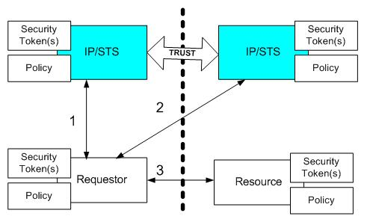
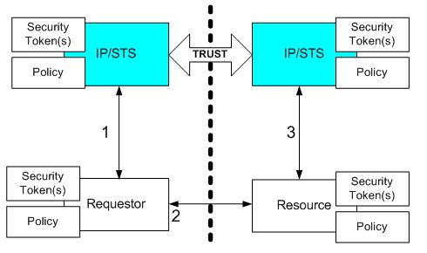
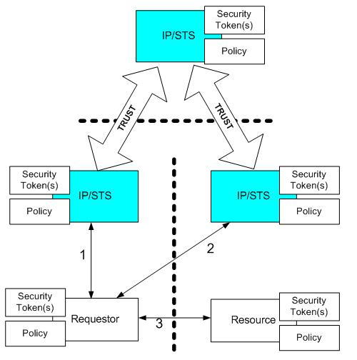
WS-Federation - Scenarios

