Slide 1
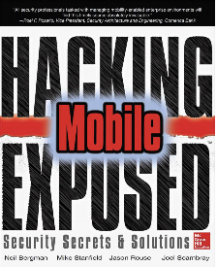
Ch 9: Mobile Payments
CNIT 128:
Hacking Mobile Devices

Slide 2
Current Generation

Slide 3
Scenarios
Mobile banking apps
NFC-based or barcode-based payment apps used by consumers to purchase goods
Near Field CommunicationNFC is a short-range high frequency wireless communication Technology
Premium-rated SMS messages to purchase virtual goods within games, or music
Users are billed later via their telephone bill

Slide 4
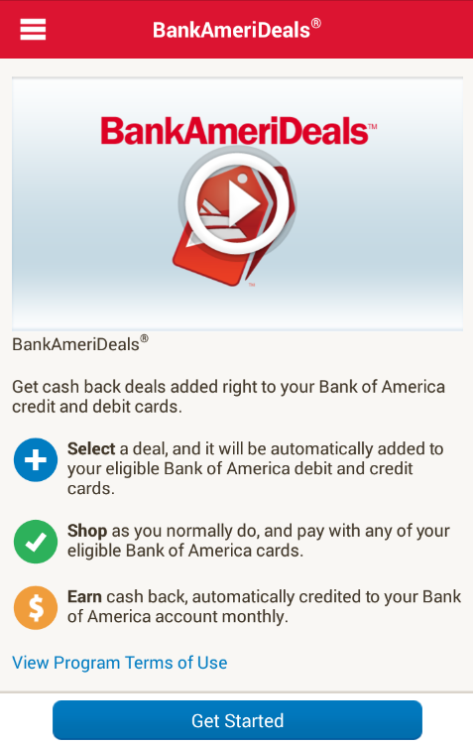
Mobile Banking Apps
Banking transactions using a phone
View account balances
Transfer money
Web applications designed to be viewed within the mobile browser
Or a WebView inside a native mobile app

Slide 5
Mobile Banking Apps
Back-end components are the same as for desktop online banking
Similar vulnerabilities
But with mobile, must also consider device theft
Sensitive information may be stored on the device improperly

Slide 6
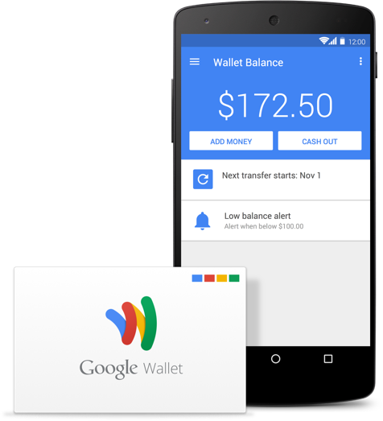
Contactless Payment Google Wallet
Started in 2011
Supports all major credit cards
Card # stored in the cloud
A virtual account number is sent to the contactless POS terminal via NFC

Slide 7
Contactless Payment ISIS (now Softcard)
Joint venture of Verizon, AT&T, and T-Mobile
Began in 2012
Changed its name in 2014 because of the "Islamic State" (link Ch 9a)
Purchased by Google in Feb., 2015
Google Wallet will be prominently preinstalled on U.S. Android phones that run KitKat (4.4) or later (link Ch 9e)

Slide 8
Android Pay
Google's new payment system
Will let developers use it in various ways through an API
"will tokenize card numbers, in the same way that Apple Pay and Samsung Pay do, meaning it generates a one-time payment token...for each transaction"
No timeline for release yet, more info. expected at Google I/O
Link Ch 9g

Slide 9
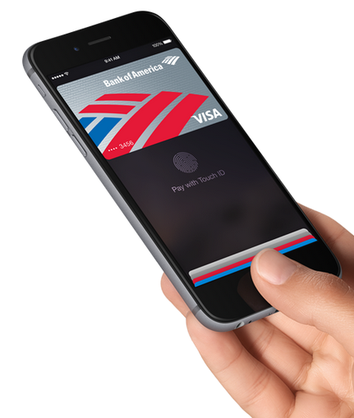
Apple Pay
Released on Oct 20, 2014
With iPhone 6 and Apple Watch
Customer payment information is kept from retailer
creates a "dynamic security code [...] generated for each transaction"
Link Ch 9d

Slide 10
Market History
Google was first, but retailers didn't play along
Only 2.4% of retailers had NFC in Oct, 2014
Chip-and-PIN deadline is Oct. 2015
Retailers must update POS systems or accept liability for credit card fraud (link Ch 9c)

Slide 11
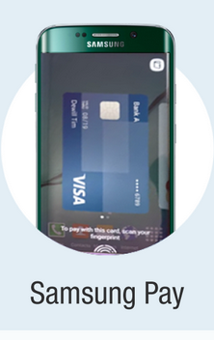
Samsung Pay
To be available in summer 2015
Only on Samsung Galaxy S6
Works with NFC or magstripe readers
90% of merchants

Slide 12
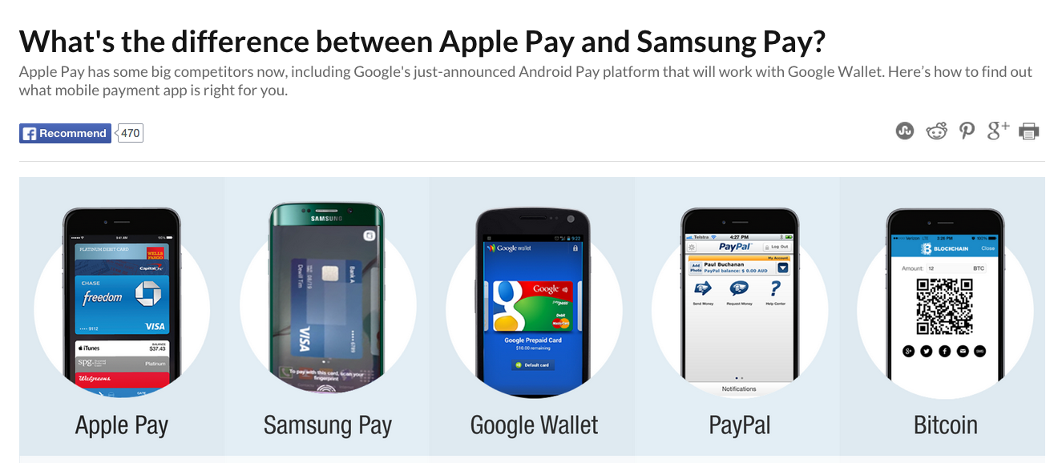
CNN Infographic
Go Through Link Ch 9f

Slide 13
CurrentC
A group of merchants (MCX)
Rite-Aid, CVS, Walmart, Target, etc.
Saves merchants credit card processing fees
Gives stores access to consumer data
Unlike Apple Pay
Link Ch 9b, 9h
Designed for merchants, not end-users

Slide 14
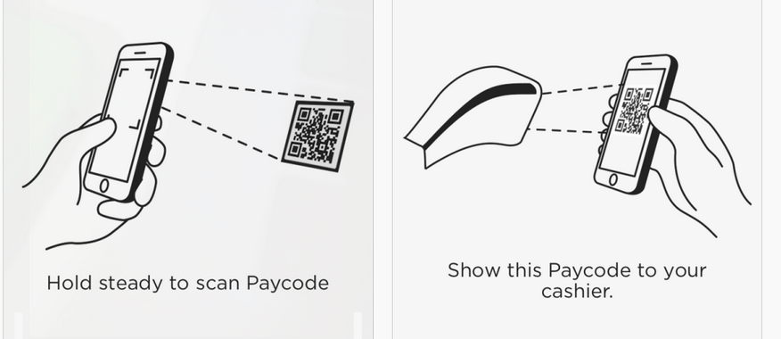
How CurrentC Works
Tied directly to your bank account
Pay with QC code

Slide 15
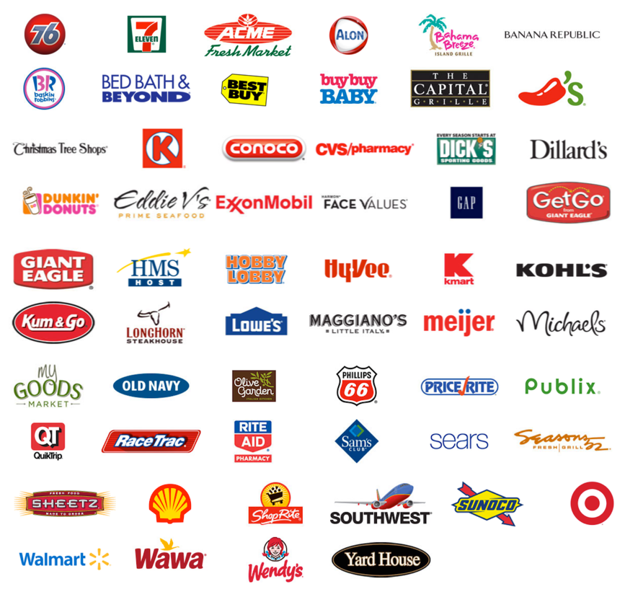
Retailers Supporting CurrentC

Slide 16
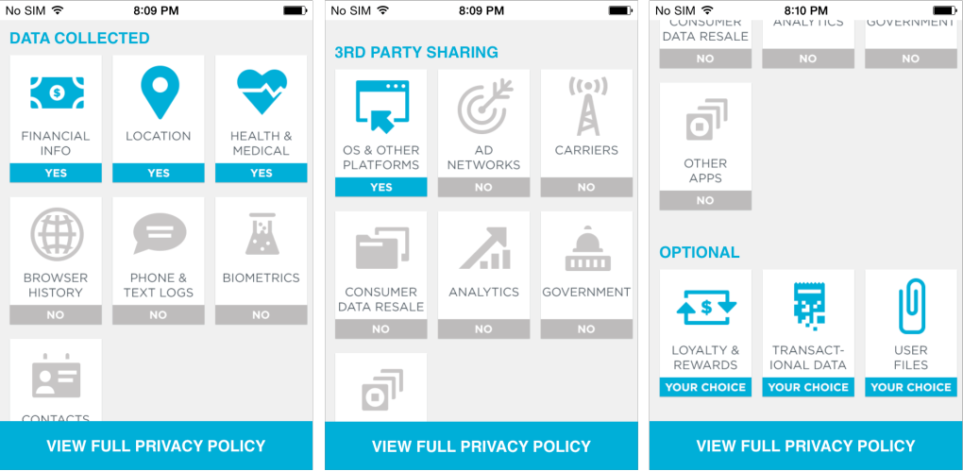
CurrentC Collects Health Data

Slide 17
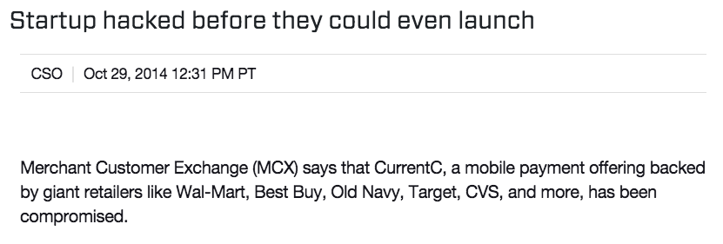
CurrentC Hacked in Oct. 2014
Email addresses of early testers exposed
Link Ch 9j

Slide 18
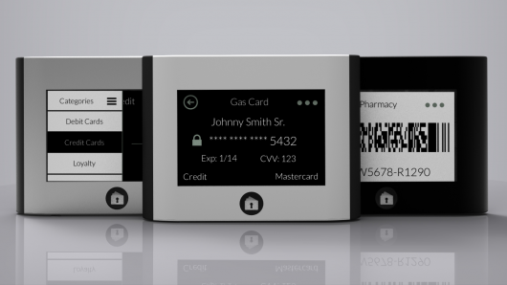
Wocket
Smart wallet, no phone required
Link Ch 9i

Slide 19
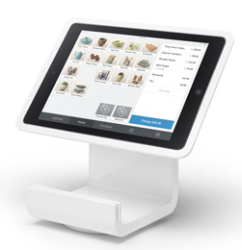
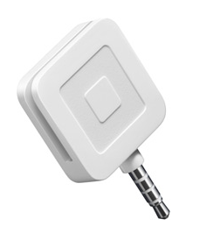
Square
Free card reader or stand
Plugs into audio jack on iOS or Android phone
Takes credit card payments by reading the magstripe
Used by Starbucks and Whole Foods
Began taking Bitcoin in 2014
Will take Apple Pay in 2015

Slide 20
Contactless Smartcard Payments

Slide 21
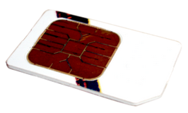
Secure Element (SE)
Core of the mobile payment platform
Secure storage of sensitive information
Embedded SE contained within the mobile device
Galaxy Nexus
UICC aka SIM card
Universal Integrated Circuit Card
Another SE form factor
Link Ch 9m

Slide 22
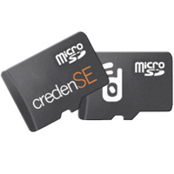
microSD Cards with NFC
Allowed early iPhones without NFC to use NFC
NFC radio included in the microSD card
Pioneered by DeviceFidelity
Purchased by Kili in 2014
Kili purchased by Square in 2015
Links Ch 9o, p, q

Slide 23
Java Card Runtime Environment (JCRE)
All SE's use this system
Payment applet stored on the card
Applet firewall keeps applets from accessing each others' information
Robust cryptography including AES and RSA
SE's are GlobalPlatform compliant

Slide 24
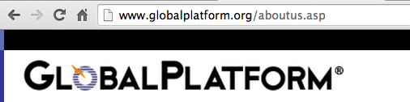
Security and interoperability standards for SE devices
Only the owner of an SE can directly read or write to it
Mutual identification uses shared keys
SE will lock after a number of failed attempts

Slide 25
Proximity Payment System Environment (PPSE)
Registry of all payment apps in the SE
App names and standard Application Identifier
Tells the payment terminal what apps are available
Allows terminal to select which app it wants to use

Slide 26
Payment Apps
Responsible for making the actual contactless payment
Contain sensitive information associated with a particular payment account
Java Card applets that are stored and run inside the SE

Slide 27
Payment Apps
Cryptographic capabilities of the JCRE allow banks to securely verify transactions
One method is to generate a one-time Card Verification Value for each transaction, called a dynamic CVV (dCVV)
Application Protocol Data Unit (APDU)
Used to send instructions to applets on the SE

Slide 28
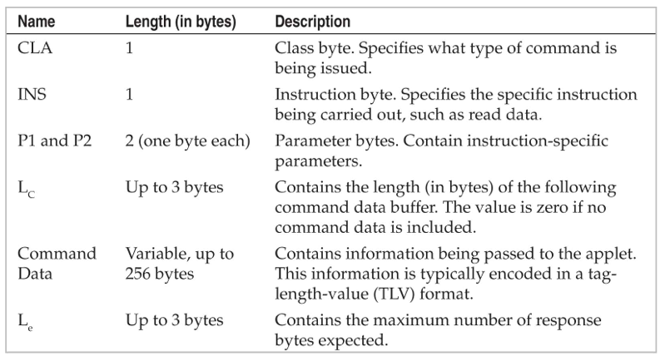
Command Application Protocol Data Unit (C-APDU)

Slide 29
Large Commands
If the amount of data to be transmitted to the applet is greater than 256 bytes
Multiple C-APDUs can be chained together

Slide 30
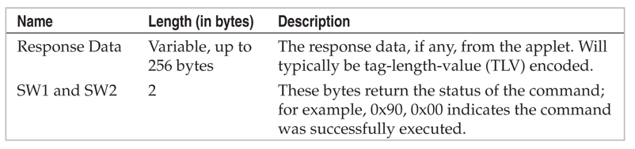
Response Application Protocol Data Unit (R-APDU)

Slide 31
Contact and Contactless Interfaces
These are the two ways to send APDUs to the SE
Contact Interface
Connects the SE to the phone itself
Contactless Interface
Connected to the NFC radio
Used to communicate with Point-of-Sale (POS) terminals
Not available to applications on the phone

Slide 32
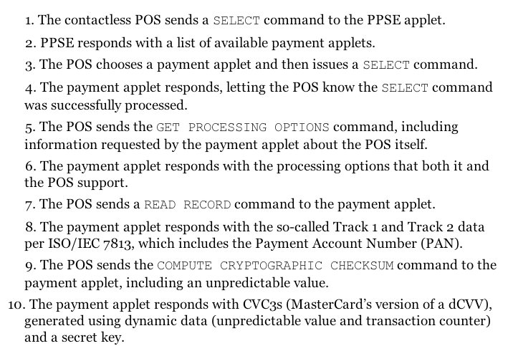
Simplified Contactless Transaction

Slide 33
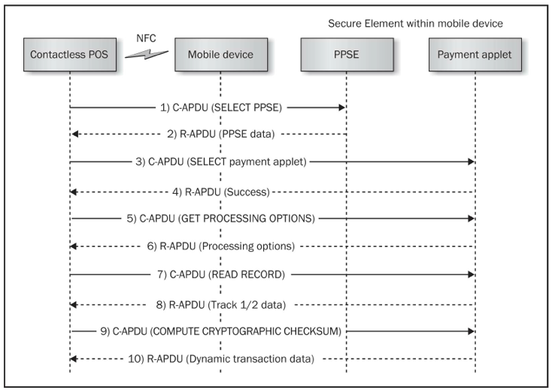

Slide 34
Secure Element API
Restricted to Google Wallet on Android
Introduced in 2.3.4 (Gingerbread)
Required system-level permissions through 4.0 (Ice Cream Sandwich)
In 4.04, allows apps with a signature in /etc/nfcee_access.xml
The only signature in that file is Google Wallet
Requires root access to update

Slide 35
SE API Limitations
Very basic—allows application to open a channel to the SE and transmit APDUs
Works for embedded SE's
But not for the UICC or microSD SE's used in some phones
For microSD SE's, you need the open-source Secure Element Evaluation Kit (SEEK)
UICC SE's is not directly connected to the application processor and must be reached through the proprietary code and the Radio Interface Layer

Slide 36
Access Control for SE's
Embedded SE's use a whitelist
/etc/nfcee_access.xml
SEEK uses GlobalPayment
An additional app on the SE with a list of application signatures and applets
Smartcard API contains Access Control Enforcer
Compares signature of calling application to signature stored in the SE card to see if application has permission for the chosen applet

Slide 37
Mobile Application
Consumers see this part
User selects which card to use for a payment
Google Wallet requires the user to enter a four-digit PIN to make a payment
Protects against device theft
Better than contactless credit cards

Slide 38
Google Wallet Vulnerabilities

Slide 39
PIN Storage Vulnerability
PIN entry required for transactions
Only six tries permitted
But an attacker who steals a device and then roots it can extract the PIN from the salted hash
Because it's not stored on the SE
Storing it on the SE would make banks liable for breaches due to stolen PINs
Links Ch 9s, 9t

Slide 40
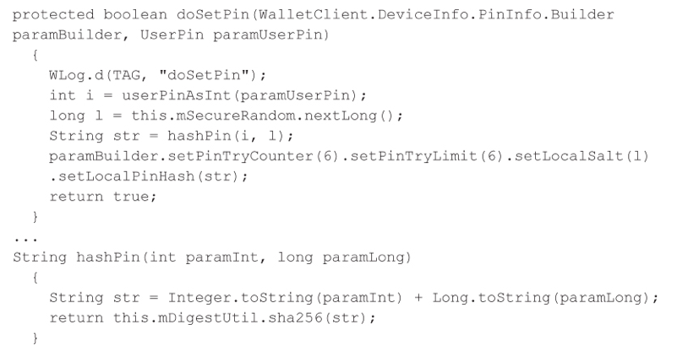
PIN Storage
PIN is salted with a 64-bit random value and hashed with one round of SHA-256

Slide 41
Storage of Hash
Salt and hash stored in a SQLite database in Google Wallet's /data directory
/data/data/com.google.android.apps.walletnfcrel/databases/walletDatastore
"Wallet Cracker" simply tries all 10,000 four-digit PINs to find PIN from the hash

Slide 42
Google's Response
Don't run Google Wallet on rooted phones
Not very reassuring since the thief can root your phone
Much better to perform PIN storage and verification on the SE
Also store the PIN try counter on the SE

Slide 43
Countermeasures for Google Wallet Cracker
Don't root your device
Enable Android lock screen
Disable ADB debugging
Keep up-to-date with patches

Slide 44
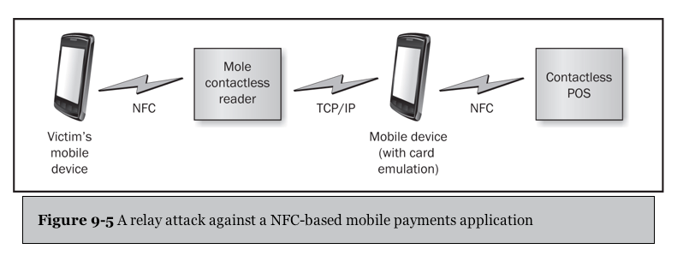
Relay Attacks (MITM)
"Mole" reader gets close to target mobile device
Attacker's mobile gets near POS terminal
APDUs are passed via TCP/IP

Slide 45
Relay Attack Limitations
Target's mobile payment app must be unlocked
Google Wallet requires entry of a PIN to unlock

Slide 46
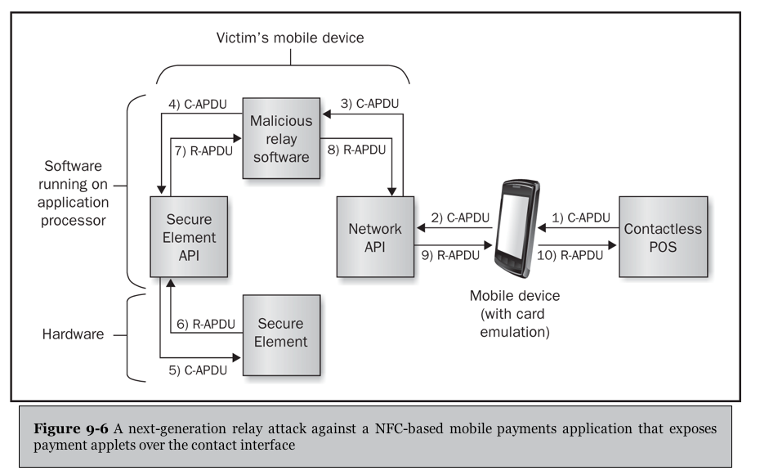
Relay Through a Malicious App
Works against Google Wallet
Because it exposes payment credentials to the contact interface
Requires root privileges to bypass SE API signature authentication

Slide 47
Relay Attack Countermeasures
Contactless POS terminals should enforce a time-out on all transactions
Relay attack requires network communications which slows it down
Not very practical because errors can cause delays in legitimate transactions
Use location information to flag suspicious transactions
Target mobile is not really near the POS
Requires target GPS to be active and consumer's consent

Slide 48
Relay Attack Countermeasures
Google Wallet is no longer vulnerable to the second attack
It no longer exposes payment applets over the contact interface

Slide 49
Square Vulnerabilities

Slide 50
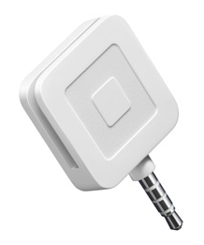
Square
Square Register
Mobile app
Magnetic stripe reader
Plugs into audio jack
Free
Allows anyone to take credit card transactions
Charging 2.75% of each transaction

Slide 51
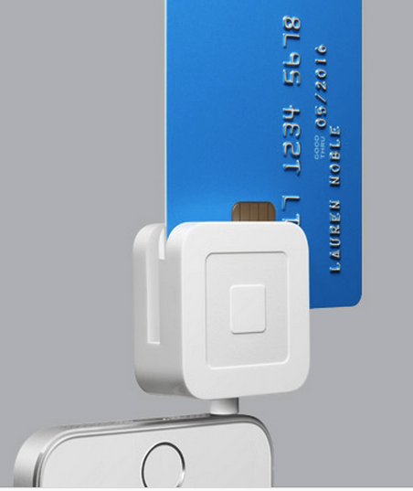
EMV (Europay, MasterCard and Visa) aka Chip-and-PIN
Much safer
New Square reader coming out in Oct. 2015
Link Ch 9u

Slide 52
Skimming
Any app that can receive audio data can steal the magnetic data from the Square device
VeriFone released an app to do this
In order to compete with Square

Slide 53
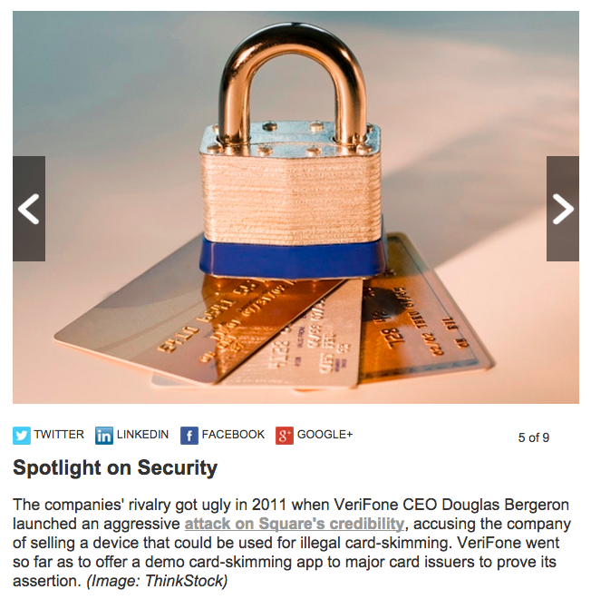
Verifone v. Square
Link Ch 9u

Slide 54
Skimming Countermeasures
Manual skimming requires the card
Same as skimmers that have been used for years
A software attack against the reader could do more harm
In 2012, Square modified their reader to encrypt the audio stream
Encrypted data is sent to Square's servers and decrypted there
Prevents rogue apps getting the credit card #

Slide 55
Replay Attack
Malicious app could record audio stream and replay is back to make another purchase
Demonstrated by Adam Laurie and Zac Franken at Black Hat in 2011
Also reverse-engineered the format Square reader uses for data from credit card
They could manufacture correct audio streams from magnetic Track 2 data, which can be purchased on the black market

Slide 56
Replay Attack
They could therefore use Square to perform mass fraud
Instead of manufacturing fake credit cards

Slide 57
Replay Attack Countermeasures
Square's encryption prevents this
Textbook author verified that replaying an encrypted audio stream is not accepted as a valid Square transaction anymore
So Square is changing the key, or using a nonce, or something similar

