Slide 1
Introduction to OpenSSL

Slide 2
Overview
What is OpenSSL
SSL Protocol
Command-Line Interface
Application Programming Interface
Problems with OpenSSL
Summary

Slide 3
What is OpenSSL
The OpenSSL Project is a collaborative effort to develop a robust, commercial-grade, fully featured, and Open Source toolkit implementing the SSL_v2/v3 and TLS_v1 protocols as well as a full-strength general purpose cryptography library.

Slide 4
What is OpenSSL – Cont.
The OpenSSL Project is managed by a worldwide community of volunteers that use the Internet to communicate, plan, and develop the toolkit and its related documentation.

Slide 5
What is OpenSSL – Cont.
OpenSSL is based on the excellent SSLeay library developed by Eric A. Young and Tim J. Hudson.
The current versions are 0.9.7c (AES Algorithm) and 0.9.6k-engine, which supports hardware accelerators for encryption and decryption.

Slide 6
What is OpenSSL – Cont.
Features:
  Open Source
  Fully Functional Implementation
  Cross-Platform (Unix & Windows)
  Command-Line Interface (openssl command)
  Application Programming Interface (C/C++, Perl, PHP & Python)

Slide 7
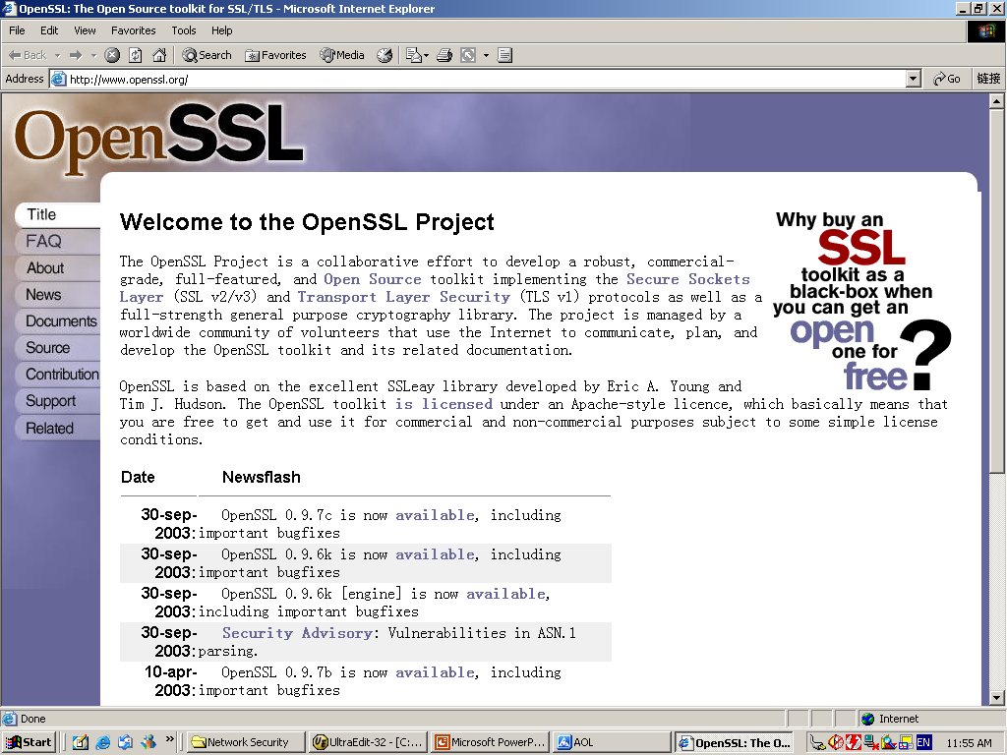

Slide 8
SSL Protocol
The primary goal of the SSL (Secure Sockets Layer) Protocol and its successor - TLS (Transport Layer Security) Protocol is to provide privacy and reliability between two communicating applications.

Slide 9
SSL Protocol – Cont.
It is composed of two layers:
  SSL Record Protocol
    It is used for the transmission of bulk data.
  SSL Handshake Protocol
    It is used to establish the secure connection for data transfer.

Slide 10
SSL Protocol – Cont.
Handshake
  Negotiate the cipher suite
  Authenticate the server
  Authenticate the client (Optional)
  Generate the session keys
  Establish a secure connection

Slide 11
Command-Line Interface
Functionality
  Creation of RSA, DSA & DH key pairs
  Creation of X509 Certificates, CSRs & CRLs
  Calculation of Message Digests
  Encryption & Decryption with Ciphers
  SSL/TLS Client & Server Tests
  Handling of S/MIME signed and/or encrypted mails

Slide 12
Command-Line Interface – Cont.
Example 1 – Secure Apache Web Server with mod_ssl & OpenSSL
Example 2 – S/MIME

Slide 13
Problems with OpenSSL
It is powerful, but is not easy for use
Non object-oriented
Be lack of documents, especially for APIs
Problems with shared libraries in some platforms

Slide 14
Summary
OpenSSL is an Open Source toolkit implementing SSL/TLS & Cryptography
It has a command-line interface & an application programming interface
There are a lot of tools using OpenSSL’s libraries to secure data or establish secure connections

Slide 15
References
OpenSSL – http://www.openssl.org
SSL – http://www.netscape.com/eng/ssl3/draft302.txt
TLS – http://www.ietf.org/rfc/rfc2246.txt
Apache – http://www.apache.org
mod_ssl – http://www.modssl.org
Network Security with OpenSSL by Pravir Chandra, Matt Messier & John Viega
Applied Cryptography by Bruce Schneier

