Slide 1
TCP Hijacking

Slide 2
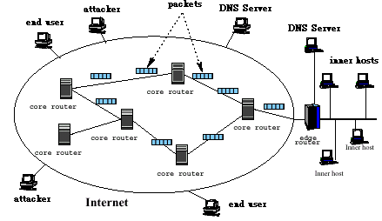
Network Architecture:

Slide 3
TCP/IP Protocol Suite

Slide 4
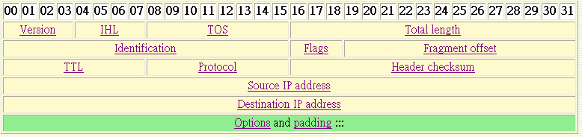
IP Header _{[networksorcery]}
Specifies the length of the IP packet header in 32 bit words. The minimum value for a valid header is 5.

Slide 5
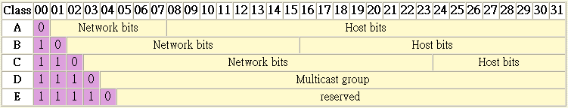
Classes of IP addresses
Class A: 1.0.0.0 ~ 127.255.255.255
Class B: 128.0.0.0 ~ 191.255.255.255
Class C: 192.0.0.0 ~ 223.255.255.255
Class D: 224.0.0.0 ~ 239.255.255.255

Slide 6
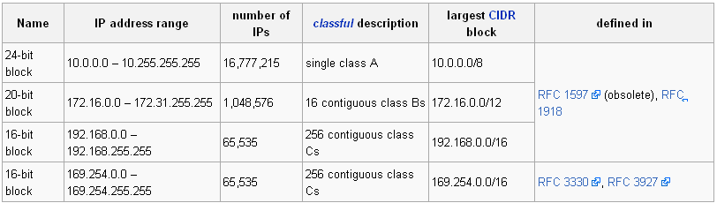
Private Network
In Internet terminology, a private network is a network that uses RFC 1918 IP address space. Computers may be allocated addresses from this address space when it's necessary for them to communicate with other computing devices on an internal (non-Internet) network but not directly with the Internet.

Slide 7


ICMP Header

Slide 8
Function of ICMP
ICMP messages are sent in several situations:
  for example, when a datagram cannot reach its destination, when the gateway does not have the buffering capacity to forward a datagram, and when the gateway can direct the host to send traffic on a shorter route.
The Internet Protocol is not designed to be absolutely reliable. The purpose of these control messages is to provide feedback about problems in the communication environment, not to make IP reliable.
There are still no guarantees that a datagram will be delivered or a control message will be returned.
Some datagrams may still be undelivered without any report of their loss. The higher level protocols that use IP must implement their own reliability procedures if reliable communication is required.
The ICMP messages typically report errors in the processing of datagrams. To avoid the infinite regress of messages about messages etc., no ICMP messages are sent about ICMP messages.

Slide 9
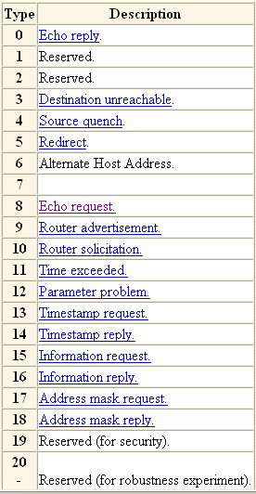
ICMP Types

Slide 10
Routing Table
Router
Interface card
eth1
eth0
180.2.3.*
180.2.3.9
172.16.55.100
Internet
172.16.55.0
R
172.16.55.36
R
172.16.55.1
172.16.50.0
H
172.16.50.12
R : Router
H : Host
172.16.55.3

Slide 11
A Routing Table Used in Previous Slide
Destination
Gateway
Genmask
Flags
Metric
Ref
Use
I_face
172.16.55.3
0.0.0.0
255.255.255.255
UH
eth0
172.16.55.0
0.0.0.0
255.255.255.0
U
eth0
172.16.55.0
172.16.55.36
255.255.255.0
UG
eth0
180.2.3.0
0.0.0.0
255.255.255.0
U
eth1
127.0.0.0
0.0.0.0
255.0.0.0
U
lo
0.0.0.0
172.16.55.1
0.0.0.0
UG
eth0
U : useful
H : to a single host
G : to a gateway
default
Flag
A destination IP performs and operation with the Genmask and compares the result with the destination field. The first interface matching will be used to transfer the packet.

Slide 12
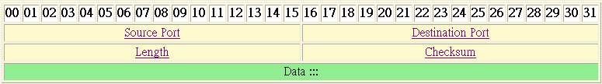
UDP Header Format
The length in bytes of the UDP header and the encapsulated data. The minimum value for this field is 8.

Slide 13
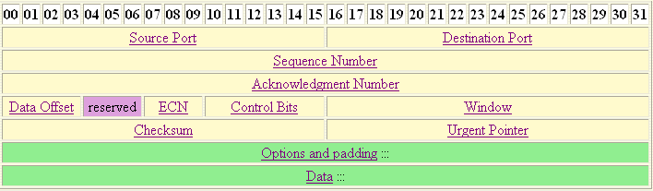
TCP Header Format

Slide 14
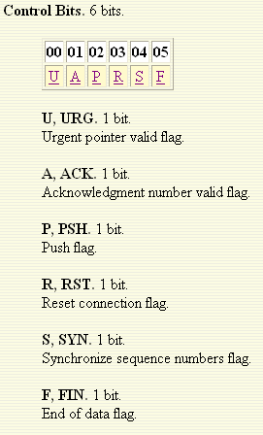
Control Bits in a TCP Header

Slide 15
TCP Sliding Windows
For each TCP connection each hosts keep two Sliding Windows,
  send sliding window, and
  receive sliding window
to make sure the correct transmission of Traffic between the send and receiver.
Each byte sent from the sender to the receiver has a unique sequence number associated with it.

Slide 16
Three-way Handshaking
Client
Server
SYN (seq# = x)
SYN / ACK
ack# = x+1
seq# = y
ACK (seq# = x ; ack# = y+1)

Slide 17
Making a TCP Connection through Sockets
Server
Client
Socket ()
Socket ()
Bind ()
Connection ()
Listen ()
Write ()
Data request
Accept ()
Read ()
Block until connection request from client
Read ()
Data reply
Process request
Write ()

Slide 18
TCP Session Hijacking

Slide 19
TCP Session Hijacking
TCP session hijacking is when a hacker takes over a TCP session between two machines. Since most authentication only occurs at the start of a TCP session, this allows the hacker to gain access to a machine.

Slide 20
Categories of TCP Session Hijacking
Based on the anticipation of sequence numbers there are two types of TCP hijacking:
  Man-in-the-middle (MITM)
  Blind Hijack

Slide 21
Man-in-the-middle (MITM)
A hacker can also be "inline" between B and C using a sniffing program to watch the sequence numbers and acknowledge numbers in the IP packets transmitted between B and C. And then hijack the connection. This is known as a "man-in-the-middle attack".

Slide 22
Man in the Middle Attack Using Packet Sniffers
This technique involves using a packet sniffer to intercept the communication between client and the server. Packet sniffer comes in two categories:
  Active sniffers
  Passive sniffers.

Slide 23
Passive Sniffers
Passive sniffers monitors and sniffs packet from a network having same collision Domain i.e. network with a hub, as all packets are broadcasted on each port of hub.

Slide 24
Active Sniffers
One way of doing so is to change the default gateway of the client’s machine so that it will route its packets via the hijacker’s machine.
This can be done by ARP spoofing (i.e. by sending malicious ARP packets mapping its MAC address to the default gateways address so as to update the ARP cache on the client , to redirect the traffic to hijacker).

Slide 25

Blind Hijacking
If you are not able to sniff the packets and guess the correct sequence number expected by server, you have to implement “Blind Session Hijacking”. You have to brute force 4 billion combinations of sequence number which will be an unreliable task.

Slide 26
Ways to Suppress a Hijacked Host to Send Packets
A common way is to execute a denial-of-service (DoS) attack against one end-point to stop it from responding. This attack can be either against the machine to force it to crash, or against the network connection to force heavy packet loss.
Send packets with commands that request the recipient not to send back response.

Slide 27
MIMT Simulation

Slide 28
TCP Session Hijacking
a
100
b
Host A
Host B
c
600
d
e
f
g
Sending window
h
Receiving window

Slide 29
TCP Session Hijacking
a
b
Host A
Host B
c
d
e
f
g
Sending window
h
Receiving window

Slide 30
TCP Session Hijacking
a
b
Host A
Host B
c
d
e
f
g
attacker
Sending window
h
Receiving window

Slide 31
TCP Session Hijacking
a
b
Host A
Host B
c
d
e
f
g
attacker
Sending window
h
Receiving window

Slide 32
TCP Session Hijacking
Host A close its socket
a
b
RST
Host A
Host B
c
d
e
f
g
attacker
Sending window
h
Receiving window

Slide 33
TCP Session Hijacking
a
b
Host A
Host B
c
Simulated Host B’s
sending window
d
e
f
Simulated Host A’s
sending window
g
Sending window
h
Receiving window
attacker

Slide 34
TCP Session Hijacking:
Send forged packets to both end hosts and suppress end hosts to create output and change both hosts’ receiving windows
a
b
Host A
Host B
c
No change
d
No change
e
f
g
Sending window
h
Receiving window
attacker

Slide 35
TCP Session Hijacking:
Then attackers take care of packets sent by both hosts.
a
b
Host A
Host B
c
Simulated A’s
Receiving window
d
e
Simulated B’s
Receiving window
f
g
Sending window
h
Receiving window
attacker

Slide 36
TCP Session Hijacking:
However Host B will receive packets from Host A with ACK number larger than its sending window.
a
b
Host A
Host B
c
d
e
f
g
Sending window
h
Receiving window
attacker

Slide 37
TCP Session Hijacking Tools
T-Sight
Hunt
Juggernaut
… and so on.

Slide 38
TCP ACK Packet Storms
Assume that the attacker has forged the correct packet information (headers, sequence numbers, and so on) at some point during the session.
  When the attacker sends to the server-injected session data, the server will acknowledge the receipt of the data by sending to the real client an ACK packet. This packet will most likely contain a sequence number that the client is not expecting, so when the client receives this packet, it will try to resynchronize the TCP session with the server by sending it an ACK packet with the sequence number that it is expecting.
  This ACK packet will in turn contain a sequence number that the server is not expecting, and so the server will resend its last ACK packet. This cycle goes on and on and on, and this rapid passing back and forth of ACK packets creates an ACK storm

Slide 39
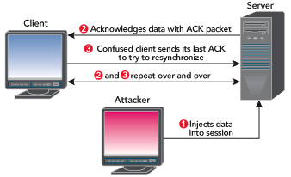
ACK Storm

Slide 40
Countermeasures - Encryption
The most effective is encryption such as IPSec. Internet Protocol Security has the ability to encrypt your IP packets based on a Pre-Shared Key or with more complex systems like a Public Key Infrastructure PKI. This will also defend against many other attack vectors such as sniffing.
  The attacker may be able to passively monitor your connection, but they will not be able to read any data as it is all encrypted. There might be actions an attacker could take against an IPSec enabled network, depending on if they use IKE-PSK or PKI to manage the encryption keys, but this would require an experienced hacker.
  Don’t think that IPSec is the panacea to all your ills, there are IPSec cracking tools available on the internet that will attempt to guess the PSK and decrypt packets.

Slide 41
Countermeasures – Encrypted Application
Other countermeasures include encrypted applications like ssh (Secure SHell, an encrypted telnet) or ssl (Secure Sockets Layer, HTTPS traffic).
  Again this reflects back to using encryption, but a subtle difference being that you are using the encryption within an application.
  Be aware though that there are known attacks against ssh and ssl. OWA, Outlook Web Access uses ssl to encrypt data between an internet client browser and the Exchange mail server, but tools like Cain & Abel can spoof the ssl certificate and mount a Man-In-The-Middle (MITM) attack and decrypt everything!

Slide 42
ARP
The address resolution protocol is used by each host on an IP network to map local IP addresses to hardware addresses or MAC addresses.
Here is a quick look at how this protocol works.
  Say that Host A (IP address 192.168.1. 100) wants to send data to Host B (IP address 192.168.1.250). No prior communications have occurred between Hosts A and B, so the ARP table entries for Host B on Host A are empty.
  Host A broadcasts an ARP request packet indicating that the owner of the IP address 192.168.1.250 should respond to Host A at 192.168.1.100 with its MAC address. The broadcast packet is sent to every machine in the network segment, and only the true owner of the IP address 192.168.1.250 should respond.
  All other hosts discard this request packet, but Host A receives an ARP reply packet from Host B indicating that its MAC address is BB:BB:BB:BB:BB:BB. Host A updates its ARP table, and can now send data to Host B.

Slide 43
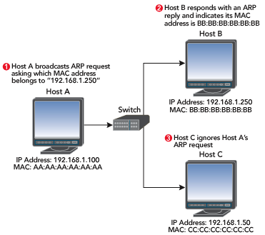
Finding the Owner of a MAC Address

Slide 44
\
INTRODUCTION
A computer connected to
an IP/Ethernet LAN
has two addresses
IP Address
Virtual address
Assigned via
software
MAC/Ethernet Address
Address of the
network card
In theory, unique & unchangeable

Slide 45
INTRODUCTION
A computer connected to
an IP/Ethernet LAN
has two addresses
A computer connected to
an IP/Ethernet LAN
has two addresses
IP Address
Used by applications
Independent of whatever
network technology operates underneath it
Each computer on a network must have an unique IP address to communicate
MAC/Ethernet Address
Necessary for Ethernet to send data
Independent of application protocols
Divides data into 1500 byte frames
Each frame has a header containing
the MAC address of the source and
destination computer.

Slide 46

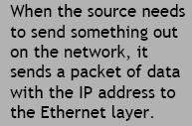
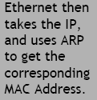



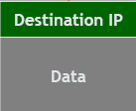


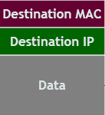


INTRODUCTION
IP & Ethernet must work together!

Slide 47





OPERATION
ARP Request
Does anyone have IP 10.0.0.3? If so, tell me your MAC address!
10.0.0.1 (IP)
00.00.00.00.00.01 (MAC)
10.0.0.2 (IP)
00.00.00.00.00.02 (MAC)
10.0.0.3 )IP(
00.00.00.00.00.03 (MAC)
10.0.0.4(IP)
00.00.00.00.00.04 (MAC)
ARP
Company Logo
network

Slide 48
OPERATION
ARP Request
10.0.0.1 (IP)
00.00.00.00.00.01 (MAC)
10.0.0.2 (IP)
00.00.00.00.00.02 (MAC)
I do!!! My MAC address is 00.00.00.00.00.03
10.0.0.3 )IP(
00.00.00.00.00.03 (MAC)
10.0.0.4(IP)
00.00.00.00.00.04 (MAC)
ARP
Company Logo
network

Slide 49
OPERATION
ARP Cache
Kept locally to minimize number of ARP
requests being broadcast
Updates the cache with the new IP/MAC
associations for each reply
Stateless protocol
- Most operating systems will update
the cache if a reply is received,
regardless of whether they sent out
an actual request
Add Your Title
Add Your Title

Slide 50
OPERATION
ARP Spoofing
Involves constructing forged ARP replies
Takes advantage of the ARP cache
Process of corrupting cache is
“Poisoning”
Ad Your Title

Slide 51

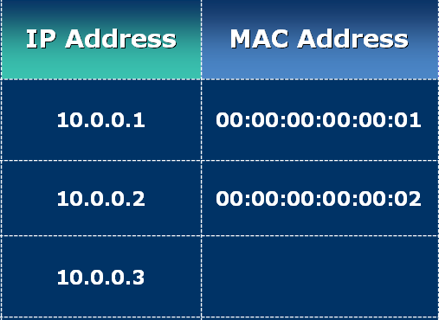
OPERATION
ARP Spoofing
ARP Request
ARP Cache

Slide 52

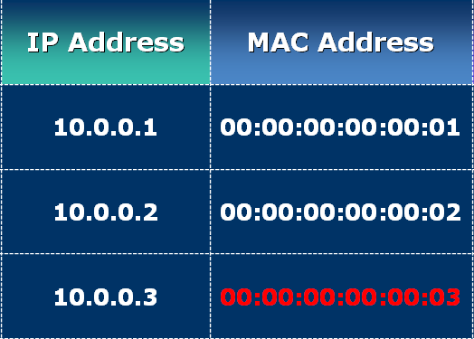
OPERATION
ARP Spoofing
ARP Response
ARP Cache

Slide 53

OPERATION
ARP Spoofing
ARP Response
ARP Cache

Slide 54

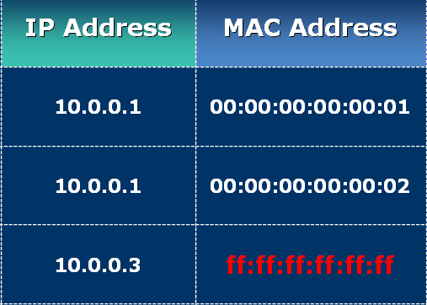
OPERATION
ARP Spoofing
ARP Response
ARP Cache

Slide 55
ARP Table Modifications
However Host A doesn’t know that Host B really did send the ARP reply. In the previous example, attackers could spoof an ARP reply to Host A before Host B responded, indicating that the hardware address E0:E0:E0:E0:E0:E0 corresponds to Host B's IP address. Host A would then send any traffic intended for Host B to the attacker, and the attacker could choose to forward that data (probably after some tampering) to Host B.

Slide 56
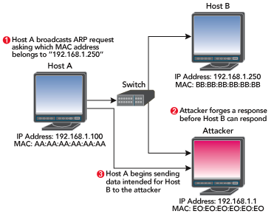
Spoofed Reply

Slide 57
Handling TCP ACK Storms
Attackers can also use ARP packet manipulation to quiet TCP ACK storms, which are noisy and easily detected by devices such as intrusion detection system (IDS) sensors.
Session hijacking tools such as hunt accomplish this by sending unsolicited ARP replies. Most systems will accept these packets and update their ARP tables with whatever information is provided.
  In our Host A/Host B example, an attacker could send Host A a spoofed ARP reply indicating that Host B's MAC address is something nonexistent (like C0:C0:C0:C0:C0:C0), and send Host B another spoofed ARP reply indicating that Host A's MAC address is also something nonexistent (such as D0:D0:D0:D0:D0:D0). Any ACK packets between Host A and Host B that could cause a TCP ACK storm during a network-level session hijacking attack are sent to invalid MAC addresses and lost.

Slide 58
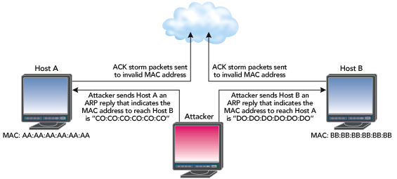
Stopping a TCP ACK Storm

