Slide 1

Network Security
Chase Q. Wu
New Jersey Institute of Technology
Oak Ridge National Laboratory
https://web.njit.edu/~chasewu
Email: chase.wu@njit.edu
wuqn@ornl.gov

Slide 2
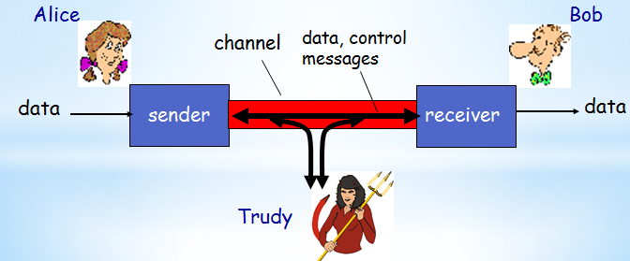

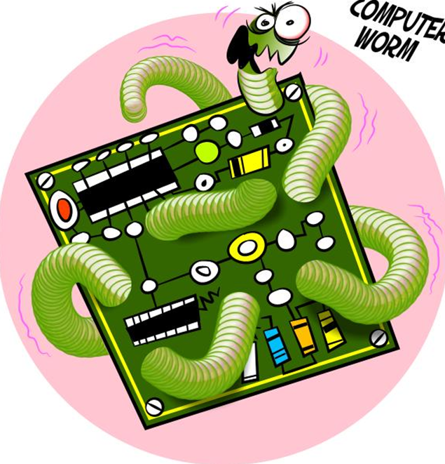

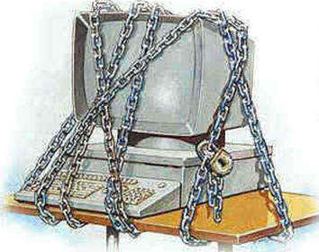



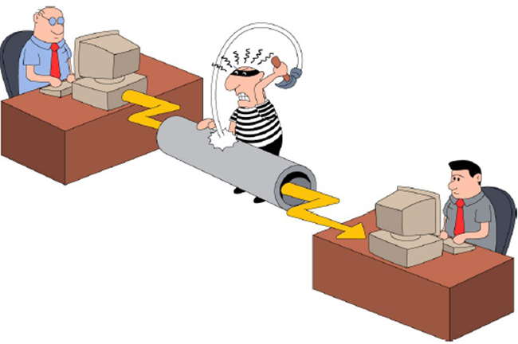
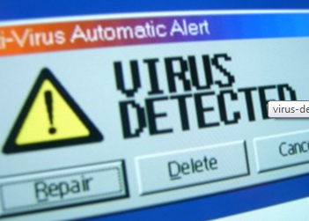
Cyber Security

Slide 3
About This Course
Textbook:
  Network Security Essentials: Applications and Standards, 3rd Ed. William Stallings
  Cryptography and Network Security: Principles and Practices, 4th Ed. William Stallings
Contents:
  Cryptography
      Algorithms and protocols
        Conventional and public key-based encryption, hash func, digital signatures, and key exchange
  Network security applications
      Applications and tools
        Kerberos, X.509v3 certificates, PGP, S/MIME, IP security, SSL/TLS, SET, and SNMPv3
  System security
      System-level issues
        Intruders, viruses, worms, DOS

Slide 4
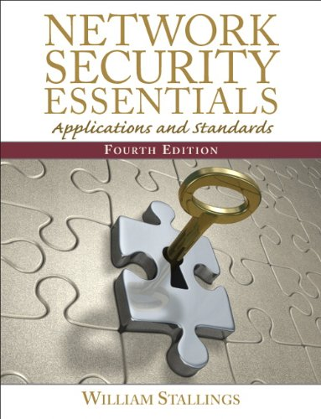

Slide 5
Coursework Components
Homework:
  After each chapter
Projects:
  Cryptography (RSA implementation)
  A secure instant messenger system
Exams: Comprehensive in English
Do I have a TA to help with the class?

Slide 6
Chapter 1 – Introduction
… teaches us to rely not on the likelihood of the enemy's not coming, but on our own readiness to receive him; not on the chance of his not attacking, but rather on the fact that we have made our position unassailable.
—The Art of War, Sun Tzu
故用兵之法，无恃其不来，恃吾有以待也；无恃其不攻，恃吾有所不可攻也。
—《孙子兵法 · 九变篇》
Notes:
This quote from the start of Ch0 sets the scene for why we want to study these issues.

Slide 7
Outline
Background
Attacks, services and mechanisms
Security attacks
Security services
Methods of Defense
A model for Internetwork Security
Internet standards and RFCs

Slide 8
Background
Information Security requirements have changed in recent times
  Traditionally provided by physical and administrative mechanisms
  Many daily activities have been shifted from physical world to cyber space
    Use of computers
      Protect files and other stored information
    Use of networks and communications links
      Protect data during transmission
The focus of many funding agencies in US
  DOD, NSF, DHS, etc.
  ONR: game theory for cyber security
Notes:
The requirements of information security within an organization have undergone two major changes in the last several decades. Before the widespread use of data processing equipment,the security of information felt to be valuable to an organization was provided primarily by physical (eg. rugged filing cabinets with locks) and administrative mechanisms (eg. Personnel screening procedures during hiring process).
Growing computer use implies a need for automated tools for protecting files and other information stored on it. This is especially the case for a shared system, such as a time-sharing system, and even more so for systems that can be accessed over a public telephone network, data network, or the Internet.
The second major change that affected security is the introduction of distributed systems and the use of networks and communications facilities for carrying data between terminal user and computer and between computer and computer. Network security measures are needed to protect data during their transmission.

Slide 9
Definitions
Computer Security
  Generic name for the collection of tools designed to protect data and to thwart hackers
Network Security
  Measures to protect data during their transmission
Internet Security (our focus!)
  Measures to protect data during their transmission over a collection of interconnected networks
Notes:
Here are some key definitions, note boundaries between them are blurred.

Slide 10
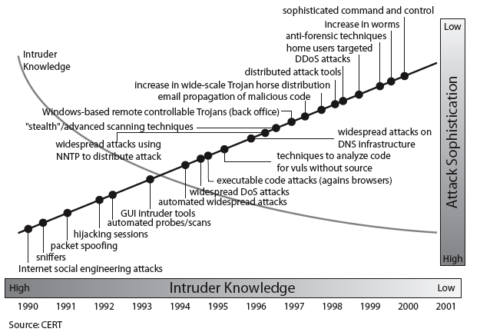
Security Trends
Notes:
Discuss observed security trends (Stallings section 1.1 & Figure 1.2 above), noting growth in sophistication of attacks contrasting with decrease in skill & knowledge needed to mount an attack.

Slide 11
OSI Security Architecture
ITU-T X.800 “Security Architecture for OSI”
  A systematic way of defining and providing security requirements
  Provides a useful, if abstract, overview of concepts we will study
ITU-T: International Telecommunication Union Telecommunication Standardization Sector
OSI: Open Systems Interconnection
Notes:
To assess effectively the security needs of an organization and to evaluate and choose various security products and policies, the manager responsible for security needs some systematic way of defining the requirements for security and characterizing the approaches to satisfying those requirements. This is difficult enough in a centralized data processing environment; with the use of local and wide area networks,the problems are compounded. ITU-T Recommendation X.800, Security Architecture for OSI, defines such a systematic approach. The OSI security architecture is useful to managers as a way of organizing the task of providing security.

Slide 12
3 Aspects of Info Security
Security Attack
  Any action that compromises the security of information.
Security Mechanism
  A mechanism that is designed to detect, prevent, or recover from a security attack.
Security Service
  A service that enhances the security of data processing systems and information transfers.
    Makes use of one or more security mechanisms.

Slide 13


Security Attacks
Threat & attack
  Often used equivalently
There are a wide range of attacks
  Two generic types of attacks
    Passive
    Active
Notes:
Expand on definition and use of “security attack”, as detailed above.
See Stallings Table 1.1 for definitions of threat and attack.

Slide 14
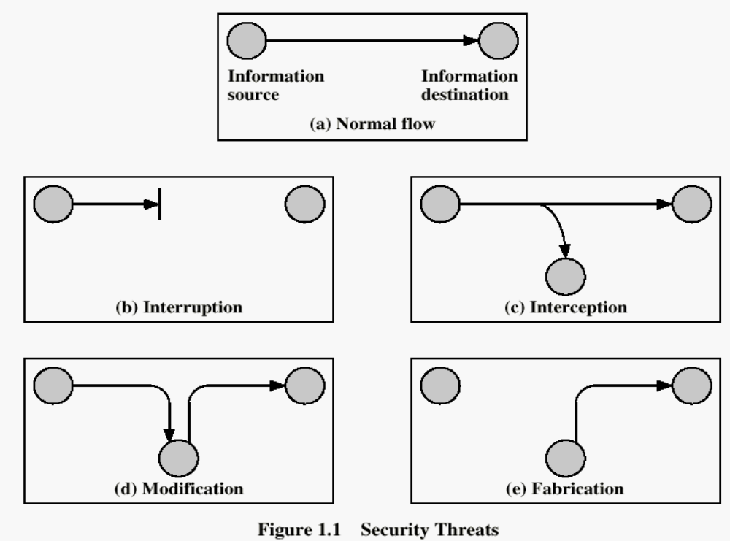
Security Attack Classification

Slide 15
Security Attacks
Interruption: This is an attack on availability
Interception: This is an attack on confidentiality
Modification: This is an attack on integrity
Fabrication: This is an attack on authenticity

Slide 16

3 Primary Security Goals
Fundamental security objectives for both data and information/computing services

Slide 17
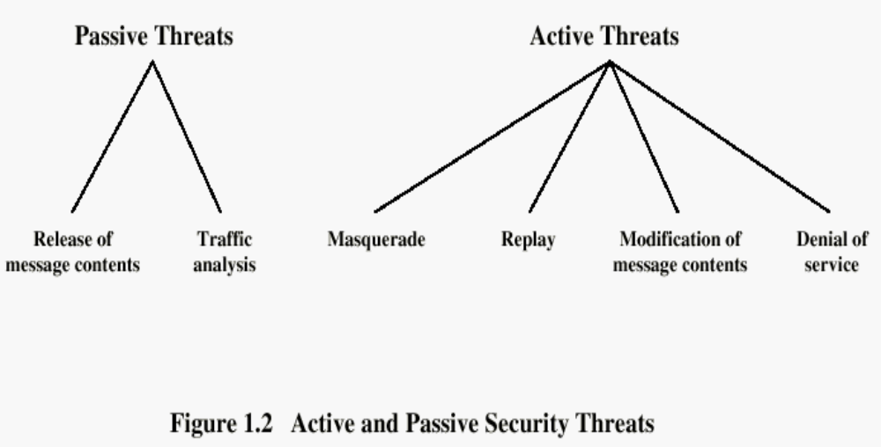

Slide 18
Security Services
X.800
  A service provided by a protocol layer of communicating open systems, which ensures adequate security of the systems or of data transfers
Confidentiality (privacy)
Authentication (who created or sent the data)
Integrity (has not been altered)
Non-repudiation (the order is final)
Access control (prevent misuse of resources)
Availability (permanence, non-erasure)
  Denial of Service Attacks
  Virus that deletes files

Slide 19
Security Mechanism
Features designed to detect, prevent, or recover from a security attack
No single mechanism that will support all services required
One particular element underlies many of the security mechanisms in use:
  Cryptographic techniques
  Hence we will focus on this topic first
Notes:
Now introduce “Security Mechanism” which are the specific means of implementing one or more security services.
Note these mechanisms span a wide range of technical components, but one aspect seen in many is the use of cryptographic techniques.

Slide 20
Security Mechanisms (X.800)
Specific security mechanisms:
  Encipherment, digital signatures, access controls, data integrity, authentication exchange, traffic padding, routing control, notarization
Pervasive security mechanisms:
  Trusted functionality, security labels, event detection, security audit trails, security recovery
Notes:
Some examples of mechanisms from X.800. Note that the “specific security mechanisms” are protocol layer specific, whilst the “pervasive security mechanisms” are not. We will meet some of these mechanisms in much greater detail later.
See Stallings Table 1.3 for details of these mechanisms in X.800, and Table 1.4 for the relationship between services and mechanisms.

Slide 21

Model for Network Security
Notes:
In considering the place of encryption, its useful to use the following two models from Stallings section 1.6.
The first, illustrated in Figure 1.5, models information flowing over an insecure communications channel, in the presence of possible opponents. Hence an appropriate security transform (encryption algorithm) can be used, with suitable keys, possibly negotiated using the presence of a trusted third party.

Slide 22
Model for Network Security
Using this model requires us to:
  design a suitable algorithm for the security transformation (message de/encryption)
  generate the secret information (keys) used by the algorithm
  develop methods to distribute and share the secret information (keys)
  specify a protocol enabling the principals to use the transformation and secret information for a security service (e.g. ssh)
Notes:
This general model shows that there are four basic tasks in designing a particular security service, as listed.

Slide 23

Model for Network Access Security
Notes:
The second, illustrated in Figure 1.6, model is concerned with controlled access to information or resources on a computer system, in the presence of possible opponents. Here appropriate controls are needed on the access and within the system, to provide suitable security. Some cryptographic techniques are useful here also.

Slide 24
Model for Network Access Security
Using this model requires us to implement:
  Authentication
    select appropriate gatekeeper functions to identify users
  Authorization
    implement security controls to ensure only authorized users access designated information or resources
Trusted computer systems may be useful to help implement this model
Notes:
Detail here the tasks needed to use this model.
Note that trusted computer systems (discussed in Ch 20 can be useful here).

Slide 25
Methods of Defense
Encryption
Software Controls
  Limit access in a database or in operating systems
  Protect each user from other users
Hardware Controls
  Smartcard (ICC, used for digital signature and secure identification)
Policies
  Frequent changes of passwords
  Recent study shows controversial arguments
Physical Controls

Slide 26
Internet standards and RFCs
Three organizations in the Internet society
  Internet Architecture Board (IAB)
    Defining overall Internet architecture
    Providing guidance to IETF
  Internet Engineering Task Force (IETF)
    Actual development of protocols and standards
  Internet Engineering Steering Group (IESG)
    Technical management of IETF activities and Internet standards process

Slide 27
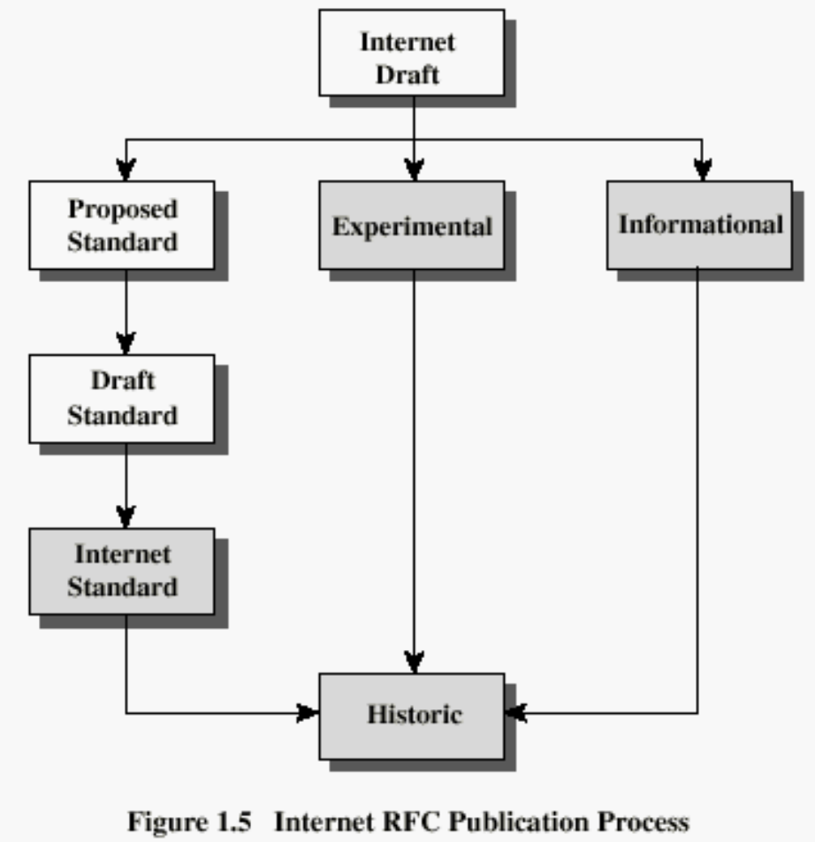
Internet RFC Publication Standardization Process

Slide 28
Recommended Reading
Pfleeger, C. Security in Computing. Prentice Hall, 1997.
Mel, H.X. Baker, D. Cryptography Decrypted. Addison Wesley, 2001.

