Slide 1
Virtual Dressing Room: Smart approach to select and buy clothes
Project ID : 2021-153

Slide 2
Project Description

Slide 3
Introduction
Nowadays most of the people do not have a time to spend for themselves because busy lifestyle.
So, they do not intend to delaying in physical clothing stores because it waste a lots of time either a cloth is purchased or not.
People have a more intend to proceed with online platforms to avoid above problems.
But online platforms are limited in facilities rather than traditional shopping style.
The research is to propose a solution to avoid the most common issues in online shopping and provide much better shopping experience through mobile phone.

Slide 4
Research Problem
People are making mistakes when determining exact sizes when selecting clothes in online shops.
Some people have a lack of identifying the best matching colors suitable for them.
Most people complain, the cloth is not looks good after wearing, although they selected the clothes without having size mismatches.
Online cloth shops do not have sales assistants to assist the customers when selecting clothes.
Maintain the stock with most demanding clothing items is a better way of improve the customer satisfaction rather than saying item is out of stock.

Slide 5
Research Gap
Features | Current System [1] | Current System [2] | Proposed System
Available in mobile | No | Yes | Yes
360’ preview of 3D model | No | No | Yes
Customizable options | No | No | Yes
Animation to the model | No | No | Yes
Fashion trend prediction | No | No | Yes
AI Powered chat bot | No | No | Yes
Skin tone detection | No | No | Yes
Filter clothes based on skin tone and & measurements | No | No | Yes

Slide 6
Research Objectives
Main objective : developing a smart ordering system for a clothing store while providing the ability to the users to fit-on the clothes virtually and pre order the desired clothes in an efficient way.
Suggest the most suitable clothing items
Provide virtual fit-on room facility
Provide assist of an intelligent bot
Generate future predictions on clothing items by analyzing customers’ purchasing data
Maintain a preferable stock to supply trending clothing items in applicable periods throughout the year.

Slide 7
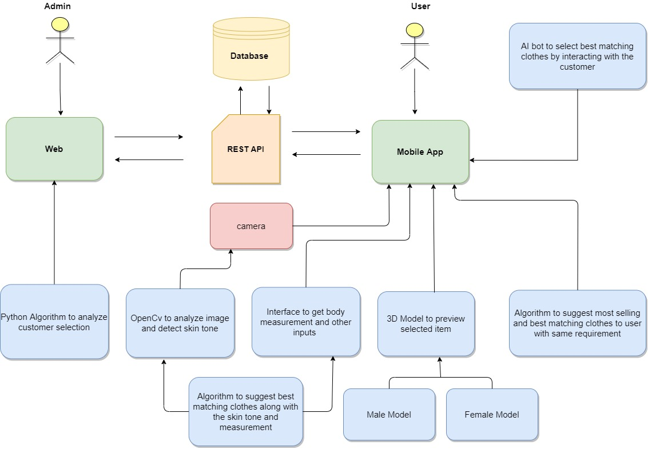
System Diagram

Slide 8
Requirement
Smart Phone
Clear Background
Internet Connection
Smart phone
Internet Connection
Laptop or Desktop for admin

Slide 9
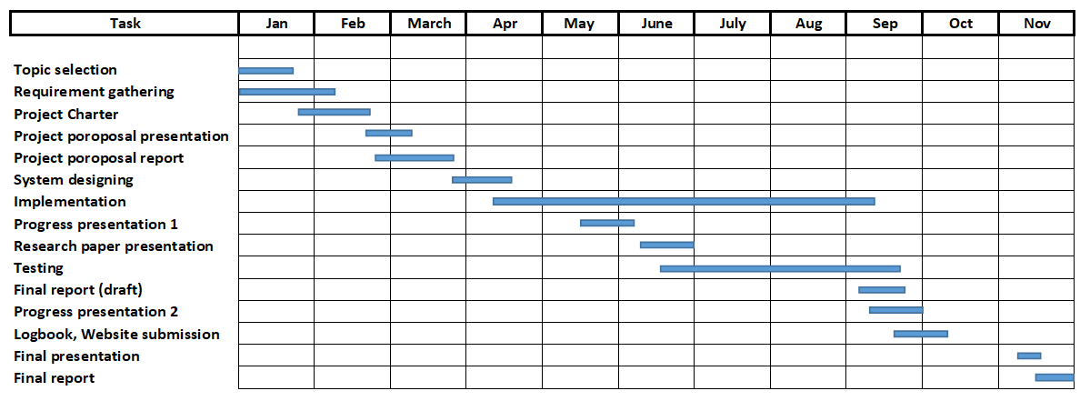
Gantt Chart
Smart Phone
Clear Background
Internet Connection

Slide 10
Budget
Smart Phone
Clear Background
Internet Connection
No | Expenditures | Cost ($)
1 | Domain | 4.99$/M
2 | Hosting | 9.99$/M
Total |  | 14.98$/M

Slide 11
References
[1] S.Priyadharsun, S.Lakshigan, S.S Baheerathan, S.Rajasooriyar, U.U.S.K. Rajapaksha and S.M.Buddika Harshanath, "Parade in the Virtual Dressing Room", in International Conference on Computer Science & Education (ICCSE 2018), Colombo, Sri Lanka, 2018.
[2] Srinivasan K. and Vivek S., "Implementation Of Virtual Fitting Room Using Image Processing", in IEEE International Conference on Computer, Communication and Signal Processing (ICCCSP-2017), 2017.

Slide 12

IT18001808 | S.W.P.N.M.Weerasinghe
B.Sc. (Hons) Degree in Information Technology Specialized in Software Engineering
IT18001808 | S.W.P.N.M.Weerasinghe | 2021-153

Slide 13
Suggest Best Matching Clothes Based on Skin tone and Body Measurements
IT18001808 | S.W.P.N.M.Weerasinghe | 2021-153

Slide 14
Introduction
IT18001808 | S.W.P.N.M.Weerasinghe | 2021-153

Slide 15
Background
Nowadays clothing industry plays major role with respective to country’s economy.
Shopping can be categorized to two major parts.
Physical Shopping
Online Shopping
Problems of those shopping methods
Factors that consider when buying clothes
Body measurement
Skin tone with cloth color
Design
IT18001808 | S.W.P.N.M.Weerasinghe | 2021-153

Slide 16
Research Gap
Features | Current Systems [3] [4] | Proposed System
Skin tone detection | No | Yes
Identify best matching color to the skin tone | No | Yes
Suggest best matching clothes to customer | No | Yes
IT18001808 | S.W.P.N.M.Weerasinghe | 2021-153

Slide 17
Research Question
How to capture Only the face?
How to identify customer skin tone?
When try to Identify skin tone, How to do that on low quality images?
How to categorized different skin tone variation?
How to suggest best matching dress color to identified skin tone?
How to suggest best matching clothes based on skin tone and body measurement?
IT18001808 | S.W.P.N.M.Weerasinghe | 2021-153

Slide 18
Objectives
Identify customer face to determine skin tone
Identify skin tone accurately & efficiently
Suggest matching dress color to the customer
Filter out best matching cloth set
IT18001808 | S.W.P.N.M.Weerasinghe | 2021-153

Slide 19
Methodology
IT18001808 | S.W.P.N.M.Weerasinghe | 2021-153

Slide 20
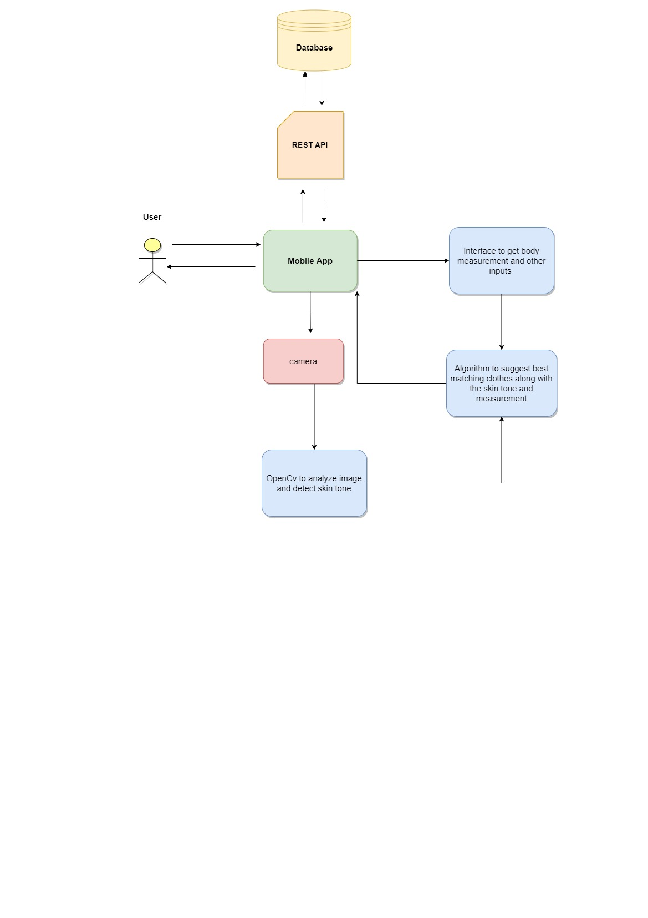
System Diagram
IT18001808 | S.W.P.N.M.Weerasinghe | 2021-153

Slide 21
Functional Requirement
Smart Phone
Clear Background
Internet Connection
Identify best matching color to the skin
Identify matching clothes to the user body measurement
Filter out best matching cloth set based on skin tone and measurement

Slide 22
Technologies
OpenCV Library
Android Studio
Flutter
MongoDB
Nodejs
IT18001808 | S.W.P.N.M.Weerasinghe | 2021-153

Slide 23
Work Breakdown Structure
Suggest Clothes based on skin tone and measurements
Initiation
Planning
Requirement Gathering
Design
Develop
Testing
Evaluation & Recommendation
Develop Project Charter
Submit Project Charter
Project Charter Approved
Feasibility Study
Plan scope
Plan Time
Plan Prototype
Literature Review
Prototype
Input /Output / Language / DB
Identify face
Identify Skin tone
Select best matching color
Suggest clothes
Unit Testing
Integrated Testing
System Testing
IT18001808 | S.W.P.N.M.Weerasinghe | 2021-153

Slide 24
Supportive Information
IT18001808 | S.W.P.N.M.Weerasinghe | 2021-153

Slide 25
Commercialization
Can easily pick a color that match to the skin tone
Can access whole shopping store in few seconds
Without time wasting can find best matching clothes
IT18001808 | S.W.P.N.M.Weerasinghe | 2021-153

Slide 26
References
[3] S.Priyadharsun, S.Lakshigan, S.S Baheerathan, S.Rajasooriyar, U.U.S.K. Rajapaksha and S.M.Buddika Harshanath, "Parade in the Virtual Dressing Room", in International Conference on Computer Science & Education (ICCSE 2018), Colombo, Sri Lanka, 2018.
[4] Srinivasan K. and Vivek S., "Implementation Of Virtual Fitting Room Using Image Processing", in IEEE International Conference on Computer, Communication and Signal Processing (ICCCSP-2017), 2017.
IT18001808 | S.W.P.N.M.Weerasinghe | 2021-153

Slide 27

IT18012866 | L.G.I Sathsara
B.Sc. (Hons) Degree in Information Technology Specialized in Software Engineering
IT18012866 | L.G.I Sathsara | 2021-153

Slide 28
Introduction
IT18012866 | L.G.I Sathsara | 2021-153

Slide 29
Render a Female 3D Model
IT18012866 | L.G.I Sathsara | 2021-153

Slide 30
Background
Online clothing market is the new trend in clothing industry.
People tend into online platforms because it reduces some major issues in traditional shopping style.
Time wastage.
Congestion in shopping stores.
Limited access hours …
There are some challenges in online cloth shopping because,
Customers are not be able to interact with clothes physically.
Customers are not be able to select the best matching cloth every time.
Most of online sellers do not accept exchange after purchase.
Cloth is not look good after wearing…
IT18012866 | L.G.I Sathsara | 2021-153

Slide 31
Research Gap
Features | Current System [5] | Current System [6] | Proposed System
Mobile based | No | Yes | Yes
Provide dynamic views of 3D model (360’ view) | Yes | No | Yes
Customize clothing items | No | No | Yes
Behavior animations on model | Yes | No | Yes
Automatically change skin tone | No | No | Yes
IT18012866 | L.G.I Sathsara | 2021-153

Slide 32
Research Question
How to render the 3D model? What are user inputs?
Is the model change the skin tone?
Is the model static?
How to apply clothes on the model? Are they customizable?
Can the model animate?
IT18012866 | L.G.I Sathsara | 2021-153

Slide 33
Objectives
Render a female 3D model dynamically with user’s inputs (measurements)
Apply the same skin tone which detected by the photograph
Add behavior animations to the model (female related)
Render related clothing items which can apply onto the rendered model
Make clothes customizable when applied onto the model
IT18012866 | L.G.I Sathsara | 2021-153

Slide 34
Methodology
IT18012866 | L.G.I Sathsara | 2021-153

Slide 35
System Diagram
Database
REST API
Mobile App
User Inputs for body measurements
Apply detected skin tone
Customer
Camera
Customizable Female model
Female body template
Apply suggested clothes
Detect Skin tone
IT18012866 | L.G.I Sathsara | 2021-153

Slide 36
Technologies
BLEnder
Android Studio
Flutter
MongoDB
Nodejs
IT18012866 | L.G.I Sathsara | 2021-153

Slide 37
Work Breakdown Structure
Render the virtual fitting room with female model
Initiation
Planning
Requirement Gathering
Design
Develop
Testing
Evaluation & Recommendation
Develop Project Charter
Submit Project Charter
Project Charter Approved
Feasibility Study
Plan scope
Plan Time
Plan Prototype
Literature Review
Prototype
Develop template model
Change model with user inputs
Change skin tone
Apply suggested clothes
Unit Testing
Integrated Testing
System Testing
Apply relevant animations
IT18012866 | L.G.I Sathsara | 2021-153

Slide 38
Functional Requirement
Smart Phone
Clear Background
Internet Connection
Virtual fitting room facility to try-out clothes virtually.
Render a dynamic female 3D model inside the room.
Make the model animative.
Make the model customizable with clothing items.

Slide 39
Supportive Information
IT18012866 | L.G.I Sathsara | 2021-153

Slide 40
Commercialization
- The room facility illustrates much clear idea on how the dress look, when it wears. It reduce
unsatisfaction of the customers with their desired dresses.
- Since this is a mobile application, the facility can be provided among a vast user base.
The room facility illustrates much clear idea on how the dress look, when it wears. It reduce unsatisfaction of the customers with their desired dresses.
Since this is a mobile application, the facility can be provided among a vast user base.
IT18012866 | L.G.I Sathsara | 2021-153

Slide 41
References
[5] Rong Li, Kun Zou, Xiang Xu, Yueqiao Li and Zan Li, “Research of Interactive 3D Virtual Fitting Room on Web Environment.” in Fourth International Symposium on Computational Intelligence and Design P.R.China, 2011.
[6] Hsin-Yu Huang, Yong-Yi Fanjiang, Ting-Suan Lee, Chia-An Lee, Tzu-Min Zhang and Wei-De Li “Implementation Simple Fitting System Using Image Recognition for Portable Device”, in Canadian Conference on Electrical and Computer Engineering. Taiwan, 2020.
IT18012866 | L.G.I Sathsara | 2021-153

Slide 42

IT18066944 | R.M.D.D Rajapaksha
B.Sc. (Hons) Degree in Information Technology Specialized in Software Engineering
IT18066944 | R.M.D.D Rajapaksha | 2021-153

Slide 43
Render a Male 3D Model
IT18066944 | R.M.D.D Rajapaksha | 2021-153

Slide 44
Introduction
IT18066944 | R.M.D.D Rajapaksha | 2021-153

Slide 45
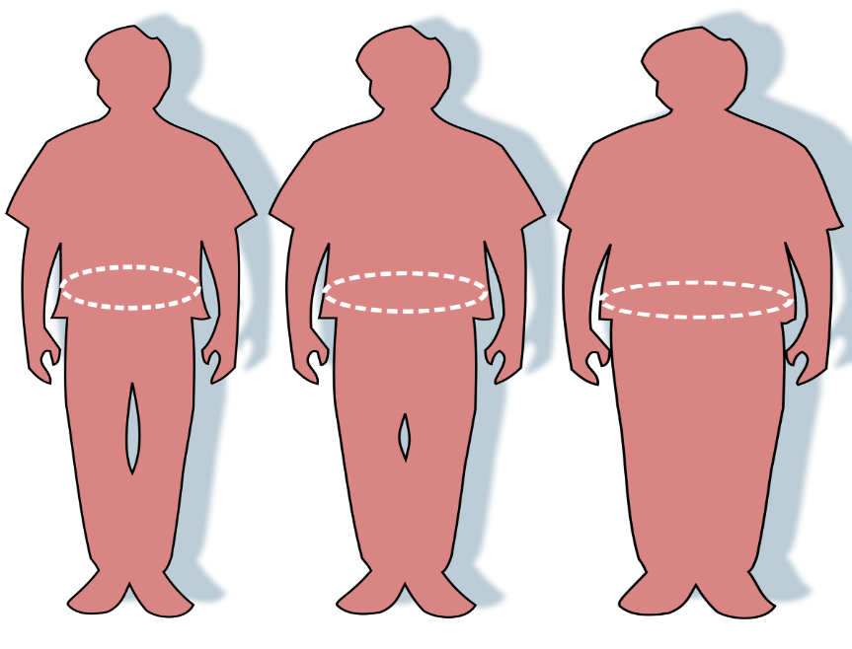
Background
Nowadays clothing industry plays major role with respective to country’s economy.
Shopping can be categorized to two major parts.
Physical Shopping
Online Shopping
Problems of online shopping methods
Customer cannot find perfect size
Customer cannot interact with clothes physically.
Most of online shopping systems there are no exchange
after purchase
IT18066944 | R.M.D.D Rajapaksha | 2021-153

Slide 46
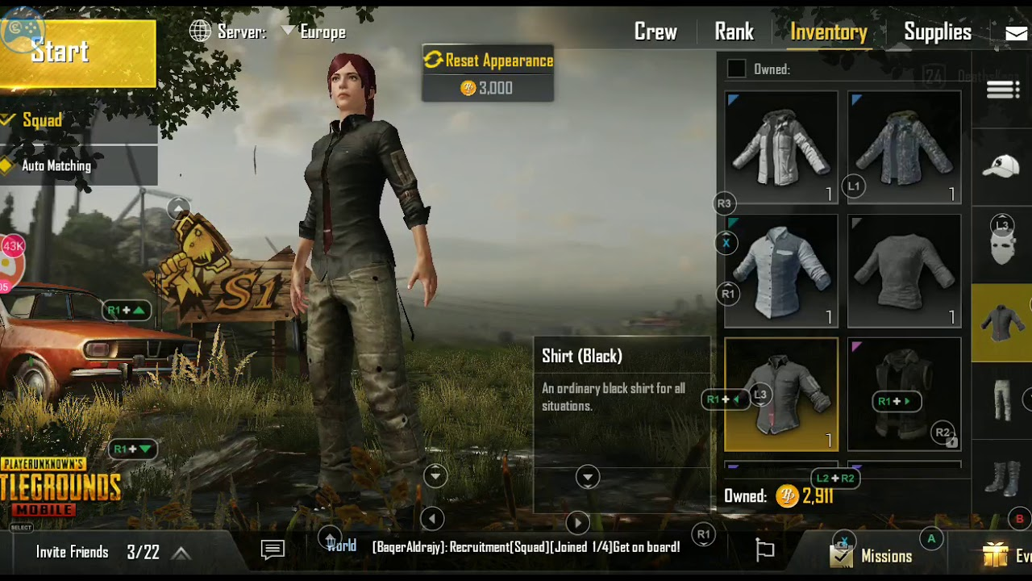
Technology Already Available
Example: PUBG Mobile
IT18066944 | R.M.D.D Rajapaksha | 2021-153

Slide 47
Research Gap
Features | Current Systems [7] [8] | Proposed System
360’ preview of 3D model | No | Yes
Customizable options (tucked and untucked shirts, roll up and roll down the sleeves etc.) | No | Yes
Animations of 3D model | No | Yes
Apply skin tone for 3D Model | No | Yes
IT18066944 | R.M.D.D Rajapaksha | 2021-153

Slide 48
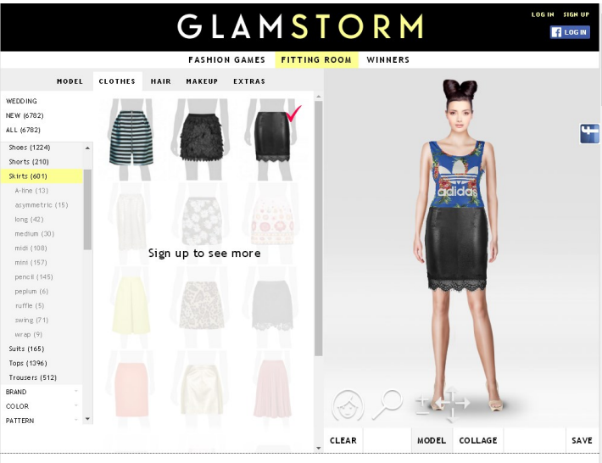
Research Gap
Current system example
IT18066944 | R.M.D.D Rajapaksha | 2021-153

Slide 49
Research Question
How to generate customized 3D model in mobile app?
How to add cloths to generated 3D model?
How to add animations to generated 3D model?
How to add skin tone to generated 3D model.?
How to add fit-on facility to 3D model?
How to display 360’ 3D model in mobile app?
IT18066944 | R.M.D.D Rajapaksha | 2021-153

Slide 50
Objectives
Generate Customizable 3D Model
Add cloths to generated 3D Model
Add fit-on facility to 3D Model
Add skin tone to 3D Model
Display 360’ 3D Model
IT18066944 | R.M.D.D Rajapaksha | 2021-153

Slide 51
Methodology
IT18066944 | R.M.D.D Rajapaksha | 2021-153

Slide 52
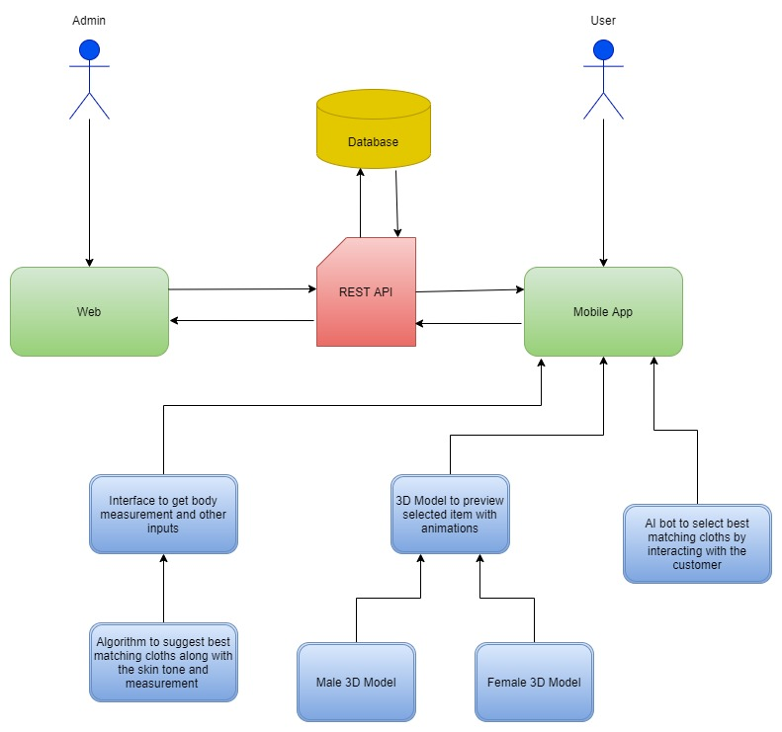
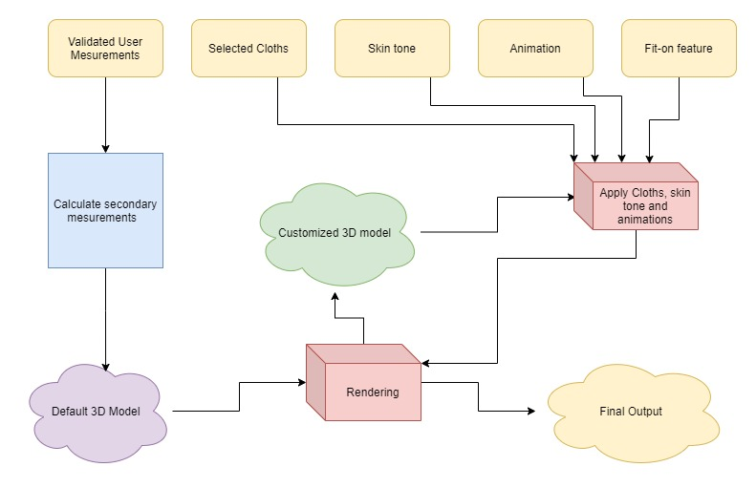
System Diagram
IT18066944 | R.M.D.D Rajapaksha | 2021-153

Slide 53
Technologies
Blender
Android Studio
Flutter
MongoDB
Nodejs
IT18066944 | R.M.D.D Rajapaksha | 2021-153

Slide 54
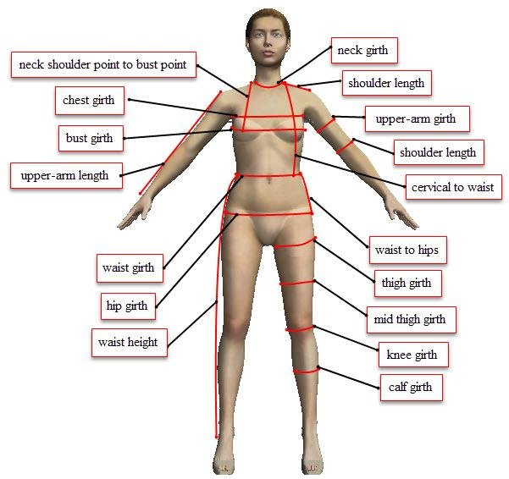
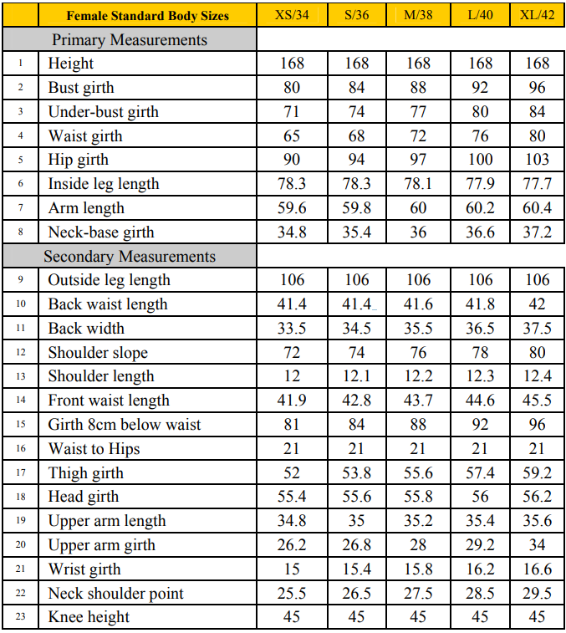
Technologies
Measurements
Primary Measurements
Height
Bust girth
Under bust grith
Waist grith
Hip grith
Inside leg length
Arm length
Neck-base girth
IT18066944 | R.M.D.D Rajapaksha | 2021-153

Slide 55
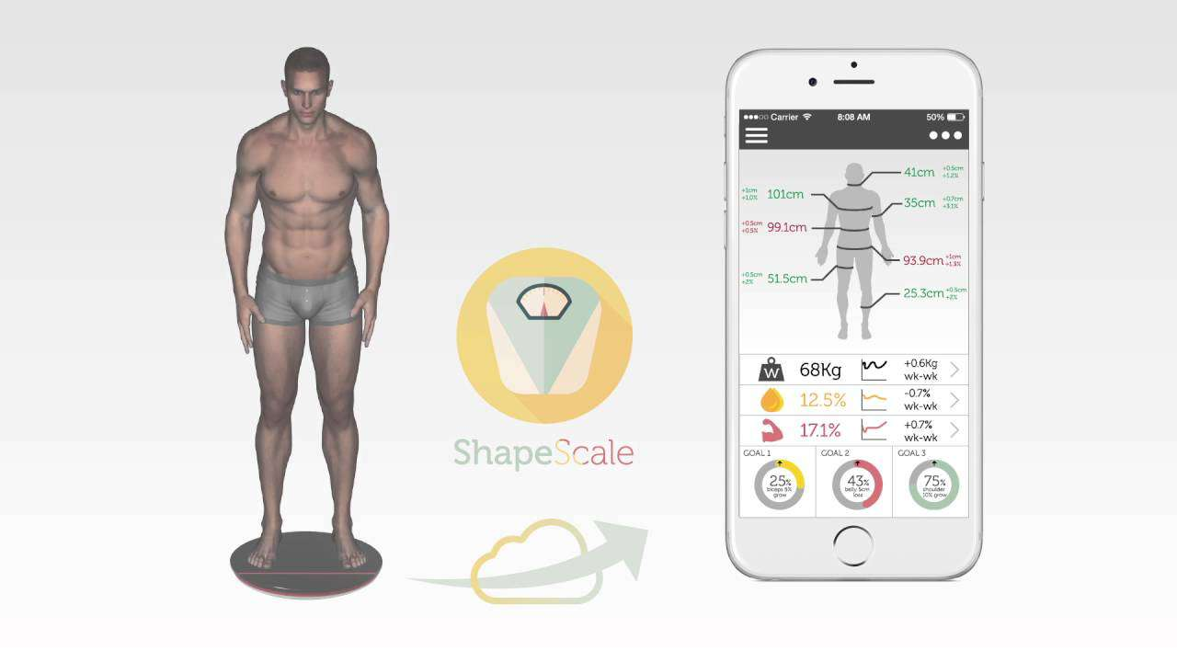
Technologies
Scale
IT18066944 | R.M.D.D Rajapaksha | 2021-153

Slide 56
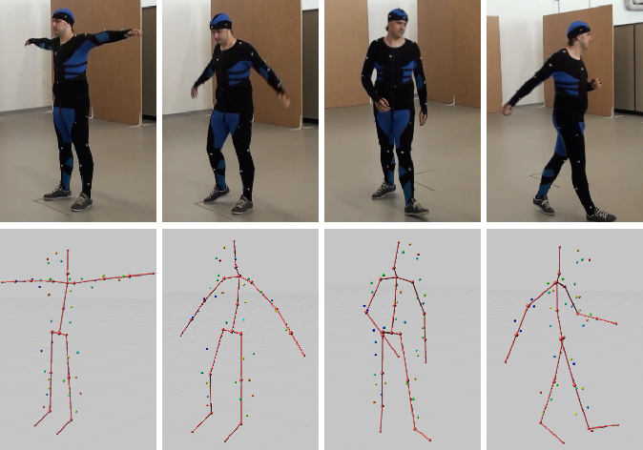
Technologies
Optical Motion Capture
Problem : No Tools
Solution : Animate Model by using mouse inputs or
Use existing animation templates
IT18066944 | R.M.D.D Rajapaksha | 2021-153

Slide 57
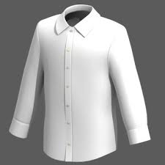
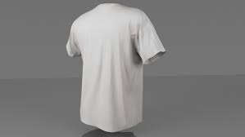
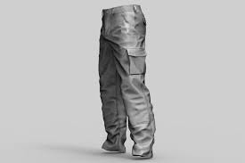
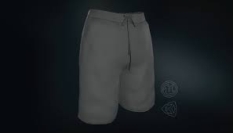
Time Management
Choosing 4 clothing designs
Shirt T-Shirt Pants Shorts
IT18066944 | R.M.D.D Rajapaksha | 2021-153

Slide 58
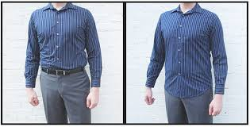
Time Management
Choosing 2 fit-on feature designs
Tucked And Untucked
IT18066944 | R.M.D.D Rajapaksha | 2021-153

Slide 59
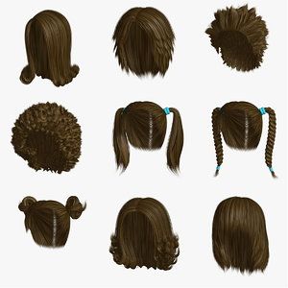
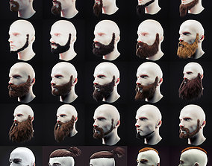
Future Enhancement
More clothing designs
More fit-on facilities
More animations
Hair and Beard
IT18066944 | R.M.D.D Rajapaksha | 2021-153

Slide 60
Work Breakdown Structure
Render a male 3D human model and provide the virtual fit-on facility and add animation (movements) to the 3D model
Initiation
Planning
Requirement Gathering
Design
Develop
Testing
Evaluation & Recommendation
Develop Project Charter
Submit Project Charter
Project Charter Approved
Feasibility Study
Plan scope
Plan Time
Plan Prototype
Literature Review
Prototype
Input /Output / Language / DB
Generate Generic 3D Model
Add Cloths to 3D Model
Add Fit-on facility
Add Animations to 3D Model
Unit Testing
Integrated Testing
System Testing
IT18066944 | R.M.D.D Rajapaksha | 2021-153

Slide 61
Functional Requirement
Smart Phone
Clear Background
Internet Connection
Render a 3D model
Add selected cloths to 3D model
Add skin-tone to 3D model
Add fit-on facility to 3D model
Add Animation to 3D model

Slide 62
Non - Functional Requirement
Smart Phone
Clear Background
Internet Connection
Fast rendering 3D model
Clear view of 3D model
Should be easy to use
App size should be low

Slide 63
Supportive Information
IT18066944 | R.M.D.D Rajapaksha | 2021-153

Slide 64
Commercialization
Smart Phone
Clear Background
Internet Connection
Improve customer satisfaction
Reduce customer returns

Slide 65
References
[7] S.Priyadharsun, S.Lakshigan, S.S Baheerathan, S.Rajasooriyar, U.U.S.K. Rajapaksha and S.M.Buddika Harshanath, "Parade in the Virtual Dressing Room", in International Conference on Computer Science & Education (ICCSE 2018), Colombo, Sri Lanka, 2018.
[8] Srinivasan K. and Vivek S., "Implementation Of Virtual Fitting Room Using Image Processing", in IEEE International Conference on Computer, Communication and Signal Processing (ICCCSP-2017), 2017.
IT18066944 | R.M.D.D Rajapaksha | 2021-153

Slide 66
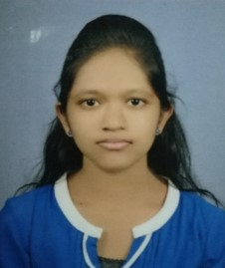
IT17084796 |H.S.D.N Gunasekara
B.Sc. (Hons) Degree in Information Technology Specialized in Software Engineering
IT17084796 | H.S.D.N Gunasekara | 2021-153

Slide 67
Introduction
IT17084796 | H.S.D.N Gunasekara | 2021-153

Slide 68
Future fashion trends prediction component & AI powered chatbot with suggestions and recommendations
IT17084796 | H.S.D.N Gunasekara | 2021-153

Slide 69
Background
Existing virtual dressing apps haven`t considered about the seller
- Concerns only the customer`s satisfaction
- Seller can be dissatisfied about the system
Online shopping platforms and existing virtual dressing apps do not assist the customers for cloth selection
- Physical clothing stores assist customers for the cloth selection
- Customer`s who have lack of cloth selection skills will face difficulties while using the platform
- Purchasing unsuited clothes will be a bad user experience
IT17084796 | H.S.D.N Gunasekara | 2021-153

Slide 70
Research Gap
 | Existing Virtual Dressing Apps [9-11] | Existing Prediction Systems [12][13] | Existing AI chatbots [14-16] | Proposed System
Fashion trends prediction | No | Yes | No | Yes
Considering useful textile aggregation levels for prediction | No | No | No | Yes
KNN approach | No | Yes | No | Yes
AI powered chatbot | No | No | Yes | Yes
Generative model based AI chatbot | No | No | No | Yes
Cloth suggestions and recommendations | No | No | No | Yes
User based collaborative filtering | No | No | No | Yes
Item based collaborative filtering | No | No | No | Yes
IT17084796 | H.S.D.N Gunasekara | 2021-153

Slide 71
Research Question
How to implement a prediction component for predicting future fashion trends?
How to implement an AI chatbot for assist customers?
How to implement suggestions and recommendation features?
IT17084796 | H.S.D.N Gunasekara | 2021-153

Slide 72
Objectives
Provide a feature for predict future fashion trends
Provide an AI chatbot assistant to the customer for cloth selection and purchase process
Commit an accurate predictive analysis results
Ensure the accuracy of chatbot assistant
IT17084796 | H.S.D.N Gunasekara | 2021-153

Slide 73
Methodology
IT17084796 | H.S.D.N Gunasekara | 2021-153

Slide 74
1. Future Fashion Trends Prediction Component
IT17084796 | H.S.D.N Gunasekara | 2021-153

Slide 75
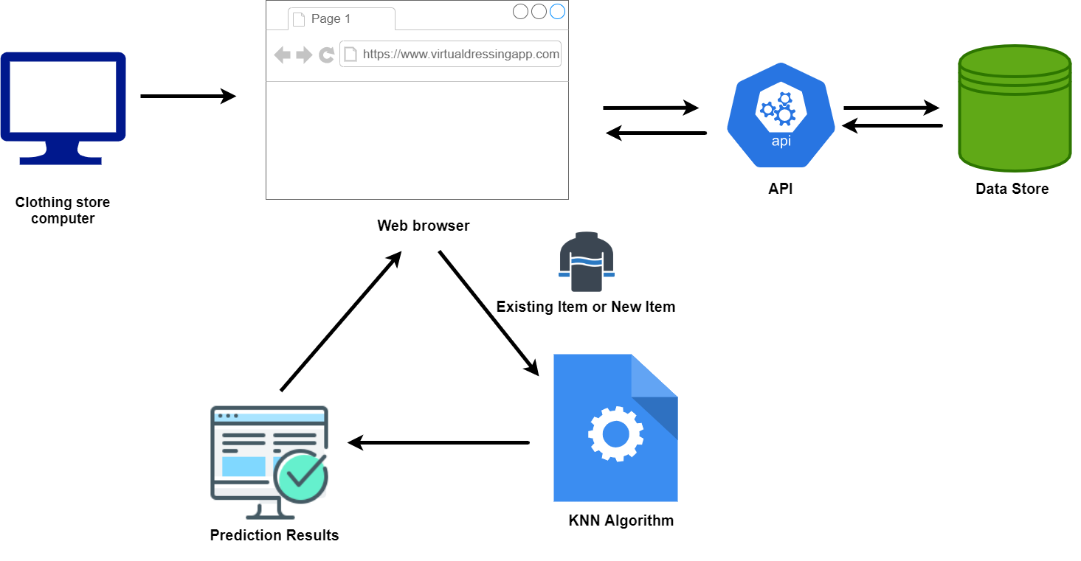
System Diagram
IT17084796 | H.S.D.N Gunasekara | 2021-153

Slide 76
Data collection and data analysis
Collect data and preprocessing the collected data set while omitting unwanted data.
Trained model using ML algorithm
Utilize supervised learning algorithm to train the module using collected data set.
Evaluation
Future demand prediction for existing and new clothing items
Compare and contrast actual values and predicted values
IT17084796 | H.S.D.N Gunasekara | 2021-153

Slide 77
Technologies
Python Library
Reactjs
MongoDB
Nodejs
IT17084796 | H.S.D.N Gunasekara | 2021-153

Slide 78
2. AI Powered Chatbot With Suggestions and Recommendations
IT17084796 | H.S.D.N Gunasekara | 2021-153

Slide 79
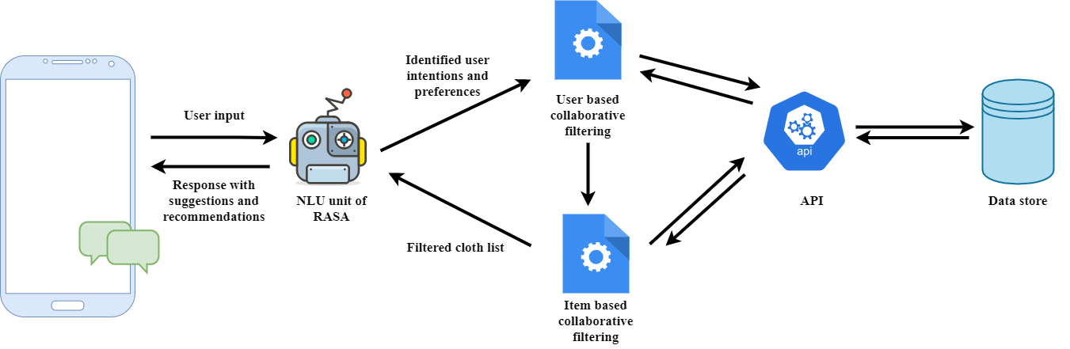
System Diagram
IT17084796 | H.S.D.N Gunasekara | 2021-153

Slide 80
Analyze the user inputs and determine the user intention
Obtain the text-based user inputs, analyze them and identify the user intention.
Ex: Not satisfied with showed cloth list
Seeking a suit of clothes
Responds to the user with appropriate outputs
Suggesting clothes utilizing item-based collaborative filtering when the customer not satisfied with the showed cloth list using their preferences
Recommend clothes utilizing item-based collaborative filtering and user-based collaborative filtering using past records of the similar customers when user is seeking a pair of clothes
IT17084796 | H.S.D.N Gunasekara | 2021-153

Slide 81
Technologies
Python Library
Android Studio
Flutter
MongoDB
Nodejs
IT17084796 | H.S.D.N Gunasekara | 2021-153

Slide 82
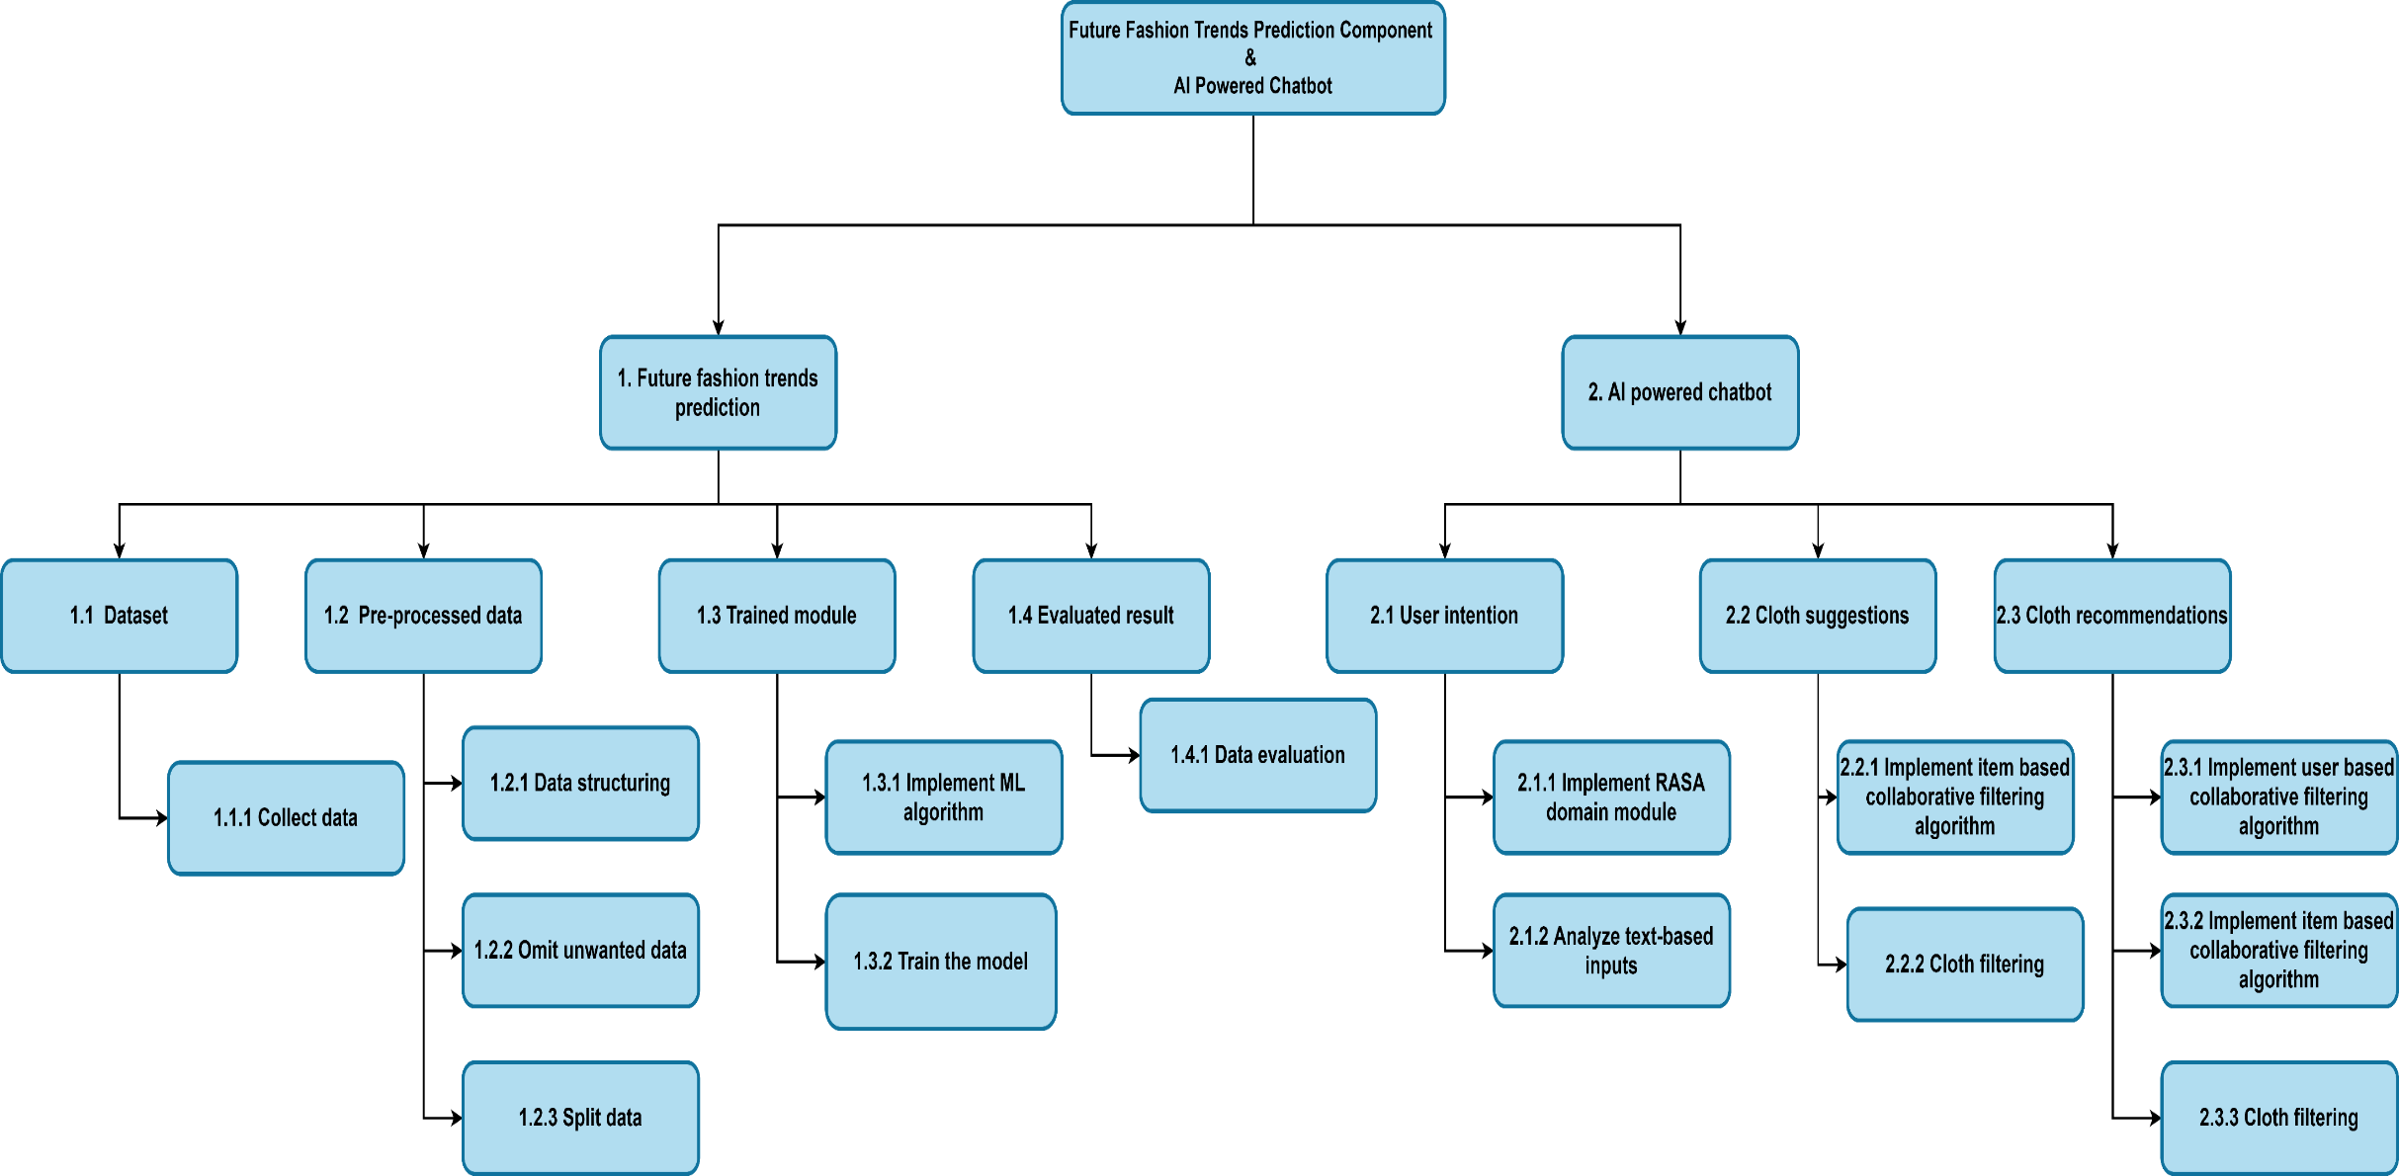
Work Breakdown Structure
IT17084796 | H.S.D.N Gunasekara | 2021-153

Slide 83
Functional Requirements
Predictive analysis functionality for predict future fashion trends
AI powered chatbot feature to aid customers for cloth selection
Cloth suggestion functionality
Cloth recommendation functionality
User Requirements
Mobile phone
Laptop or desktop computer
Internet connection
IT17084796 | H.S.D.N Gunasekara | 2021-153

Slide 84
Supportive Information
IT17084796 | H.S.D.N Gunasekara | 2021-153

Slide 85
Commercialization
Autonomous prediction system boosts the business values of the clothing store
AI powered chatbot assist customers throughout the purchase process and provides the experience as in a physical clothing store
Cloth recommendation aids customers to select best matching clothes easily
Suggestions help customers to check and view different clothing items withing a low time period.
IT17084796 | H.S.D.N Gunasekara | 2021-153

Slide 86
References
[9] S.Priyadharsun, S.Lakshigan, S.S Baheerathan, S.Rajasooriyar, U.U.S.K. Rajapaksha and S.M.Buddika Harshanath, "Parade in the Virtual Dressing Room", in International Conference on Computer Science & Education (ICCSE 2018), Colombo, Sri Lanka, 2018.
[10] Srinivasan K. and Vivek S., "Implementation Of Virtual Fitting Room Using Image Processing", in IEEE International Conference on Computer, Communication and Signal Processing (ICCCSP-2017), 2017.
[11] Rong Li, Kun Zou, Xiang Xu, Yueqiao Li and Zan Li, "Research of Interactive 3D Virtual Fitting Room on Web Environment", in 2011 Fourth International Symposium on Computational Intelligence and Design, 2011
[12] A. Mia and M. Yousu, "Business Forecasting System using Machine Learning Approach", in 2021 2nd International Conference on Robotics,Electrical and Signal Processing Techniques (ICREST), 2021.
[13] M. Hasan, M. Zahar and M. Sykot, "Solving Onion Market Instability by Forecasting Onion Price Using Machine Learning Approach", in 2020 International Conference on Computational Performance Evaluation (ComPE) North-Eastern Hill University, Shillong, Meghalaya, India. Jul 2-4, 2020 978-1-7281-6644-5/20/$31.00 ©2020 IEEE Solving Onion Market Instabil, 2020.
[14] K. Deepik, V. Tilekya and J. Mamatha, "Jollity Chatbot- A contextual AI Assistant", in Proceedings of the Third International Conference on Smart Systems and Inventive Technology (ICSSIT 2020) IEEE Xplore Part Number: CFP20P17-ART; ISBN: 978-1-7281-5821-1, 2020.
[15] H. Santoso, G. Saraswat and M. Rohman, "Dinus Intelligent Assistance (DINA) Chatbot for University Admission Services", in 2018 International Seminar on Application for Technology of Information and Communication (iSemantic), 2018.
[16] Thomas N T, "An E-business Chatbot using AIML and LSA", in 2016 Intl. Conference on Advances in Computing, Communications and Informatics (ICACCI), Sept. 21-24, 2016, Jaipur, India, 2016
IT17084796 | H.S.D.N Gunasekara | 2021-153

Slide 87
Any Questions?

