Slide 1
Time-Series Forecasting
using Machine Learning to predict grocery store sales
Project Work on Data Mining M
Pasit Khantigul

Slide 2
Contents
Goal of the project
Dataset
Time-Series components
Time Dependence
Serial Dependence
Hybrid Model
Forecasting results
Conclusion

Slide 3


Goal of the project
Problem: time-series prediction problem
presented as a Kaggle competition.
Time-series: a set of observations recorded over time.
Goal: use machine learning to forecast store sales on data from Corporación Favorita:
forecast for the next 15 days (from the last day of the training data)
get lowest score from submissions
by modelling both:
time dependence features
serial dependence features
hybrid model
Notes:
main mission in this competition is, predicting sales for each product family and store combinations.

Slide 4
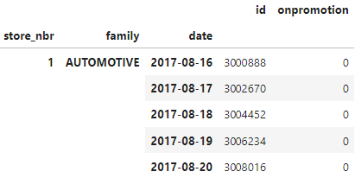
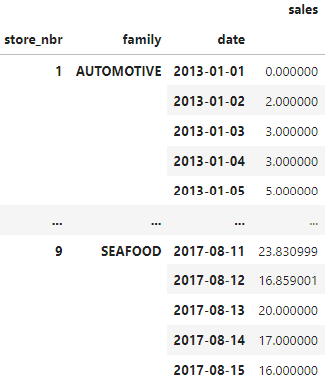
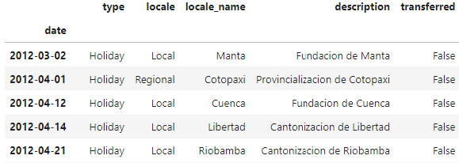
Datasets
.to_period('D')
training.csv
transaction.csv
stores.csv
holiday_events.csv
oil.csv
test.csv
sample_submission.csv

Slide 5
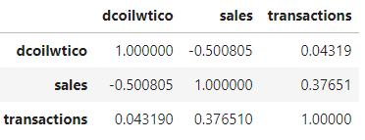
EDA results
Total duration of data:
Training data: 2013-01-01 --> 2017-08-15
Test data: 2017-08-16 --> 2017-08-31
Total number of families (of products): 33
some family does not have any sales for some stores -> forecast easily to 0 sales.
Total number of stores: 54
The top 5 most sold are Grocery, beverages, cleaning, dairy, and produce. Grocery and beverage account for more than 50% of total sales.
Correlation between oil prices and (avg) sales and (avg) transaction suggests
that the country's economic status and everyday grocery consumption do not
have a particular relationship.
forecast origin
forecast horizon
valid test size = 15

Slide 6

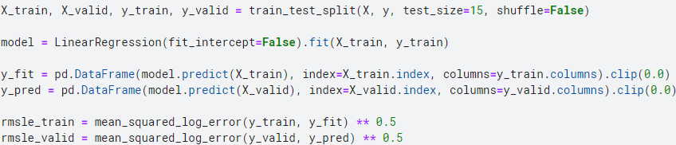
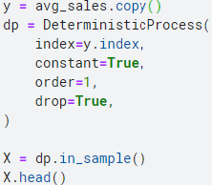
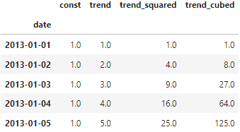
Modelling time dependence
A series is time dependent if its values can be predicted from the time they occured - from time-step features, which can be modelled from:
Trend : a persistent, long-term change in the mean of the series, estimated from the Moving Average Plot.
Notes:
Moving average is a calculation to analyse data points by creating a series of averages of different subsets of the full data set
window = smooth over short-term changes within the year
dp = a function from the statsmodels library called DeterministicProcess (non-random time series). Using this function will help us avoid some tricky failure cases

Slide 7
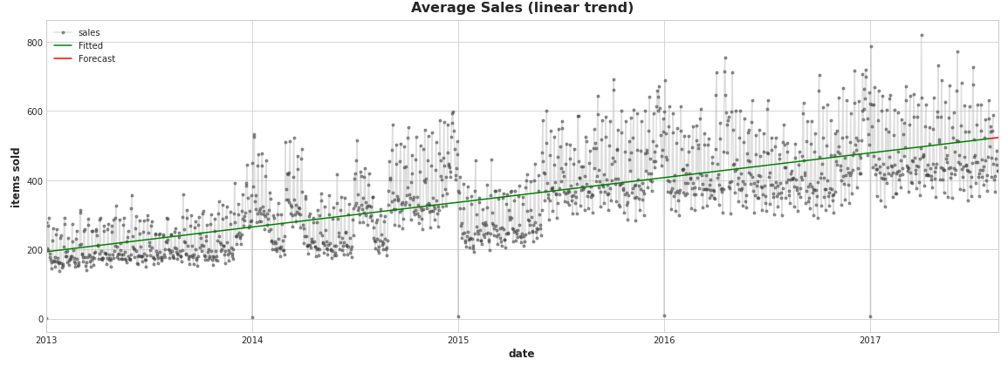
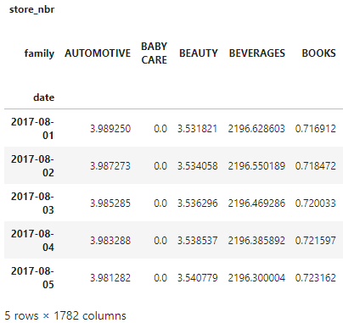


Trend for each family:
y_pred =
polynomial
order 3 =
polynomial
order 1 =
Notes:
target fitted and predicted has index=[store_nbr, date], column=[trendXfamily, sales]

Slide 8
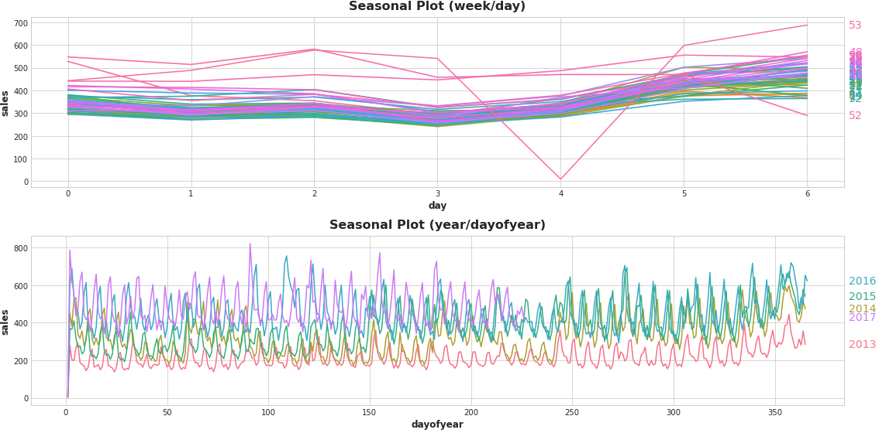
Seasonality
= regular, periodic changes in the mean of the series caused by weekly, monthly, seasonal or yearly patterns.
Seasonal indicators:
For a season with
few observations
represented
through one-hot-
encoded categorical
features.
weekly seasonality
= > added 6 features
Notes:
Interpretation: The two plot show an evident increase of sales during week-ends.
More specifically
* The *weekly seasonal plot* shows for each weeks within a year (1-53) the number of sales in days from Monday (0) to Sunday (6).
On week 53, the last of the year, on Friday (4) there are very few sales. This is jusified by the fact that most years have 52 week, in the period of the traning data from 2013 to 2017 there is only one 53th week. On the graph, that friday corresponds to new year's eve, which usually has few sales, and the line representing the 53th week show exactly the sales of that week from 2015-12-28 to 2016-01-03.
This analysis shows that it is important to consider the holidays in the modelling process.
* In fact in the *yearly seasonal plot* it is shown that sales are low on every 1st of Jannuary. And also that the sales changes with a similar frequency, but they don't match with the exact day of year. It is worth noticing that the end of the year there is an increase of sales, probabily due to holidays.

Slide 9

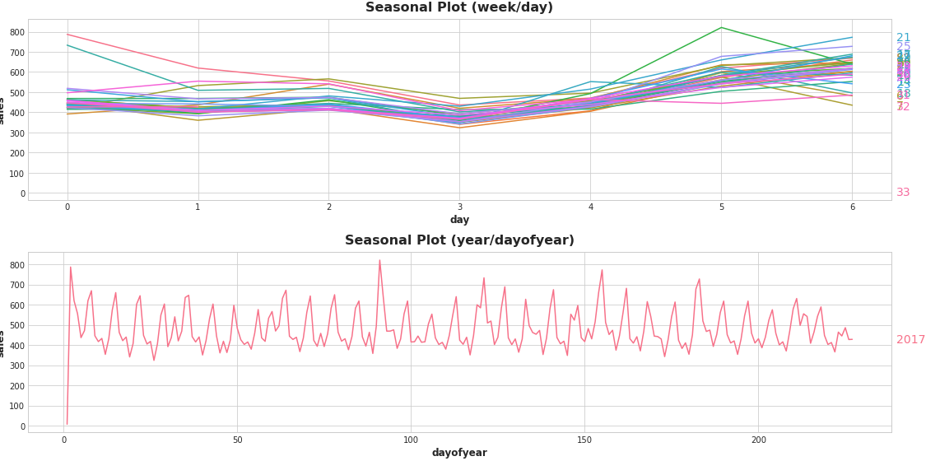
Period restriction of 2017
-> Since the previous model does much better in the validation set than in the training set.
Notes:
Restricting the period of store sales (train data) = BECAUSE THE MODEL DOES MUCH BETTER IN THE VALIDATION SET THEN THE TRAINING SET, it might not be useful to try to fit (not well for RMSLE score) all of the previous years while we want to predict on just a few days in 2017.
Intuition from the above plots and results: Since the period of the training data is 4.5 years while the period of the test data is 15 days, we can restrict the period of the training data to be considered to make the trend of the past year (2017) generalize to the validation/test data.

Slide 10
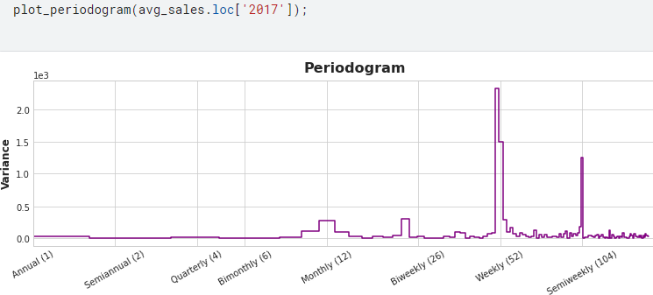
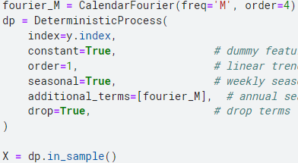
… but for long seasons (with frequent observations)?
Fourier Feature: a pair of sine and cosine curves for each potential frequency in the season starting with the longest, to capture the overall shape of the seasonal curve.
How many pairs?
monthly/biweekly seasonality
= > added 2 Fourier features
Notes:
Periodogram: shows strength of the frequencies in a time-series. From left to right, the periodogram shows appreciating Fourier contributions starting from a monthly frequency. This is followed by a significant biweekly contribution. These two make sense in view of the notes to the Store Sales dataset which mentions that wages in the public sector are paid out biweekly, on the 15th and last day of the month -- a possible origin for these seasons.
the value on the y-axis of the graph is (a ** 2 + b ** 2) / 2, where a and b are the coefficients of the sine and cosine at that frequency.

Slide 11
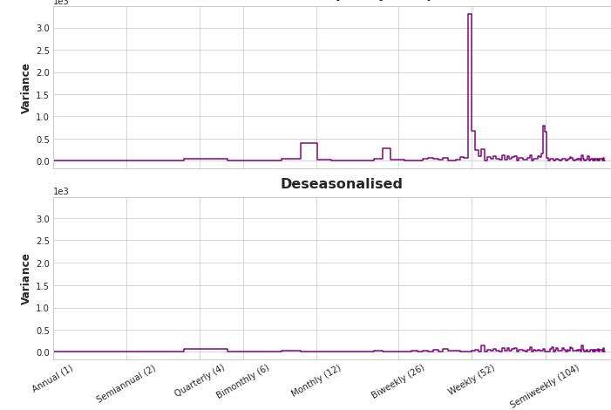
Residual Analysis
A residual of a model are differences between target the model was trained on and the predictions the model makes, representing what the model failed to learn about the target from the features.
Deseasonalising: to check the effectiveness of seasonality modelling:
plot the residuals against a feature to get the deseasonalised and detrended plot.
Hybrid forecasting
by considering the additive model :
series = trend + seasons + cycles + error
Notes:
NEXT: residuals will be plotted as Holidays on deseasonalised plot of average sales

Slide 12
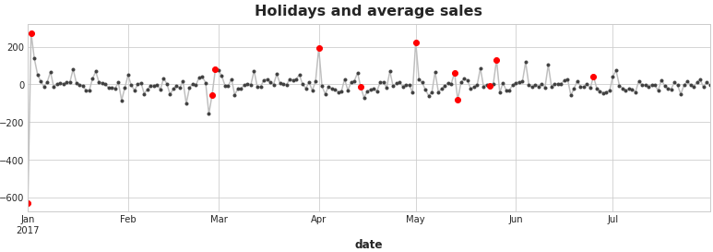
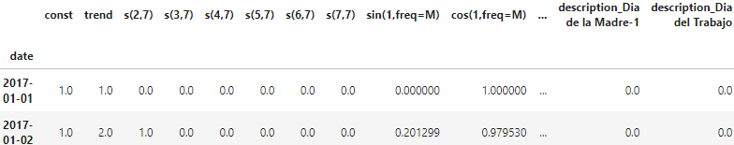
Holiday Feature
Selecting only national and regional, from 2017, created as seasonal indicator : X_holidays = pd.get_dummies(holidays)
X_1 :
Notes:
tabella = df = all time dependent FEATURES JOINT
const == intercept in dp features

Slide 13
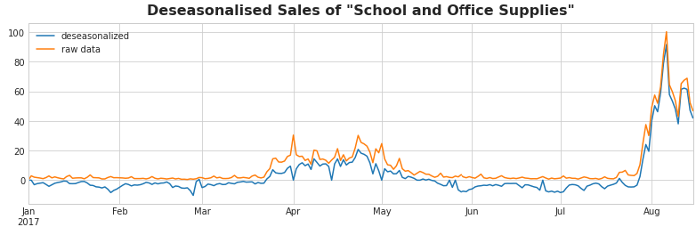
Modelling serial dependence
A time series has serial dependence when an observation can be predicted from previous observations, what happened in the recent past is relevant. Can be linear or non-linear.
Cyclic behaviour: pattern of changes associated with how the value at one time depends on values at previous time and not necessarily on time-steps.
Notes:
Interpretation: the two curves are close to each other, showing a predominant cyclic behaviour of the raw data of supply sales (target) and the need to model a serial dependence on the residual curve.
DESEASONALISED
y_resid_train = y_train - y_fit
y_resid_valid = y_valid - y_pred
y_resid = pd.concat([y_resid_train, y_resid_valid])
TYPES
* **Linear**: where past and present observations are linearly related. Such linear serial dependence can be explored through lag series/plots where **the lag features are chosen by calculating (partial) autocorrelation**. They can also be anticipated through leading indicators, like online trends or promotions.
* **Non-linear**: where past and present observations can not be related by a simple linear relationship, hence **we can't calculate lag features through (partial) autocorrelations.** Non-linear relationships like these can either be transformed to be linear or else learned by an appropriate algorithm (e.g. XGBoost).

Slide 14
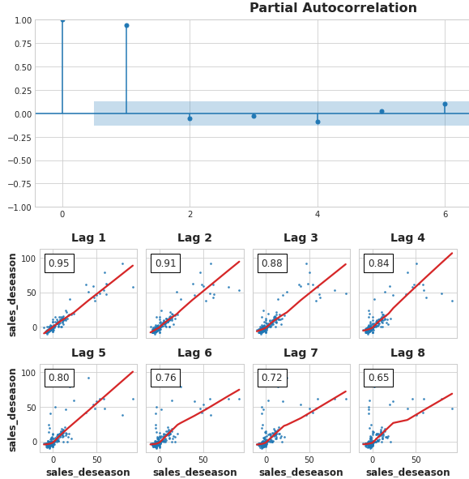
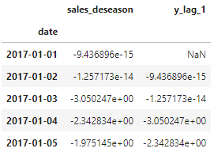
Lagged Series and Plots
Correlogram:
Lag features are values at prior timesteps obtained by shifting the observations of the target series .
Choosing lags through Partial Autocorrelation: shows the amount of new correlation that the lag contributes (Only for linear serial dependency).
Add Lag 1 feature of Supply Sales
residual supply sales
Notes:
Modeling these cycles with lag features will allow our forecaster to react dynamically to changing conditions instead of being constrained to exact dates and times as with seasonal features.
—
The correlogram is for lag features essentially what the periodogram is for Fourier features.
Partial autocorrelation the amount of "new" correlation that the lag contributes.
LAG PLOT INTERPRETATION:
the autocorrelation at lag 2 might result entirely from "DECAYED" information from lag 1 -- just correlation that's carried over from the previous step. If lag 2 doesn't contain anything new, there would be no reason to include it if we already have lag 1.
To make a lag feature we shift the observations of the target series so that they appear to have occurred later in time (shifting by one or multiple steps).
lag plots where each observation in a series is plotted against the previous observation.
When creating lag features, we need to decide what to do with the missing values produced. Filling them in is one option, maybe with 0.0 or "backfilling" with the first known value. Instead, we'll just drop the missing values, making sure to also drop values in the target from corresponding dates.

Slide 15
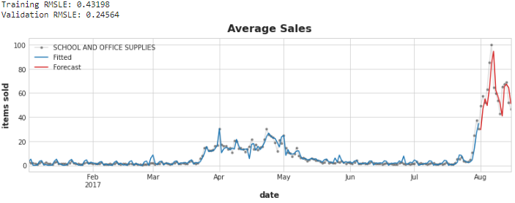
Training and Forecasting on residual:
Looking for a leading indicator providing "early notice" of changes in the target.
Add ‘onpromotion’ feature
time-step delay
Notes:
Delay of forecasting: model needs a time step to react to sudden changes in the target series.
Can improve considering Leading Indicators, in this case found as onpromotion: a series indicating whether a sale for a product (belonging to a family of product) was in promotion -> Boolean variable.

Slide 16
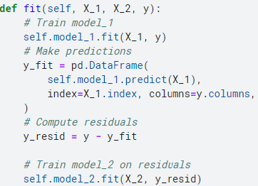
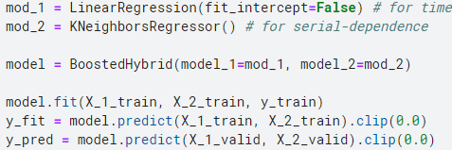
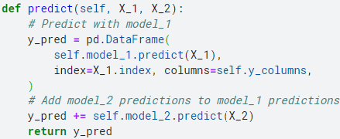
Hybrid Model: forecaster that combine complementary learning algorithms.
mod_1
mod_2
Additive model: series = trend + seasons + cycles + error
Motivation: Target-transforming algorithm cannot extrapolate trends.
Train and predict with first model
Train and predict with second model on residuals
Add to get overall predictions
1
Phases:
2
3
Notes:
Starting from considering that the series is a sectionable set of components, each of which works with the residual curve obtained by removing the previous components from the target series (the difference between the actual curve and the fitted curve).
DT, XGBoost, RF : it predicts the trend in the last step of training data into the future forever
BOOSTEDHYBRID: The method of fitting to residuals is actually the same method the gradient boosting algorithm uses

Slide 17
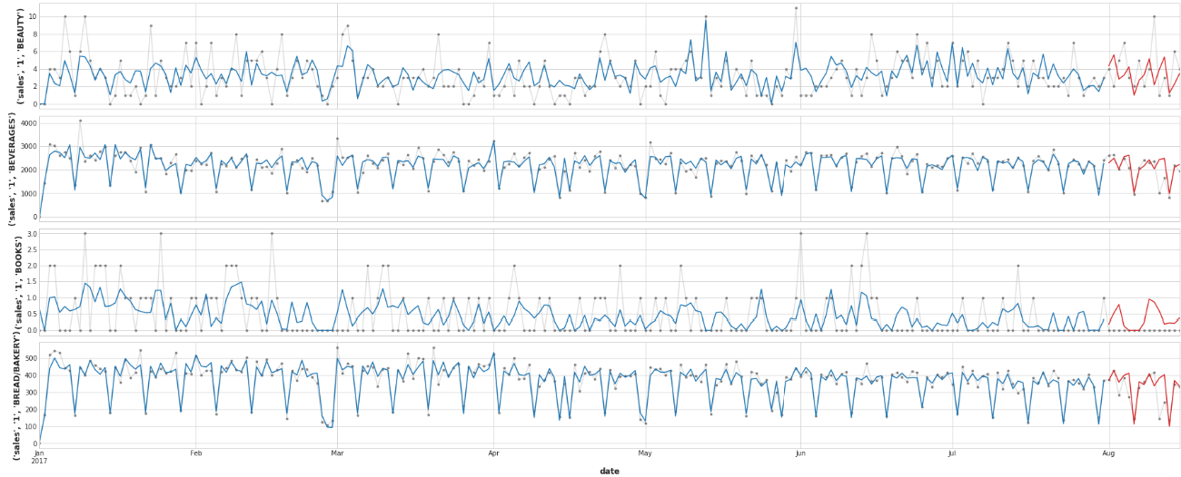
Forecasting Results (best submission score 0.58129)
Notes:
Beverages is most accurate because the time-series data present (in train dataset) are more then other product family.
Interpretation: In some product family the model is fitting and predicting well (e.g. BABY CARE, BREAD/BAKERY, BEVERAGES). In others it does not perform as well as for other family of products. This might suggest that it is a good idea to implement more models, one for each product family and train them with their product family sales data, which means identifying different features for each model/family. (e.g. as we did with School and Office Supplies)

Slide 18
Conclusions
The forecasting results are good, but not for every families.
The most accurate predictions are for top-sales families of product (e.g. Beverages, Grocery, Cleaning, etc…).
There are several possible variation of hybrid model design:
One model for each family (33 models): to identify different features for each family.
One model for each store (54 models): identify feature such as local holidays, analysing ‘store.csv’ dataset.
The use of different kind of plots are essential to the workflow of Time-Series Forecasting.

