Slide 1




Student Performance Analysis
Exploring factors affecting students' academic outcomes
Paskah Sitohang
My Profile LinkedIn
Data Analyst Portfolio Project
July, 2025

Slide 2
PROBLEM STATEMENT & OBJECTIVE
Problem Statement:
Why do some students perform poorly in core academic exams?
Objective:
To identify key factors that influence students’ academic performance using data analysis.
Approach Used:
5 Whys Technique
Data Analysis Lifecycle: Ask, Prepare, Process, Analyze, Share, Act

Slide 3

DATASET SUMMARY
Gender
1000 Student Record
Race/Ethnicity
Parental Level of Education
Lunch Type
8 Columns
Test Preparation Course
Math Score
Reading Score
Writing Score
Preview Table
Source: Kaggle [Students Performance in Exams]

Slide 4
DATA PREPARATION
Steps Taken:
Checked for missing values (None Found)
Create new columns:
Average Score: Mean of math, reading, writing scores
Performance Category: Classified as “Good”, “Passed”, “Bad”
Excellent ≥ 80
Average ≥ 60
Poor < 60
Tools Used: Excel 365

Slide 5

Key Finding #1 – Test Preparation Matters
Insight
Students who completed the test preparation course scored on average 8 points higher than those who did not.

Slide 6
Key Finding #2 – Gender Differences
Insight
Male students perform better in Math, while female students excel in Reading and Writing

Slide 7
Key Finding #3 – Parental Education Impact
Insight
Students whose parents have higher education levels tend to perform better, showing a positive correlation.

Slide 8
CONCLUSION & RECOMMENDATIONS
Conclusion Summary:
Test preparation improves academic scores
Gender performance gaps exist by subject
Parental education level influences student performance
Actionable Recommendations:
Encourage test preparation programs for all students
Provide support for students at risk (especially males with no prep & standard lunch)
Personalize learning strategies based on student background

Slide 9
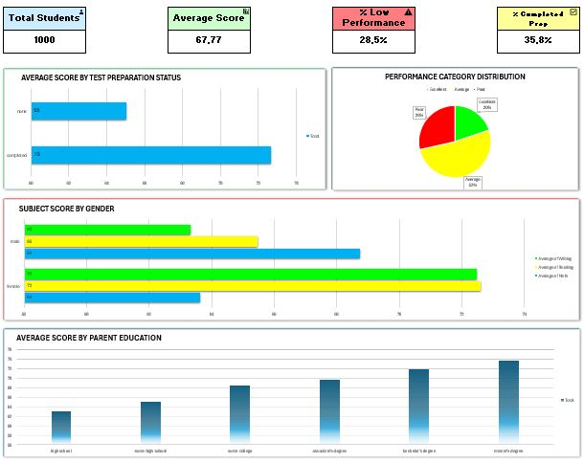
VISUAL
DASHBOARD
OVERVIEW

Slide 10


About the Analyst
Paskah Sitohang
My Github Portfolio
Excel 365, Power Pivot, Pivot Table

