Slide 1
Personal Loan Campaign
Supervised Learning Classification Project - PGP AIML
Chandramouli Pasumarthi
Date: 01/02/2024

Slide 2
Contents / Agenda
Executive Summary
Business Problem Overview and Solution Approach
EDA Results
Data Preprocessing
Model Performance Summary
Appendix

Slide 3
Executive Summary
Actionable Insights:
Customer Segmentation: Identify segments based on deposit sizes, demographics, and transaction behavior. Design targeted campaigns for each segment to improve personal loan conversion rates.
Historical Campaign Analysis: Analyze the successful 9% conversion rate from the previous campaign.
Identify patterns and characteristics of successfully converted customers for future campaign refinement.
Predictive Attribute Analysis: Identify key attributes influencing personal loan purchases.
Prioritize marketing efforts on customers exhibiting these attributes for enhanced campaign success.
Cross-Selling Strategies: Recognize potential for cross-selling to existing depositors.
Develop cross-sell strategies aligned with financial goals to encourage exploration of personal loans.
Customer Engagement Score: Develop a customer engagement scoring system based on interactions and transaction history.
Prioritize outreach to customers with higher engagement scores for increased responsiveness.
Recommendations:
Behavioral Triggers: Identify triggers indicative of a customer's readiness for a personal loan.
Implement automated systems to detect triggers and initiate targeted communication at optimal times.
Campaign Personalization: Understand the importance of personalized messaging.
Leverage customer data to tailor marketing messages, showcasing loan benefits based on individual profiles and preferences.
Multi-Channel Marketing: Recognize the importance of diverse communication channels.
Implement multi-channel marketing strategies to reach a broader audience effectively.
Customer Retention Focus: Emphasize the retention of customers as depositors.
Develop campaigns that balance conversion objectives with retaining primary banking relationships for long-term loyalty.
Continuous Model Improvement: Acknowledge the need for ongoing model refinement.
Regularly update the predictive model with new data and incorporate feedback from campaign outcomes to enhance accuracy and relevance.

Slide 4
Business Problem Overview and Solution Approach
Business Problem Overview:
The number of customers who are also borrowers (asset customers) is quite small, and the bank is interested in expanding this base rapidly to bring in more loan business and in the process, earn more through the interest on loans. In particular, the management wants to explore ways of converting its liability customers to personal loan customers (while retaining them as depositors).
Solution Approach:
1. Data Collection: Gather comprehensive data on customer demographics, transaction history, deposit sizes, and any other relevant attributes
2. Data Cleaning and Preprocessing: Clean the data by handling missing values, outliers, and ensuring consistency.
3. Exploratory Data Analysis (EDA):Conduct EDA to gain insights into the distribution of liability and asset customers.
4. Feature Engineering: Identify and create relevant features that may influence the likelihood of a customer purchasing a personal loan.
5. Model Selection: Choose appropriate machine learning models for classification such as Decision tree
6. Model Training: Split the data into training and testing sets.
7. Model Evaluation: Evaluate the performance of the model on the testing set, using metrics such as accuracy, precision, recall, and F1 score.

Slide 5
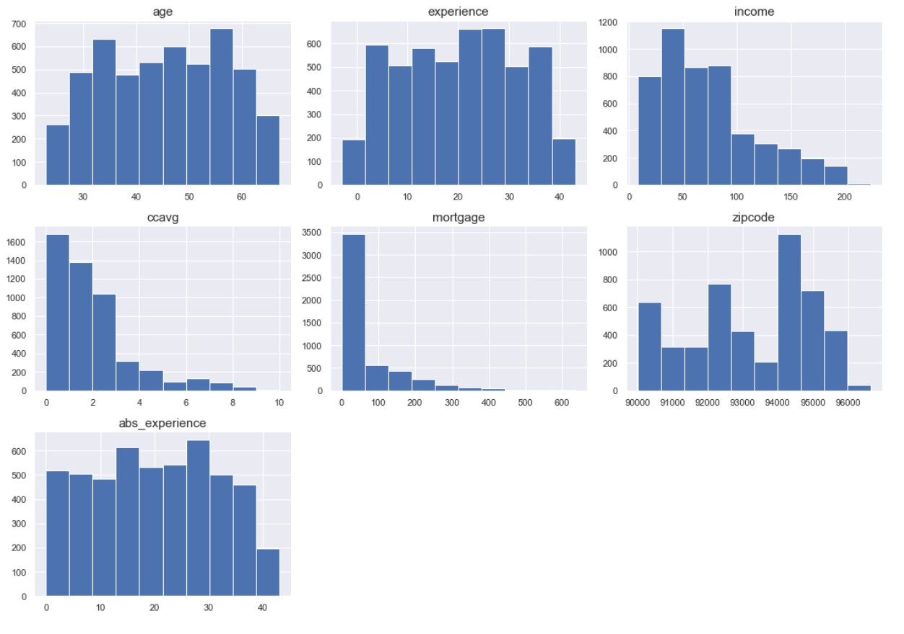
EDA –Results-Univariate Analysis
•
Average age is about 45 years old. The age distribution is uniform.
•
Experience has a uniform distribution.
•
Income is right skewed with many outliers to upside.
•
ccavg is right skewed with many outliers to upside.
•
Mortgage is right skewed with many outliers to upside.

Slide 6
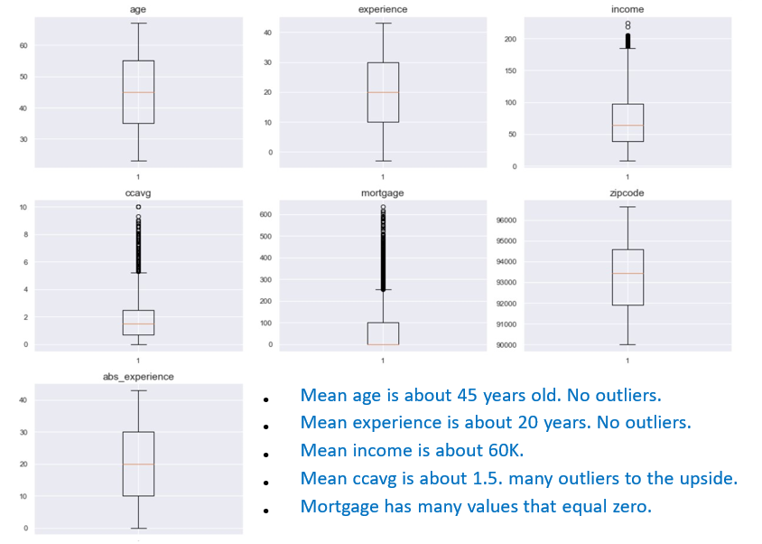
EDA Results-Outlier detection using Boxplot

Slide 7
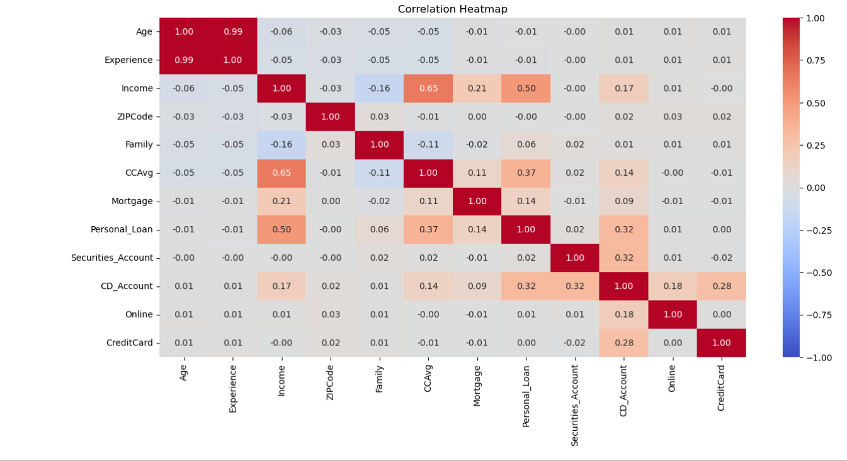
EDA Results- Bivariate Analysis
Age and experience are heavily correlated with each other.
Credit card usage and income are heavily correlated with each other

Slide 8
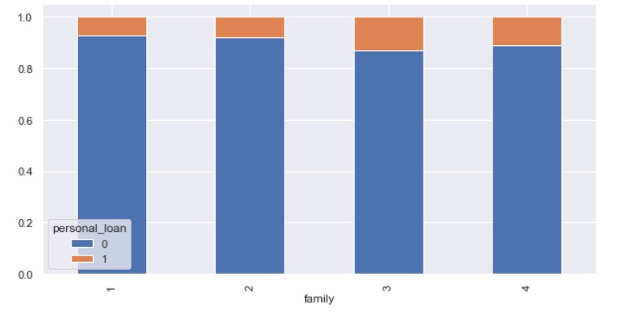
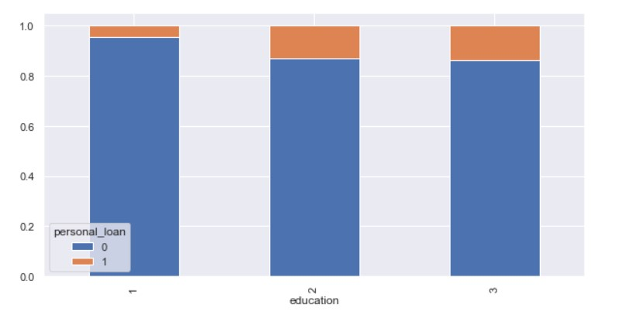
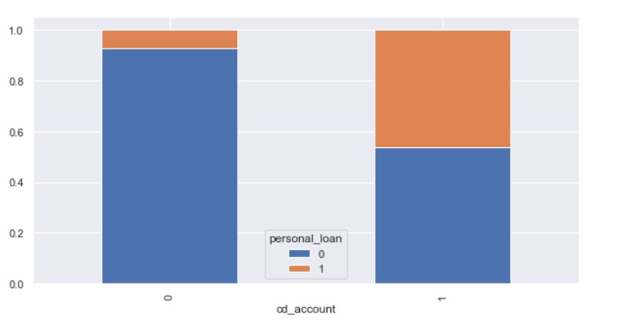
EDA Results- Bivariate Analysis
Those customers with an education of '2' and '3' hold a greater percentage of personal loans that those customer with an education of '1'.
personal_loan vs family
personal_loan vs
education
personal_loan vs cd_account
Those customers with cd accounts have a greater percentage of personal loans than those customer without a cd account.
Those customers with a family of 3 have a greater percentage of personal loans than the other family categories.
A family of 4 has the second greatest percentage of personal loans followed by a family of 2, and 1

Slide 9
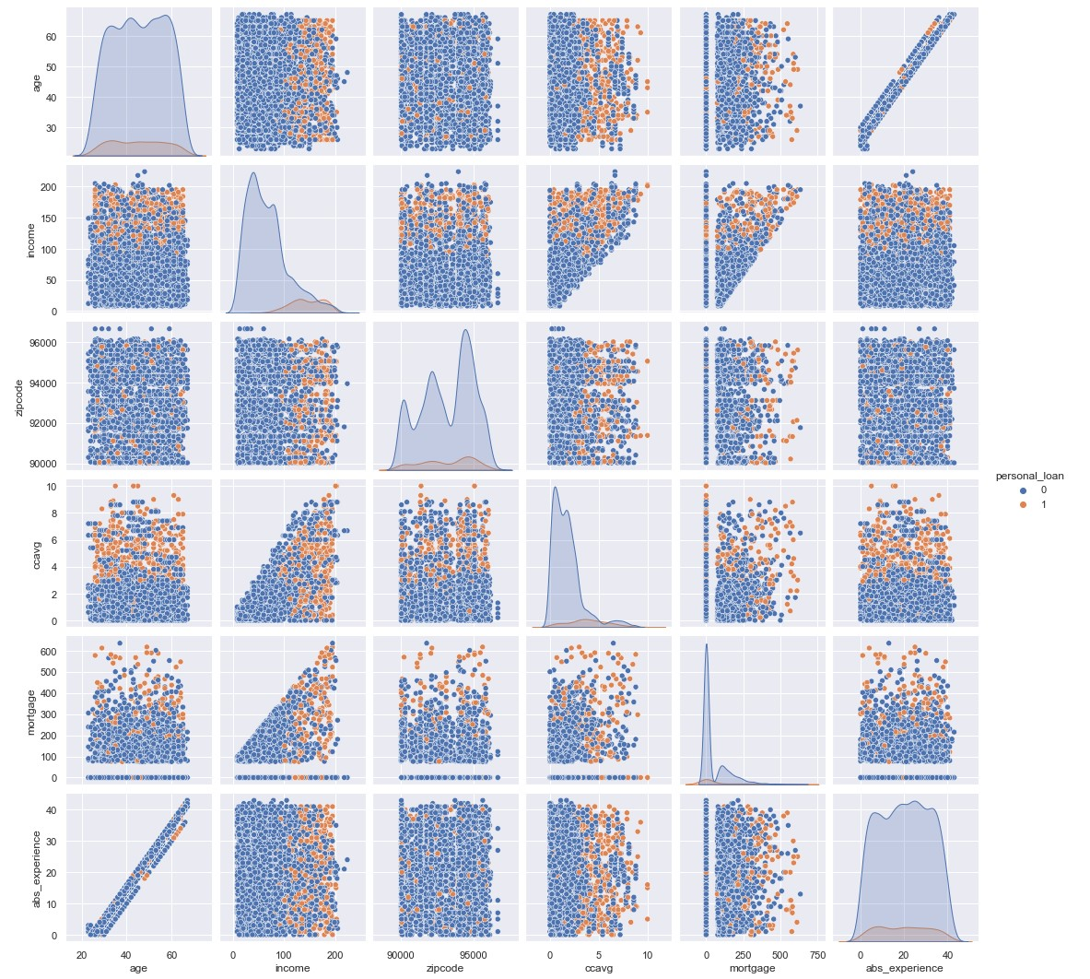
EDA Results- Bivariate Analysis using Pairplot
•
The plot shows income is higher among those customers with personal loans.

Slide 10
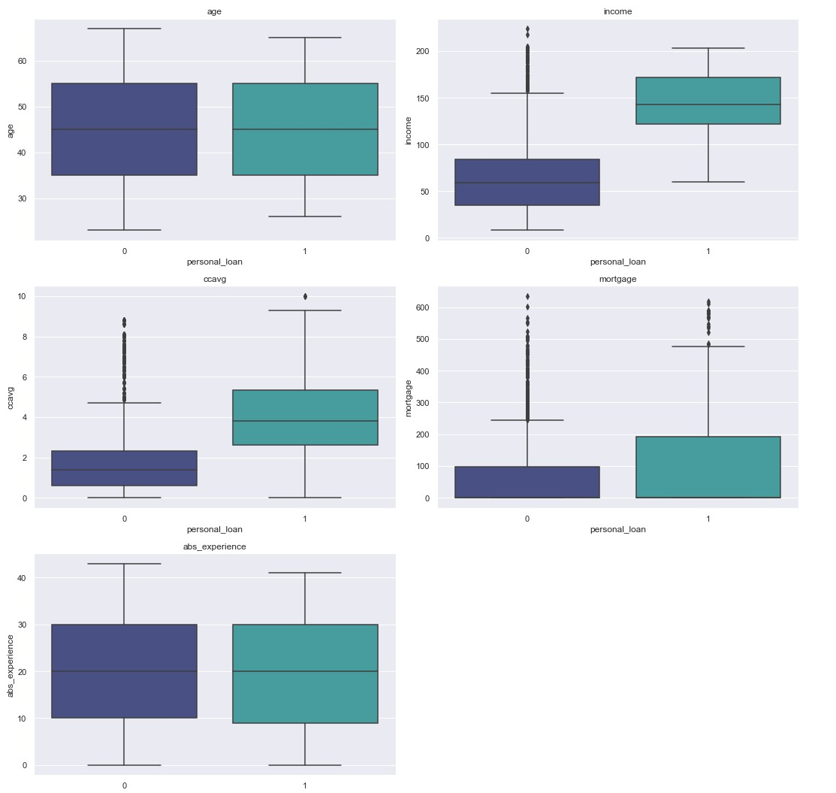
EDA Results-Bivariate Analysis
On average, those customers with higher incomes have personal loans.
On average, those customers with higher credit card usage have personal loans

Slide 11
Data Preprocessing
Duplicate value check: - Detected one duplicate row in the dataset and dropped
Unique Values: - The ID column contains unique values, and we can drop it. As it does not provide
meaningful information and can be redundant for analysis.
Missing value treatment: - There are no null values in the dataset
Feature Engineering: - In this feature engineering step, the categorical features, including "Education,"
“Family" are being optimized by converting their data
type to 'category' for more efficient memory usage and enhanced
representation in the dataset.

Slide 12
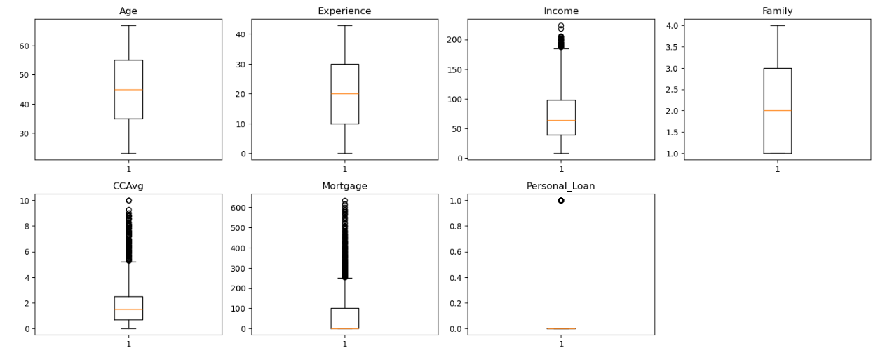
Data Preprocessing-Outlier Check
* There are quite a few outliers in the data.
* However, we will not treat them as they are proper values

Slide 13
Data Preparation for Modeling
The objective is to predict whether a liability customer will buy personal loans.
Before you proceed to build a model, you need to split the data into train, test and validation to be able to evaluate the model that you build on the train data
You'll have to encode categorical features and scale numerical values.
You will build a model using the train data and then check performance

Slide 14
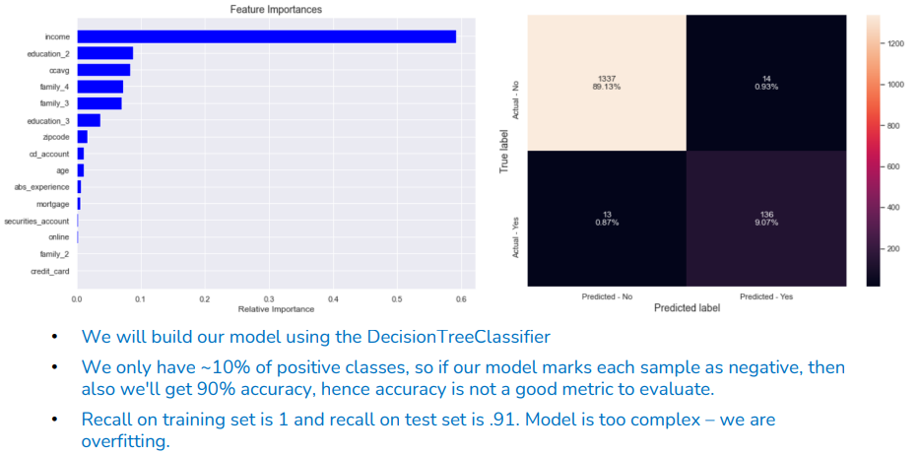
Model Building-Initial

Slide 15
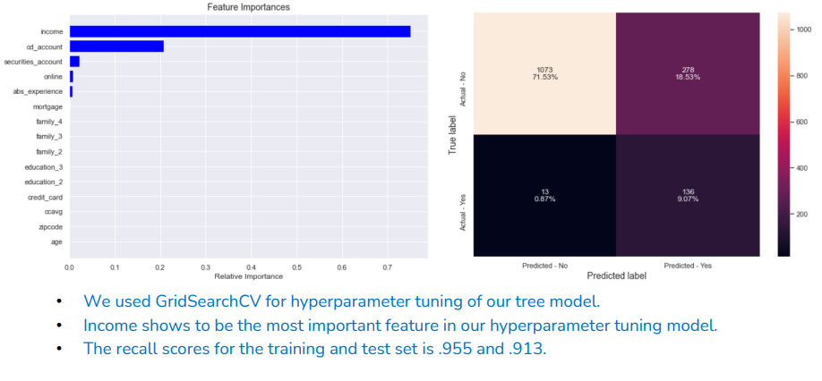
Model Building with HyperParameters Tuning

Slide 16
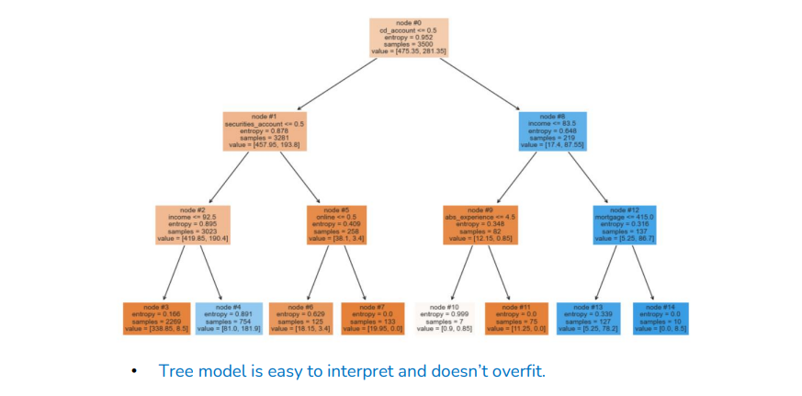
Model Building with HyperParametersTuning

Slide 17
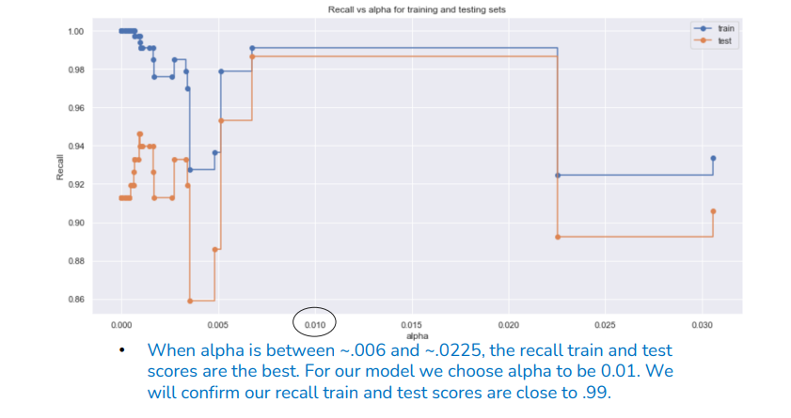
Model Building with Cost Complexity Pruning

Slide 18
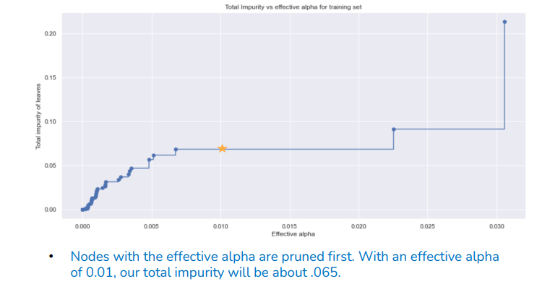
Model Building with Cost Complexity Pruning

Slide 19
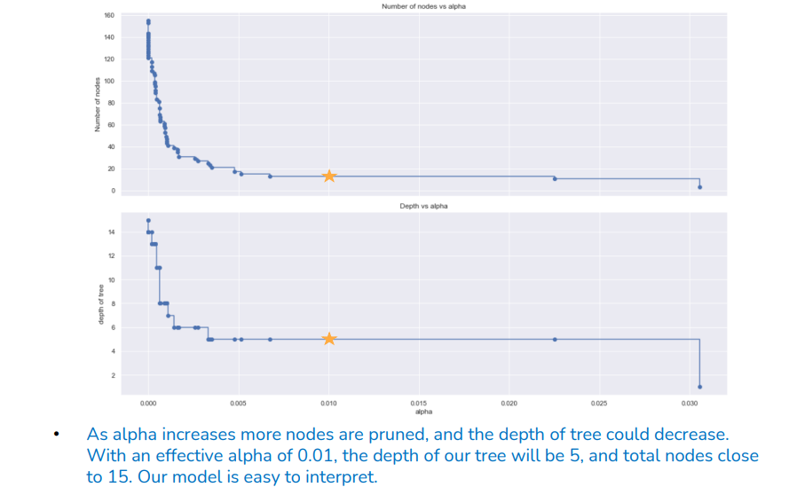
Model Building with Cost Complexity Pruning

Slide 20
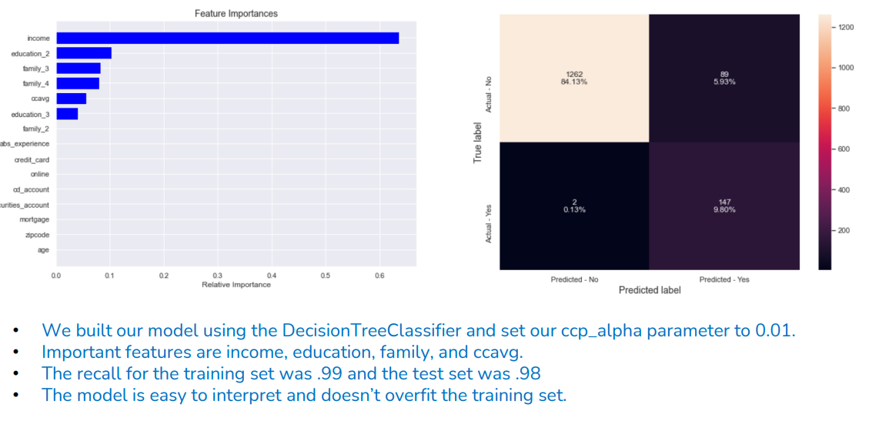
Model Building with Cost Complexity Pruning

Slide 21
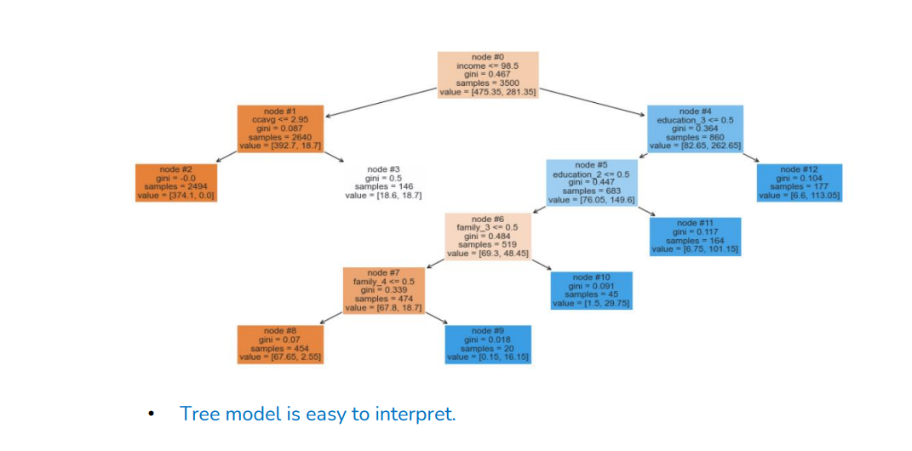
Model Building with Cost Complexity Pruning

Slide 22
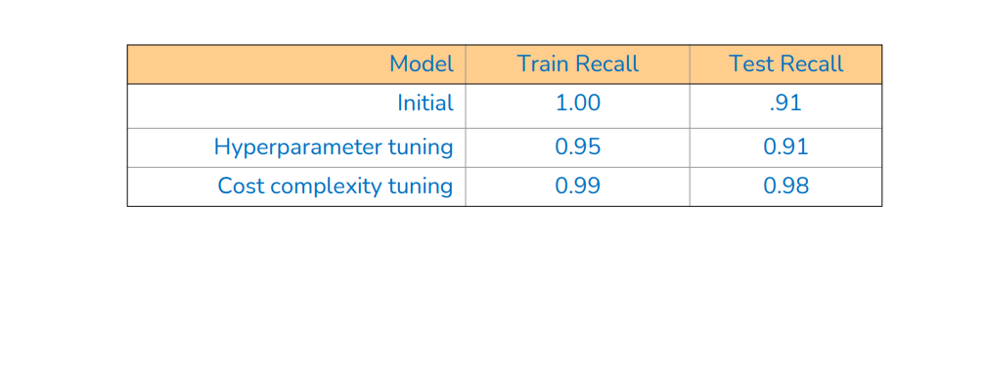
Model Performance Summary

Slide 23
