Slide 1
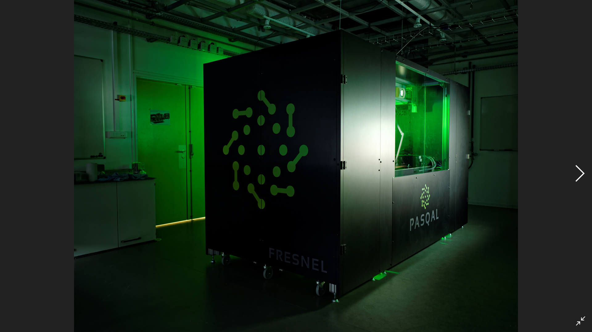

Anton Quelle
CINECA
Practical Quantum Computing 2022
Efficient Quantum simulation using Tensor Network states

Slide 2

Contents
Quantum complexity
Tensors
Tensor Network representation
Contraction order
Example: Hardware efficient ansatz QVC
If time permits: Controlling bond dimension

Slide 3

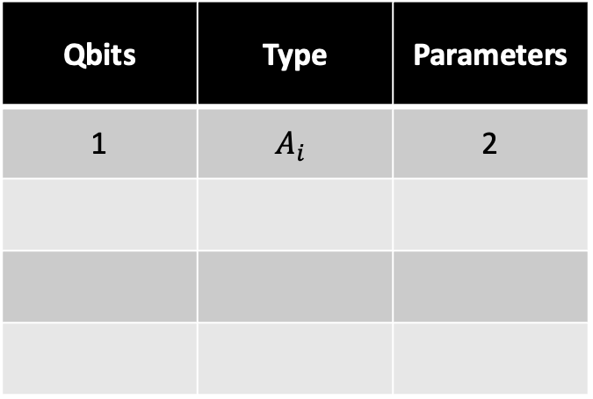

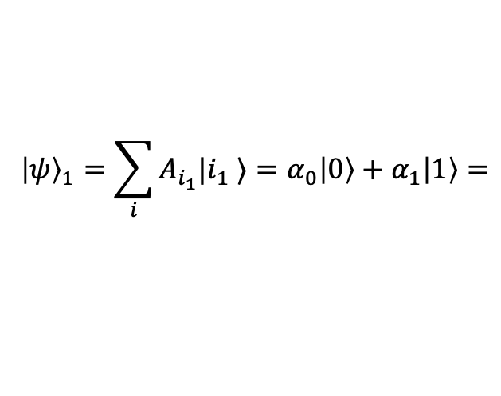



Quantum complexity
$${\left|ψ\right\rangle }_{1}=\sum_{i}{A_{i_{1}}|i_{1} ⟩}=α_{0}\left|0\right\rangle +α_{1}\left|1\right\rangle =$$
Qbits | Type | Parameters
1 | $$A_{i}$$ | 2
1
0
0
1
$$α_{0}$$
$$α_{1}$$
$$α_{0}$$
$$+$$
$$α_{1}$$
$$=$$

Slide 4
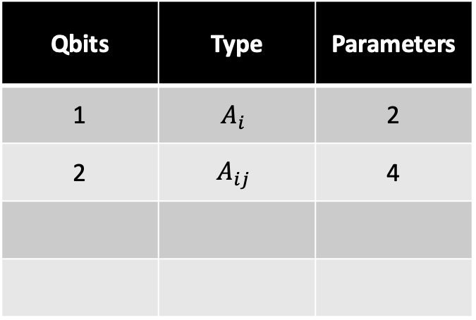



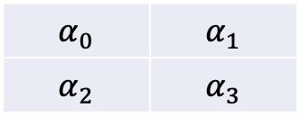

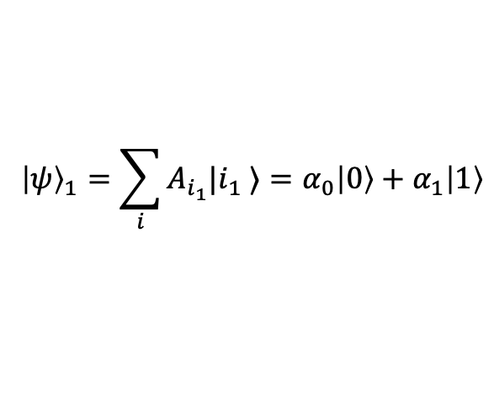





Quantum complexity
$${\left|ψ\right\rangle }_{1}=\sum_{i}{A_{i_{1}}|i_{1} ⟩}=α_{0}\left|0\right\rangle +α_{1}\left|1\right\rangle$$
Qbits | Type | Parameters
1 | $$A_{i}$$ | 2
2 | $$A_{ij}$$ | 4
$${\left|ψ\right\rangle }_{2}=\sum_{i}{A_{i_{1}i_{2}}|i_{1} i_{2}⟩}=α_{00}\left|00\right\rangle +α_{01}\left|01\right\rangle +α_{10}\left|10\right\rangle +α_{11}\left|11\right\rangle$$
1
0
0
0
0
1
0
0
0
0
1
0
0
0
0
1
$$α_{0}$$
$$α_{1}$$
$$α_{2}$$
$$α_{3}$$
$$α_{0}$$
$$+$$
$$α_{1}$$
$$+$$
$$α_{2}$$
$$+$$
$$α_{3}$$
$$=$$
$$α_{0}$$ | $$α_{1}$$
$$α_{2}$$ | $$α_{3}$$
The same information can be represented in vector or matrix form

Slide 5
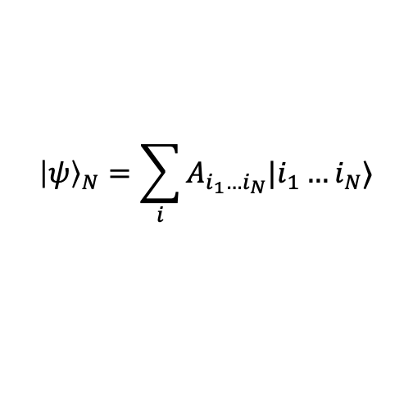
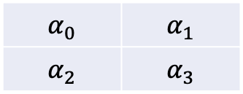
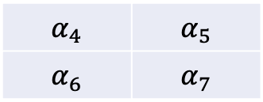
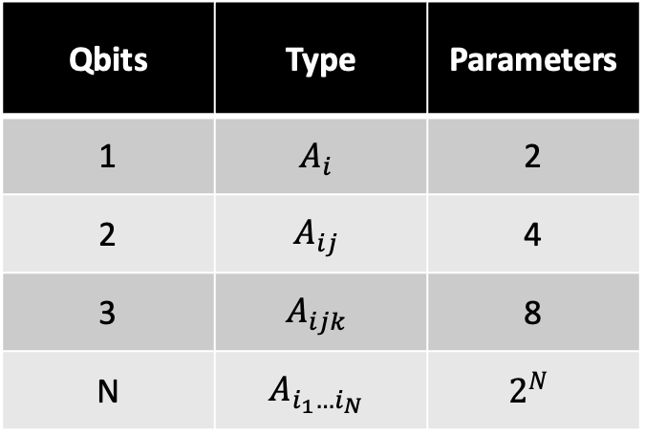
Quantum complexity
$${\left|ψ\right\rangle }_{1}=\sum_{i}{A_{i_{1}}|i_{1} ⟩}=α_{0}\left|0\right\rangle +α_{1}\left|1\right\rangle$$
Qbits | Type | Parameters
1 | $$A_{i}$$ | 2
2 | $$A_{ij}$$ | 4
3 | $$A_{ijk}$$ | 8
N | $$A_{i_{1}…i_{N}}$$ | $$2^{N}$$
$${\left|ψ\right\rangle }_{2}=\sum_{i}{A_{i_{1}i_{2}}|i_{1} i_{2}⟩}=α_{00}\left|00\right\rangle +α_{01}\left|01\right\rangle +α_{10}\left|10\right\rangle +α_{11}\left|11\right\rangle$$
$${\left|ψ\right\rangle }_{N}=\sum_{i}{A_{i_{1}…i_{N}}|i_{1}…i_{N}⟩}$$
$$α_{4}$$ | $$α_{5}$$
$$α_{6}$$ | $$α_{7}$$
$$α_{0}$$ | $$α_{1}$$
$$α_{2}$$ | $$α_{3}$$
For 3 qubits the quantum state can be encoded as a rank 3 tensor

Slide 6

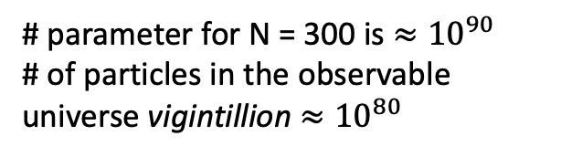
Quantum complexity
$${\left|ψ\right\rangle }_{1}=\sum_{i}{A_{i_{1}}|i_{1} ⟩}=α_{0}\left|0\right\rangle +α_{1}\left|1\right\rangle$$
Qbits | Type | Parameters
1 | $$A_{i}$$ | 2
2 | $$A_{ij}$$ | 4
3 | $$A_{ijk}$$ | 8
N | $$A_{i_{1}…i_{N}}$$ | $$2^{N}$$
$${\left|ψ\right\rangle }_{2}=\sum_{i}{A_{i_{1}i_{2}}|i_{1} i_{2}⟩}=α_{00}\left|00\right\rangle +α_{01}\left|01\right\rangle +α_{10}\left|10\right\rangle +α_{11}\left|11\right\rangle$$
$${\left|ψ\right\rangle }_{N}=\sum_{i}{A_{i_{1}…i_{N}}|i_{1}…i_{N}⟩}$$
$$A_{i_{1}…i_{N}}$$
is an object with N indices, i.e. A rank N tensor
# parameter for N = 300 is $≈{10}^{90}$ # of particles in the observable universe vigintillion $≈{10}^{80}$
Array of coefficients for 40 qbits requires 1 Tb of memory. How to store it in a computer ?

Slide 7














































Tensors
vector
matrix
3d tensor
N d tensor
$$v$$
$$M$$
$$T$$
$$A$$
$$i$$
$$j$$
$$i$$
$$k$$
$$i$$
$$j$$
$$i_{1}$$
$$i_{N}$$
$$\sum_{j}{w_{j} v_{j} = }$$
$$w$$
$$v$$
$$=$$
$$c$$
$$j$$
$$j$$
$$m$$
$$m$$
$$\sum_{j}{M_{ij} v_{j}= }$$
$$i$$
$$k$$
$$i$$
$$M$$
$$v$$
$$=$$
$$w$$
$$A$$
$$B$$
$$n$$
$$=$$
$$D$$
$$n$$
$$i$$
$$j$$
$$i$$
$$l$$
$$\sum_{j}{M_{ij} N_{jk}= }$$
$$M$$
$$N$$
$$=$$
$$C$$
$$i$$
$$j$$
$$k$$
$$i$$
$$k$$

Slide 8



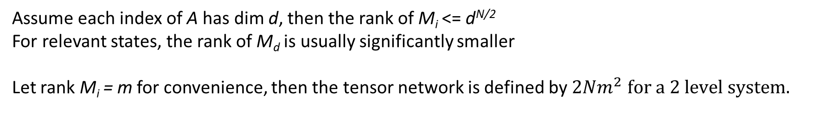




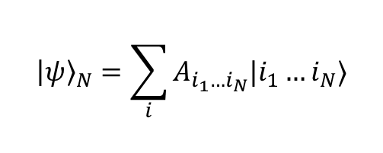







Tensor Network representation
$${\left|ψ\right\rangle }_{N}=\sum_{i}{A_{i_{1}…i_{N}}|i_{1}…i_{N}⟩}$$
We represent a high rank tensor as a product of low rank tensors.
$$i_{1}$$
$$i_{2}$$
$$i_{3}$$
$$i_{N}$$
$$i_{1}$$
$$…$$
$$i_{N}$$
$$M_{1}$$
$$M_{2}$$
$$M_{3}$$
$$…$$
$$M_{N}$$
$$=$$
$$A$$
Matrix Product State/ Tensor Train
Assume each index of A has dim d, then the rank of M_{i} <= d^{N/2}
For relevant states, the rank of M_{d} is usually significantly smaller
Let rank M_{i} = m for convenience, then the tensor network is defined by $2Nm^{2}$ $for a 2 level system.$
Matrix Product State(MPS)/ Tensor Train
The density-matrix renormalization group
U. Schollwöck Rev. Mod. Phys. 77, 259

Slide 9




















Tensor Network representation
$$⟨ψ |$$
$$…$$
$$\left\langle ψ \right| ψ ⟩=$$
$$i_{1}$$
$$i_{2}$$
$$i_{3}$$
$$i_{N}$$
$$…$$
$$|ψ⟩$$
$$…$$
$$⟨ψ |$$
$$A$$
$$\left\langle ψ \right| AB| ψ ⟩=$$
$$B$$
$$i_{1}$$
$$i_{2}$$
$$i_{3}$$
$$i_{3}$$
$$i_{N}$$
$$…$$
$$|ψ⟩$$

Slide 10
Contraction order
The algorithmic complexity of a tensor network contraction depends on the contraction order!
O(d⁴)
O(d⁴)
=
=
O(d⁵)
O(d⁴)
=
=

Slide 11
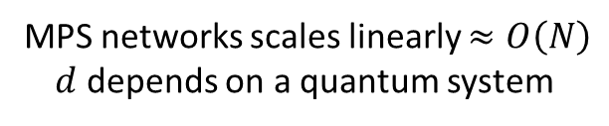
Contraction order
Dim = d
=
Dim = s
$$…$$
$$…$$
$$…$$
$$…$$
=
$$…$$
$$…$$
=
O(sd³)
$$…$$
MPS networks scales linearly $≈O\left(N\right)$
$d$ depends on a quantum system
$$…$$

Slide 12






Example: Hardware efficient ansatz QVC
CNOT gate is an MPO of bond dimension 2
$$a$$
A
$$b$$
A and B both have dims (2,2,2)
The non-zero elements are, with indices in alphabetical order
A₀₀₀ = A₁₁₁ = B₀₀₀ = B₀₁₁ = B₁₀₁ = C₁₁₀ = 1
CNOT =
$$c$$
$$d$$
$$B$$
$$e$$
Single qubit gates are MPO’s of bond dimension 1 in a trivial way

Slide 13













Example: Hardware efficient ansatz QVC
3 qubit hardware-efficient ansatz as a tensor network
$$q1$$
R_{y}
$$\text{R}\text{x}$$
$$\text{R}\text{y}$$
A
$$\text{1}$$
$q$₂
$$\text{R}\text{y}$$
$$\text{R}\text{x}$$
$$\text{R}\text{y}$$
B
A
$$q3$$
$$\text{R}\text{y}$$
$$\text{R}\text{x}$$
$$\text{R}\text{y}$$
$$\text{1}$$
B

Slide 14
Controlling bond dimension
Dim = d₂
=
$$…$$
$$…$$
$$…$$
Dim = d₁*d₂
Dim = d₁
Bond dimension grows exponentially in the number of MPO applications.
However, the rank of the matrices in the MPS might be much lower than the bond dimension.
There are multiple algorithms to deal with this solution. A simple one uses the canonical form.

Slide 15



Controlling bond dimension
We can write:
=
$$…$$
$$…$$
Such that
$$…$$
are diagonal
is the identity for all bonds, and similar for all the mirrored networks.
$$…$$
This is called the canonical form (A Practical Introduction to Tensor Networks: Matrix Product States and Projected Entangled Pair States, R. Orus, AOP 349: 117-158)

Slide 16
Controlling bond dimension
If the bond dimension of an MPS is larger than it needs to be, the
The bond dimension can be reduced by truncating those bonds.
will contain zeroes.
This also forms the basis for an approximation scheme. In the canonical form,
one can truncate a bond to drop all entries of smaller than some cutoff.
In practice, this works really well.

Slide 17
loic@pasqal.com

