Slide 1


BPFCTRL
Eloïse Brocas – Éric Leblond

Slide 2

Suricata
Network Traffic Analysis
  Intrusion Detection System
  Network Security Monitoring
Community driven
Code:
  Open Source
  Mixed of C and Rust

Slide 3
Suricata on live traffic
Sniffer mode
  Get raw traffic
  Use AF_PACKET socket
  Like tcpdump
suricata –af-packet=$(wtfiseth0) port 80 and host 10.0.0.1
Note: alias wtfiseth0='ip r l | grep default | cut -d " " -f 5'

Slide 4

Suricata on selected live traffic (hipster style)
BPF is your grand mother technology
Linux has eBPF
  Extended Berkeley Packet Filter
  Filters can be developed in C
  Shared data structure
    Between kernel and user space
    Data can be managed by external tool

Slide 5
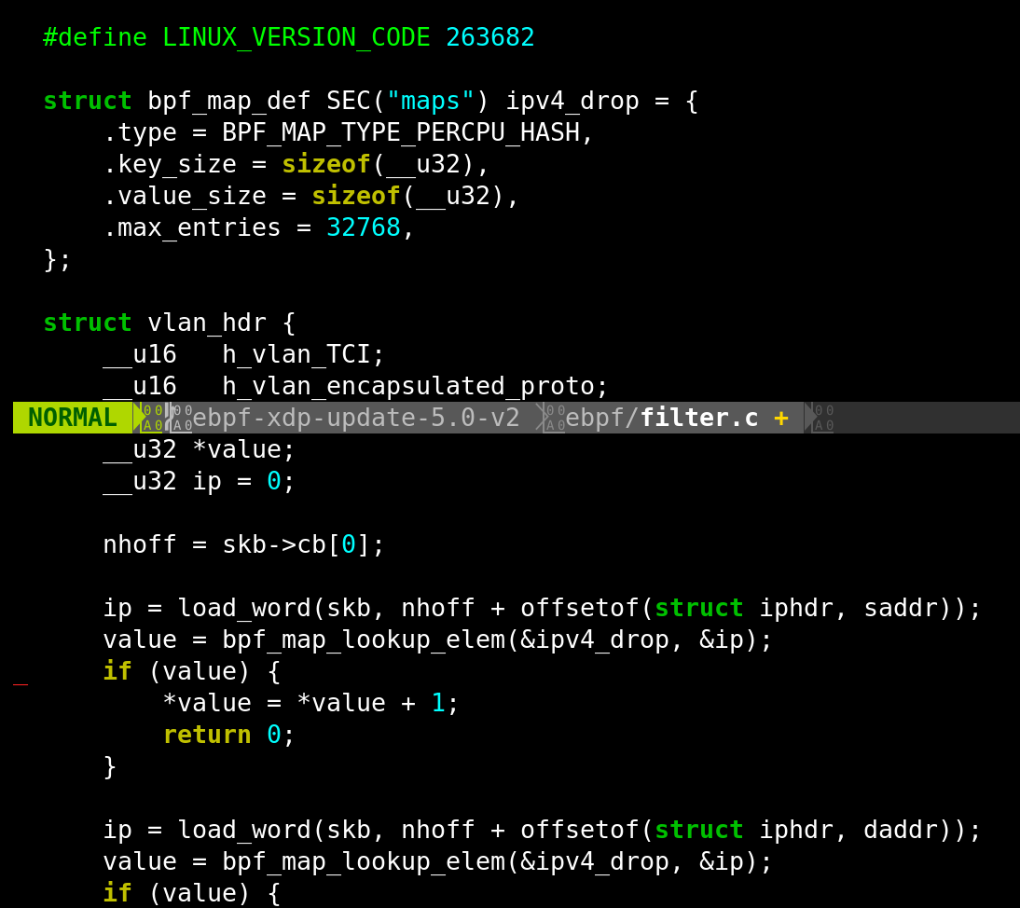
Simple eBPF filter

Slide 6
Introducing bpfctrl
Wrapper on top of bpftool
LGPLv2
Manage pinned maps
Currently support
  IPv4 with counters
  Single integer

Slide 7

Demonstration
Verify Suricata sees traffic
Add IP to drop list
Nothing anymore

Slide 8
Thank You!
https://github.com/stamusNetworks/bpfctrl
Eloïse Brocas
eloise@brocas.org
Éric Leblond
el@stamus-networks.com

