Slide 1
Welcome to the #pts21 VIRTUAL edition!

Slide 2

27 proposals

Slide 3
27 proposals
16 accepted talks
3 afternoons

Slide 4
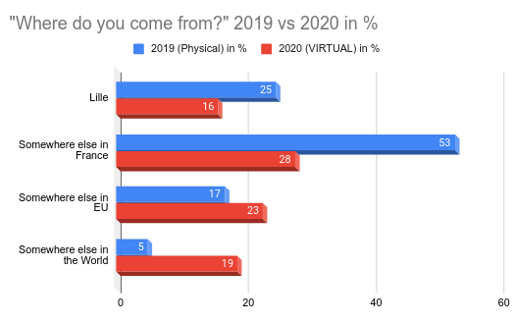
Virtual VS In Real Life event

Slide 5


Sponsoring

Slide 6

Partners

Slide 7
Going virtual (again) implied (again)
a big drop of our expenses:
travel reimbursement,
on site communication,
catering,
etc.

Slide 8
So, we invited our #pts20/#pts21
sponsors to
stay sponsors for #pts22 at no cost

Slide 9
And now!
> Ask questions through Q&A on Zoom,
speakers will answer at the end of their talk.
> Discussions: #pts21 on libera.chat
> On Twitter : @passthesaltcon #pts21

Slide 10
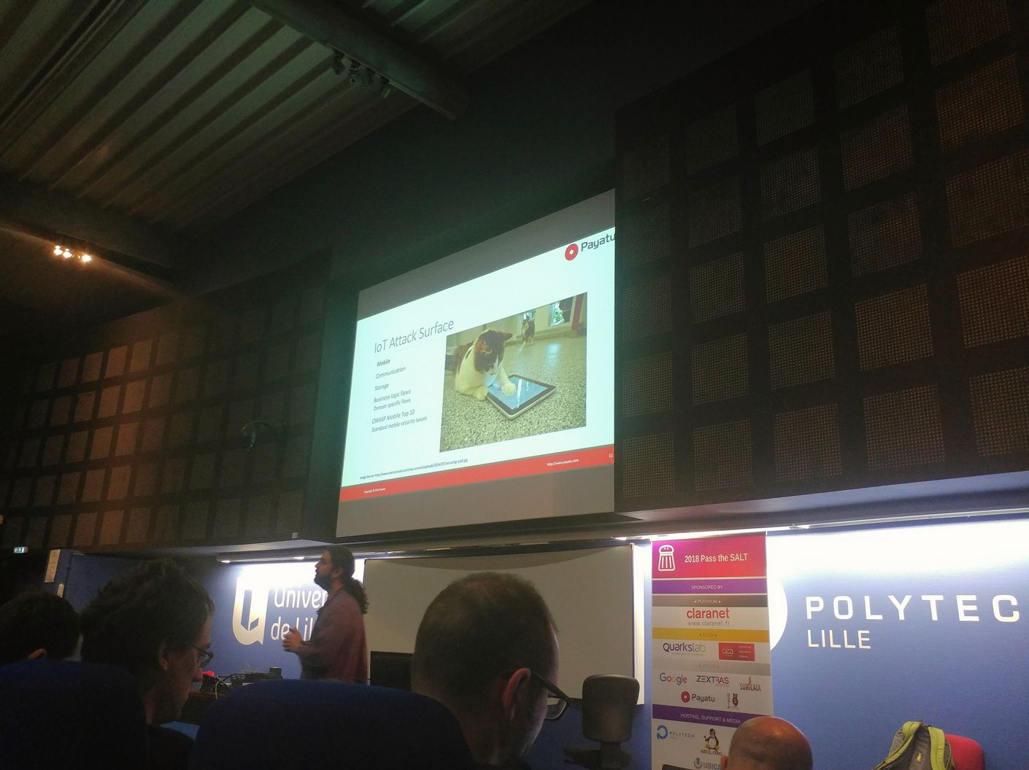
Dear speakers,
the (virtual) stage is yours!

