Slide 1

Pass the SALT 2023
6th edition

Slide 2
CALL FOR PAPERS
44 proposals / 25 accepted (2022: 39 / 27)
→ Acceptation Rate: 55% (2022: 69 %)

Slide 3
CALL FOR PAPERS
44 proposals / 25 accepted (2022: 39 / 27)
→ Acceptation Rate: 55% (2022: 69 %)
27 speakers / 6 from EU / 1 from outside EU (2022: 26 / 6 from EU)

Slide 4








SPONSORS
2023 presents a perfect mix between long term supporters and new comers!
Thanks to you all 🥰

Slide 5





PARTNERS
Without our partners, nothing would be possible. A big applause to them too 🥰

Slide 6
Code of Conduct
Be excellent to each other.
Take care of what you share.
Come to us in case of any problem.
🫶 ✊ https://2023.pass-the-salt.org/code-of-conduct/

Slide 7

Speaking English
Look at the badge and switch to EN in case of a non FR speaking person.
Thanks by advance 🫶 ✊

Slide 8
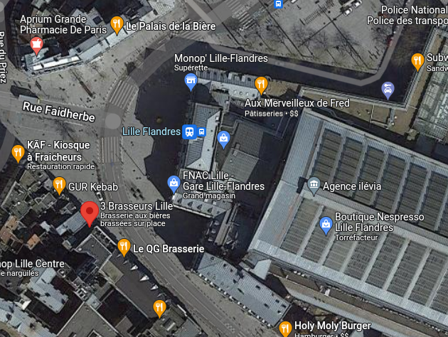
Social event
→ « 3 brasseurs » bar near Flandres station
→ Tuesday evening
19h30

Slide 9
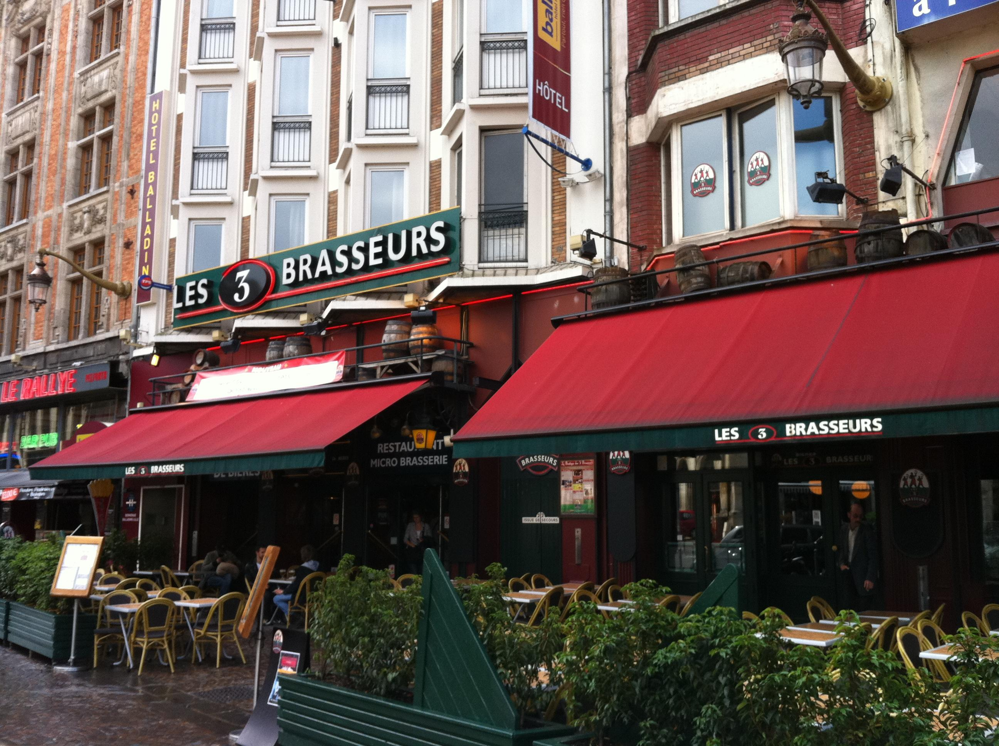
Social event
→ « 3 brasseurs » bar near Flandres station
→ Tuesday evening
19h30

Slide 10
Social event
Your badge is required to access.

Slide 11
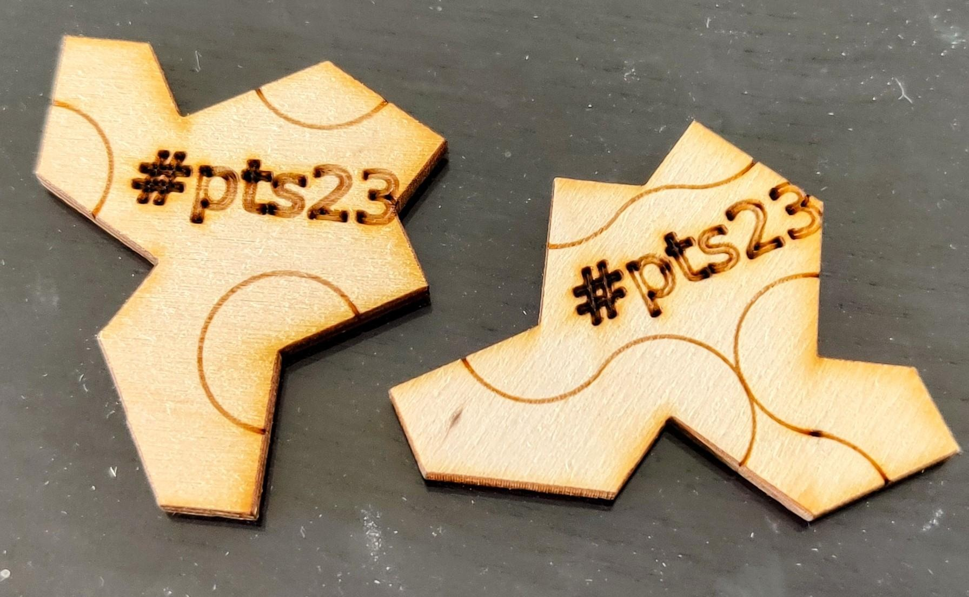
Social event
Your badge is required to access.
2 coins → 2 free drinks

Slide 12

Rumps Session
Lightning talks (between 3-5min)
Tuesday 16:55 ↔17:45
Topic : Free software + Security
Send your topic+title to : rumps@pass-the-salt.org

Slide 13
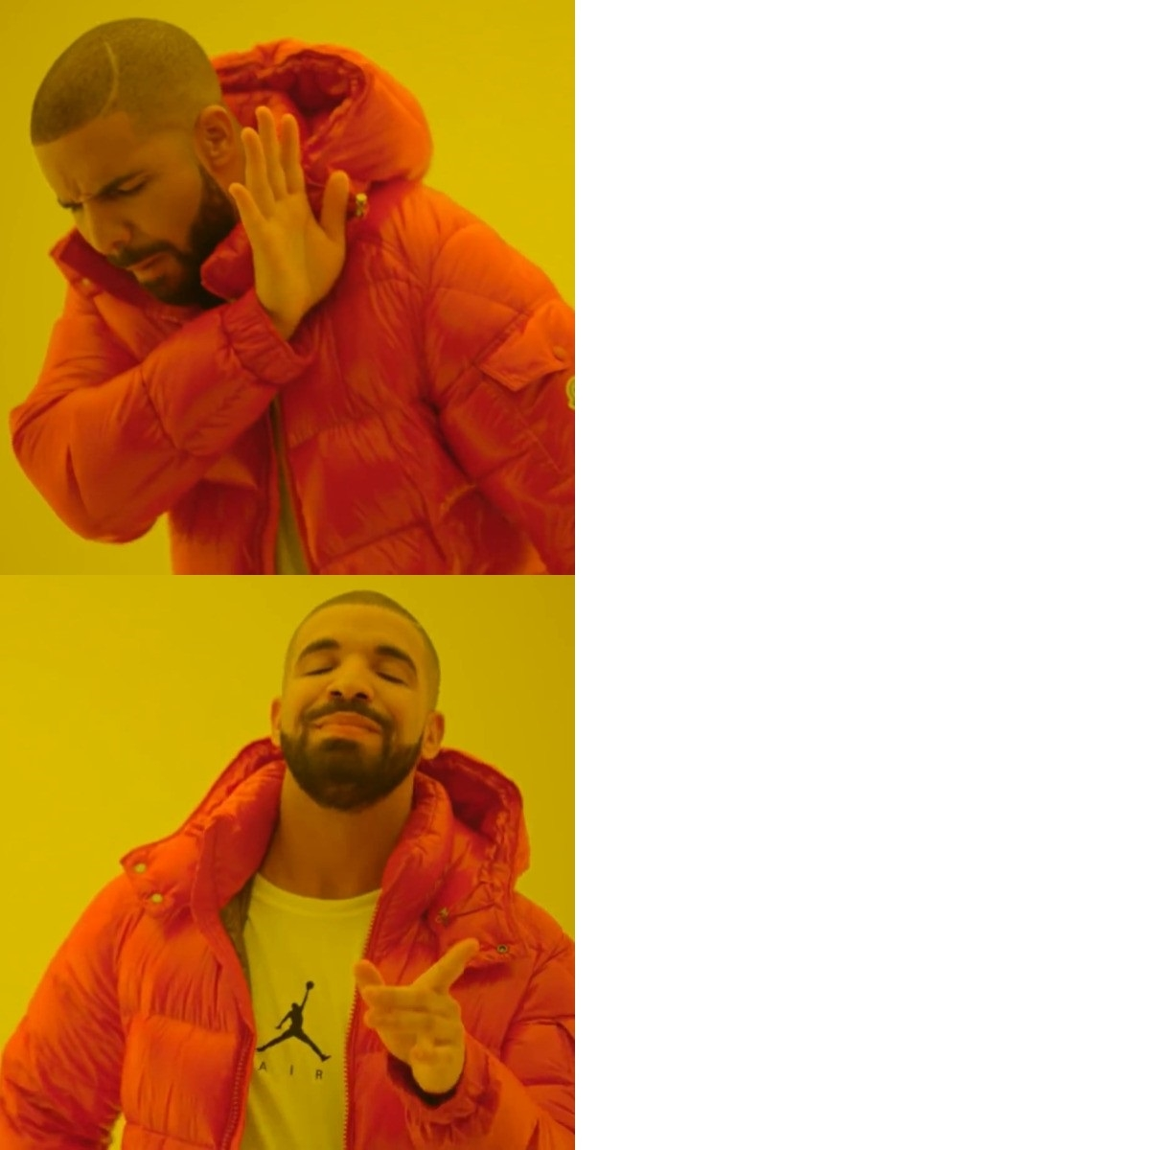
Rumps Session
I have nothing interesting to say

Slide 14
Rumps Session
I have nothing interesting to say
I submit a rump
& I get a collector speaker sticker!

Slide 15


Slide 16
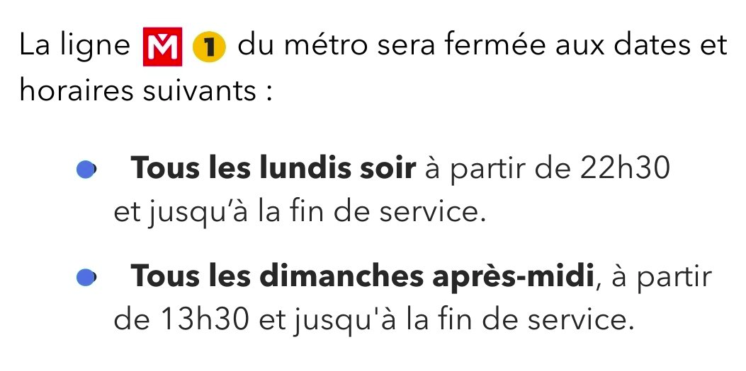
Transports Warning
Métro Line 1 will stop at 22:30 on Monday night for work on the line

