Slide 1

Rumps Session
Lightning talks (between 3-5min)
Tuesday 16:55 ↔17:45
Topic : Free software + Security rumps@pass-the-salt.org
Bonus: a collector sticker for you!

Slide 2

Speakers Dinner
Las Tapas
116 Rue Saint-André, 59000 Lille
🚨 20-25min walk from Lille
Flandres station.

Slide 3
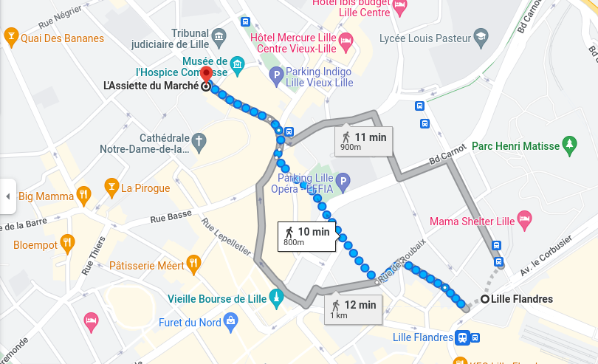
Speakers Dinner

