Slide 1

Rumps Session
Lightning talks (between 3-5min)
Tuesday 16:55 ↔17:45
Topic : Free software + Security rumps@pass-the-salt.org
Bonus: a collector sticker for you!

Slide 2

SLIDES
Please send us your slides just after your talk (or even before) in order to publish them along your video!
→ org@pass-the-salt.org

Slide 3
Speakers Dinner
Las Tapas
116 Rue Saint-André, 59000 Lille
🚨 20-25min walk from Lille
Flandres station.
Backup: bus line 10

Slide 4
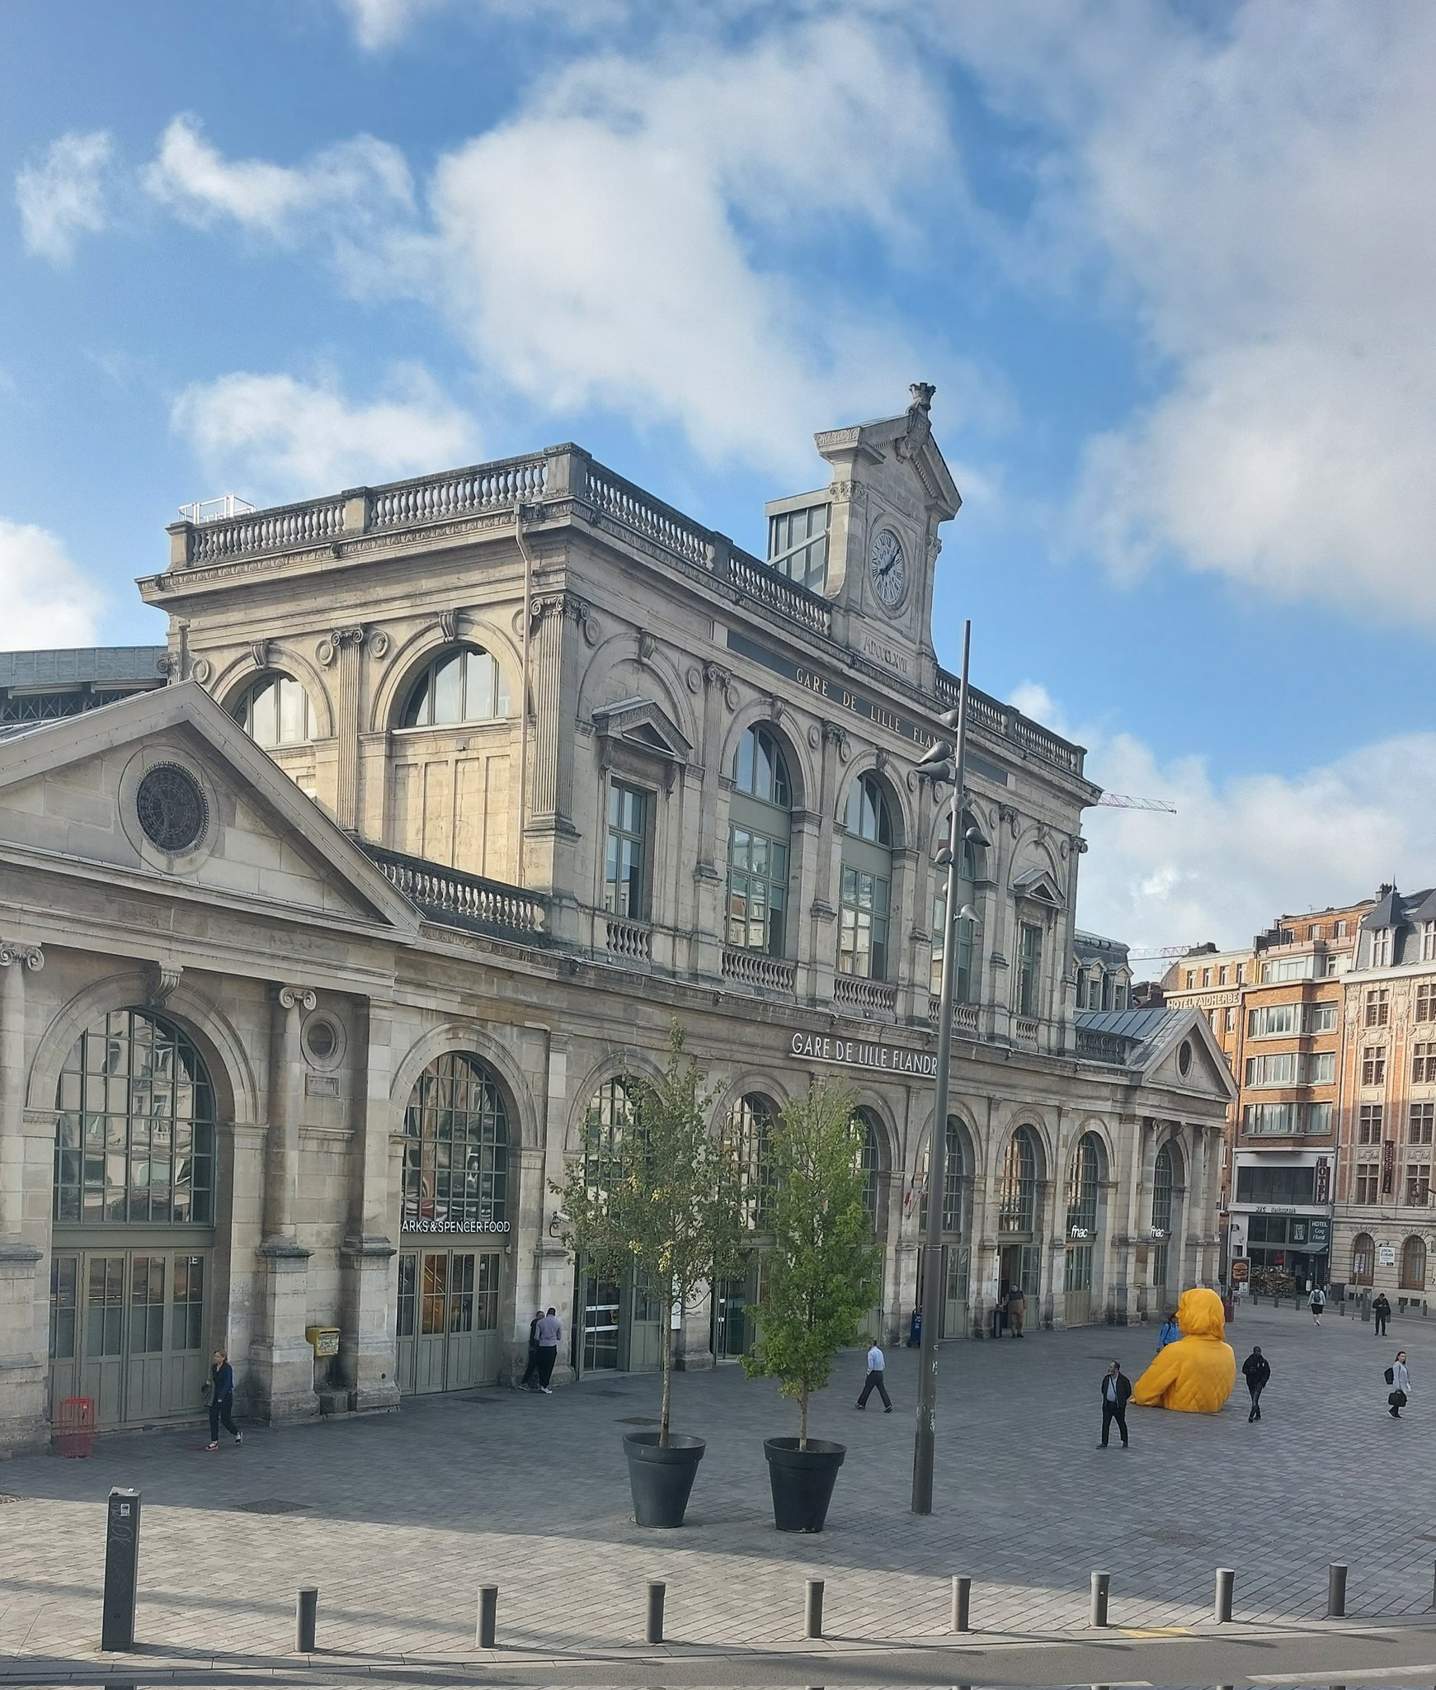
Speakers Dinner
Meeting Point :
Yellow Statue in front
Lille Flandres Station
Leaving at 19:30

