Slide 1
Welcome to the #pts22 PHYSICAL edition!

Slide 2

39 proposals

Slide 3
39 proposals
27 accepted talks
3 days

Slide 4
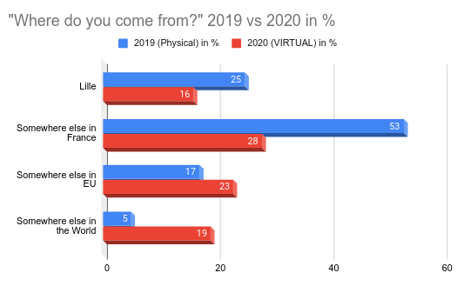
Virtual VS In Real Life event

Slide 5



Sponsoring

Slide 6





Partners

Slide 7
And now!
> Discussions: #pts22 on libera.chat
> On Twitter : @passthesaltcon #pts22

Slide 8
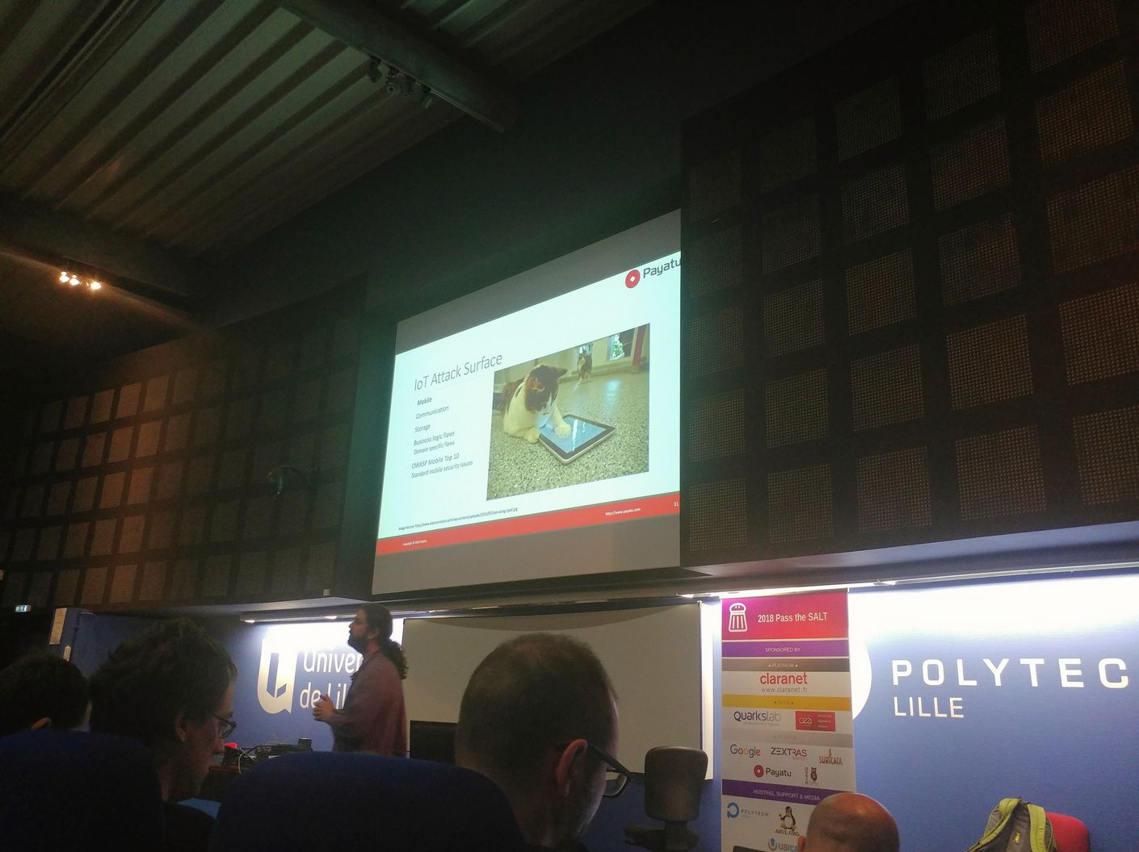
Dear speakers,
the stage is yours!

