Slide 1

> SPONSORSHIP Brochure
Pass the SALT 2024
7th edition
sponsoring@pass-the-salt.org
V1.1

Slide 2

The conference
n
Pass the SALT is a technical conference held in English and entirely dedicated to Security and Free Software. Last edition, in July 2023, hosted 22 talks and 3 workshops.
2024 edition will be held:
Date : from 3 to 5 July, 2024
Location: FR, Lille, Polytech engineering school
Entrance : Free
Attendance (goal) : 200-300 people

Slide 3
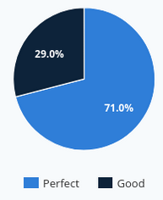

Attendance & evaluation (2023)
The 2023 edition saw its no-show rate dropped from 33% to 20%, which is good for a free access event. 108 persons attended and most of them stayed all along the 3 days. Their event evaluation has been excellent (post event survey) on the organization and content sides.
Our complete 2023 edition report is available at : https://2023.pass-the-salt.org/annual-report/

Slide 4




Feedback

Slide 5
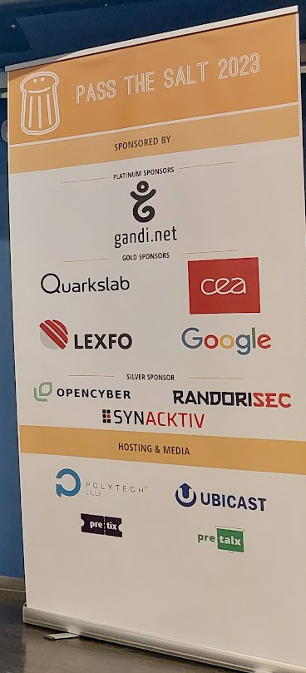
Why sponsoring
Brand exposure: your brand strengthens its image with the participants present (hackers, professionals, researchers) or with those watching in streaming / replay..
Recruitment: your hiring process will be made more credible by your presence as a partner. (attendees: 15 % students and academics, 21 % public sector and 55 % from private sector).
Strengthen your brand image inside the community by allowing :
– a free access to quality talks about Security and Free Software ;
– exchanges and collaborations [1] between experts from these communities, passionate hackers but also professionals using Open Source Security solutions.
[1] https://www.pass-the-salt.org/achievements/#contributions

Slide 6
2024 edition sponsoring counterparts
Sponsoring Level | Platinum (2 sponsors max. per edition) | Gold | Silver | Associations
Donation | Min 3000€ | Min 2000€ | Min 1000€ | Min 500€
Presence on all media supports (press, web, on site) | Yes, under « Platinum Sponsors » | Yes, under « Gold Sponsors » | Yes, under « Silver Sponsors » | Yes, under « Associations »
Possibility to have a rollup/kakemono at room entrance | Yes | Yes | No | No
Pre-booked seats for the event | Yes (4) | Yes (2)
Possibility to have a booth (table + rollup/kakemono) | Yes | No | No | No
Invitations for the Speakers Dinner | Yes (2) | No | No | No

Slide 7

Sponsoring form
2024
Complete and send it to SPONSORING@PASS-THE-SALT.ORG
Name :
Company name :
Address :
Email :
Website :
My company engages itself to sponsor 2024 Pass the SALT at the following level: :
□ Platinum sponsor 3000€ or more : ..............................€
□ Gold sponsor 2000€ or more : ..............................€
□ Silver sponsor 1000€ or more : ..............................€
□ Association 500€ or more : ..............................€
Bank transfer to :
IBAN FR7616798000010000065413623
BIC TRZOFR21XXX
Account name Association PASS THE SALT
Bank Treezor Rue Gallieni 150 92100 Boulogne-Billancourt France
Transfer label : « Sponsor Pass The SALT 2024 »
City ............................… Date ....…….......… Signature & company stamp :

