Slide 1


Processing RNAseq (with reference genomes)
Dr Daniel Pass

Slide 2
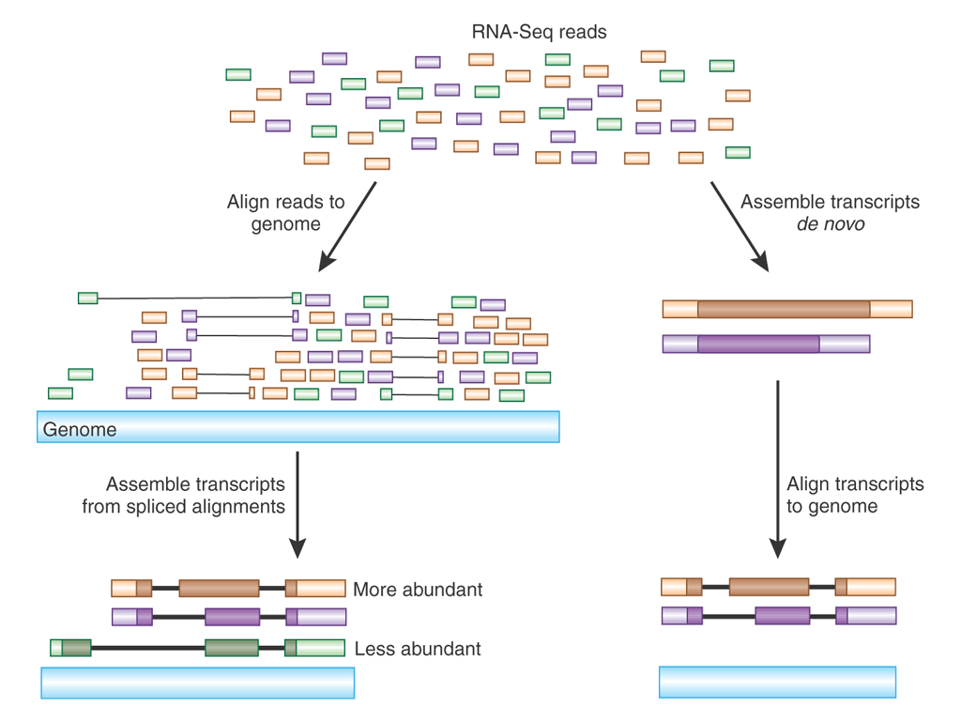
Unmapped
reads

Slide 3
Process
Route 1 — genome alignment
STAR / HiSAT2
Align reads to the genome
featureCounts / htseq
Count reads per gene
DESeq2 / edgeR
Differential gene expression
Route 2 — pseudo-alignment
Salmon / kallisto (pseudo-alignment)
Map to transcriptome & quantify in one step — no BAM

Slide 4
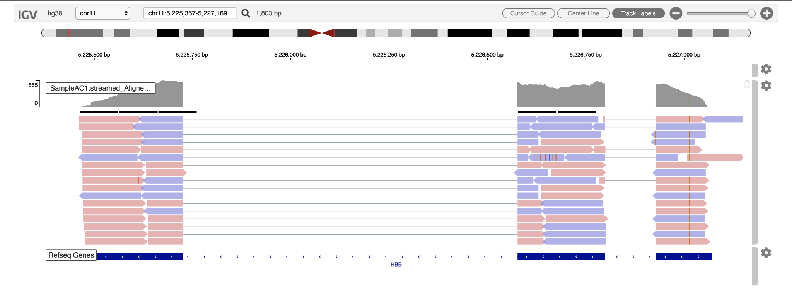
Alignment to a reference genome

Slide 5
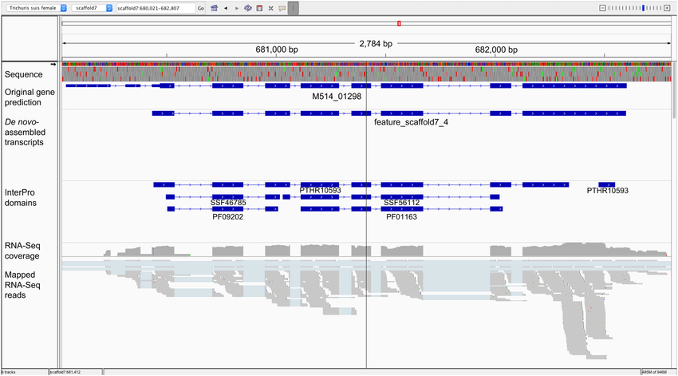

Slide 6
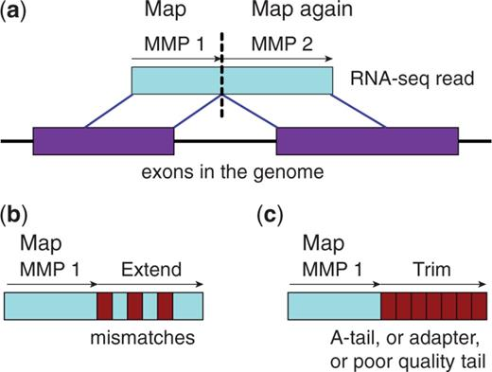
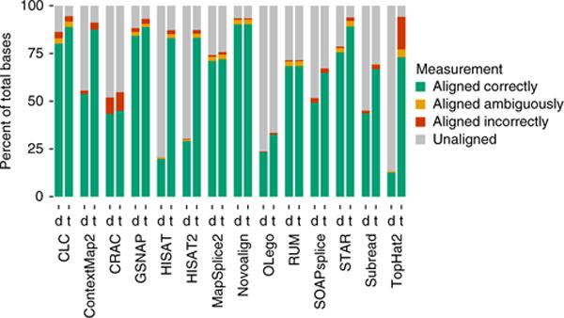
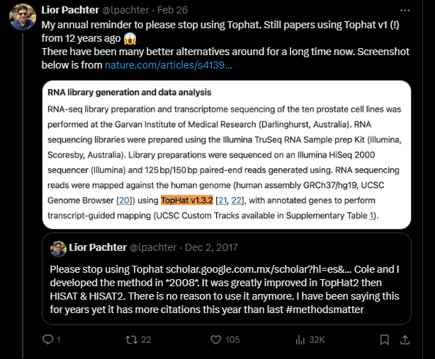
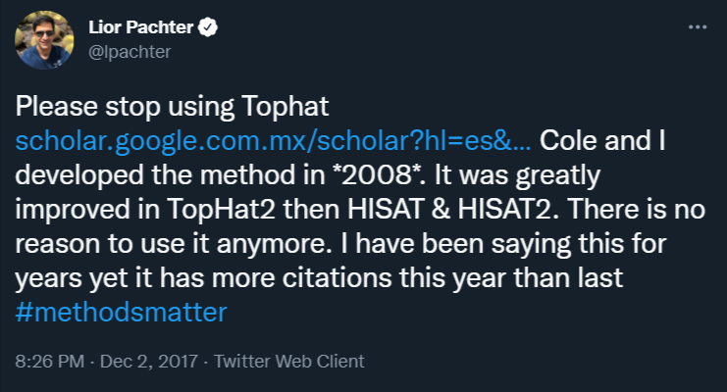
Alignment with Star
d= default parameters
t= trained on dataset
Spliced Transcripts Alignment to a Reference (STAR)
https://github.com/alexdobin/STAR
Novel RNA-seq alignment algorithm that uses sequential maximum mappable seed search.
“STAR outperforms other aligners by a factor of >50 in mapping speed”
Note: Multimapping
Combine reference genome (fasta), gene boundaries (gtf) and RNAseq (fastq)
Alternatives: Hisat2 (formerly Tophat), kallisto, Salmon, (many others)
Alexander Dobin, et. al, (2013), STAR: ultrafast universal RNA-seq aligner, Bioinformatics, https://doi.org/10.1093/bioinformatics/bts635
Baruzzo, Giacomo et al. (2017) “Simulation-based comprehensive benchmarking of RNA-seq aligners.” Nature methods doi:10.1038/nmeth.4106

Slide 7
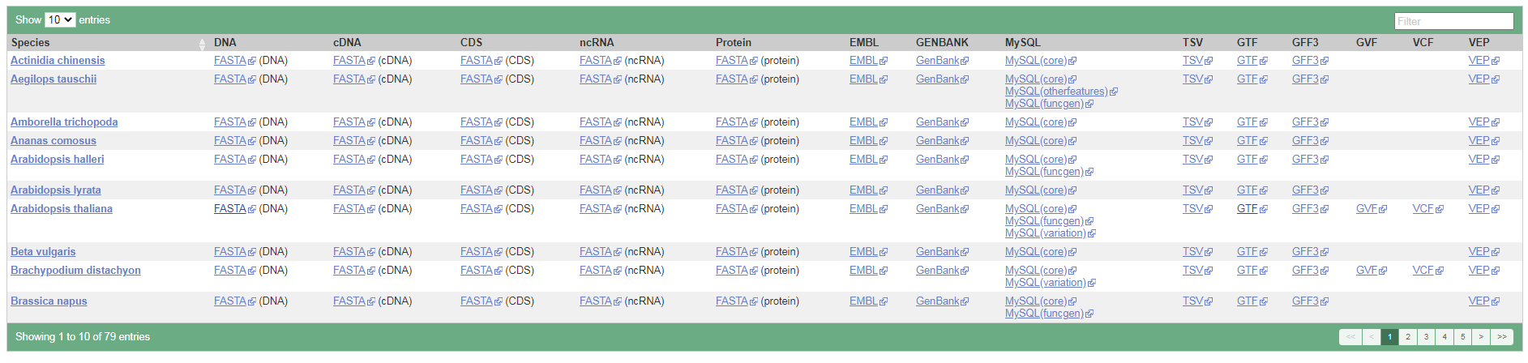
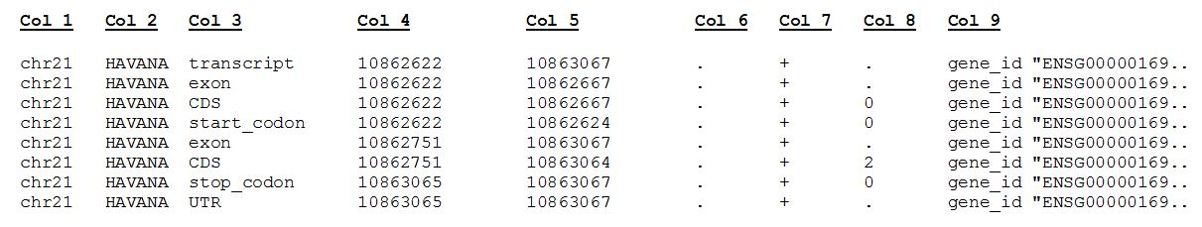
Ensembl reference databases
https://plants.ensembl.org/info/website/ftp/index.html
Genome
Annotation

Slide 8
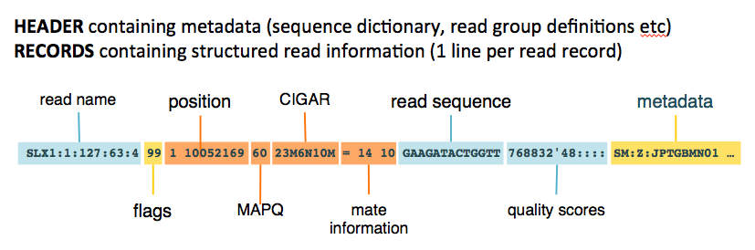
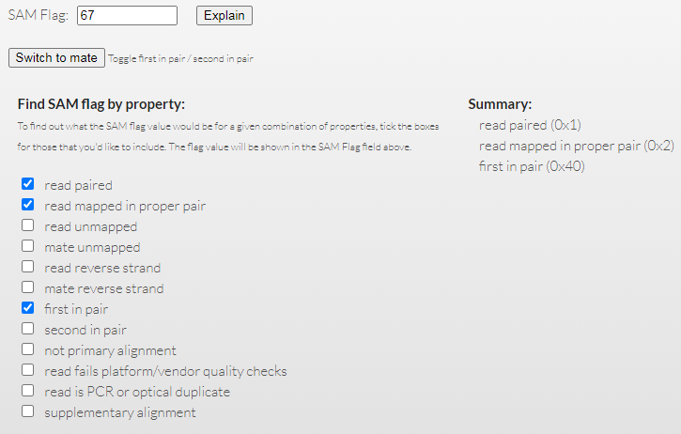
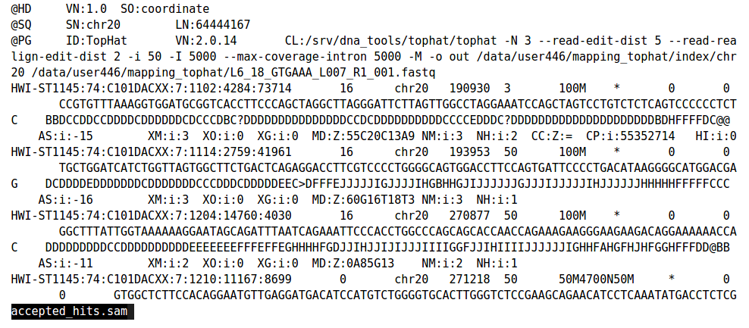
Output from alignment: bam/sam files
Optional step: Mark Duplicates
Picard
https://broadinstitute.github.io/picard/explain-flags.html

Slide 9
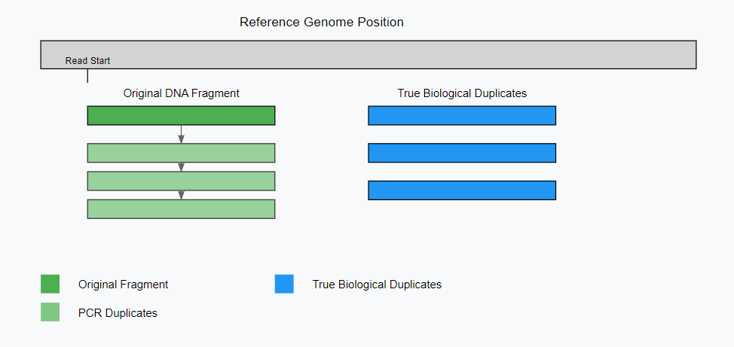
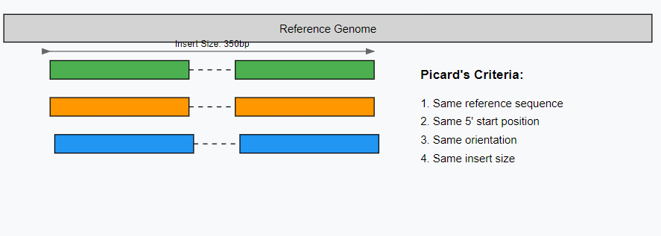
Duplicates? Again?
2026: Not recommended to remove unless you have specific concerns about your data. Can distort expression.
Technical Duplicates:
Identical start/ends/inserts
Perhaps slight differences in sequence

Slide 10
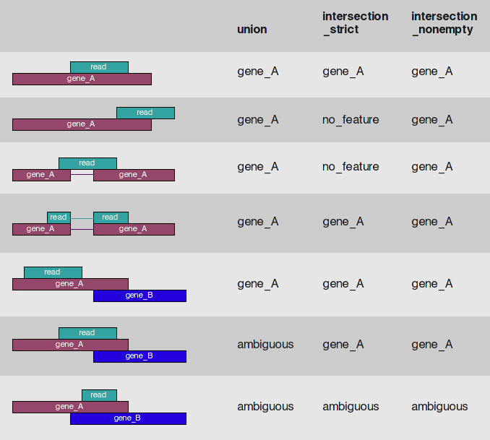
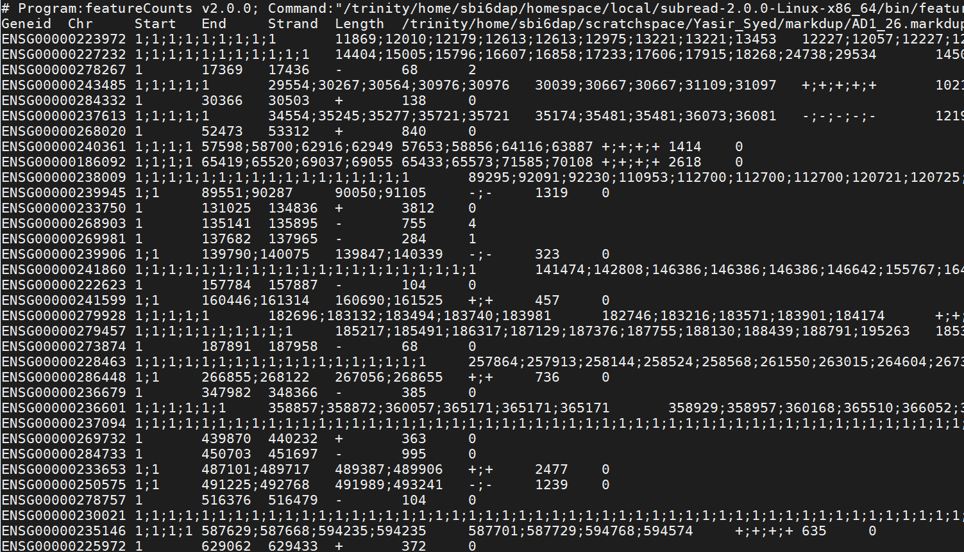
Counting
FeatureCounts part of subread
a software program developed for counting reads to genomic features such as genes, exons, promoters and genomic bins.
~20x faster (than HTseq)
More definitive on ambiguities
Better with paired end data (use -p --countReadPairs)
http://subread.sourceforge.net/
Htseq

Slide 11
Pseudo-alignment with Salmon
Map to the transcriptome, not the genome
When to use which
• No genome alignment and no BAM — quantifies in one fast, low-memory step
• Handles multi-mapping reads and isoforms more gracefully
• Builds the index once from the transcriptome (cDNA) fasta
• Output: per-transcript estimates (quant.sf)
• Summarise to genes with tximport, then straight into DESeq2
Pseudo-align — Salmon / kallisto
Gene / transcript quantification. The right default for most differential-expression studies.
Full alignment — STAR
When you need the BAM itself: novel-junction discovery, variant calling, coverage tracks.
salmon quant -i index -l A -1 R1.fq.gz -2 R2.fq.gz --gcBias -o out/

Slide 12
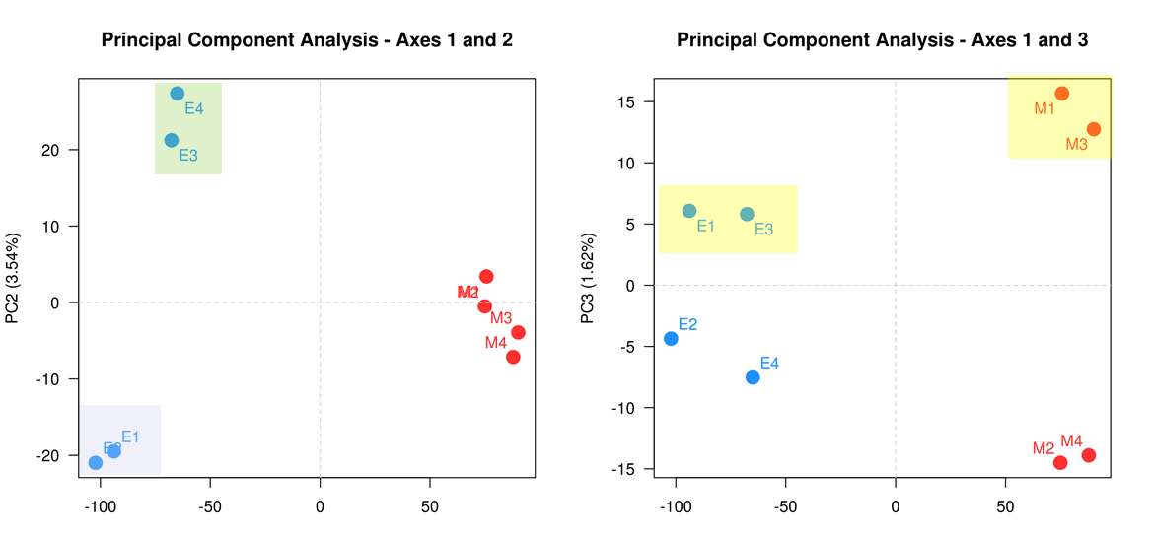
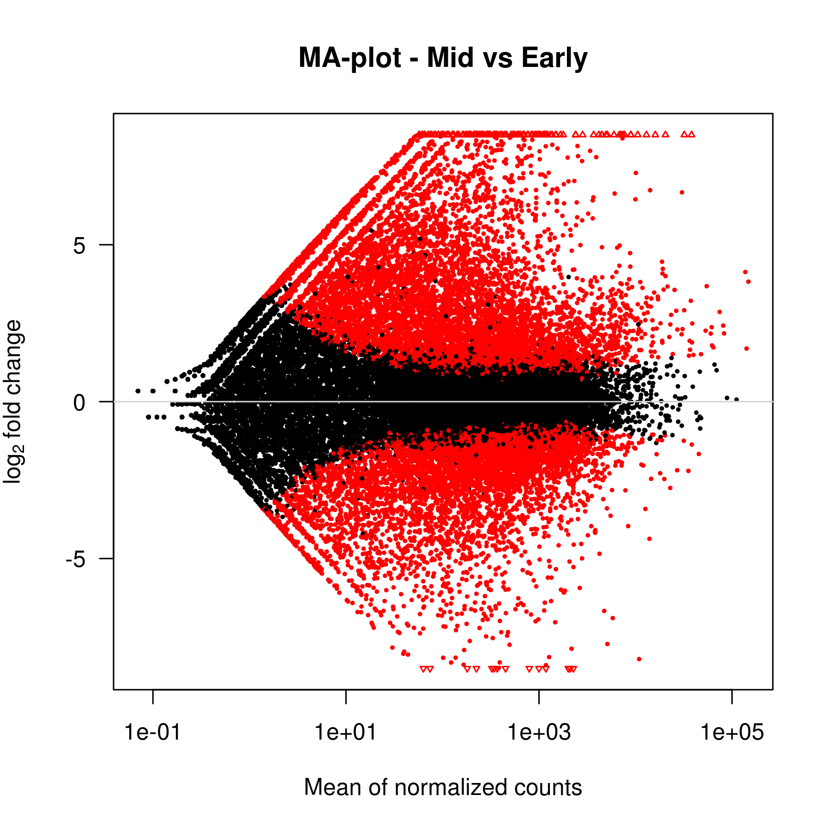
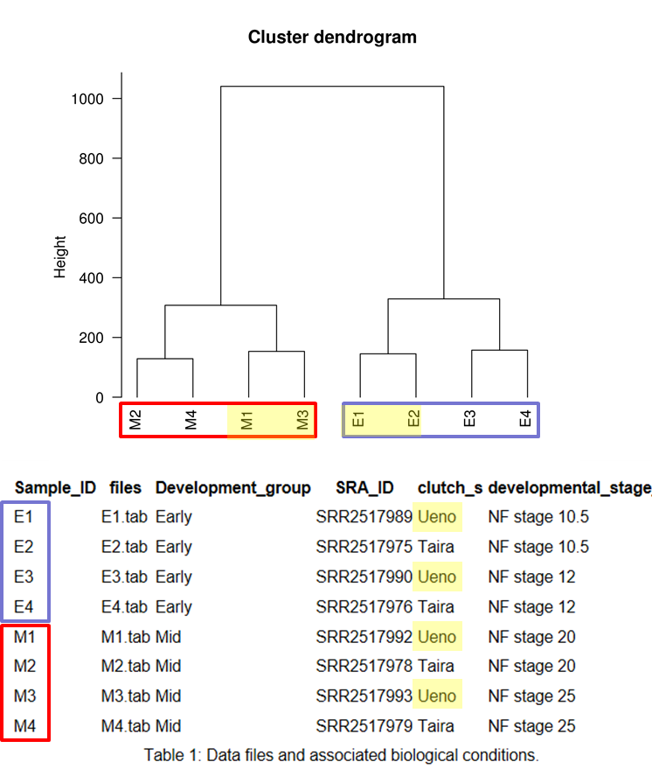
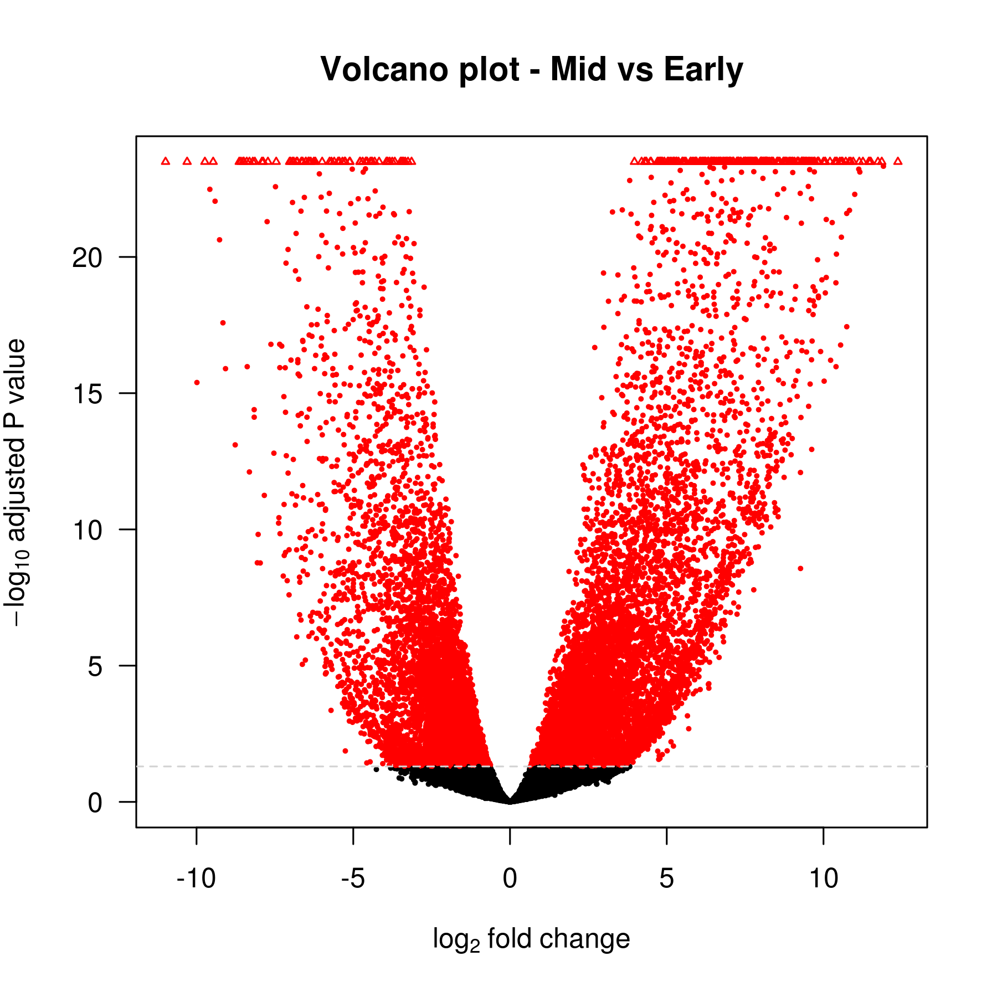
Differential gene Analysis
Deseq2 vs edgeR
Both do the same:
T-tests / Volcano plots
Log2(fold change) vs mean count (MA plots /FC plots)
Dendrograms
Principal Component Analysis (PCA)
ANOVA
Multiple Sample correction
Hierarchical Cluster Analysis
More next time!

