Slide 1
Code Analysis Optimization with PE / RAG / FT
Celery cross-file dependency analysis, strict layered scoring, and ablation-driven strategy selection
54
20
500
0.4757
Eval set
Few-shot
FT data
Best strict GPT PE
Best business-model route: GPT-5.4 + postprocess_targeted
Final delivery on main | March 29, 2026

Slide 2
Dataset and Evaluation Design
Real open-source Celery cases, not synthetic toy samples
54
20
500
15 / 19 / 20
Manual eval cases
Strict few-shot
FT rows
Difficulty split
Failure Types
Scoring
direct / indirect / implicit are preserved in the schema
All 54 official cases are manually labeled against real source code
Strict assets are used for audit, replay, and defense hardening
Type A 7 | Type B 9 | Type C 11 | Type D 11 | Type E 16 The eval set emphasizes dynamic resolution, re-export chains, finalize/proxy flows, and ambiguity-heavy cases.
Primary metric: union F1. Strict add-on: active-layer macro F1 and mislayer rate. This exposes cases where the model finds the FQN but puts it in the wrong layer.
Official eval file: data/eval_cases.json

Slide 3
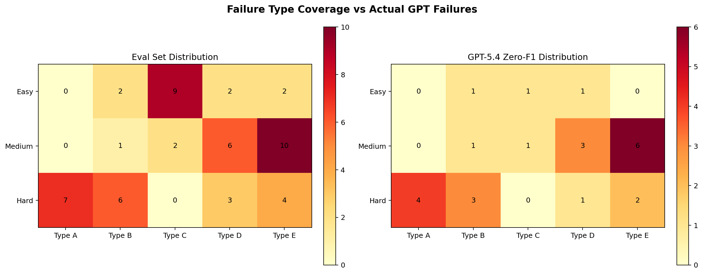
Why This Task Is Hard
Cross-file dependency analysis fails for different reasons than simple import matching
Long call chains
Implicit runtime edges
Layer placement
The model must follow multi-hop routes from CLI or public entry points through wrappers, re-exports, and factories before reaching the final stable symbol.
finalize hooks, Proxy resolution, decorator registration, string-based symbol lookup, and loader callbacks create dependencies that plain static matching misses.
Finding an FQN is not enough. The model must also decide whether it is direct, indirect, or implicit without flattening everything into one bucket.
Long-context loss
Implicit edge omission
Cross-file association breaks
High union but wrong layer assignment
Key bottleneck framing: 'find the FQN' and 'place the layer' are different problems

Slide 4
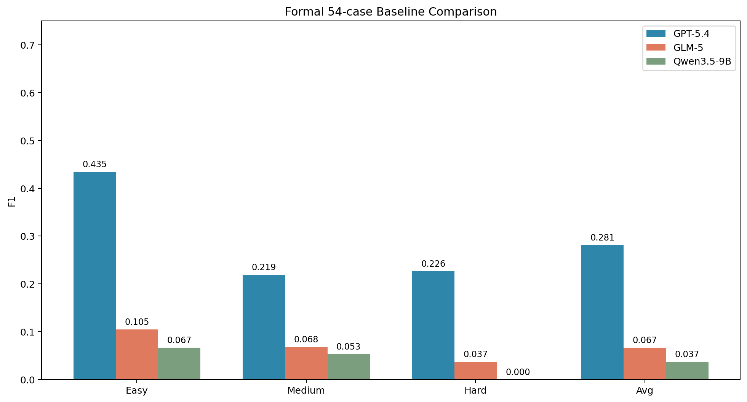
Baseline Models
Commercial ceiling vs. open-source starting point
GPT-5.4
Commercial upper bound. Avg = 0.2815
GLM-5
Mostly limited by structured-output adaptation. Avg = 0.0666
Qwen3.5-9B
Strict baseline is very low before systematic enhancement. Avg = 0.0370
Formal baseline table appears in reports/DELIVERY_REPORT.md

Slide 5
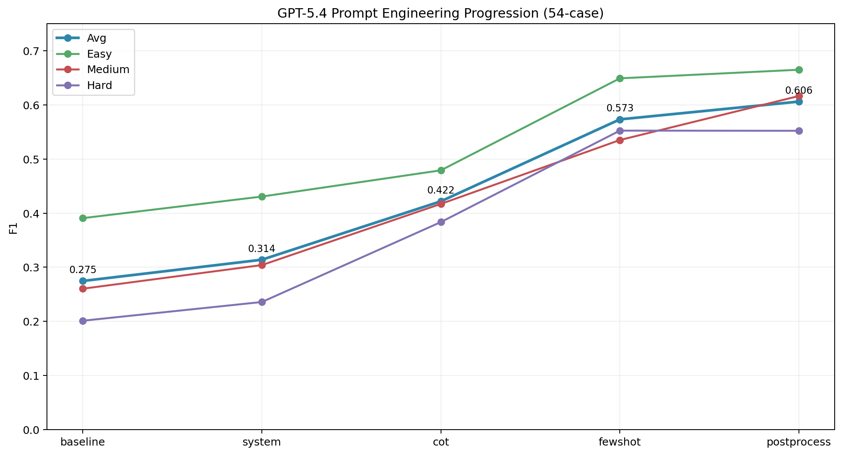
Prompt Engineering Is The Strongest Single Lever
Official 54-case progressive GPT-5.4 run
Baseline 0.2745 -> postprocess 0.6062
CoT is positive on the official 54-case line
Few-shot is the main jump before post-processing
But union F1 alone still overestimates layer quality
0.2745
0.5733
0.6062
Baseline
Few-shot
Postprocess
PE result files: results/pe_eval_54_20260328/

Slide 6
Why Strict Metrics Matter
Union F1 can look high even when the model places dependencies in the wrong layer.
0.6136
0.4372
0.2336
0.6338
0.4757
Old strict-best union
Old strict-best macro
Old mislayer
New strict-best union
New strict-best macro
Metric 1: active-layer macro F1
Metric 2: mislayer rate
Main lesson
Penalizes wrong layer placement. A method must improve the active dependency layers, not only the union set.
Measures how often the model hits an FQN but assigns it to the wrong layer. Lower is better.
The best PE strategy is the one that keeps union high while also increasing macro and reducing mislayer.
Strict search report: reports/strict_pe_search_20260329.md

Slide 7
Strict PE Search: What Worked and What Failed
The winning change was targeted example routing, not stronger prompt wording
Failed: layer_guard
Failed: assistant few-shot
Worked: fewshot_targeted
Best: postprocess_targeted
Higher union but much worse strict macro and mislayer. The model became more pattern-driven, not more correct.
Better JSON-following did not translate into better layer placement. Strict metrics regressed sharply.
Injected failure-mode anchors for Type B / E / D cases. Improved macro without exploding mislayer.
Targeted selection plus layer-preserving parsing produced the new strict-best line.
Type B anchors: shared_task / finalize / proxy / pending
Type E anchors: symbol_by_name / loader / string import / backend
Type D anchors: ambiguity-heavy registry or naming collisions
Remaining few-shot slots are filled dynamically by relevance
Best strict PE numbers
postprocess_targeted union 0.6338 | macro 0.4757 | mislayer 0.1620 | exact-layer 0.1296 This beats the prior strict-best 0.6136 / 0.4372 / 0.2336.
Result file: results/pe_targeted_full_20260329/pe_postprocess_targeted_strict.json

Slide 8
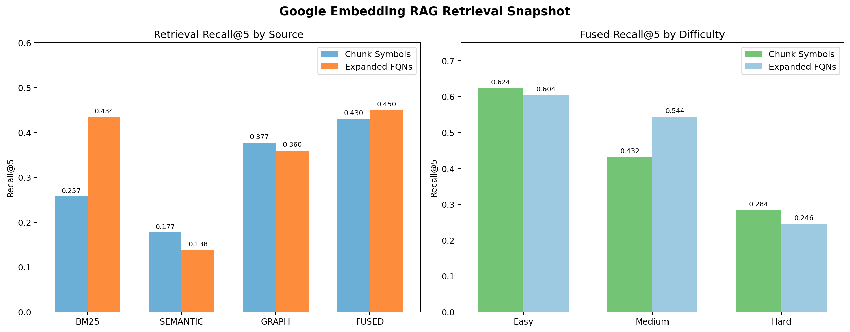
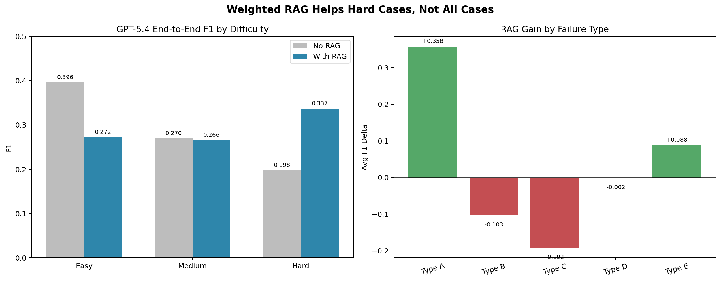
RAG Helps Hard Cases, Not Every Case
RAG is a targeted fixer for long-chain and dynamic scenarios
Retrieval quality is measured separately: Recall@5 and MRR
End-to-end gain is modest overall: 0.2783 -> 0.2940
Hard cases improve strongly: 0.1980 -> 0.3372
Conclusion: RAG should be enabled selectively, not by default
Operational recommendation
Turn on RAG for hard, long-chain, Type A, and Type E cases. Do not assume more context always means better code analysis quality.
Official RAG reports: reports/rag_pipeline.md and reports/rag_retrieval_eval_round4.md

Slide 9
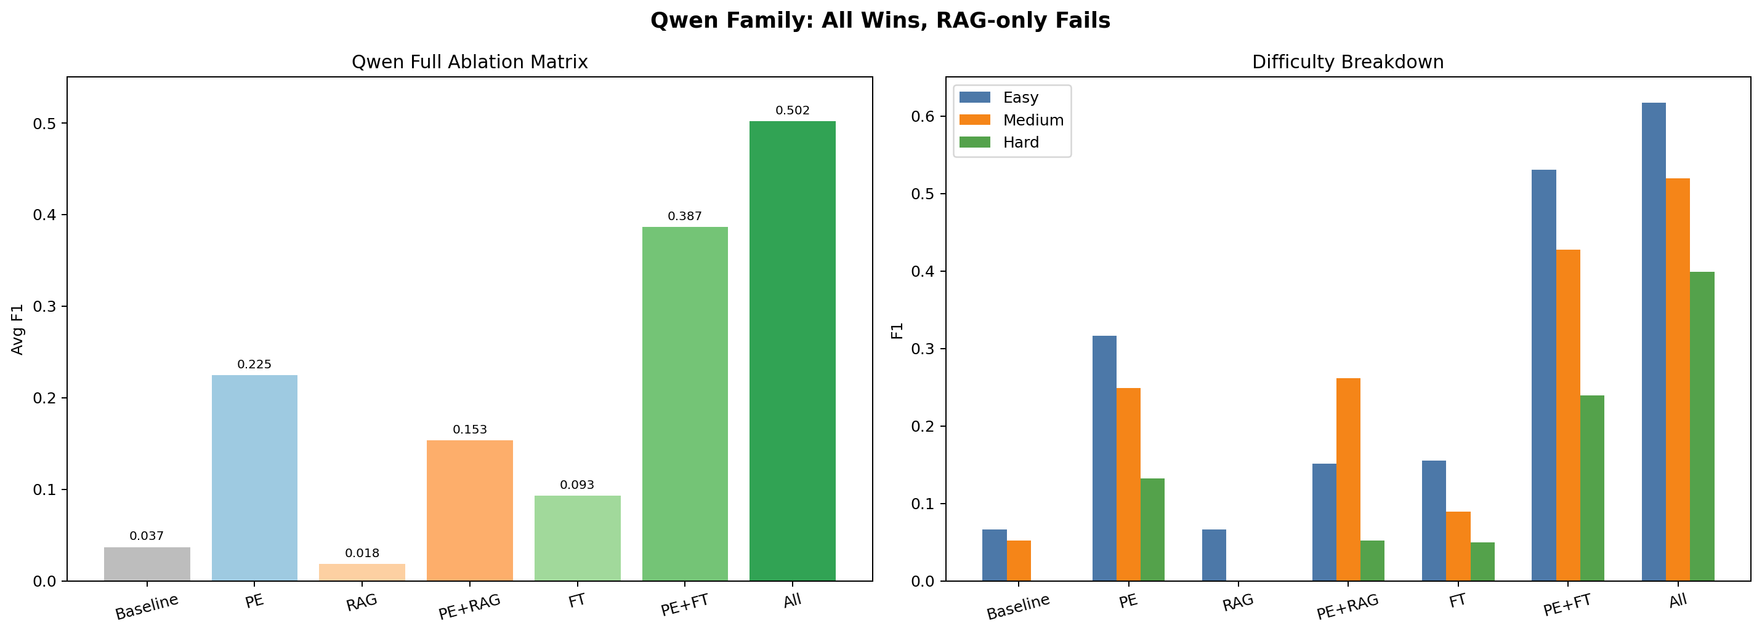
Open-Source Model Strategy: PE + FT Is The Core
Fine-tuning alone is not enough
0.0932
0.2246
0.3865
FT only
PE only
PE + FT
Main takeaway
PE is the core gain source. FT learns domain patterns, but PE is what turns those patterns into stable, scorable JSON/FQN output.
Best open-source route
Highest strict-clean score: PE + RAG + FT = 0.5018 Lower-complexity strict route: PE + FT = 0.3865
Formal ablation matrix: reports/ablation_study.md

Slide 10
Final Strategy Recommendation
Business model path
Open-source highest score
Open-source default route
Use GPT-5.4 + postprocess_targeted. This is the current strict-best PE route and the easiest line to defend methodologically.
Use Qwen PE + RAG + FT as the current strict-clean highest-score route. It is the strongest complete open-source path in the repo.
Use Qwen PE + FT as the lower-complexity strict-clean route. Keep historical 0.4315 only as an archived comparison point.
The key methodological conclusion is not 'stronger prompts win'. It is: failure-mode definition + targeted few-shot + layer-preserving postprocess wins.
Best strict GPT PE result: union 0.6338 | macro 0.4757 | mislayer 0.1620

Slide 11
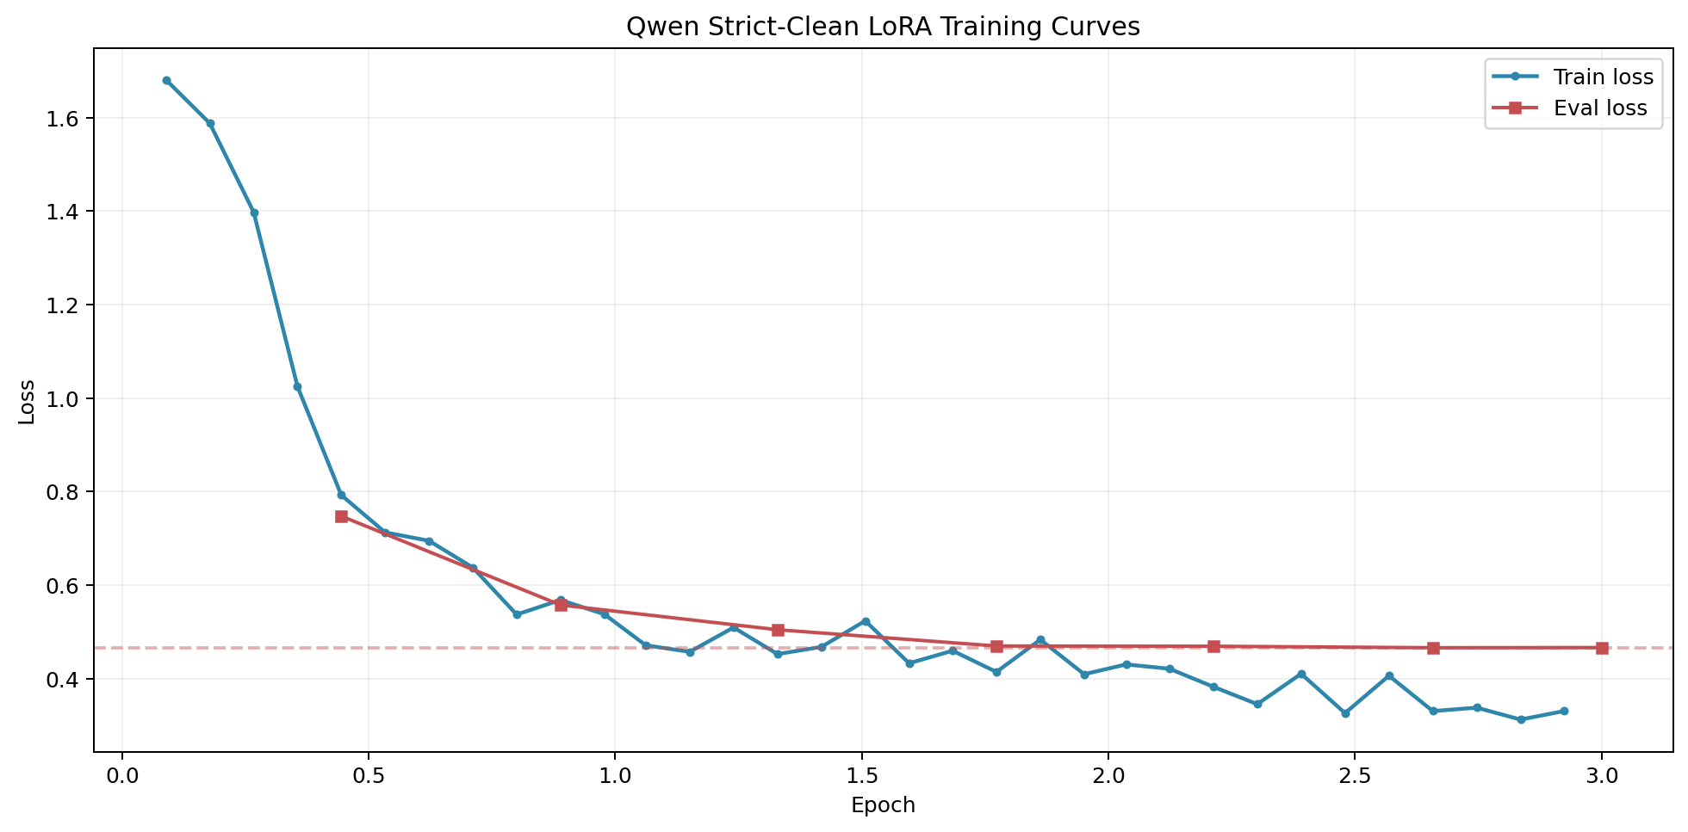
Appendix: Training Evidence and Boundary Conditions
Useful if the defense moves toward FT quality or risk questions
The current strict-clean training curve is stable, with best eval_loss 0.4661 and last logged eval_loss 0.4664
This run keeps a step-wise eval curve and intermediate checkpoints, so the training evidence is materially stronger than the historical formal run
The strict replay config fixed the old issue by using eval_steps/save_steps=50 and best-checkpoint selection
GLM official thinking mode was explored but not included in the formal matrix because both stream and non-stream smoke runs stalled on the first case
Strict assets are the recommended path for replay and defense hardening
One-line boundary statement
Supporting docs: reports/strict_replay_guide_20260329.md and reports/strict_data_audit_20260329.md
RAG is a hard-case fixer, PE is the core gain source, and FT becomes effective mainly when combined with PE.

