Slide 2
Respiratory system

Slide 3
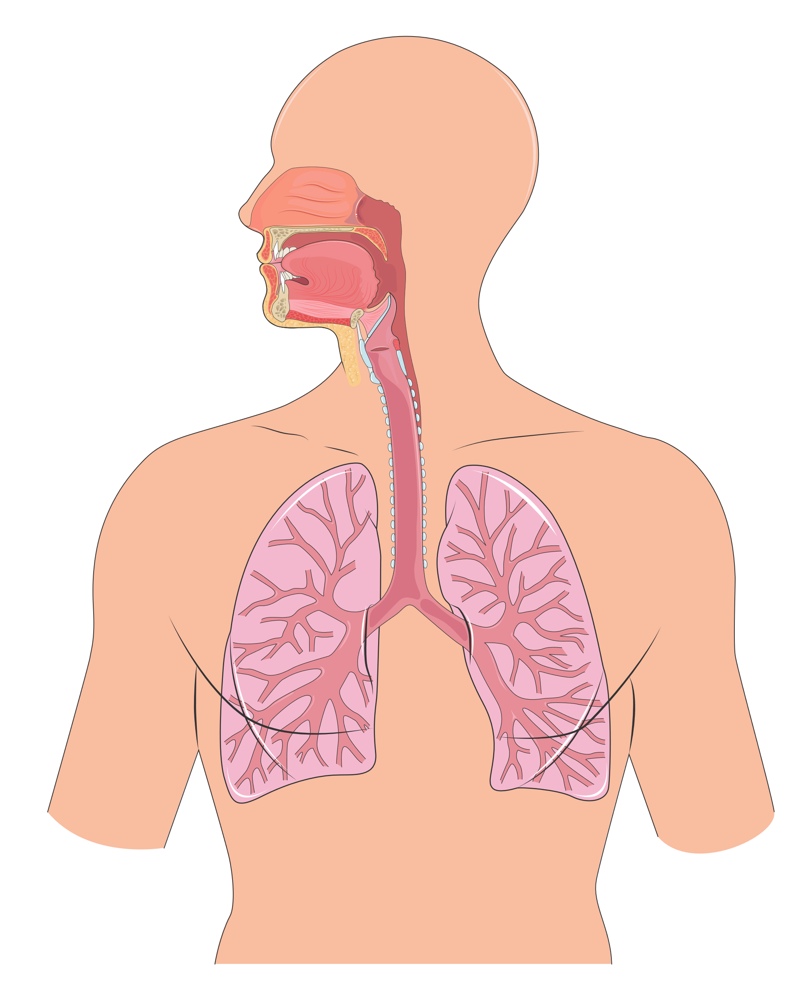
Conducting zone
Nose
Pharynx
Larynx
Trachea
Bronchus
Bronchiole

Slide 4
Nasal cavity

Slide 5
Lungs

Slide 6
Trachea and bronchi

Slide 7
Bronchi sections
Healthy bronchus
Inflamed bronchus

Slide 8
Lobes (1)

Slide 9
Lobes (2)

Slide 10
Intrapulmonary airways (1)

Slide 11
Intrapulmonary airways (2)

Slide 12
Pulmonary circulation

Slide 13
Breathing
Inspiration
Expiry

Slide 14
Gas exchanges
C
O
C
O
2
O
2
2
O
2
O
O
2
C
O
C
O
2
2
2
Systemic circulation
Pulmonary circulation

Slide 15
Pneumothorax
Healthy lungs
Pneumothorax

Slide 16
Pulmonary embolism (1)

Slide 17
Pulmonary embolism (2)

Slide 18
Pulmonary edema

Slide 19
Chronic bronchitis

Slide 20
Emphysema

Slide 21
Lung cancer
Cancer
Healthy lung
Smoker’s lung

Slide 22
Cough

Slide 23
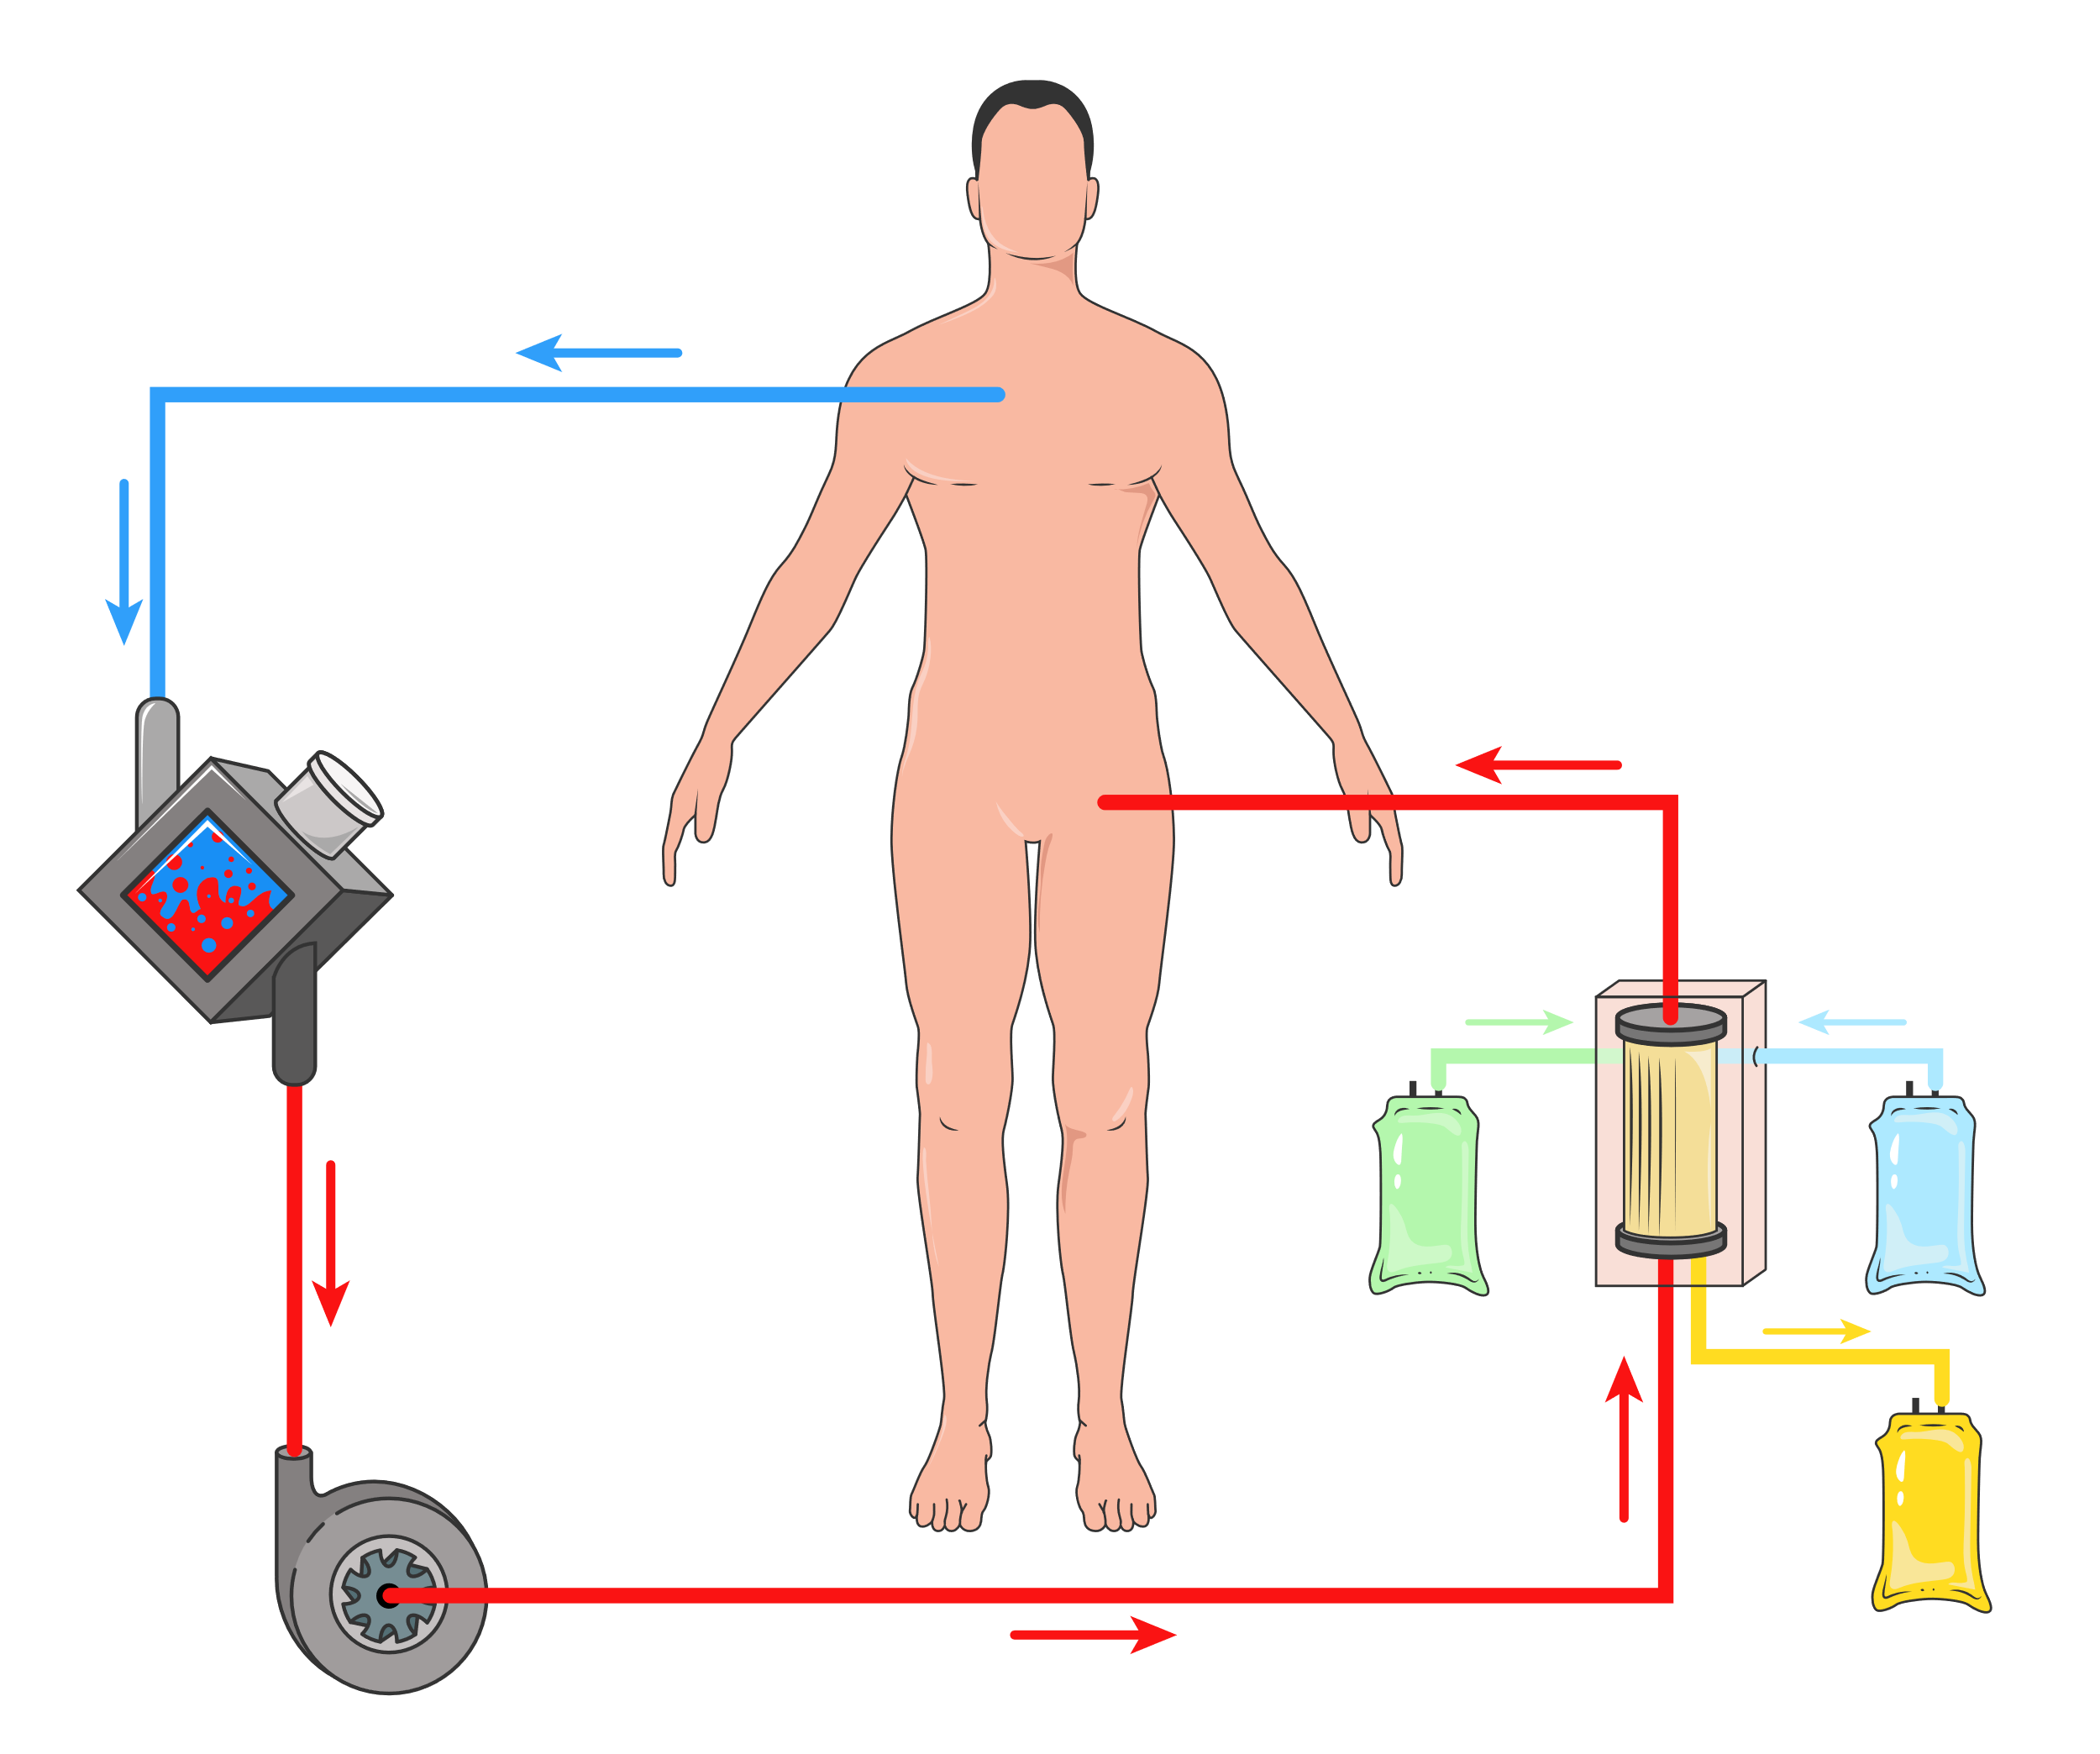
CRRT and ECMO
Continuous renal replacement therapy (CRRT) in extracorporeal membrane oxygenation (ECMO)

