Slide 1
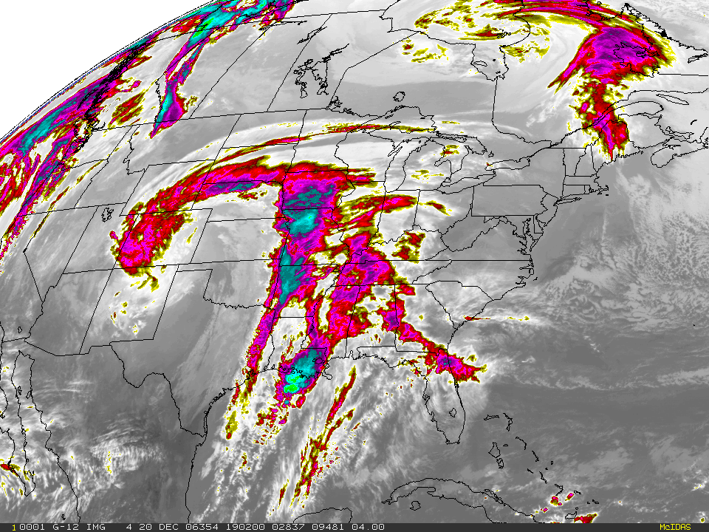
Weather Modification
Efforts and Theories
By Lance Reinsel

Slide 2
Is it New?
People have tried to control weather for a long time.
Rain dances and ceremonies were held by Midwestern American Indian tribes such as the Cherokee. (Many dances were persecuted by the U.S. government. As a result, some dances were also disguised as a “rain dance”, which was allowed to be practiced.)
1839, U.S. newspaper articles publicize various people and their ideas to create rain.
1957, Eisenhower’s advisory committee on weather control gave warning to the potential of weather control, stating that it has higher potential than the atom bomb.
1977, U.N. General Assembly Prohibited hostile use of environmental modification techniques.

Slide 3
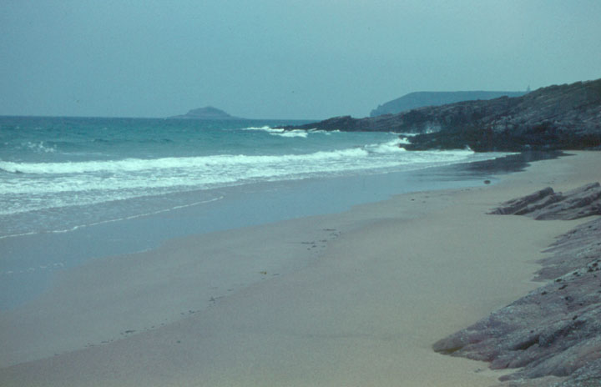
Harm or Help?
“[i]n Europe bad weather is the worst enemy of the air [operations]. Some soldier once said, “The weather is always neutral.” Nothing could be more untrue. Bad weather is obviously the enemy of the side that seeks to launch projects requiring good weather, or of the side possessing great assets, such as strong air forces, which depend upon good weather for effective operations. If really bad weather should endure permanently, the Nazi would need nothing else to defend the Normandy coast!”
-Dwight D. Eisenhower

Slide 4
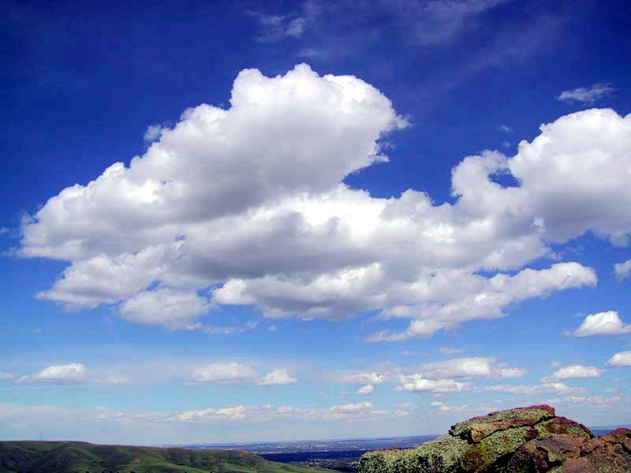
Weather Modification
Weather modification: “any activity performed with the intention of producing artificial changes in the composition, behavior, or dynamics of the atmosphere.”
Weather includes varying day to day occurrences of…
Temperature
Cloudiness
Wind Speed
Relative Humidity
Precipitation
Visibility

Slide 5
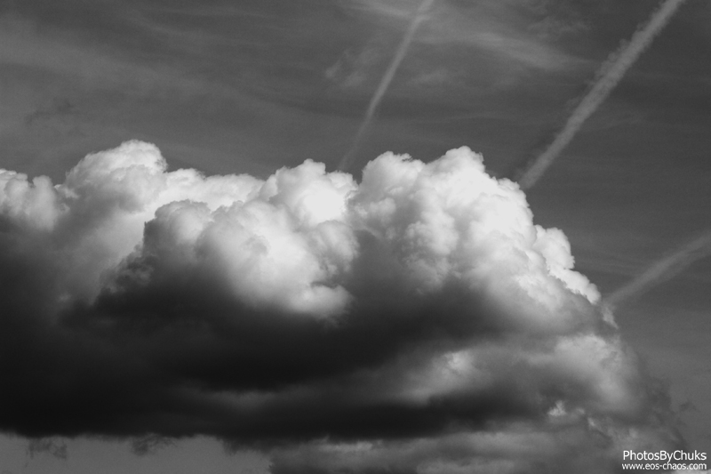
Weather Modification
-Weather Modification:
Suppression of weather. Ex: Seeding clouds so that rain falls before its projected target.
Intensification of tailored/natural processes. Ex: The use of ELFs (extremely low frequency) waves to agitate water molecules in clouds, ultimately warming them.
Creation of weather events. Ex: Creation of cumulonimbus clouds.

Slide 6


NOAA
Let’s begin with a driver.
It appears that the largest proponent to weather control and modification relies heavily on information.
Developing systems that can act on many nonlinear accurately are essential.
Knowledge is Key.

Slide 7

NOAA
NOAA’s (National Oceanic and Atmospheric Administration) plans are not stated to change, control, or alter weather. Instead they include…
Extensive data gathering programs such as Next Generation Radar (NEXRAD) and Doppler weather surveillance systems throughout the U.S.
Data collected is fed into over 100 forecasting centers.
The data is then processed by the Advanced Weather Interactive Processing System (AWIPS).
This provides “data communication, processing, and display capabilities for forecasting.”

Slide 8
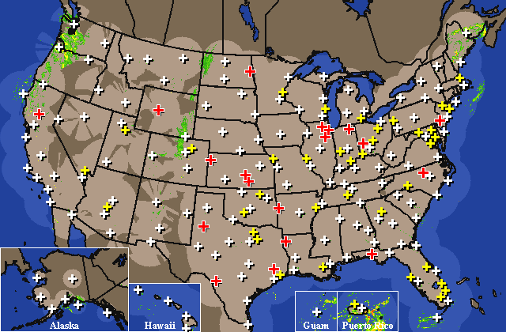

Slide 9
Variables of Owning the Sky
Scientists already poses the ability to control single variable nonlinear systems of weather.
They also claim that they can manage up to five variables thanks to modern mathematics and computing capacity.
Key Note: This means that many breakthroughs are still to be made in the field of weather modification.

Slide 10
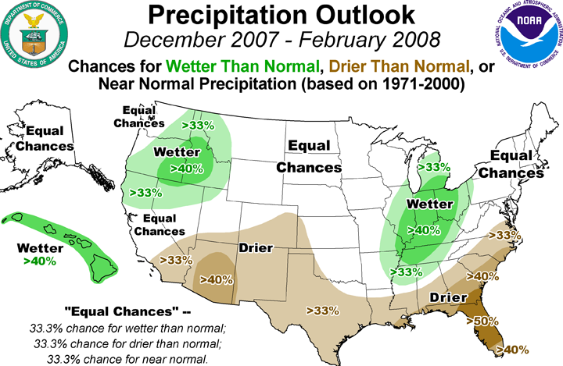
Precipitation
Precipitation: “Particles of liquid water or ice that fall from the atmosphere and may reach the ground.” –Strahler & Strahler

Slide 11
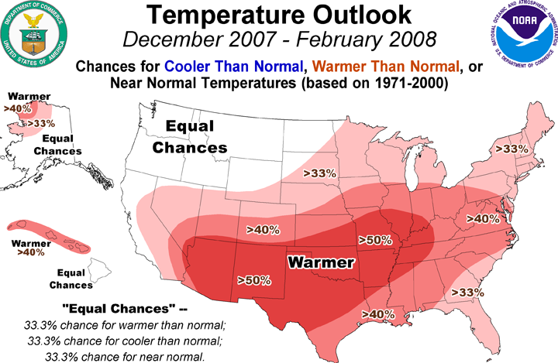
Compare and Contrast

Slide 12
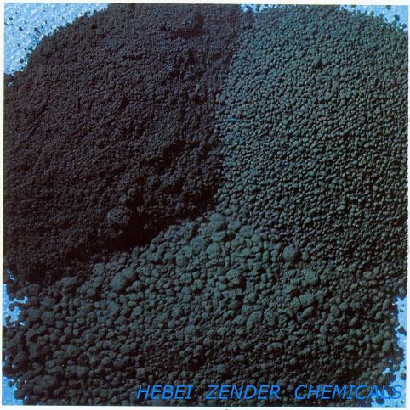
Black Carbon
Black carbon readily absorbs solar energy.
It holds the consistency of a fine dust and is released over large bodies of water.
It dries the air above the water body, forcing cooler and moister air below it to rise.
Clouds condense
Precipitation takes place.

Slide 13
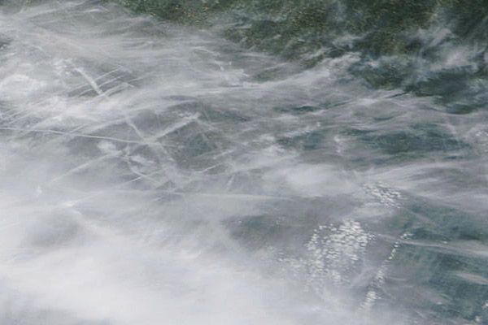
Dispersal Techniques
Afterburner-type jet engines are the most effective, safe, and efficient method of carbon and aerosol dispersal. It also holds price advantages over earlier forms of dispersal.
UAV (Unmanned Aerial Vehicle)can disperse clouds while avoiding detection.
http://www.youtube.com/watch?v=Q9KLLqEL96Y&feature=related
Contrails: “According to the U.S. Air Force, jet contrails form above 33,000 feet when hot engine exhaust momentarily condenses ice crystals into pencil-thin vapor trails that quickly vanish like the wake behind a boat.”
Chemtrails: Chemtrails start out initially like contrails, but persist for much greater amounts of time, eventually becoming clouds.

Slide 14
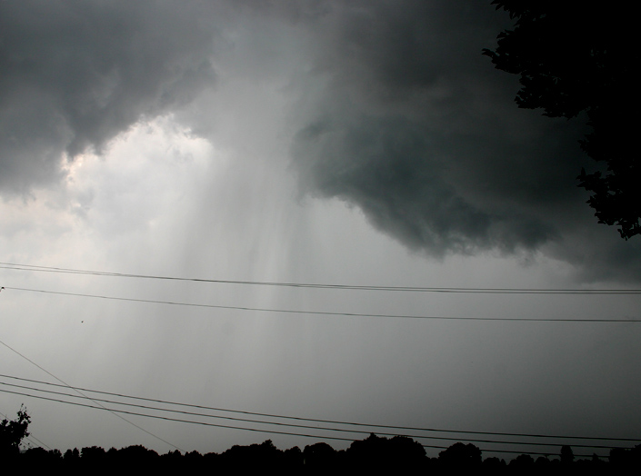
Precipitation Applications
Precipitation tech. can induce drought by creating premature precipitation.
It can provide rain to areas in need.
Military applications include…
The lowering of enemy moral.
Dries muddied terrain for friendly traffic enhancement.
Muddies enemy ground to make mobilization increasingly more difficult.

Slide 15

Fog
Essentially, there are two forms of fog..
Cold fog exists in conditions 32 degree F and below. The best known method is to seed from the air with agents that promote ice crystal growth.
Warm fog exists in conditions above 32 degrees Fahrenheit and accounts for about 90% of fog related flight operation problems.

Slide 16
Fog
A small temperature increase is generally all that is needed to dissipate fog (it evaporates it). however Heating is impractical in many situations.
Hydroscopic seeding is the next best bet.
This is the use of a salt deposited at the base of a cloud and acts as a catalyst to create water droplets (Pulp paper has also been noted to have similar effects).
It works more efficiently when agents are released from the sky, but also works when released from the ground.
Information is again key, as fog depth, water content, and wind patterns must be known for the best results to be derived.

Slide 17
Microwaves
As mentioned earlier, heating is not currently practical, but technological advances in lasers and microwave may provide a breakthrough.
Microwave work well, but use a lot of energy.
100watt/m2 (The U.S. power density exposure limit) is exceeded by their use.
http://www.youtube.com/watch?v=F3-SIXCkh5E&feature=player_embedded

Slide 18
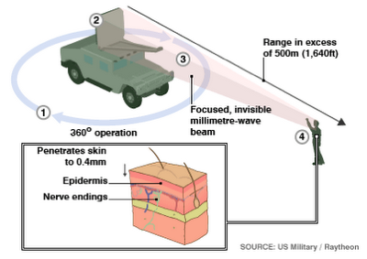

Slide 19
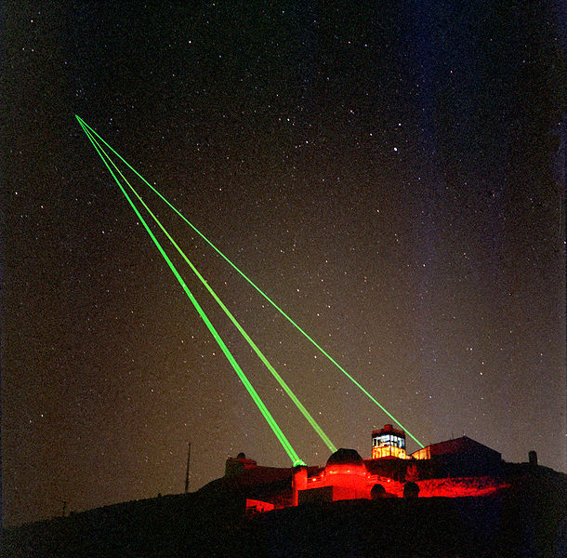
Lasers
Have dissipated fog at an airfield with zero visibility.
Generate at 1watt/cm2
Increased visibility to a forth of a mile in 20 seconds.
This has space applications, seeming that lasers could be generated from space.

Slide 20
Smart Materials
Nano technology could be used to greatly enhance for seeding operations.
They are currently being developed with “gigaops computer capability at their core.”
Can disperse intelligently based on buoncy, communication with one another, and self driven steering.
They would also provide feedback to a larger network to which would instruct their dimensions and temperature chance.
UAVs could deploy these nanobots, hopefully undetected.

Slide 21
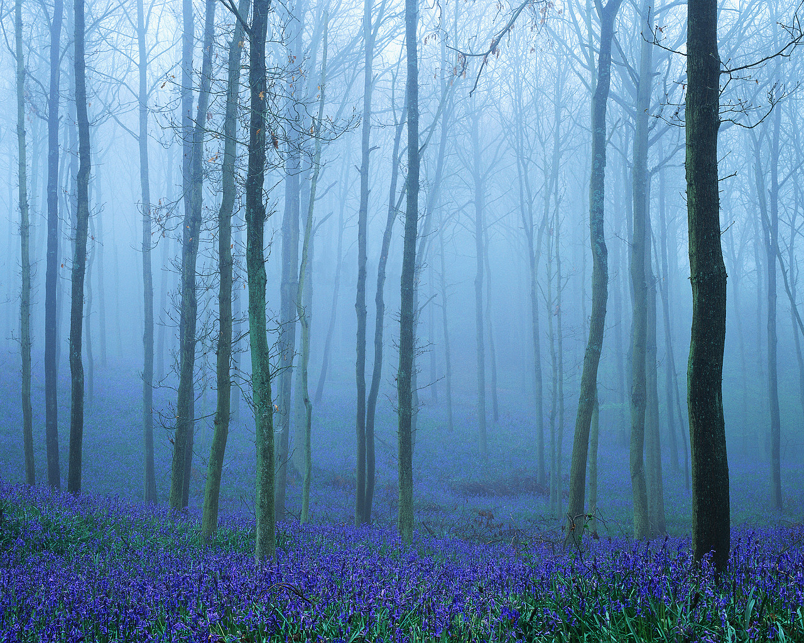
Currently
Recent army experiments have used commercial equipment to generate thick fog in an area of 100m in length.
Studies show that fog blocks UV, IR, and visible wave lengths well.
This could mask emitters of IR radiation fairly well.

Slide 22
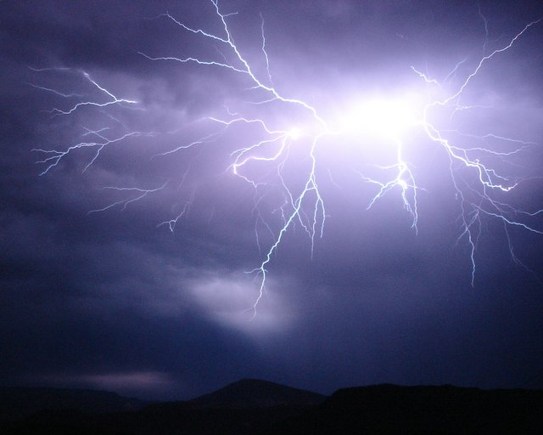
Storms (The Aggressor)
This is were Eisenhower was warned.
A tropical storm contains the amount of energy released by about 10,000 one-megaton hydrogen bombs.
They are crippling to structures, harmful to humans, and costly to governments.
Many legal and moral restrictions have been implemented in order to prevent the use of weather modification efforts such as severe storms.

Slide 23
Thunderstorms
Thunderstorms are powerful, and occur around the planet all the time (~45,000 daily).
How do they naturally occur?
Warm air is moved upward by a cold front. Dark cumulonimbus clouds begin to form. When liquid or solid water particles condense and fall, a downdraft is created and latent heat is given off, thus intensifying the storm.
More extensive research is required concerning their efficiency, stimulants, repellants, and triggers.

Slide 24

The Future Aircraft
Projected by the ‘Weather as a Force Multiplier: Owning the Weather in 2025’ report.
Future aircraft (envisioned by the report) will have
Autopilot systems to steer the craft in the safest route during a thunderstorm and rapid winds.
Will be able to map out alternative routes through an onboard system.
Will have hardened electronics to withstand lightning, or even better yet an electropotential field to repel lightning strikes.

Slide 25
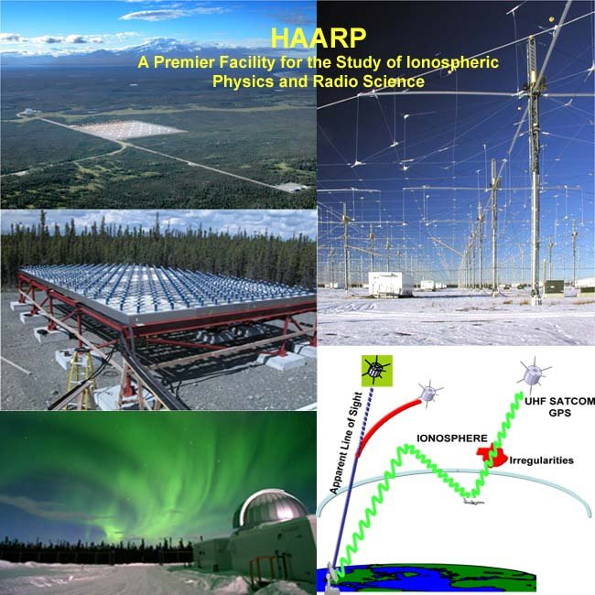
HAARP (High Frequency Active Auroral Program) is a research facility dedicated to studying the ionosphere for communication and surveillance systems.
It’s research is geared towards both defense and civilian use.

Slide 26
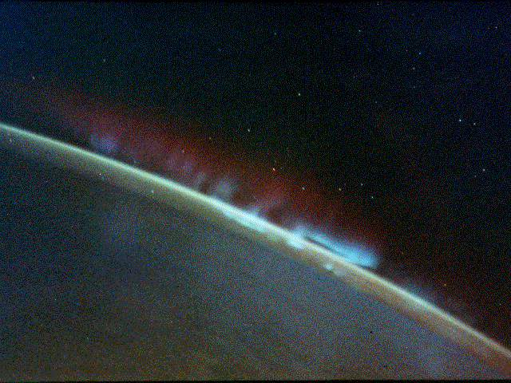
The Ionosphere
General Charles Horner, former commander in chief, U.S. space command explained his worst nightmare as “seeing an entire Marine battalion wiped out on some foreign landing zone because he was unable to deny the enemy intelligence and imagery generated from space.”
It will enhance our communicating, precision, navigating, and sensing capabilities.

Slide 27
The Ionosphere
The ionosphere is variable due to its interaction between space weather and events.
The Ionosphere rises, sinks, and crinkles based on weather.
Much research is still being conducted on the reflective properties of the ionosphere.
It also effects the transmission of UHF (ultra high frequency) waves cast by the Earth and satelites.

Slide 28
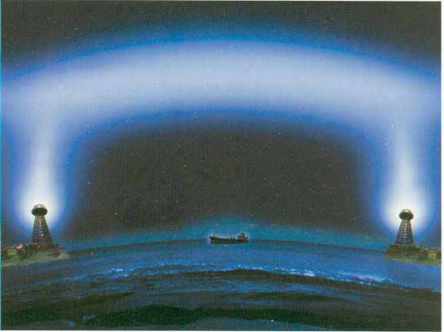
Tesla Again!
Tesla realized that the Earth-ionosphere cavity was about 60-90 miles thick.
At Colorado Springs, Colorado he believed that a by resonating radio waves at the natural frequency within this space would allow access to the energy transmitted around the globe.
Decades later, peaks were discovered in the ELM noise around the Earth from frequencies of 6-50 hertz.
Energy in that spectrum of wavelength is primarily added by lightning, meaning that it provides access to energy naturally provided.
Tesla could detect frequencies of lightning storms great distances away.

Slide 29

Conclusion
Weather modification has been around for over a century in claims and scientific attempts.
It heavily depends on accurate information.
Many factors can contribute to natural weather patterns in our favor (or demise)
With advancing technology, computing systems, and research, there is not need for the U.S. to not take advantage of weather by 2025.

Slide 30
Questions
Does the grid actually exist?
How strong is it?
How long would it take to create a cloud under fixed conditions?
Is it possible to create a wind current, a grid?
Could one connect the currents, ultimately feeding into a central one?
Is it possible to direct a storm using artificial ‘current highways’?
Can one both create and direct weather?

Slide 31
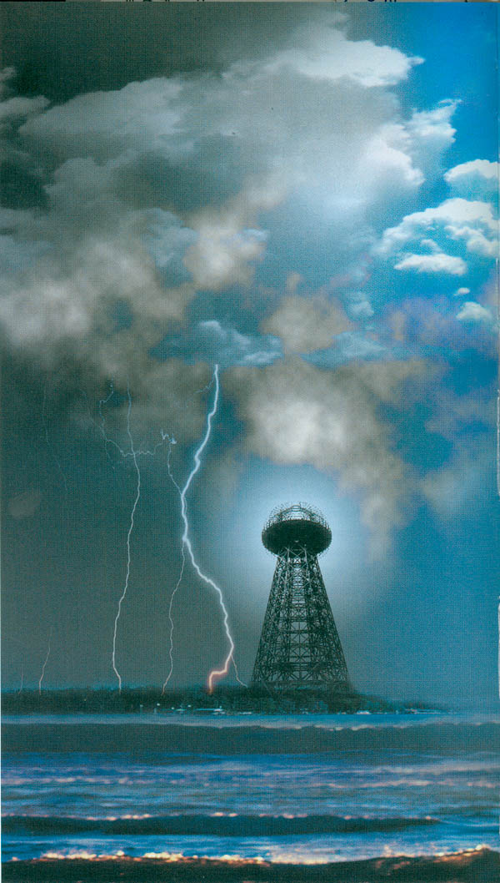
Electrical Precipitation of Rainfalls

