Slide 1
Visualizing OpenMP Execution using OMPT
Yonghong Yan, Philip Conrad, Yudong Sun
Department of Computer Science and Engineering, University of South Carolina

Slide 2
OpenMP Tool Interface
OpenMP Instrumentation and Tracing API
For building OpenMP performance profiling and analysis tools
First party tools
Built into the OpenMP runtime
No user instrumentation or recompilation/relinking needed
Detailed inspection of program events/states via callbacks.
Thread states
Mutex behavior
Parallel behavior

Slide 3
Some Events and Callback
ompt_callback_thread_begin
ompt_callback_thread_end
ompt_callback_parallel_begin
ompt_callback_parallel_end
ompt_callback_task_create
ompt_callback_task_schedule
ompt_callback_implicit_task
ompt_callback_target
ompt_callback_target_data_op
ompt_callback_target_submit
ompt_callback_control_tool
ompt_callback_device_initialize
ompt_callback_device_finalize
ompt_callback_device_load
ompt_callback_device_unload
ompt_callback_sync_region_wait
ompt_callback_mutex_released
ompt_callback_task_dependences
ompt_callback_task_dependence
ompt_callback_work
ompt_callback_master
ompt_callback_target_map
ompt_callback_sync_region
ompt_callback_reduction
ompt_callback_lock_init
ompt_callback_lock_destroy
ompt_callback_mutex_acquire
ompt_callback_mutex_acquired
ompt_callback_nest_lock
ompt_callback_flush
ompt_callback_cancel
ompt_callback_dispatch
...

Slide 4
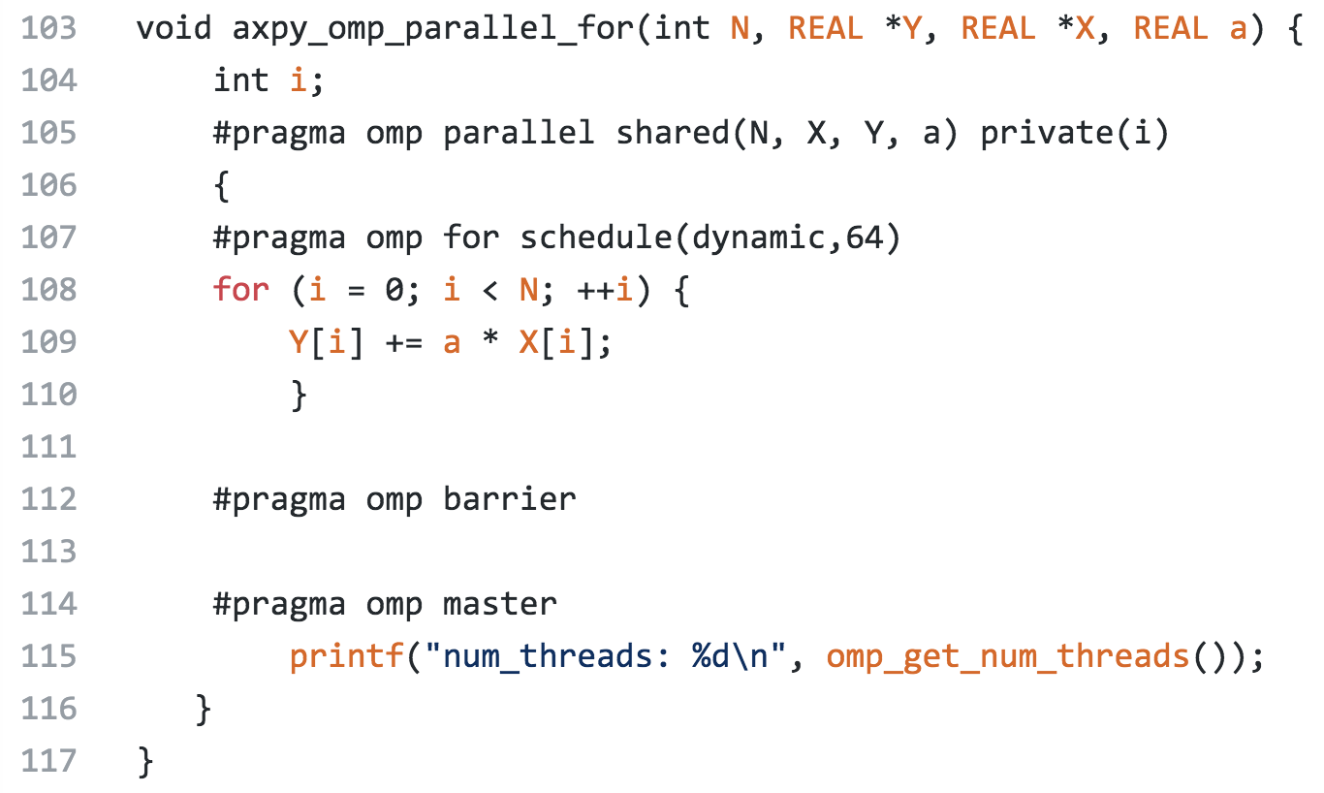
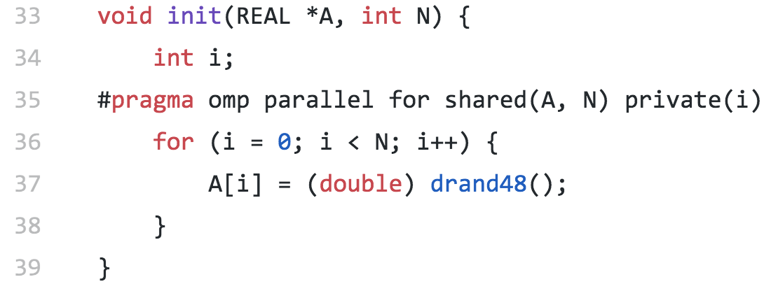
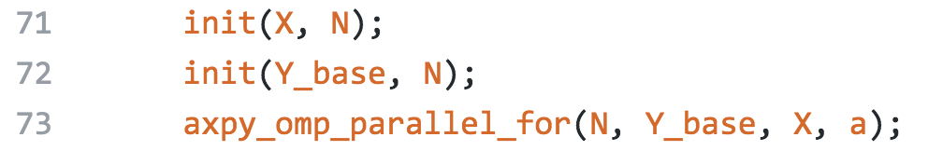
An Example

Slide 5
OMPT Events Tracing

Slide 6
OMPT Events Tracing

Slide 7
OMPT Events Tracing

Slide 8
Tracing
Each thread has its own tracing buffer for storing tracing events
Consecutively added when an event happen by the trace callback
Lexgion: OpenMP Lexical Code Region
Lexical scope provided by codeptr_ra
Each thread has its own lexgion stack
Each lexgion has a link-list of events for the region
Parallel region
Master threads has buffer to store the implicit-task-begin events records of worker threads
Added some performance profiling features
Timestamp, PAPI read, and power read
GraphML output

Slide 9
Existing Tracing and Performance Tools
Score-P, TAU, HPCToolkit, etc
Instrumentation or sampling based
Dedicated software tools and interface for HPC, e.g. tracing format, PAPI, etc
Kernel tracing is limited or not possible (mostly not needed)
Instrumentation
Early instrumentation requires recompilation to wrap OpenMP directives with tracing calls
E.g. TAU instrumentor or OPARI2 Instrumentor
With OMPT → No instrumentation needed
Sampling, e.g. HPCToolkit, only needs binary
Co-relocating tracing data with source code using libunwind

Slide 10
PInsight: Performance Tools that Leverage Existing Linux Tools
perf
LTTng
Eclipse-based TraceCompass
http://www.brendangregg.com/perf.html

Slide 11
What’s LTTng?
High-performance tracing framework for Linux.
Used to instrument the kernel and find performance bugs.
Can add tracepoints userland applications as well!
Adding a tracepoint is usually as difficult as adding a printf() for debugging.
Trace format is flexible and customizable.
Common Trace Format: https://diamon.org/ctf/
https://lttng.org/

Slide 12
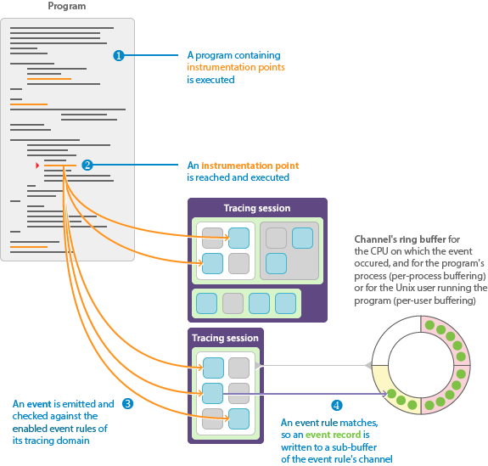
LTTng Operation
Tracepoints are added to a program.
LTTng tracing session is started.
The program executes a tracepoint.
LTTng collects the event’s trace data.
If the tracepoint matches an event rule, it is saved.
When tracing is done, or a buffer fills with trace records, the buffer is written to disk.

Slide 13
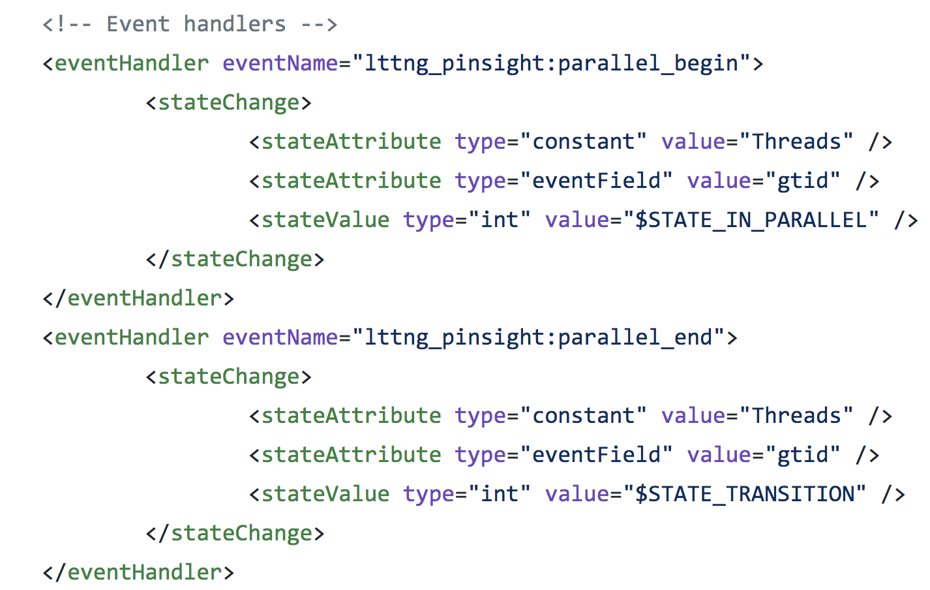
What’s TraceCompass?
CTF Trace visualization tool based on Eclipse
Can read CTF format traces (such as those from LTTng).
Visualizations built with short XML description files.

Slide 14
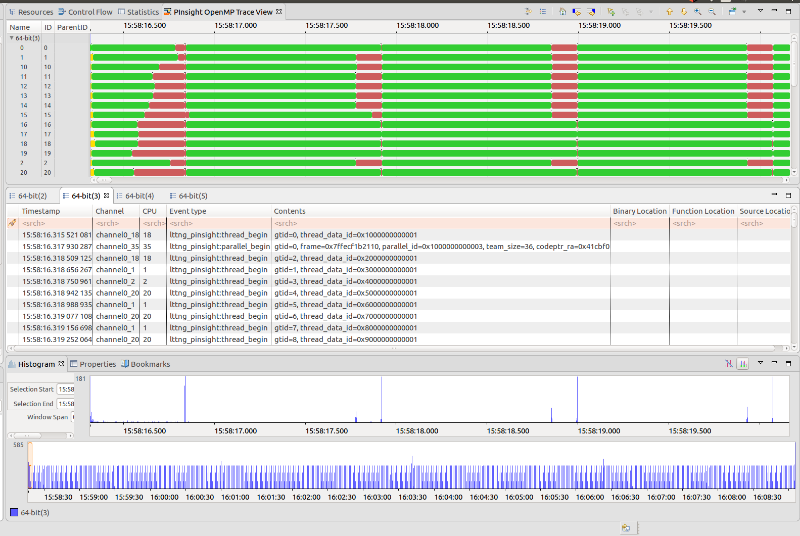
SPEC OMP md

Slide 15
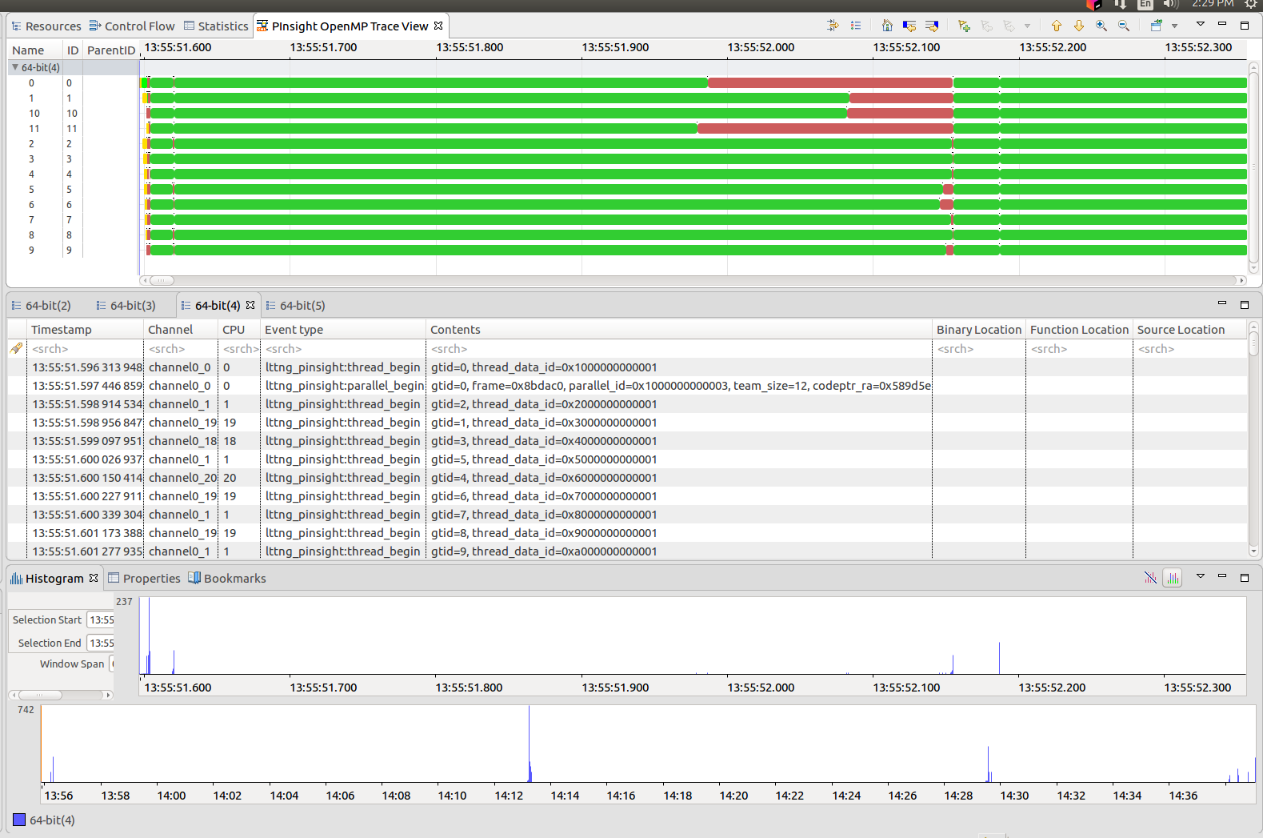
SPEC OMP Imagick

Slide 16
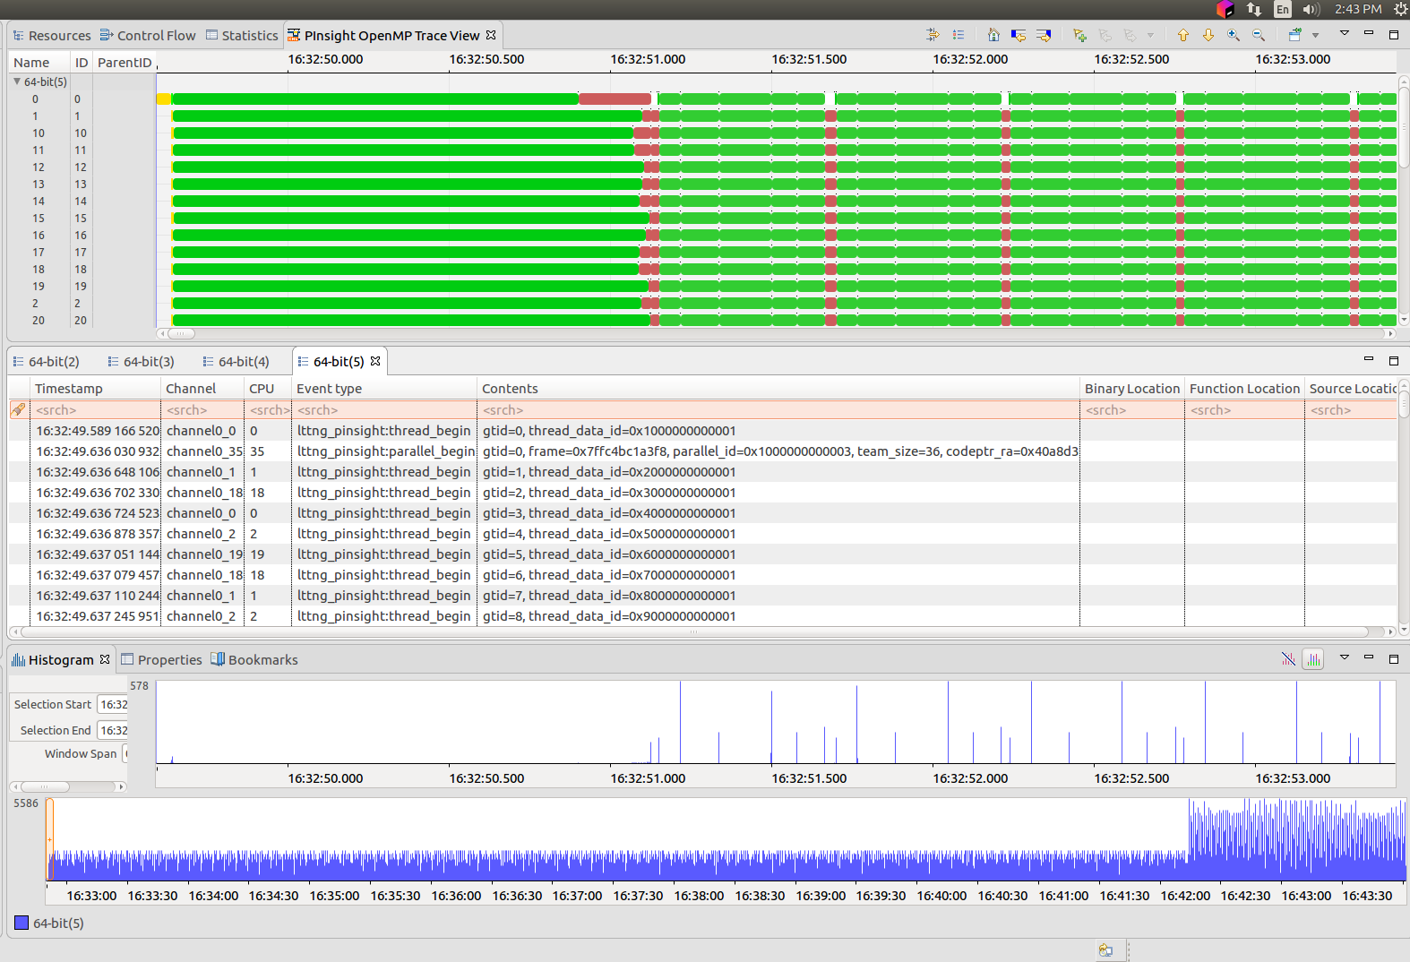
SPEC OMP NAB

Slide 17
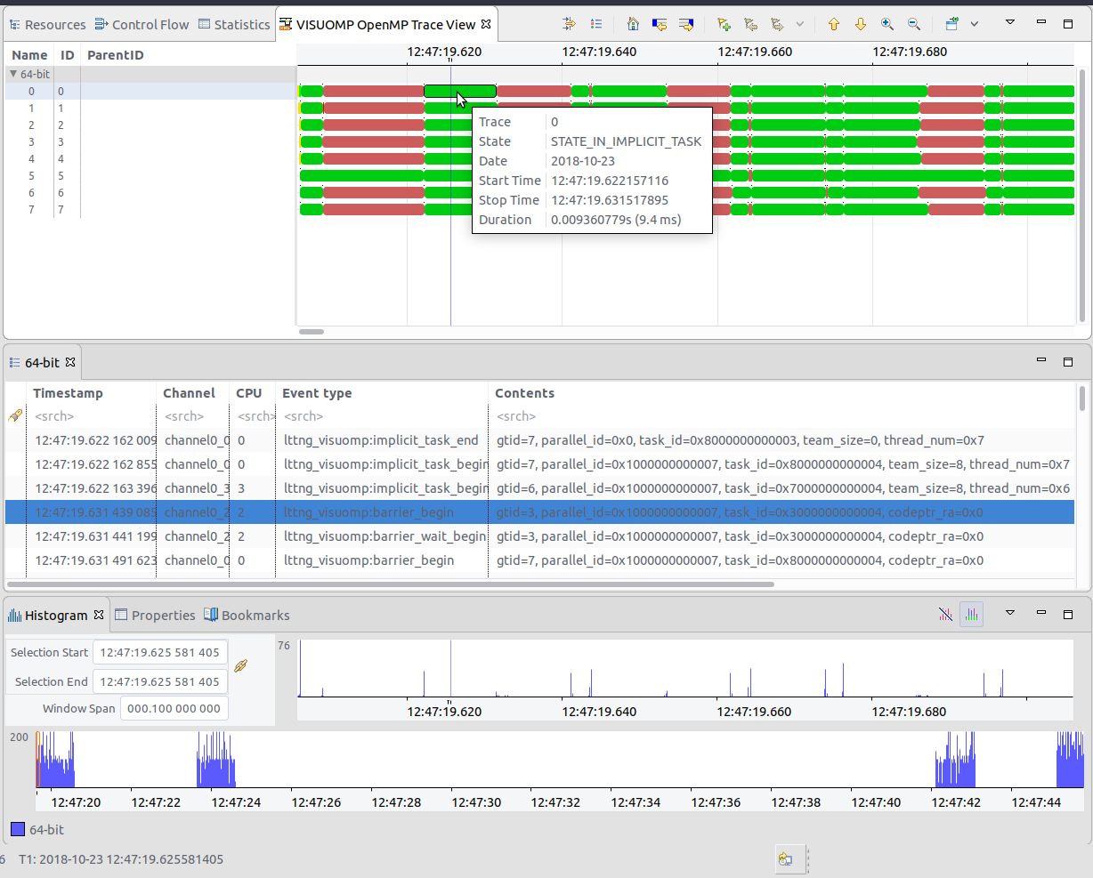
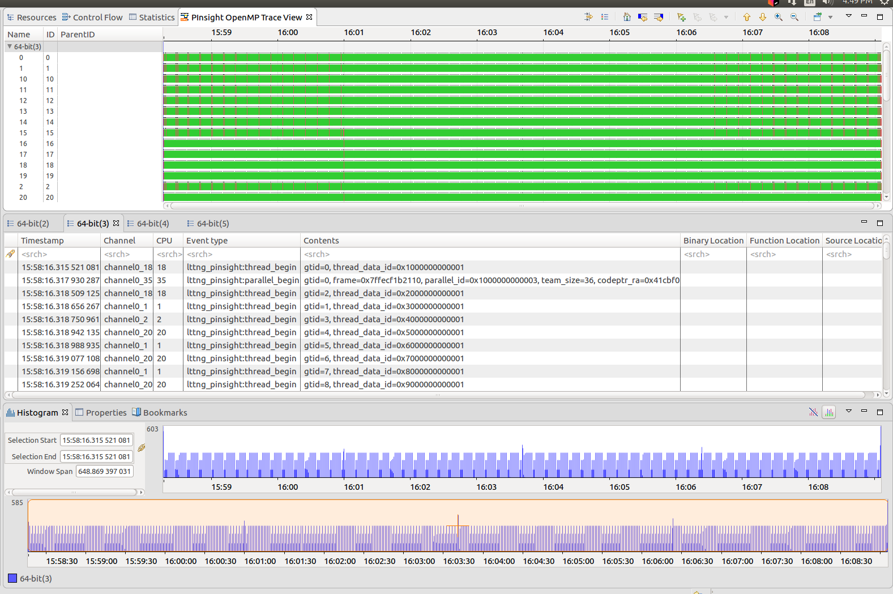
Event Histogram

Slide 18
Showing Event/State Info

Slide 19
Extra Slides

Slide 21
Design Goals
Non-invasive instrumentation for OpenMP programs.
Take advantage of existing APIs and standards.
Compatibility with existing tools. (e.g. TraceCompass)
Easy deployment in the wild.

