Slide 1
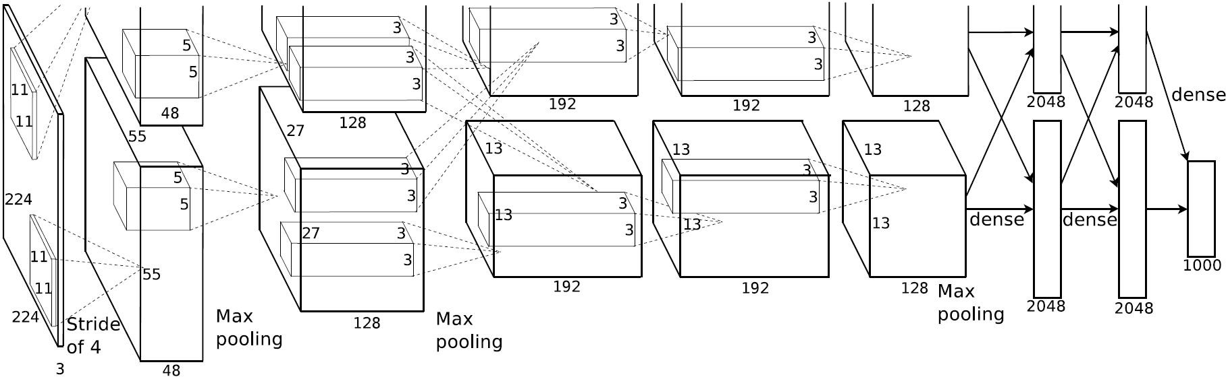
AlexNet详解
AlexNet是2012年ISLVRC 2012（ImageNet Large Scale Visual Recognition Challenge）竞赛的冠军网络，分类准确率由传统的 70%+提升到 80%+。 它是由Hinton和他的学生Alex Krizhevsky设计的。也是在那年之后，深
度学习开始迅速发展。
ISLVRC 2012
训练集：1,281,167张已标注图片 验证集：50,000张已标注图片 测试集：100,000张未标注图片

Slide 2
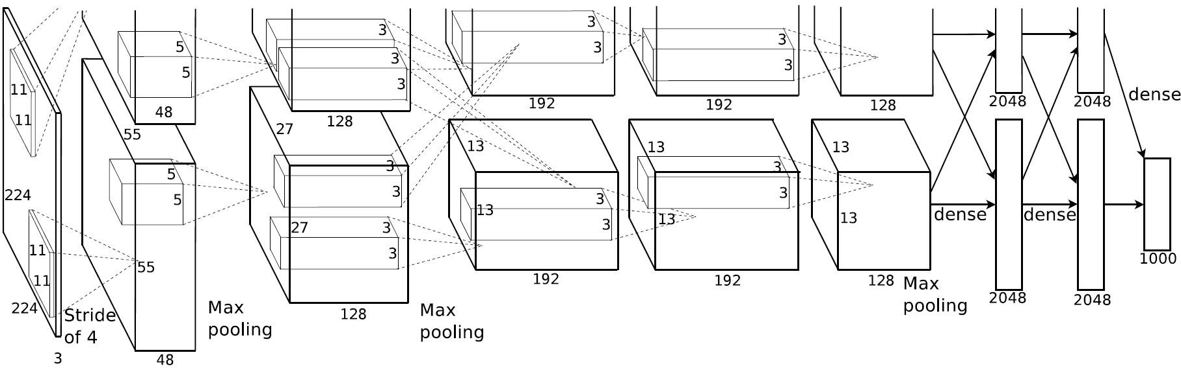
AlexNet详解
该网络的亮点在于：
首次利用 GPU 进行网络加速训练。
使用了 ReLU 激活函数，而不是传统的 Sigmoid 激活函数以及 Tanh 激活函数。
使用了 LRN 局部响应归一化。
在全连接层的前两层中使用了 Dropout 随机失活神经元操作，以减少过拟合。

Slide 3
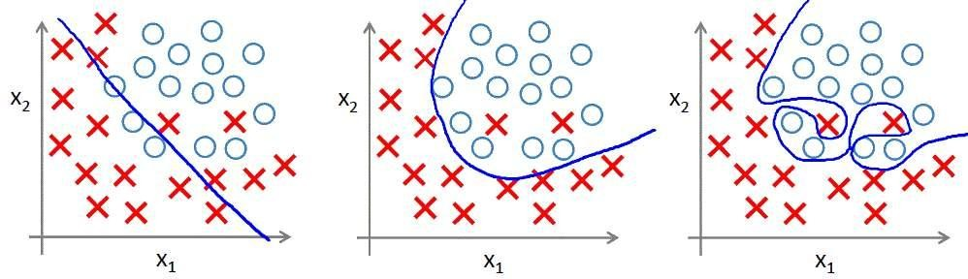
AlexNet详解
过拟合：根本原因是特征维度过多，模型假设过于复杂，参数 过多，训练数据过少，噪声过多，导致拟合的函数完美的预测 训练集，但对新数据的测试集预测结果差。 过度的拟合了训练 数据，而没有考虑到泛化能力。

Slide 4
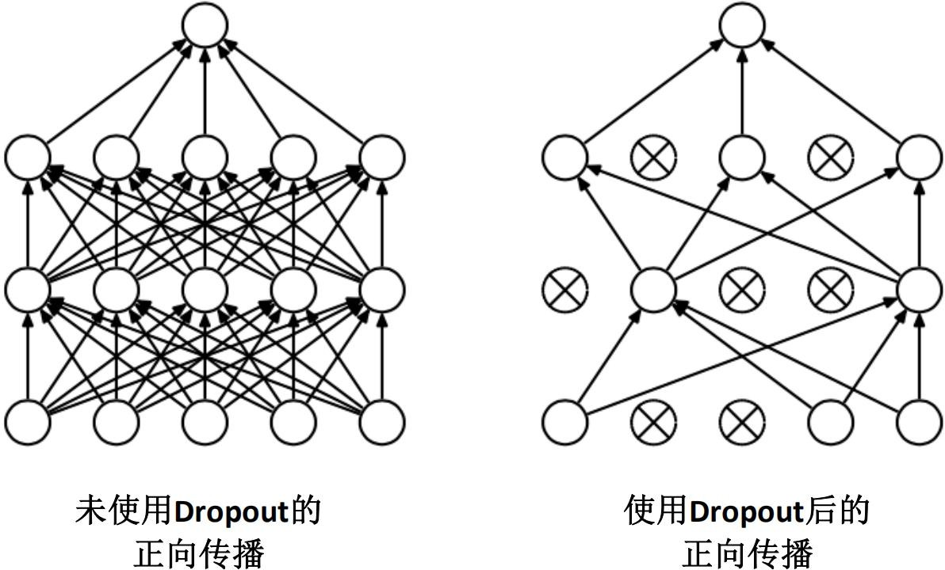
AlexNet详解
使用 Dropout 的方式在网络正向传播过程中随机失活一部分神经元

Slide 5
AlexNet详解
经卷积后的矩阵尺寸大小计算公式为：
N = (W − F + 2P ) / S + 1
① 输入图片大小 W×W
② Filter大小 F×F
③ 步长 S
④ padding的像素数 P

Slide 6
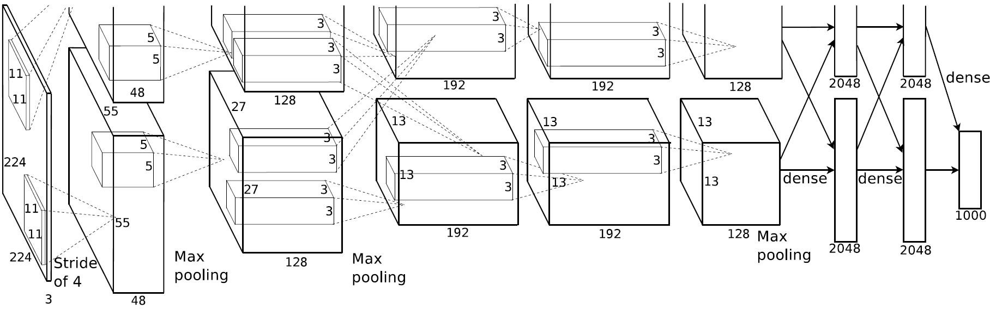
AlexNet详解
Conv1
Conv1: kernels:48*2=96 kernel_size:11 padding:[1, 2] stride:4
input_size: [224, 224, 3]
output_size: [55, 55, 96]
N = (W − F + 2P ) / S + 1
=[224-11+(1+2)]/4+1

Slide 7
AlexNet详解
Maxpool1
Conv1: kernels:48*2=96 kernel_size:11 padding: [1, 2] stride:4
output_size: [55, 55, 96]
Maxpool1: kernel_size:3 pading: 0 stride:2
input_size: [55, 55, 96]
output_size: [27, 27, 96]
N = (W − F + 2P ) / S + 1
=(55-3)/2+1

Slide 8
AlexNet详解
Conv2
Conv2: kernels:128*2=256 kernel_size:5 padding: [2, 2] stride:1
Conv1: kernels:48*2=96 kernel_size:11 padding: [1, 2] stride:4
output_size: [55, 55, 96]
Maxpool1: kernel_size:3 pading: 0 stride:2
input_size: [27, 27, 96]
output_size: [27, 27, 256]
N = (W − F + 2P ) / S + 1
=(27-5+4)/1+1
output_size: [27, 27, 96]

Slide 9
AlexNet详解
Maxpool2
Maxpool2: kernel_size:3 pading: 0 stride:2
input_size: [27, 27, 256]
output_size: [13, 13, 256]
Conv1: kernels:48*2=96 kernel_size:11 | Maxpool1: kernel_size:3 pading: 0 | Conv2: kernels:128*2=256 kernel_size:5
padding: [1, 2] | stride:2 | padding: [2, 2]
stride:4 |  | stride:1
output_size: | output_size: | output_size:
[55, 55, 96] | [27, 27, 96] | [27, 27, 256]
N = (W − F + 2P ) / S + 1
=(27-3)/2+1

Slide 10
AlexNet详解
N = (W − F + 2P ) / S + 1
=(13-3+2)/1+1
Conv3
Conv3: kernels:192*2=384 kernel_size:3 padding: [1, 1] stride:1
input_size:
Conv1: | Maxpool1: | Conv2: | Maxpool2:
kernels:48*2=96 | kernel_size:3 | kernels:128*2=256 | kernel_size:3
kernel_size:11 | pading: 0 | kernel_size:5 | pading: 0
padding: [1, 2] | stride:2 | padding: [2, 2] | stride:2
stride:4 |  | stride:1
output_size: | output_size: | output_size: | output_size:
[55, 55, 96] | [27, 27, 96] | [27, 27, 256] | [13, 13, 256]
[13, 13, 256]
output_size: [13, 13, 384]

Slide 11
AlexNet详解
Conv4
N = (W − F + 2P ) / S + 1
=(13-3+2)/1+1
Conv1: | Maxpool1: | Conv2: | Maxpool2: | Conv3:
kernels:48*2=96 | kernel_size:3 | kernels:128*2=256 | kernel_size:3 | kernels:192*2=384
kernel_size:11 | pading: 0 | kernel_size:5 | pading: 0 | kernel_size:3
padding: [1, 2] | stride:2 | padding: [2, 2] | stride:2 | padding: [1, 1]
stride:4 |  | stride:1 |  | stride:1
Conv4: kernels:192*2=384 kernel_size:3 padding: [1, 1]
output_size: [55, 55, 96]
output_size: [27, 27, 96]
output_size: [27, 27, 256]
output_size: [13, 13, 256]
output_size: [13, 13, 384]
stride:1
input_size: [13, 13, 384]
output_size: [13, 13, 384]

Slide 12
AlexNet详解
Conv5
N = (W − F + 2P ) / S + 1
=(13-3+2)/1+1
Conv5: kernels:128*2=256 kernel_size:3 padding: [1, 1] stride:1
Conv1: kernels:48*2=96 kernel_size:11 padding: [1, 2] stride:4
Maxpool1: kernel_size:3 pading: 0 stride:2
Conv2: kernels:128*2=256 kernel_size:5 padding: [2, 2] stride:1
Maxpool2: kernel_size:3 pading: 0 stride:2
Conv3: Conv4:
kernels:192*2=384 kernels:192*2=384
kernel_size:3 padding: [1, 1] stride:1
kernel_size:3 padding: [1, 1] stride:1
output_size: [55, 55, 96]
output_size: [27, 27, 96]
output_size: [27, 27, 256]
output_size: [13, 13, 256]
output_size: [13, 13, 384]
output_size: [13, 13, 256]
input_size: [13, 13, 384]
output_size: [13, 13, 256]

Slide 13
AlexNet详解
Maxpool3
N = (W − F + 2P ) / S + 1
=(13-3)/2+1
Conv1: kernels:96 kernel_size:11 padding: [1, 2] | Maxpool1: kernel_size:3 pading: 0 stride:2 | Conv2: kernels:256 kernel_size:5 padding: [2, 2] | Maxpool2: kernel_size:3 pading: 0 stride:2 | Conv3: kernels:=384 kernel_size:3 padding: [1, 1] | Conv4: kernels:384 kernel_size:3 padding: [1, 1] | Conv5: Maxpool3: kernels:128*2=256 _{kernel_size:3} kernel_size:3 _{padding: 0} padding: [1, 1]
stride:4 |  | stride:1 |  | stride:1 | stride:1 | stride:1 | stride:2
output_size: | output_size: | output_size: | output_size: | output_size: | output_size: | output_size: | input_size: [13, 13, 256]
[55, 55, 96] | [27, 27, 96] | [27, 27, 256] | [13, 13, 256] | [13, 13, 384] | [13, 13, 384] | [13, 13, 256] | output_size: [6, 6, 256]

Slide 14
AlexNet详解
layer_name | kernel_size | kernel_num | padding | stride
Conv1 | 11 | 96 | [1, 2] | 4
Maxpool1 | 3 | None | 0 | 2
Conv2 | 5 | 256 | [2, 2] | 1
Maxpool2 | 3 | None | 0 | 2
Conv3 | 3 | 384 | [1, 1] | 1
Conv4 | 3 | 384 | [1, 1] | 1
Conv5 | 3 | 256 | [1, 1] | 1
Maxpool3 | 3 | None | 0 | 2
FC1 | 2048 | None | None | None
FC2 | 2048 | None | None | None
FC3 | 1000 | None | None | None

Slide 15


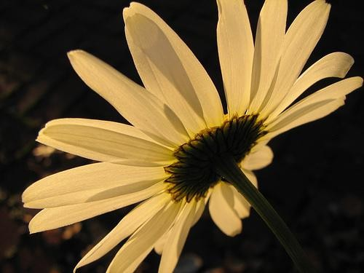
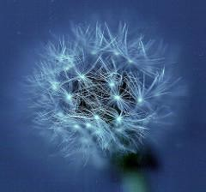

AlexNet详解
下载花分类数据集
daisy
雏菊
dandelion
蒲公英
roses
玫瑰
sunflower
向日葵
tulips
郁金香

