Slide 1
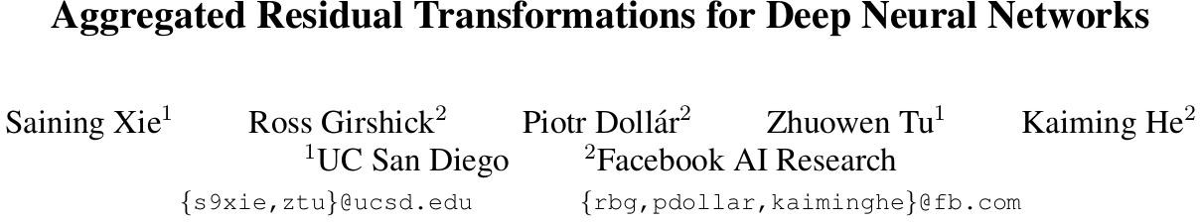
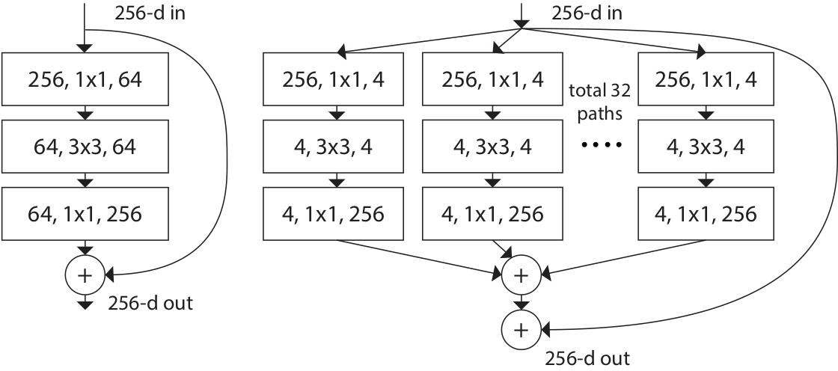
ResNeXt
更新了block

Slide 2
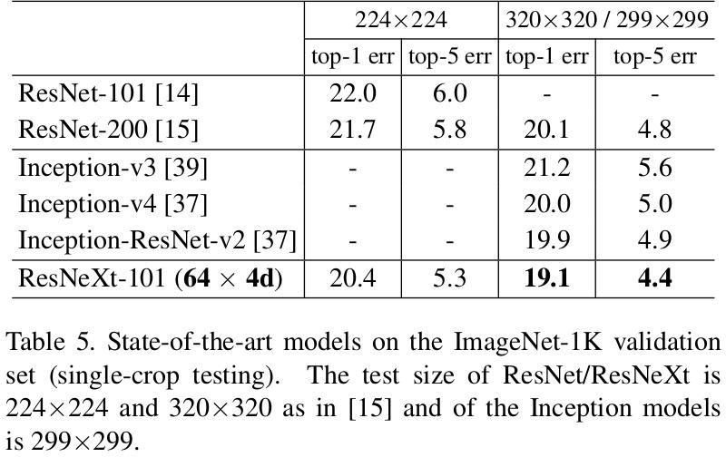
ResNeXt

Slide 3
ResNeXt
在计算量相同的情况下，错误率更低

Slide 4



























ResNeXt
Convolution
Parameters:
x n
.....
channel=n
Group Convolution
Parameters:
.....
channel=
x
x
.....
channel=
当g=C_{in，}n=C_{in}此时就是DW Conv

Slide 5
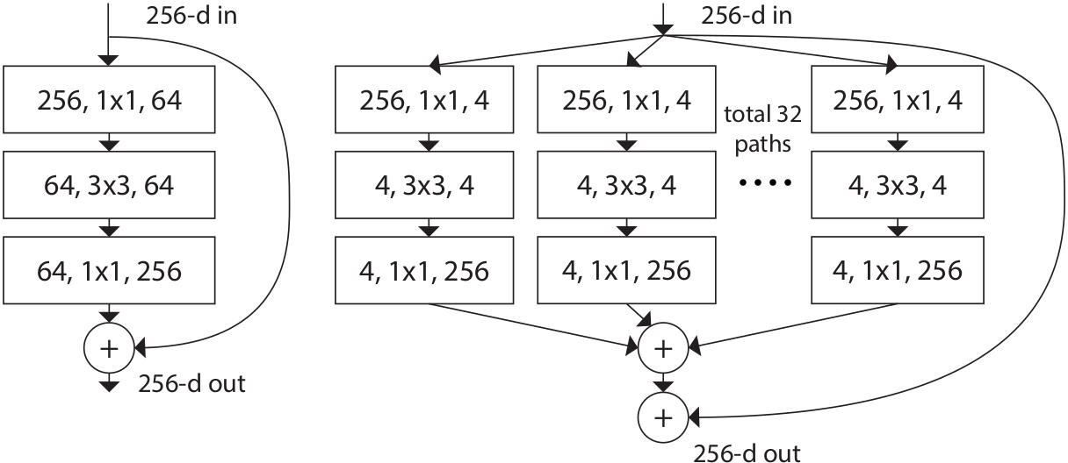
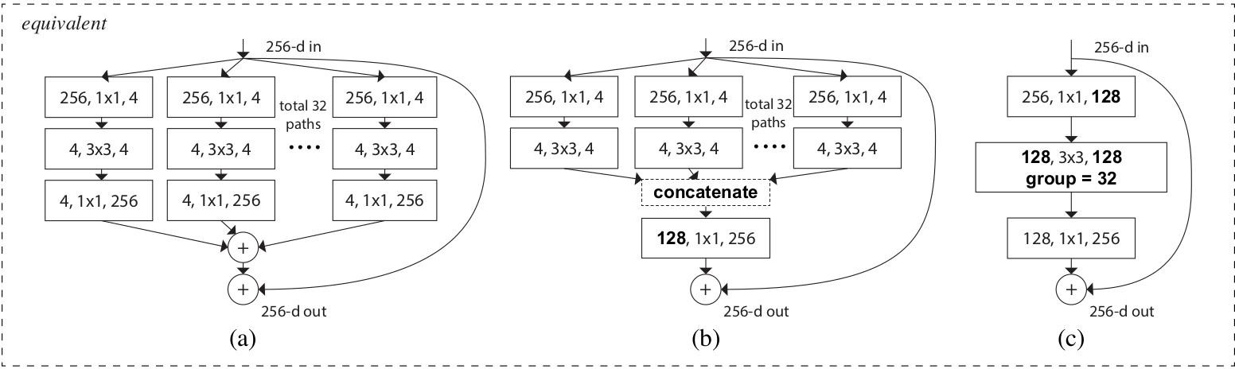
ResNeXt
下面的block模块，它们在数学计算上完全等价

Slide 6
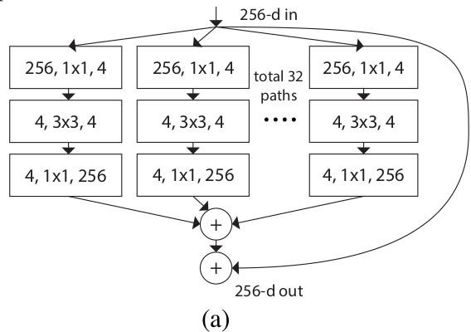
ResNeXt
feature map
feature map
kernel
0 | 1
1 | 0
1
1 | 1
1 | 0
-1 | 0
0 | 0
-1
-3 | -2
-1 | -1
1 | 1
1 | 1
-1
-2 | -2
-1 | -1
1 | 1
0 | 0
-1

Slide 7
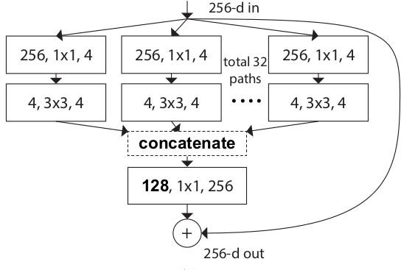
ResNeXt
feature map
0 | 1
1 | 0
kernel
feature map
1 | 1
1 | 0
1 | 1
1 | 1
1
-1
-1
-1
1 | 1
0 | 0
-3 | -2
-1 | -1

Slide 8
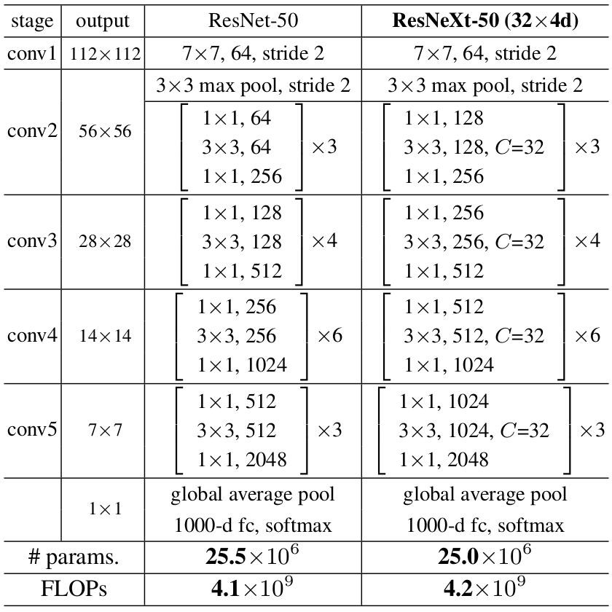
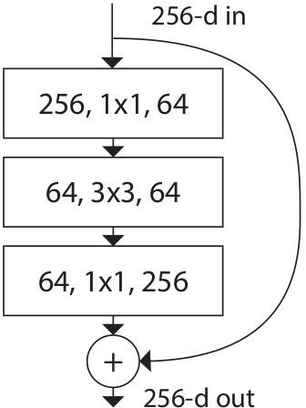
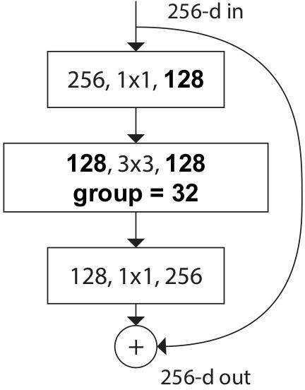
ResNeXt
为什么group数要设置为32？

Slide 9
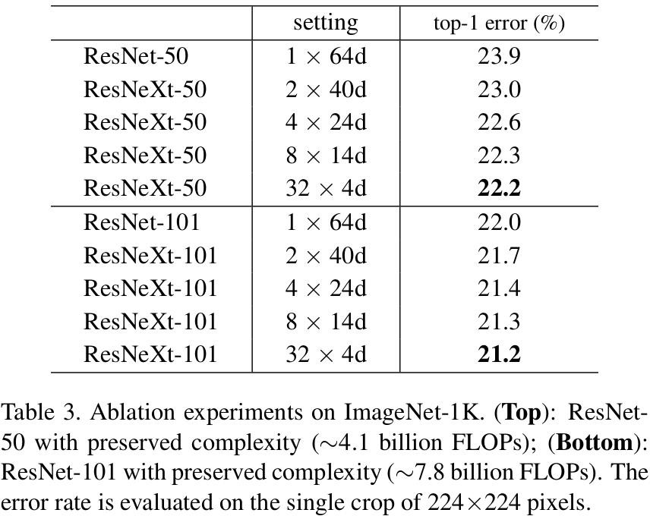
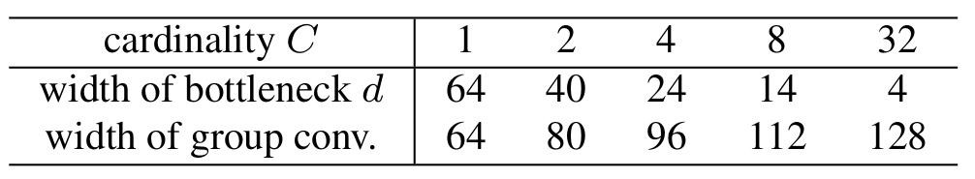
ResNeXt

Slide 10
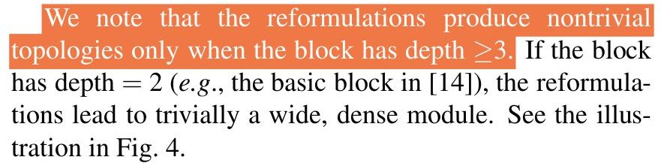
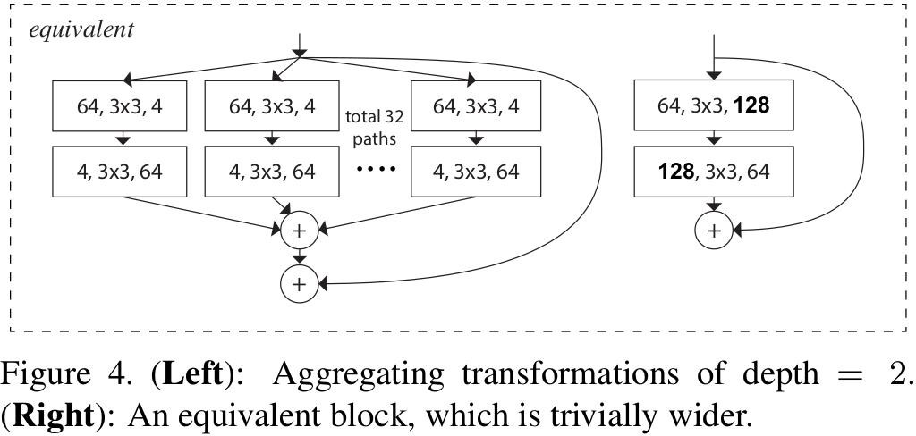
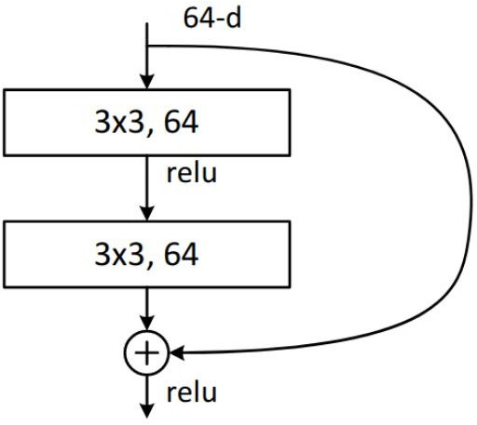
ResNeXt

