Slide 1
Nova AI Coordinator System
Asynchronous Multi-Agent Task Processing

Slide 2
System Architecture & File Structure
src/ ├── main.py # Entry point with async processing ├── core/ │ ├── knowledge_base.py # Shared memory implementation │ ├── task_manager.py # Task representation and management │ └── functions_registery.py # Core functions for all agents ├── agents/ │ ├── base_agent.py # Base agent class │ ├── nova.py # Coordinator agent │ ├── emil.py # Energy modeling specialist │ ├── ivan.py # Python script specialist │ └── lola.py # Analysis and report specialist └── utils/ ├── do_maths.py # Math functionality ├── general_knowledge.py # Q&A functionality ├── open_ai_utils.py # LLM integration └── function_logger.py # Logging infrastructure

Slide 3
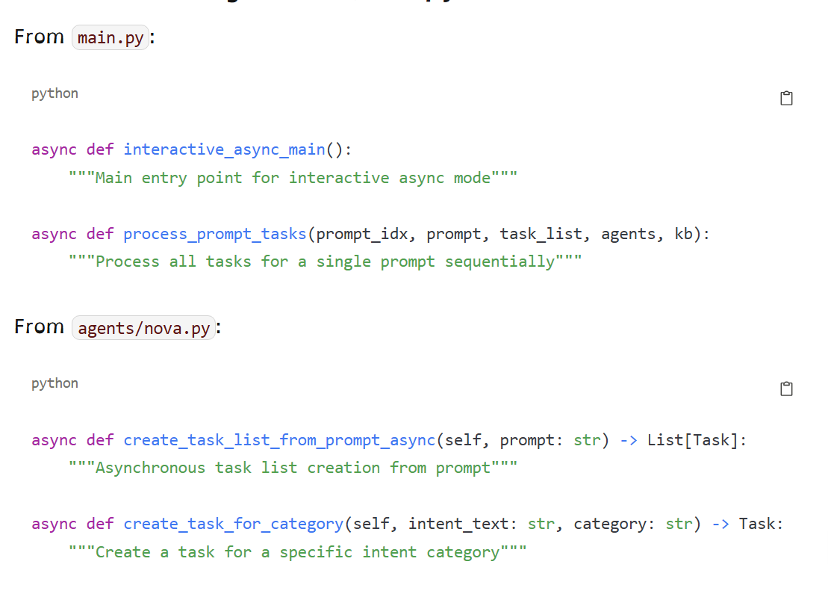
Core Function Signatures (main.py)
From main.py: ---------------- async def interactive_async_main(): """Main entry point for interactive async mode""" async def process_prompt_tasks(prompt_idx, prompt, task_list, agents, kb): """Process all tasks for a single prompt sequentially""" From agents/nova.py: --------------------- async def create_task_list_from_prompt_async(self, prompt: str) -> List[Task]: """Asynchronous task list creation from prompt""" async def create_task_for_category(self, intent_text: str, category: str) -> Task: """Create a task for a specific intent category"""

Slide 4
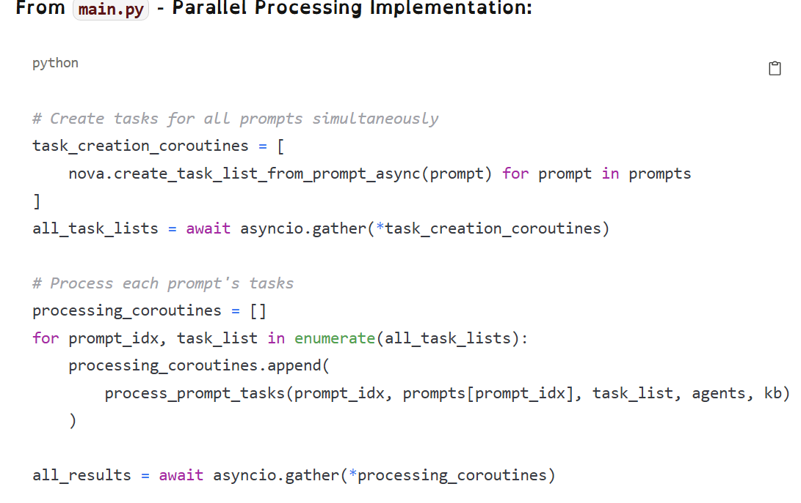
Asynchronous Task Processing (main.py)
The system processes multiple intents in parallel, with sequential execution for dependent subtasks. Example Input Prompt: "Who wrote the harry potter books, what is 2 * 2, build a model for france, analyse the data and write a report"

Slide 5
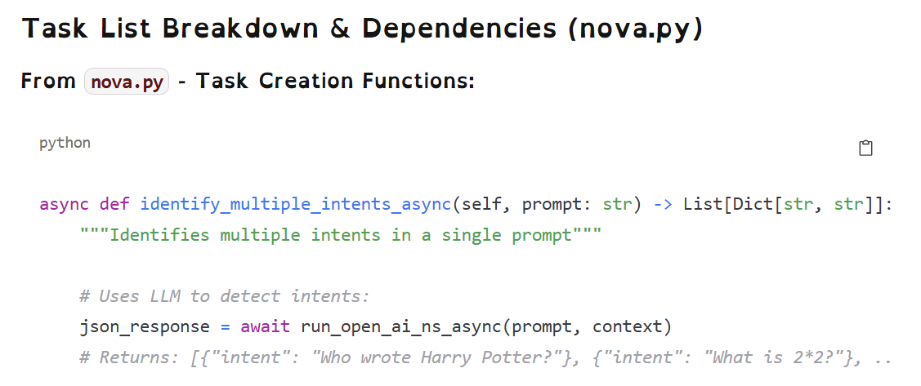
Task List Breakdown & Dependencies (nova.py)
Task Group Structure: --------------------- Task 1: Answer general knowledge question (Nova) - Who wrote Harry Potter? Task 2: Perform math calculation (Nova) - What is 2 * 2? Task 3: Energy modeling sequence (Multi-agent): - Task 3A: Build France energy model (Emil) - Task 3B: Analyze model data (Lola) [Depends on 3A] - Task 3C: Write report (Lola) [Depends on 3A and 3B]

Slide 6
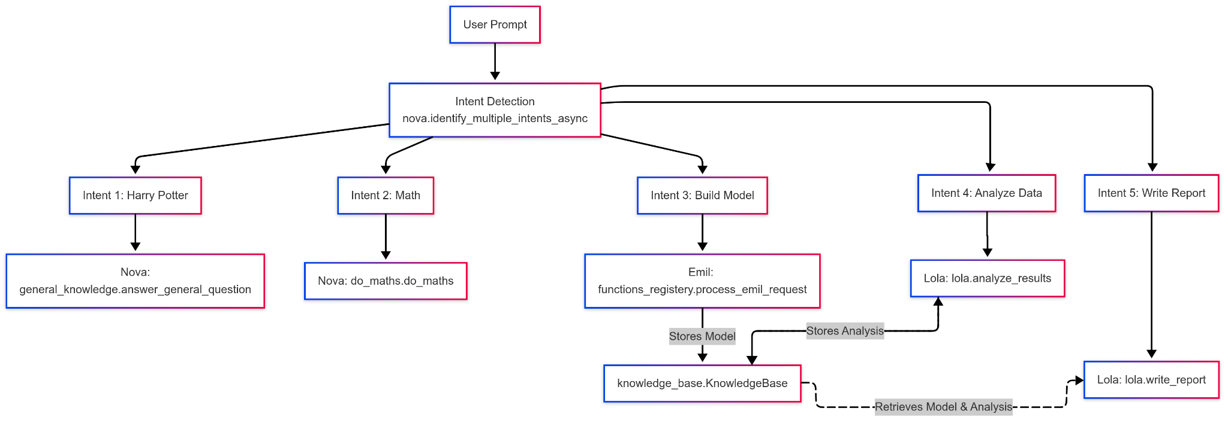
Processing Flow & Dependencies

Slide 7
Complex Execution Timeline
[Time: 0.00s] main.py: interactive_async_main() starts
[Time: 0.05s] nova.py: identify_multiple_intents_async() completes
[Time: 0.10s] nova.py: create_task_for_category() completes for all intents
[Time: 0.15s] main.py: process_prompt_tasks() begins
[Time: 0.20s] TASK 1: nova.py:handle_task_async() calls general_knowledge.py
[Time: 0.20s] TASK 2: nova.py:handle_task_async() calls do_maths.py
[Time: 0.20s] TASK 3A: emil.py:handle_task_async() calls functions_registery.py:process_emil_request()
[Time: 0.21s] TASK 2: do_maths.py:do_maths() completes (4.0)
[Time: 4.19s] TASK 1: general_knowledge.py:answer_general_question() completes
[Time: 5.50s] TASK 3A: functions_registery.py:create_single_location_model() completes
=> knowledge_base.py: set_item("latest_model_file", output_xml)
[Time: 5.55s] TASK 3B: lola.py:analyze_results() begins
=> knowledge_base.py: get_item("latest_model_file")
[Time: 7.20s] TASK 3B: lola.py:analyze_model() completes
=> knowledge_base.py: set_item("latest_analysis_results", results)
[Time: 7.25s] TASK 3C: lola.py:write_report() begins
=> knowledge_base.py: get_item("latest_model_details")
=> knowledge_base.py: get_item("latest_analysis_results")
[Time: 9.10s] TASK 3C: lola.py:generate_executive_summary() completes
[Time: 9.15s] main.py: Results aggregated and returned

Slide 8
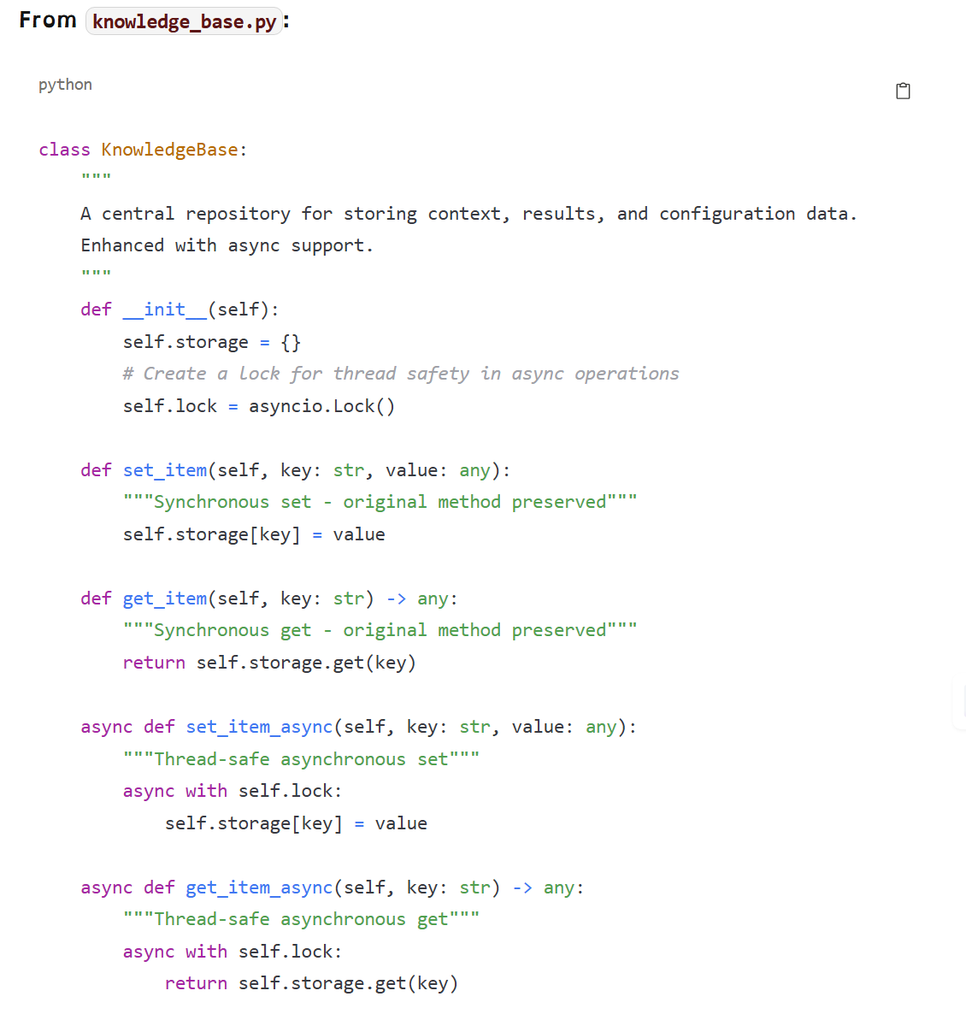
Knowledge Base as the Central Coordination Point (knowledge_base.py)
The Knowledge Base (knowledge_base.py) serves as the critical bridge enabling independent components to work together seamlessly:

Slide 9
Data Flow Between Components & Files
emil.py knowledge_base.py lola.py
───────────────────── ──────────────────────── ────────────────────
create_simple_xml()
┌──────────────────────┐
│ "latest_model_file" │
kb.set_item() ───────►│ "France_hydro.xml" │◄───── kb.get_item()
└──────────────────────┘
┌──────────────────────┐
│ "latest_model_details"│
kb.set_item() ───────►│ {location: "France", │◄───── kb.get_item()
│ generation: "hydro"} │
└──────────────────────┘
analyze_results()
Knowledge Base Keys Used for Coordination:
python
# Model building keys (Emil -> Lola)
# In functions_registery.py:
kb.set_item("latest_model_file", output_xml)
kb.set_item("latest_model_details", model_details)
# Analysis keys (Lola analysis -> Lola reporting)
# In lola.py:
kb.set_item("latest_analysis_results", analysis_results)
# Report keys (Lola -> main)
# In lola.py:
kb.set_item("final_report", report)

Slide 10
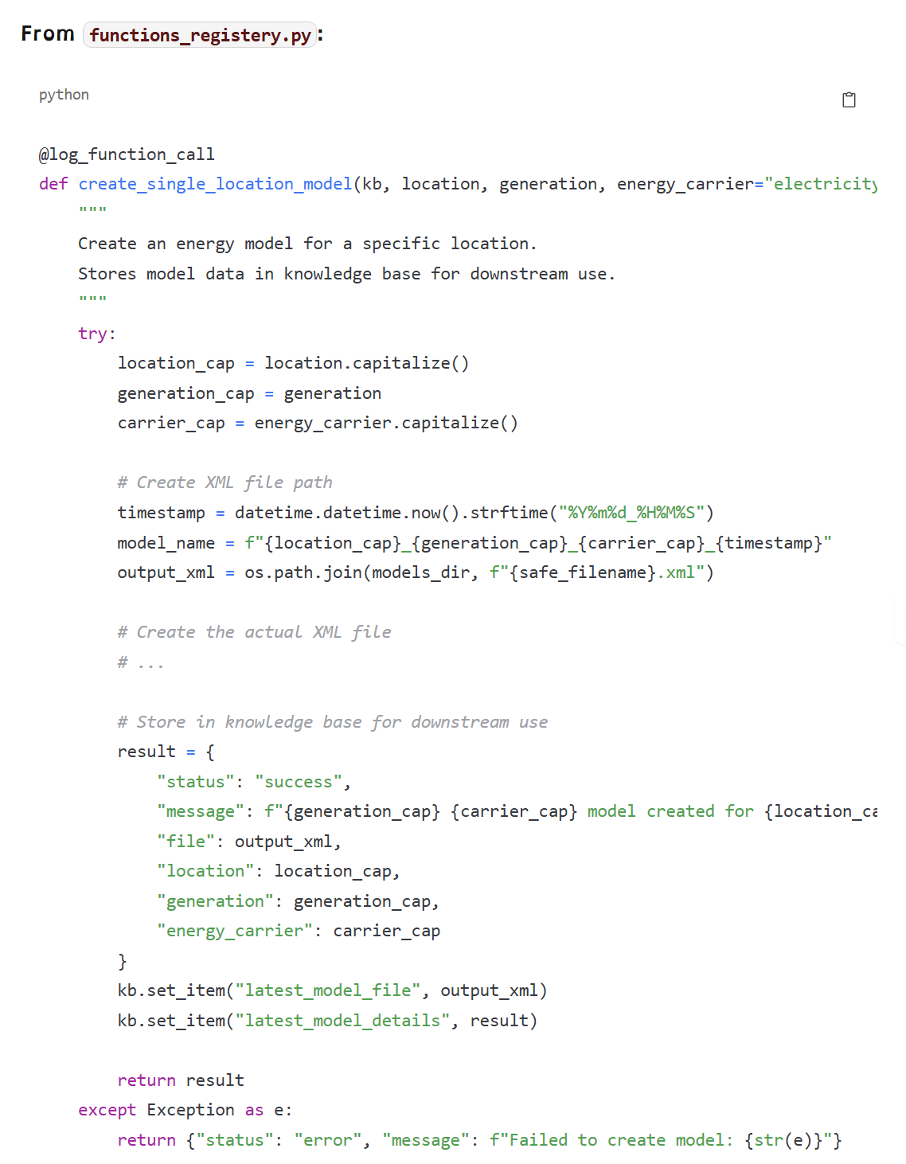
Model Building Process (functions_registery.py)
Emil handles energy model creation via functions in functions_registery.py:

Slide 11
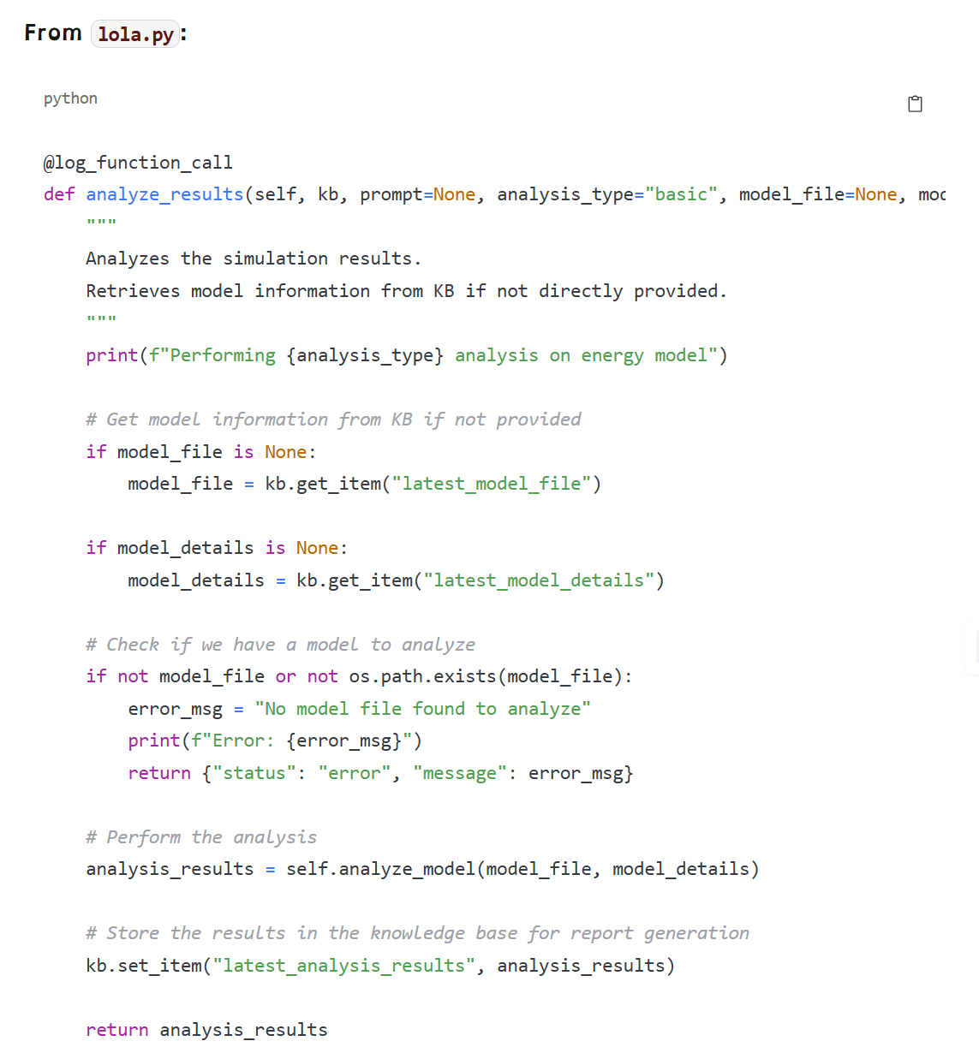
Data Analysis Process (lola.py)
Data Analysis in Lola: ---------------------- 1. Retrieve model file and details from KB 2. Call analyze_model() to parse XML & extract key data 3. Store analysis results in KB as latest_analysis_results 4. Returns a summary of key findings and insights

Slide 12
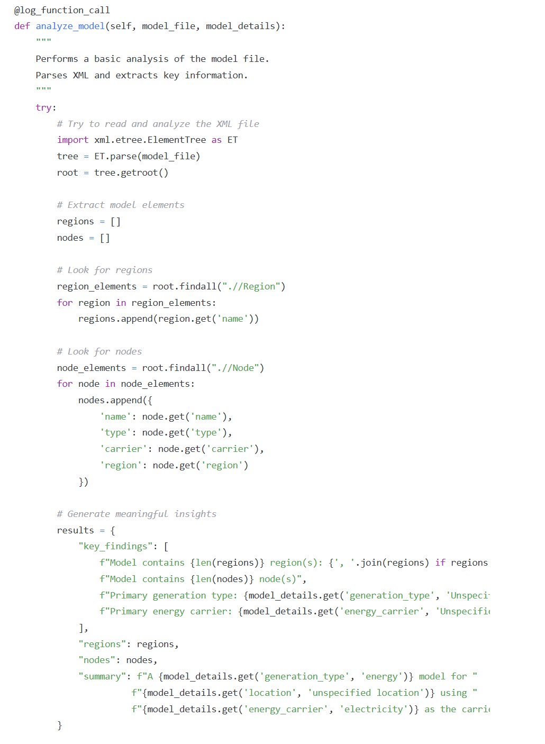
XML Parsing and Analysis (lola.py)
Function: analyze_model() -------------------------- 1. Parse the XML model using ElementTree 2. Extract regions and nodes information 3. Generate insights: - Count and list regions - Count nodes and list details 4. Return a results dictionary with key findings

Slide 13
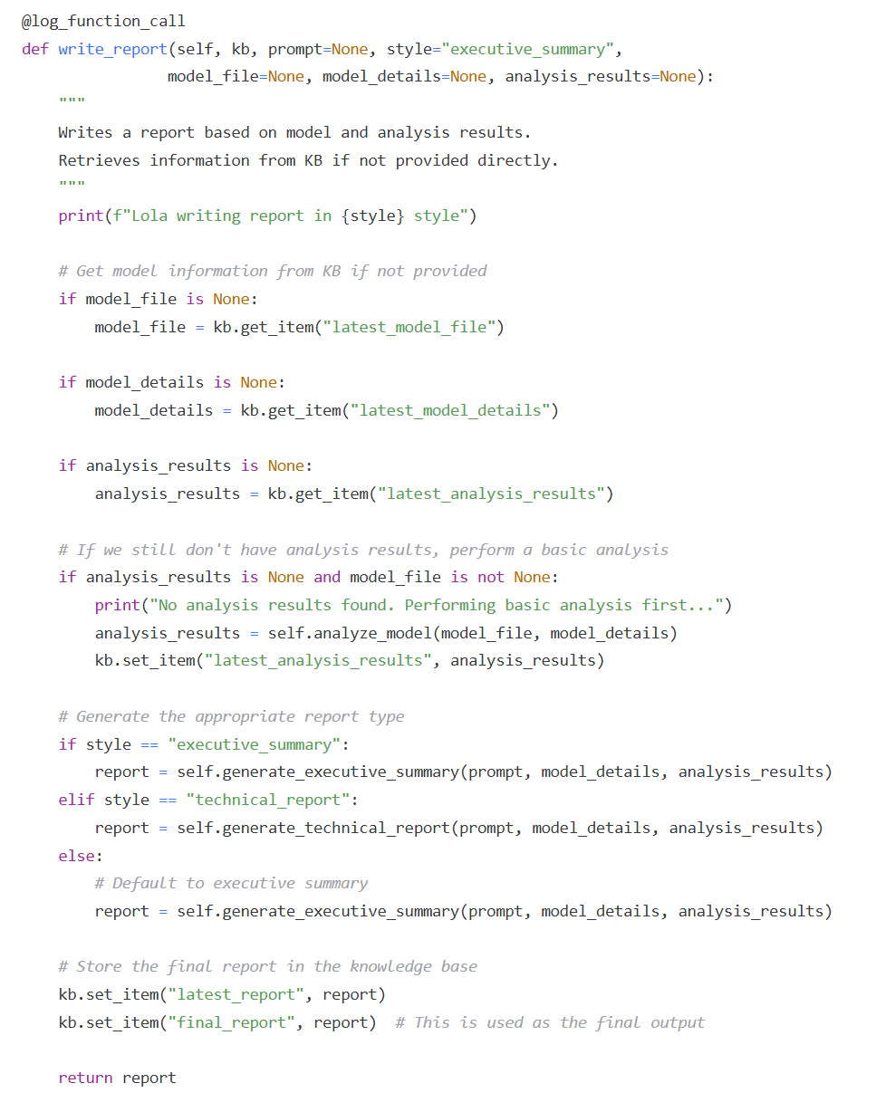
Report Writing Process (lola.py)
Function: write_report() -------------------------- 1. Retrieve model and analysis data from KB 2. If missing analysis, perform a basic analysis first 3. Generate report based on style (executive or technical) 4. Store final report in KB (latest_report & final_report) 5. Return the generated report

Slide 14
Sample Executive Summary Report (Generated by lola.py)
# Executive Summary: Hydro Energy Model for France
## Overview
This report summarizes the energy model created for France, focusing on hydro generation with hydrogen as the primary energy carrier.
## Key Findings
- Model contains 1 region(s): France
- Model contains 1 node(s)
- Primary generation type: hydro
- Primary energy carrier: Hydrogen
## Summary
A hydro model for France using Hydrogen as the carrier.
## Recommendations
- Consider performing detailed simulations with this model
- Enhance the model with additional data sources
- Compare results with historical data for validation
Report generated based on user request: "build a model for france, analyse the data and write a report"

Slide 15
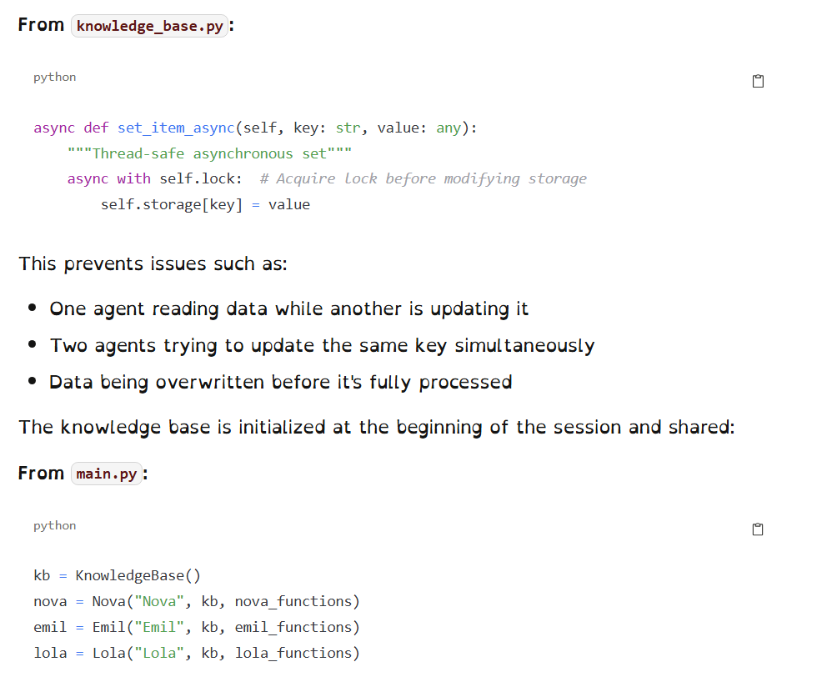
Thread Safety for Concurrent Operations (knowledge_base.py)
Knowledge Base uses async locks to ensure: - One agent does not read while another writes - Prevents race conditions on shared keys - Ensures data is stored and retrieved safely in a concurrent environment

Slide 16
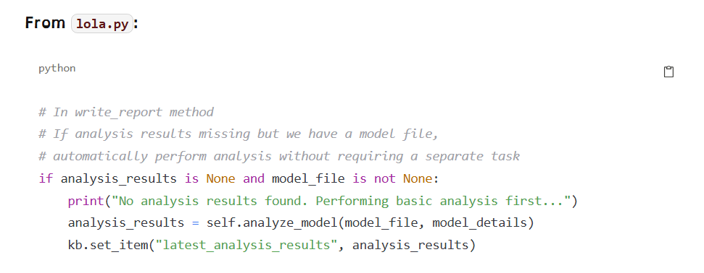
Advanced Dependency Management (lola.py)
In write_report(): - Checks if analysis results exist; if missing, performs basic analysis automatically - Ensures report generation never fails due to missing prerequisites - Manages task dependencies intelligently using KB data retrieval

Slide 17
Workflow Sequence Breakdown
User->>Nova: "build model, analyze, write report"
Nova->>Nova: identify_multiple_intents_async()
Note over Nova: Splits into 3 intents
Nova->>Emil: process_emil_request()
Emil->>Emil: create_single_location_model()
Note over Emil: functions_registery.py
Emil->>KB: set_item("latest_model_file", output_xml)
Emil->>KB: set_item("latest_model_details", result)
Emil-->>Nova: Return model creation result
Nova->>Lola: analyze_results()
Lola->>KB: get_item("latest_model_file")
Lola->>KB: get_item("latest_model_details")
Lola->>Lola: analyze_model()
Lola->>KB: set_item("latest_analysis_results", analysis_results)
Lola-->>Nova: Return analysis results
Nova->>Lola: write_report()
Lola->>KB: get_item("latest_model_details")
Lola->>KB: get_item("latest_analysis_results")
Lola->>Lola: generate_executive_summary()
Lola->>KB: set_item("final_report", report)
Lola-->>Nova: Return final report
Nova-->>User: Combined results from main.py

Slide 18
To Do
Unlike the model creation process,which saves XML files, Lola's reportting functionality:
Does not export to PDF, DOCX or other document formats
she will hoever save to the knowldge base under latest_report or final_report
Analysis Storage:
"latest_analysis_results" - Contains structured data with key findings, regions, nodes, etc.
Used by Lola's report writing function and potentially other agents
Report Storage:
"latest_report" - Stores the most recently generated report
"final_report" - Used by the main system for output display

