Slide 1
Option Pricing Under
Stochastic Volatility
REVIEW 2 · PROGRESS UPDATE
Using the Heston Model and Machine Learning to Make Option Pricing Faster and More Honest About Its Own Uncertainty
Rikhil Modalavalasa — 25BCE2884
Vishwanathan — 25BCE2885

Slide 2
From 10% to 70%: What Changed
REVIEW 1
REVIEW 2 — TODAY
10% — the idea, on paper
70% — a working, verified pipeline
Proposal + motivation slides only
No code written yet
Roadmap defined (7 steps), untested
6 of 7 roadmap steps implemented and tested
Every result checked against a known benchmark
Working ML calibrator with honest uncertainty
Full code pushed to a public GitHub repo
github.com/pastbologanesh0101/option-pricing-heston

Slide 3
The 7-Step Roadmap: Status
✓
✓
✓
✓
✓
✓
7
Foundation
Simulation
Realism
Data
Calibration
Confidence
Validation
GBM + Black-Scholes
Monte Carlo + variance reduction
Heston stochastic volatility
6,000-sample training set
Baseline + ML, prices → params
Uncertainty range per parameter
Live market data pulled
6 / 7
~250x
~28%
LIVE
roadmap steps complete
faster calibration vs. baseline
MC standard-error reduction
step 7 underway: real SPY data pulled

Slide 4
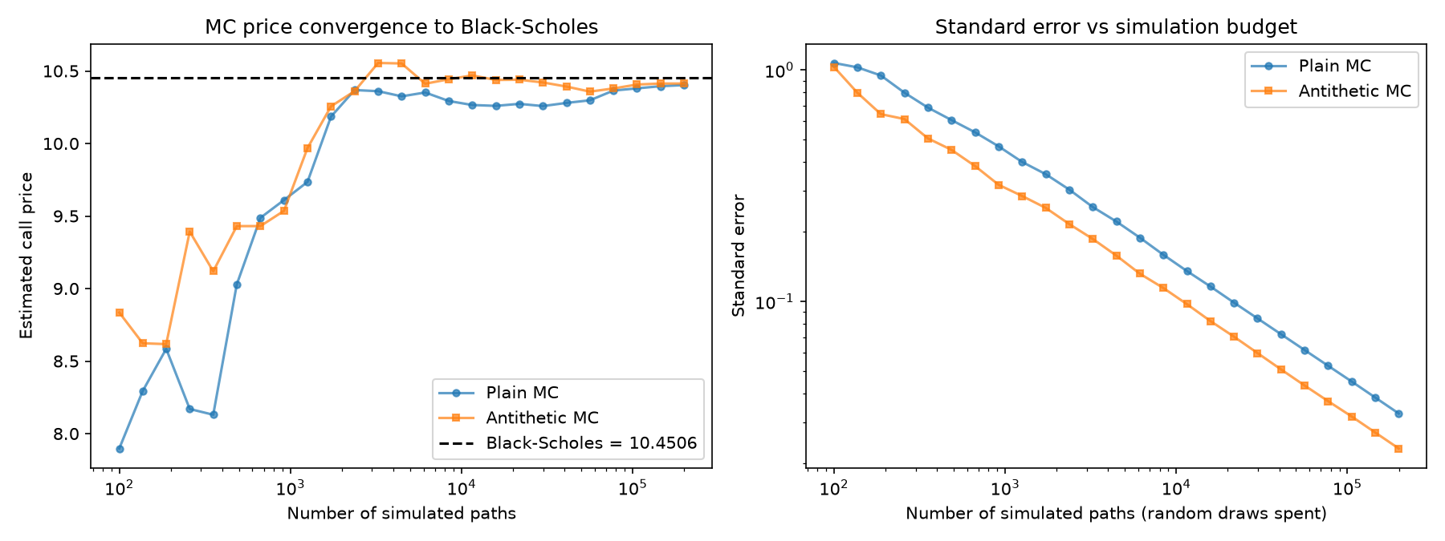
Steps 1–2: Foundation & Simulation
Black-Scholes closed-form pricer
Verified via put-call parity — exact match.
Monte Carlo under GBM
Simulate thousands of random price paths, average the discounted payoff — converges to Black-Scholes as path count grows.
Antithetic variates (variance reduction)
Mirror every random path with its negation and average the pair — cancels out simulation noise.
MC price converges to the Black-Scholes benchmark; antithetic variates shrink the standard-error band faster, for the same simulation budget.
~28% lower standard error
same number of random draws spent

Slide 5
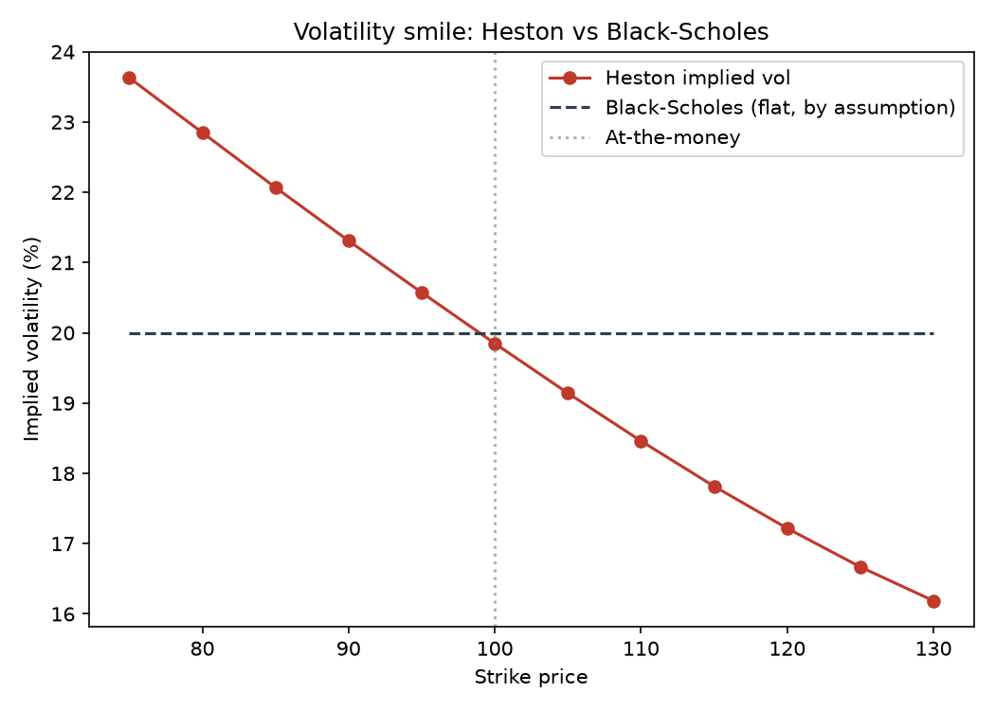
Step 3: Realism — The Heston Model
Volatility itself becomes random
dv = κ(θ − v)dt + ξ√v·dW₂, correlated with the stock's own shocks via ρ.
Correctness check: collapses to Black-Scholes
Setting vol-of-vol ξ=0 reproduces the Black-Scholes price within 3 standard errors.
Produces a genuine volatility skew
With realistic equity parameters (ρ = −0.7), implied vol runs from 23.6% to 16.2% across strikes 75–130 — something Black-Scholes cannot do by construction.
Implied volatility backed out of Heston prices, vs. the flat line Black-Scholes is structurally forced to produce.

Slide 6
Step 5a: The Slow Way — Baseline Calibration
Calibration is the reverse problem: given a surface of market prices, find the Heston parameters that produced them. The traditional approach re-runs the simulator inside a numerical optimizer, strike by strike, iteration by iteration.
WHY THIS MATTERS
A single calibrated number quietly hides this ambiguity. That's exactly the gap our project is built to close — report a confidence range, not a false sense of certainty.
~2s
~55
per single calibration
Monte Carlo re-simulations needed
A finding worth reporting, not hiding:
Recovered parameters don't exactly match the true ones, even though fitted prices are close. This is Heston's well-documented parameter non-identifiability — different parameter sets can explain the same market prices almost equally well.
This directly motivates Steps 5b–6: an ML calibrator that is both fast and upfront about what it doesn't know.

Slide 7
Steps 4–6: Faster, and Honest About Uncertainty
1
2
3
4
Generate data
→
Train the model
→
Read the ensemble
→
Carry it to price
6,000 random parameter sets, priced across 7 strikes
Random Forest: price surface → parameters
Each of 200 trees votes — spread = confidence range
Parameter range → final option price range
~8 ms
~250x
90%
ML calibration time
faster than the baseline optimizer
confidence range on every parameter
The final deliverable, in the field's own words:
“Fair price ≈ ₹10.40, likely between ₹8.89 and ₹11.88.”

Slide 8
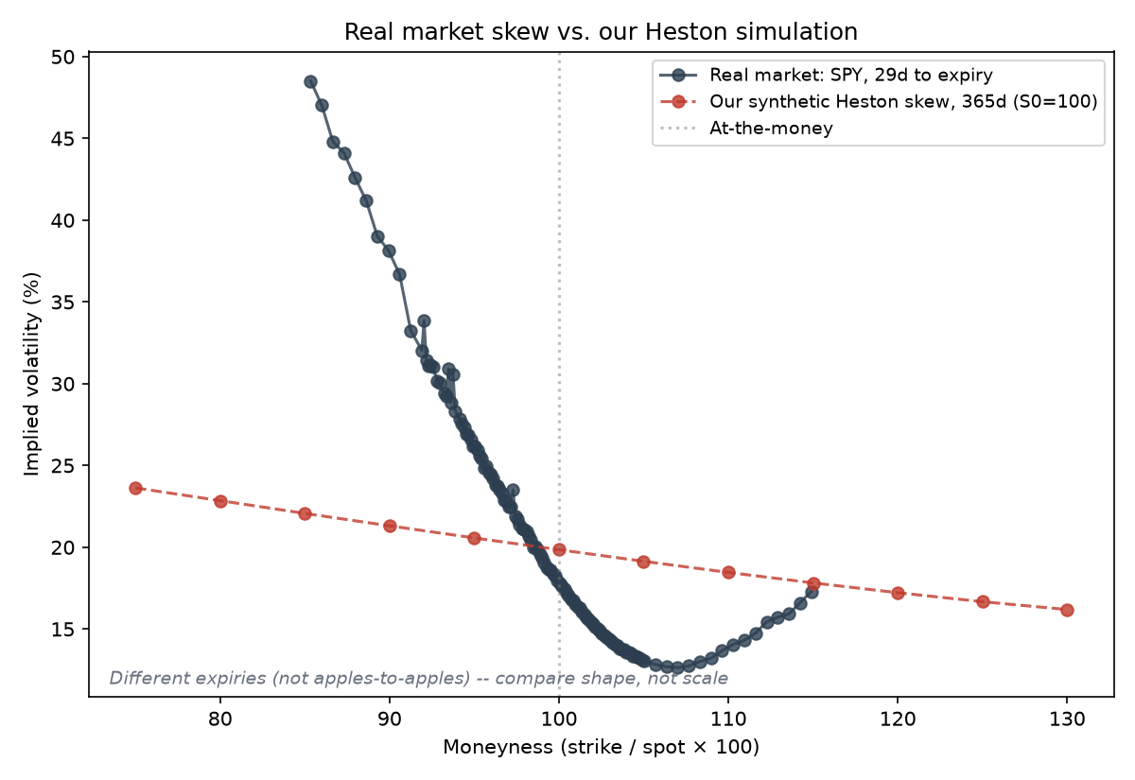
Step 7, Started: Real Market Data
The real market shows the same skew direction
Negative slope, confirmed: implied vol runs from ~49% down to ~13% near the money — real markets are structurally non-flat, exactly as predicted.
Honest caveat: not apples-to-apples (yet)
This real chain is ~29 days to expiry vs. 1 year for our synthetic example — short-dated skews run naturally steeper. Compare shape, not scale.
Also attempted: NSE India (NIFTY)
Blocked by NSE's bot detection — a known, documented limitation, not hidden. yfinance/SPY is the reliable path we kept.
Live SPY options chain (yfinance), ~30 days to expiry, 123 liquid strikes — pulled minutes before this slide was built.

Slide 9
What's Left to Finish Step 7
FROM SHAPE-MATCHING TO TRUE CALIBRATION
EVERYTHING IS REPRODUCIBLE
Feed the live SPY chain into calibration.py / ml_calibration.py directly
Recover the Heston parameters that actually fit today's market, not just compare shapes
Check that our confidence ranges actually contain the true market-consistent prices
Compare ML calibrator vs. baseline optimizer on real, noisier data
All code for Steps 1–6 is written, tested, and documented — open to inspection, not just described in slides.
github.com/pastbologanesh0101/
option-pricing-heston
7 Python modules
Full progress write-up (PROGRESS.md)
6,000-row training dataset included

Slide 10
Thank You
Questions welcome — code, data, and results are all open for review.
github.com/pastbologanesh0101/option-pricing-heston

