Slide 1
Govhack Unleashed!
Protecting Australian
Endangered Mammal Species
From the impact of Disaster
A Data Journalism Feat
By Team Disaster Area

Slide 2

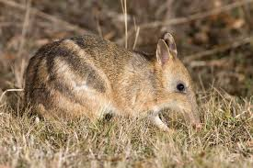
Australia has 286 endangered Mammal Species

Slide 3
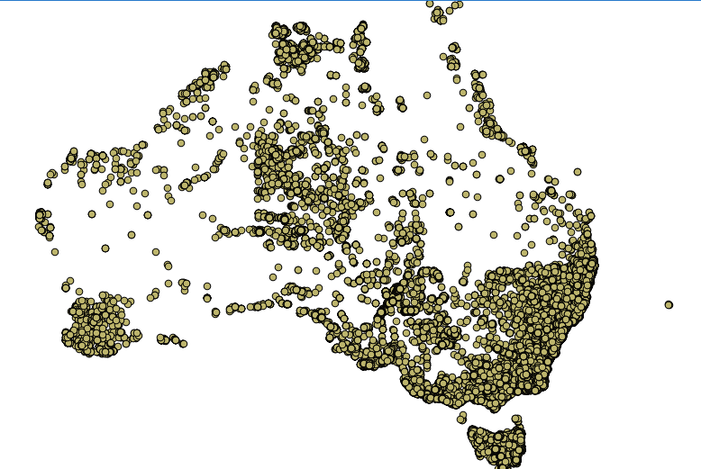
Of these 286 endangered Mammals Species, there have been only approx. 600 sightings per animal over the last 30 years.*
*Based on an average per animal.

Slide 4
Also over the last 30 years there has been many disasters in Australia.

Slide 5
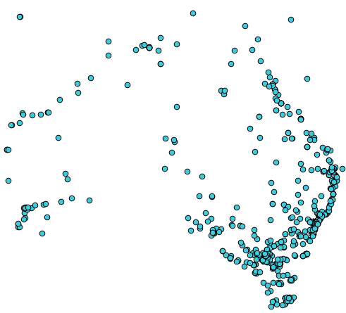

Slide 6
Where there is a concentrate of disasters, there is also a concentrate of Endangered Mammals.

Slide 7
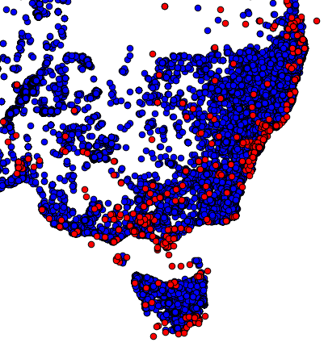

Slide 8
Using this data, the Australian Government can focus their funding for protecting Endangered Species where they are most at risk from Disaster.

Slide 9
You have been watching a presentation by Disaster Area!

Slide 10
Zachary McDonnell: Design, Data Exploration, Video Voice and Editing, Presentation and Page Maker.
Ryan Leach: Lots of Data Exploration, Hard work on our previous attempt.
Tamsyn: Hard work on our previous attempt, Data Exploration.
Andrew McDonnell: Technical Support and Video Director.

