Slide 1




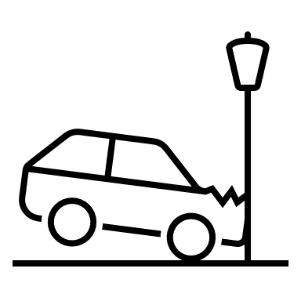
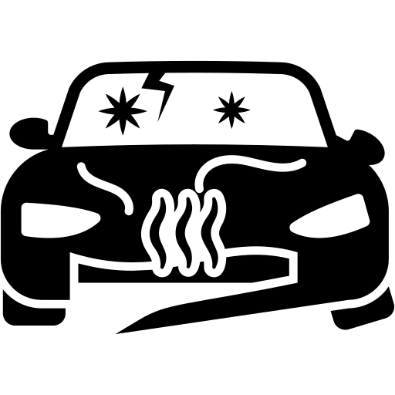






Vehicle Registration
Is related to
Is subject to
Vehicle Repair
Land Vehicle
Vehicle Specification
Is involved in
Assessment Result
Is assessed in
Is manufactured from
Is insured by
Involves
Loss Event
Is originated by
Loss Occurrence
Initiates
Claim
Is affected to
Policy
Is based on
Insurance Product Specification
Includes
Includes
Describes
Loss Notification
Party Role in Claim
Claim declarer
Witness
Third party driver
Claim handler
Claim expert
Service provider (ex. Body shop)
…
Party Role in Policy
Policy holder
Insured
Driver
…
Party
Plays
Plays
Person
Organization

Slide 2
Agreement
Person
Customer
Agreement
Claim
Person
Activity
Event
…
Data Processing Activity
Point In Time
Agreement
Data Quality Rule
Data Element
Claim
FNOL

