Slide 1
Client Website Redesign
By Tom Kent

Slide 2
Introduction
I was tasked with redesigning the client’s (SHIFT Media) website.
I took inspiration from the current website’s file structure and recreated the file structure and incorporated it into the new design.
I compiled a list of pros and cons from the current website to help get a better understanding of what to include and what not to include with my redesign.

Slide 3
Current website design
Pros
There is pictures of students doing projects.
The client has their logo front and center.
The client has their social media outlets listed on all of their pages.
The client have a good amount of information on the page about the client and other internal projects.
The website is bright and colourful which attracts people’s attention.
Cons
It doesn’t look like a website used by an education establishment.
The majority (2/3) of download links are broken.
There is a duplicate of the index page.
The way that the client has represented Ofsted looks unprofessional.
There is not enough information about the courses that the client provides on the website itself, however there is a file on the server that can be gained if a person is interested.

Slide 4
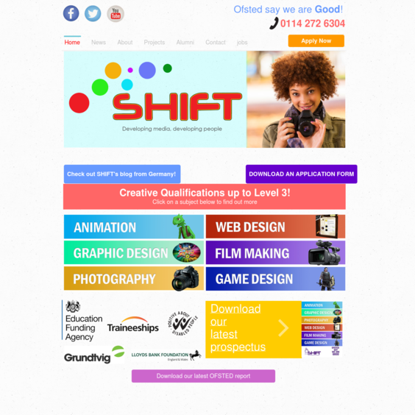

Slide 5
Changes that the new website will bring
The new website will be adding new webpages on top of what is currently active to help both parents and students who are with the client.
These new features include a calendar & slideshow of pictures to name a few of the new planned features.
The website will also be removing some of the old features like the replacing the dependancy on Google Maps Services (Changing GMS with OpenStreetMap) and removing the captcha on the Contact page.

Slide 6
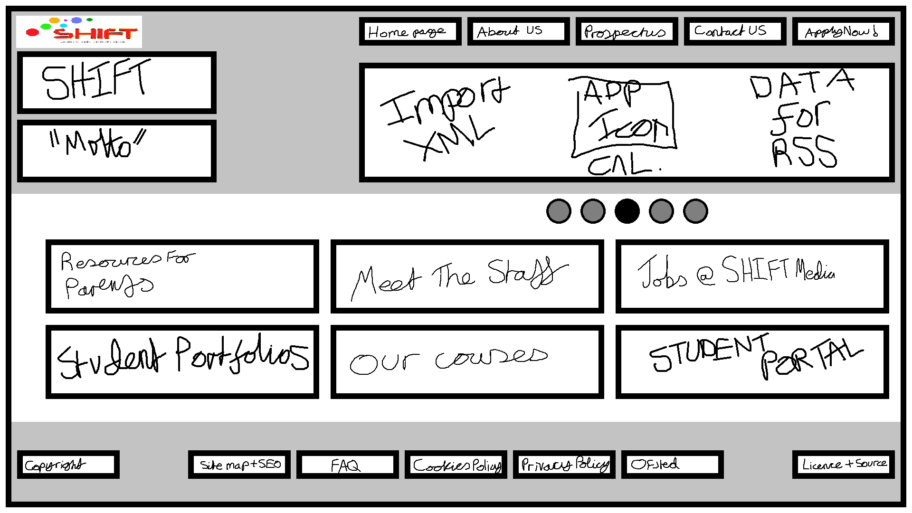

Slide 7

Alternative Layouts
The following layouts are rough drafts that didn’t get past the redesign 1st hurdle.
However, I will be showing you these designs to allow you as the client to pick and choose which layout would be the best pick for your company’s image and character.

Slide 8
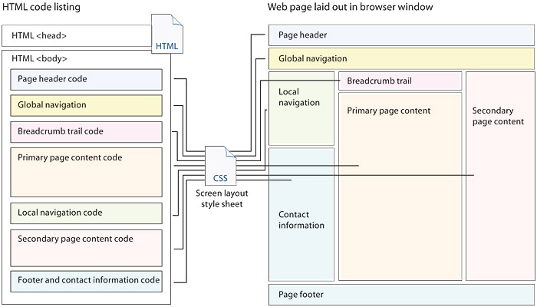

Slide 9
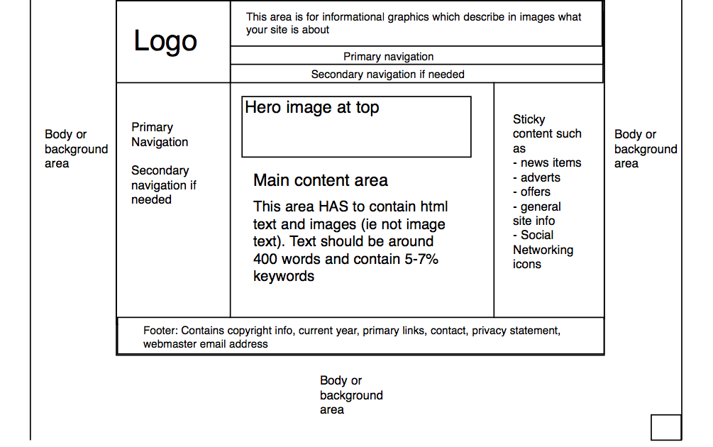

Slide 10
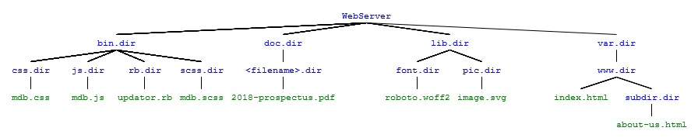
The file structure is needed to ensure that files don’t become mismatched.
The file structure would stay the same regardless of what kind of theme is used.

Slide 11
Conclusion
In conclusion, I feel that I have made relevant changes on the website’s design, enough for it to be redesigned but still retaining a slight structure from the previous website.
I feel that the first design that I pitched is more accessible to end users and will bring in the audience desired.
Thank you for your time, any questions?

