Slide 1
LMY Home Exercise
Summary
Inga Paster
20/07/2025

Slide 2
Task 2:
Explore and explain existing methods for fusing DSM with RGB imagery to improve building detection

Slide 3
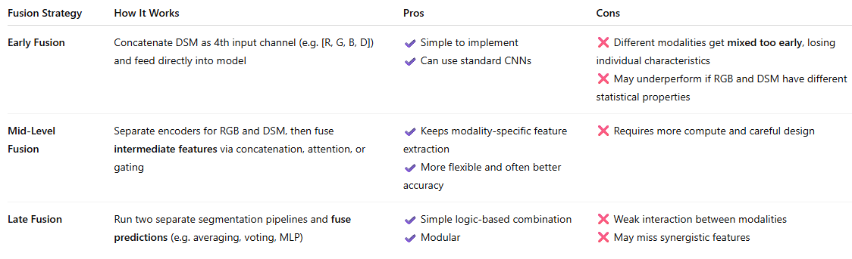
Fusion Levels Comparison
Mid-level fusion models balance modality-specific feature learning with strong cross-modal interaction, leading to better accuracy and flexibility than early or late fusion.
Let's go with Mid-Level Fusion

Slide 4
Summary of 3 Models
Model's Name | GitHub | Article | Year | Source | Fusion
Dformer | https://github.com/VCIP-RGBD/Dformer | https://arxiv.org/pdf/2309.09668 | 2024 | CVPR | Mid
HDBFormer | https://github.com/Weishuobin/HDBFormer?tab=readme-ov-file | https://arxiv.org/abs/2504.13579 | 2024 | IEEE Signal Processing Letters | Mid
CEN | https://github.com/yikaiw/CEN | https://arxiv.org/abs/2011.05005 | 2020 | NeurIPS | Mid
CEN looks like old for SOTA model
See the details of each of 3 models in the “Details” section of the presentation

Slide 5
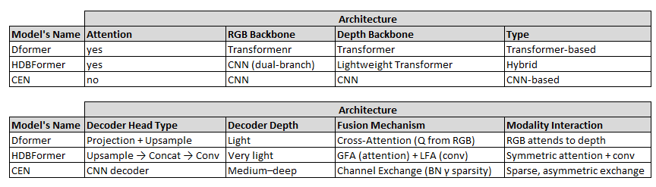
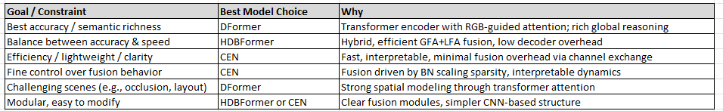
Summary of 3 Models

Slide 6
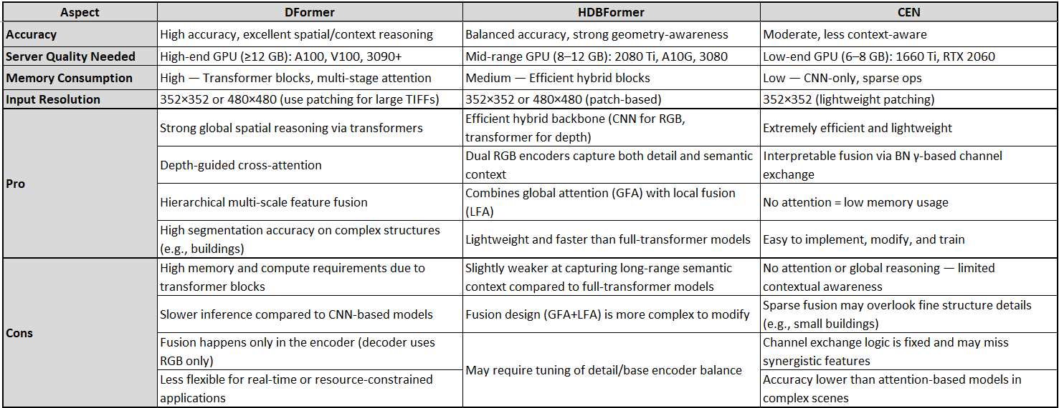
Summary of 3 Models

Slide 7
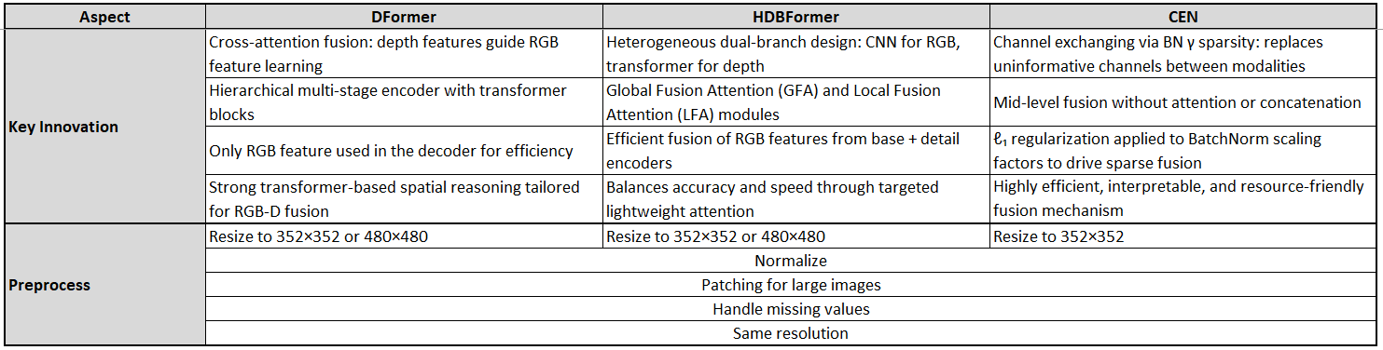
Summary of 3 Models

Slide 8
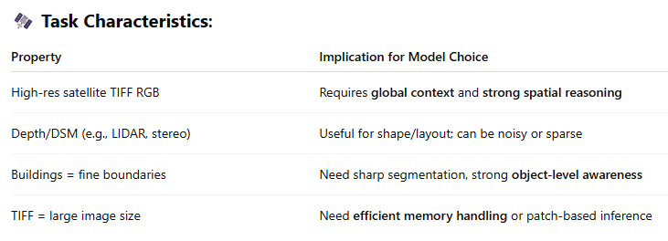
Recommendation for building semantic segmentation using satellite TIFF images + depth

Slide 9
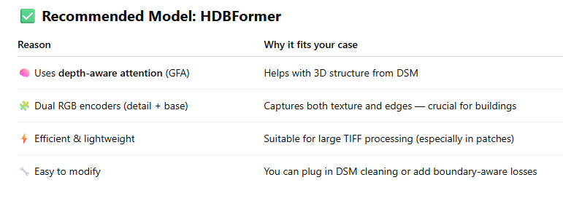
Recommendation for building semantic segmentation using satellite TIFF images + depth

Slide 10
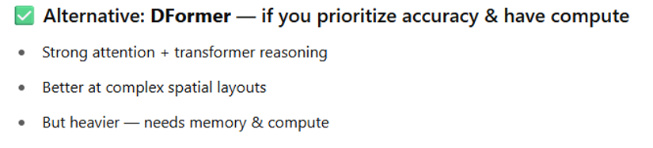
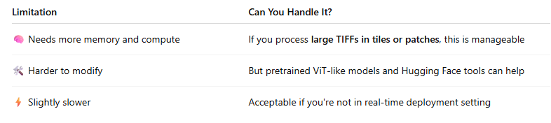
Recommendation for building semantic segmentation using satellite TIFF images + depth

Slide 11
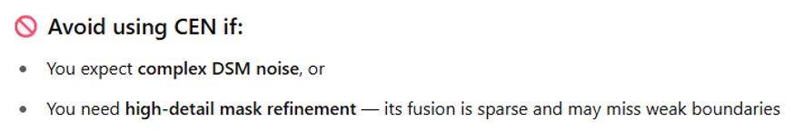
Recommendation for building semantic segmentation using satellite TIFF images + depth

Slide 12
Additional Models
Name | Fusion | Open-Source Link
CMX | Late | https://github.com/huaaaliu/RGBX_Semantic_Segmentation
DPLNet | Late | https://github.com/ShaohuaDong2021/DPLNet
Omnivore | Unified Fusion (implicit) | https://github.com/facebookresearch/omnivore/
AsymFormer | Hybrid mid-late | https://github.com/Fourier7754/AsymFormer/
MultiMAE | Mid-implicit | https://github.com/EPFL-VILAB/MultiMAE/
ACNet | Mid | https://github.com/anheidelonghu/ACNet
SGNet | Mid-level fusion via depth-guided convolution | https://github.com/LinZhuoChen/SGNet
SA-Gate | Mid-level fusion via gated feature recalibration between RGB and HHA (depth) streams | https://github.com/charlesCXK/RGBD_Semantic_Segmentation_PyTorch
ShapeConv | Mid | https://github.com/hanchaoleng/ShapeConv
ESANet | Mid | https://github.com/TUI-NICR/ESANet
EMSANe | Mid | https://github.com/TUI-NICR/EMSANet
TokenFusion | Mid (implicit) | https://github.com/yikaiw/TokenFusion

Slide 13
Details

Slide 14
Dformer
Depth-guided Transformer

Slide 15
Dformer - Source
Mid-level – RGB-D blocks fuse features during backbone encoding
GitHub repo: https://github.com/VCIP-RGBD/Dformer
Article: https://arxiv.org/pdf/2309.09668, 2024, CVPR

Slide 16
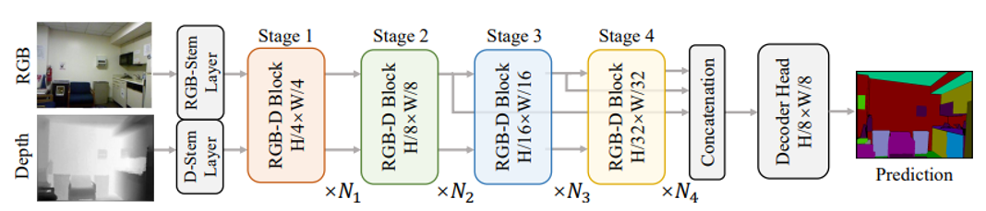
Dformer – Architecture - Diagram
Four fusion stages
Transformer Backbone
Head
In depth frame:
Dark pixels = closer objects (low depth values)
Bright pixels = farther objects (high depth values)

Slide 17
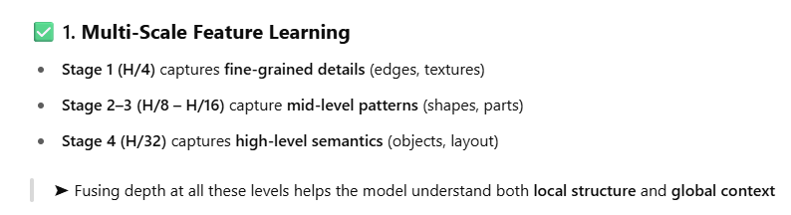
Dformer – Four Stages Fusion - Diagram

Slide 18
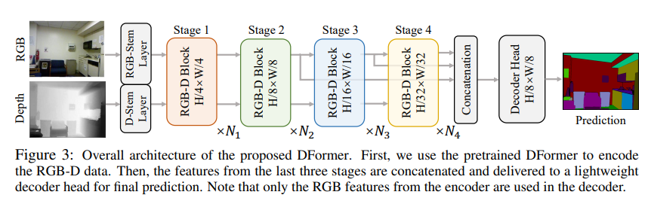
Dformer – Architecture - Stem
Stem Layers:
RGB-Stem Layer: Processes the RGB image to extract low-level features.
D-Stem Layer: Processes the Depth image to extract complementary depth features.
These stem layers are typically convolutional and serve as the initial embedding layers.

Slide 19
Dformer – Architecture - Stages
Stage 1 to Stage 4: RGB-D Blocks
Each stage has an RGB-D Block which performs joint feature fusion of RGB and Depth:
Stage 1: Resolution: H/4 × W/4
Stage 2: Resolution: H/8 × W/8
Stage 3: Resolution: H/16 × W/16
Stage 4: Resolution: H/32 × W/32
The blocks are repeated N1, N2, N3, N4 times respectively at each stage.
These blocks integrate both RGB and Depth modalities at different resolutions.

Slide 20
Dformer – Architecture – Stage 1
Input to Stage 1:
From RGB Stage 1 output
From Depth Stage 1 output

Slide 21
Dformer – Architecture – Stage 3
Input to Stage 3:
RGB output from Stage 2 (main stream) +
RGB intermediate feature from earlier block (e.g., residual) +
Depth output from Stage 2

Slide 22
Dformer – Architecture – Stage 4
Input to Stage 4:
RGB output from Stage 3
Depth output from Stage 3
RGB feature from earlier RGB branch (likely Stage 2 or 1)
Another RGB feature from an even earlier point (likely Stage 1 or stem)

Slide 23
Dformer – Architecture - Concatenation
Input to Concatination:
Stage 2 RGB output (H/8)
Stage 3 RGB output (upsampled to H/8)
Stage 4 RGB output (upsampled to H/8)

Slide 24
Dformer - Architecture - Concatenation
Feature Concatenation
After all stages, features from the last three stages (Stages 2, 3, and 4) are concatenated.
This concatenation combines multi-scale contextual features, which helps in dense prediction tasks like segmentation.

Slide 25
Dformer – Architecture - Head
Decoder Head
Takes only RGB features from the encoder (The RGB features after they have been enhanced by depth fusion are kept).
The decoder receives only these depth-aware RGB features (not separate or raw depth features).
The depth branch is dropped after Stage 4.
Produces the final semantic segmentation map at a resolution of H/8 × W/8.

Slide 26
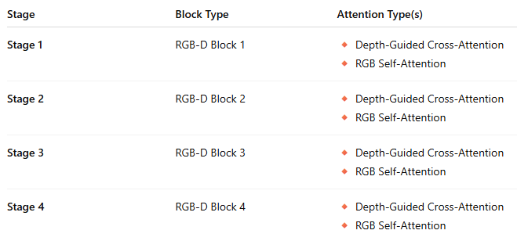
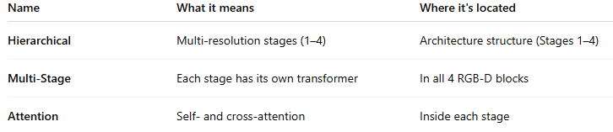
Dformer - Attentions
Hierarchical Multi-Stage Attention mechanism:
Depth-Guided Cross-Attention (in RGB-D Blocks)
Self-Attention (within RGB branch)

Slide 27
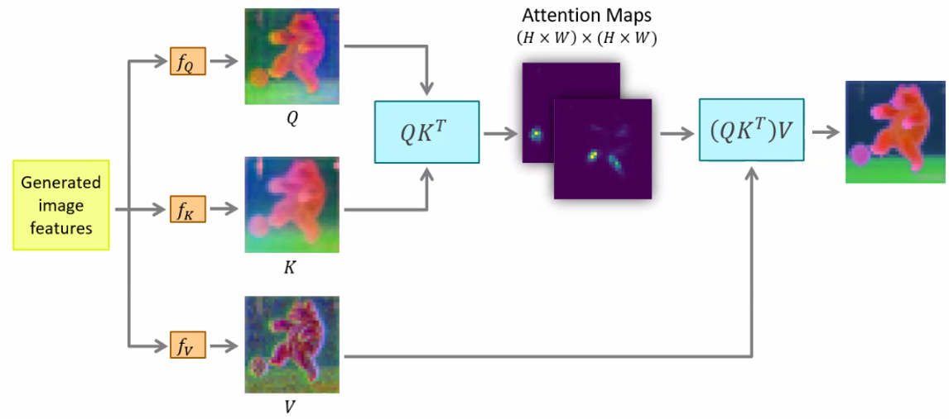
Dformer – Fusion Stages 1-4
After Stage 1, the RGB features are no longer “pure” RGB — they are depth-guided via attention (Depth used as Key/Value). RGB features modified by Depth via attention.
However, depth features themselves remain separate and are not altered by RGB. Depth not modified by RGB.
RGB
RGB updated
depth
depth

Slide 28
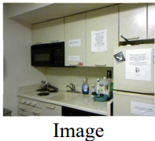
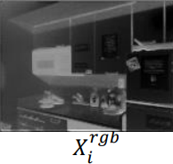
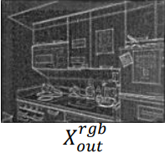



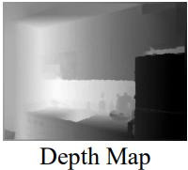
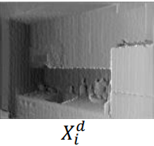
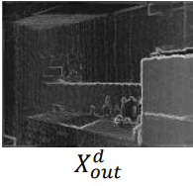
Dformer – Fusion Stages 1-4
Depth features are updated per stage but remain in a separate stream.
They guide RGB via cross-attention but are not mixed with RGB.

Slide 29
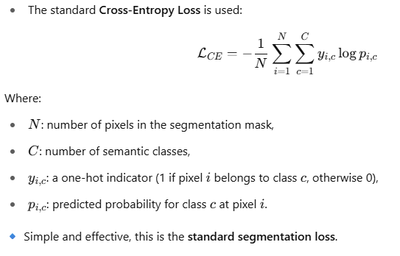
Dformer - Loss

Slide 30
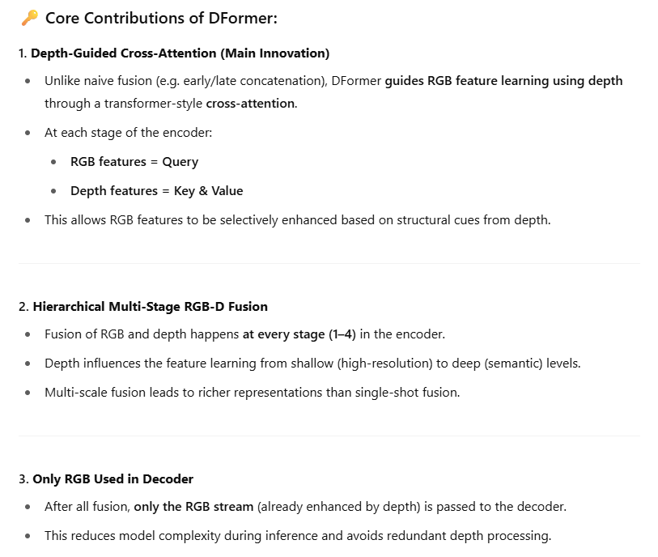
Dformer - Key Innovation
DFormer's key innovation is the introduction of depth-guided cross-attention blocks at multiple encoder stages, enabling effective and efficient RGB-D feature fusion for semantic segmentation.

Slide 31
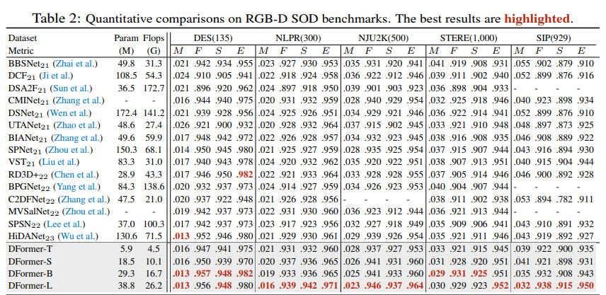
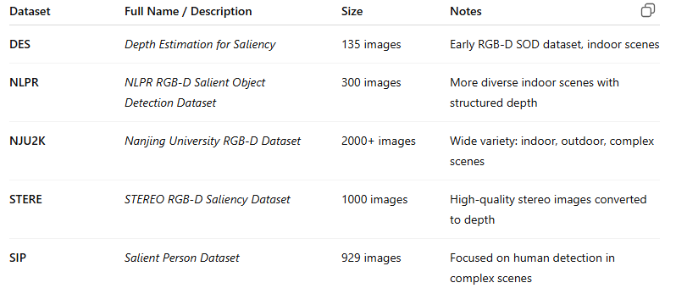
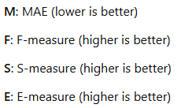
Dformer - Performance

Slide 32
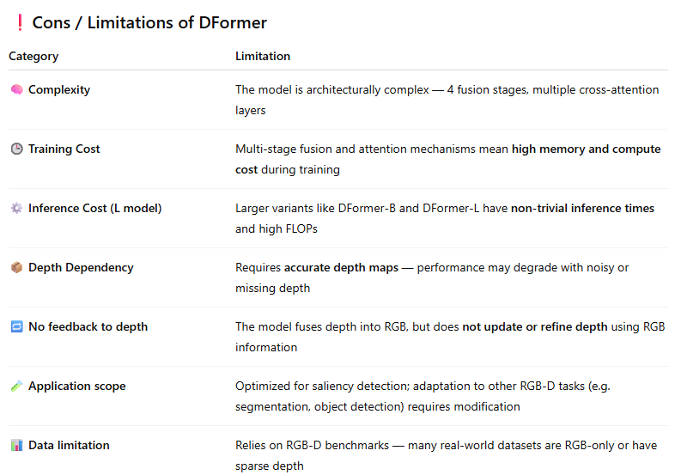
Dformer - Cons

Slide 33
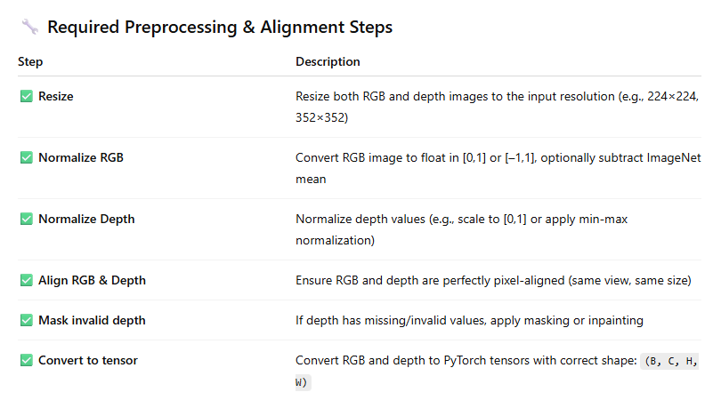
Dformer -
Preprocessing/alignment techniques

Slide 34
HDBFormer
Heterogeneous Dual-Branch Framework

Slide 35
HDBFormer - Source
Mid-level – two separate encoders (RGB and depth) fused via Modality Information Interaction Module.
GitHub repo: https://github.com/Weishuobin/HDBFormer?tab=readme-ov-file
Article: https://arxiv.org/abs/2504.13579, 2024, IEEE Signal Processing Letters

Slide 36
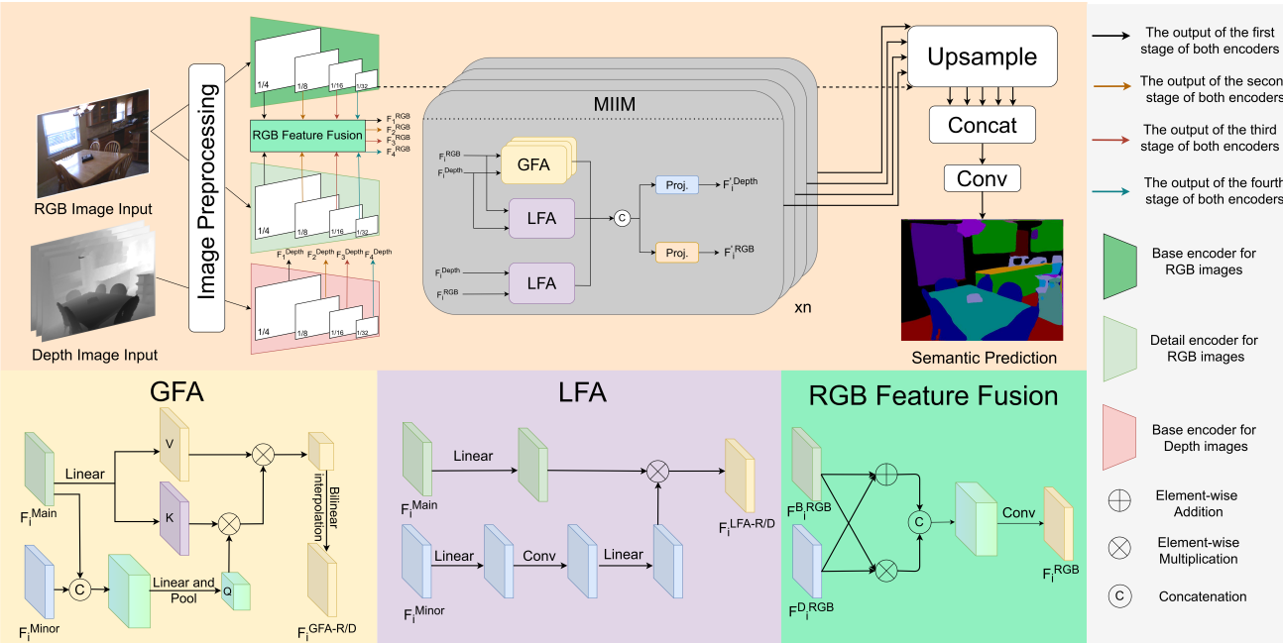
HDBFormer – Architecture - Diagram

Slide 37
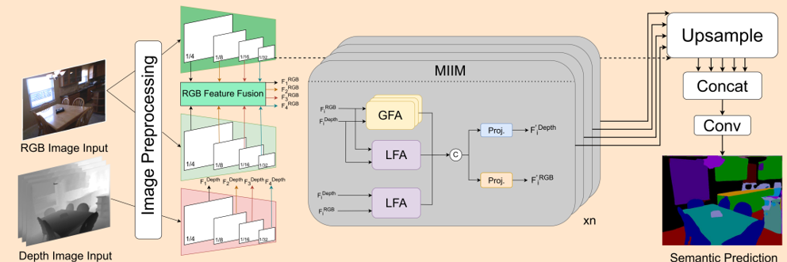
HDBFormer – Architecture - Diagram
Head
Hybrid (heterogeneous) Backbone

Slide 38
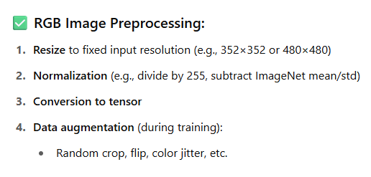
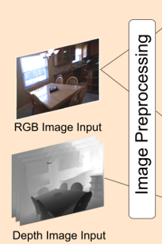
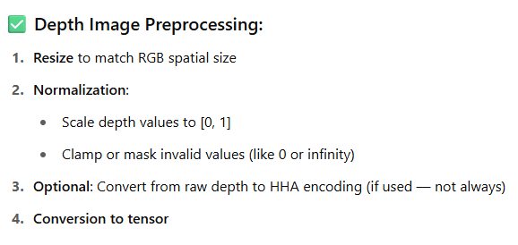
HDBFormer – Architecture - Preprocessing

Slide 39
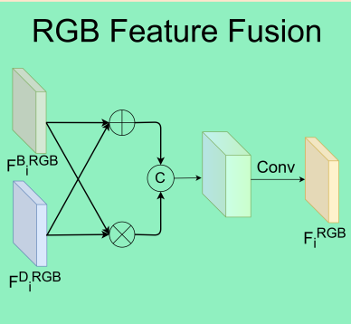
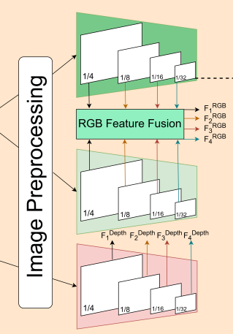
HDBFormer – Architecture - Encoding
Base encoder (CNN-based)
Captures high-level semantic features (context)
Element-wise addition, element-wise multiplication, concatenation, and a final convolution => produces strong, edge-aware RGB features
Detail encoder (Lightweight CNN)
Captures low-level spatial/detail features (edges, textures)
Base encoder (Lightweight Transformer)
Depth maps inherently capture object boundaries, edges, and geometry - so a separate "detail encoder" like RGB doesn’t add much.
Transformer for depth because depth requires global geometric understanding, which Transformers capture better than CNN

Slide 40
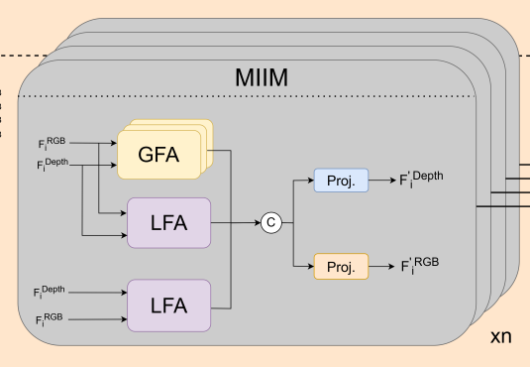
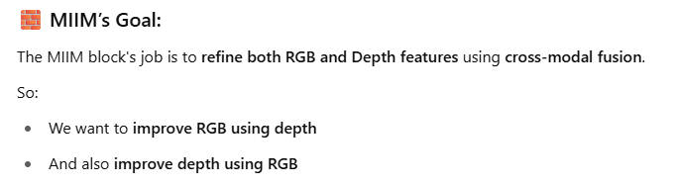
HDBFormer – Architecture - MIIM
MIIM (Modality Interaction and Integration Module)

Slide 41
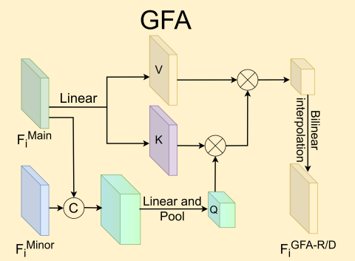
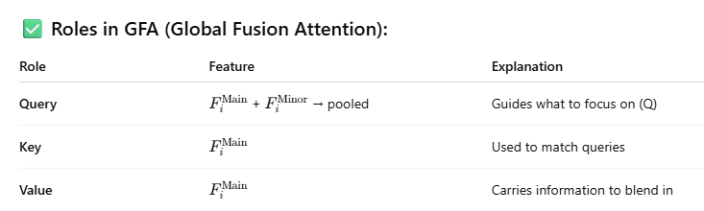
HDBFormer – Architecture - GFA
GFA (Global Fusion Attention)
Input:
RGB Feature Fusion (Main)
Depth Features (Minor)
Cross attention fusion
RGB
Depth
MIIM (Modality Interaction and Integration Module)

Slide 42
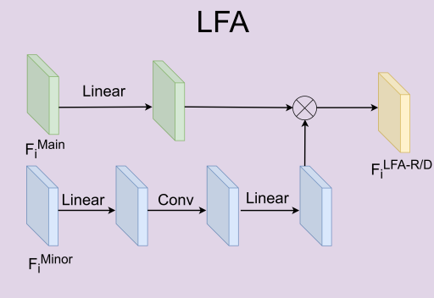
HDBFormer – Architecture - LFA
LFA (Local Fusion Attention)
LFA is designed to fuse local spatial information between RGB and Depth in a lightweight, convolution-based way.
LFA doesn’t use self-attention or cross-attention like in Transformers, it mimics an attention-like filtering mechanism by:
Computing an importance map from the minor modality (depth or RGB)
Modulating the main modality features using element-wise multiplication (like an attention mask)
It’s called Local Fusion Attention because it modulates the main feature map using spatially-aware cues from the minor modality, similar to how attention emphasizes relevant features — but implemented through convolution and element-wise gating, not true self-attention.
MIIM (Modality Interaction and Integration Module)

Slide 43
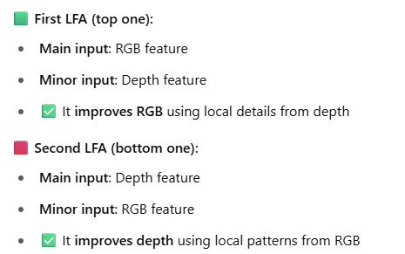
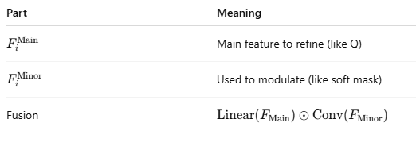
HDBFormer – Architecture - LFA
MIIM (Modality Interaction and Integration Module)

Slide 44
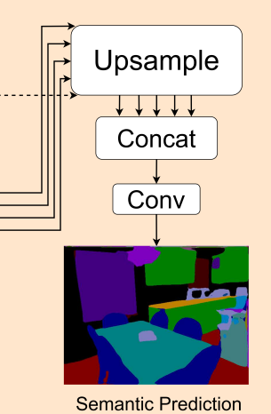
HDBFormer – Architecture - Head
HDBFormer doesn’t use a full decoder.
Instead, it uses upsampling + concatenation + 1 conv layer because the MIIM blocks already fuse and refine features effectively.
This keeps the model lightweight, fast, and accurate, making a separate decoder unnecessary.

Slide 45
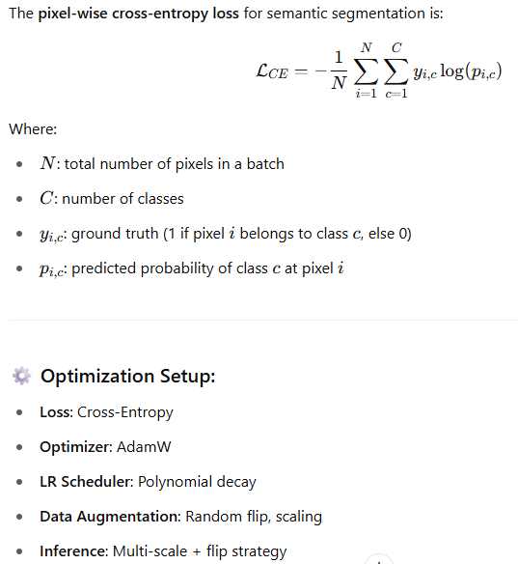
HDBFormer - Loss

Slide 46
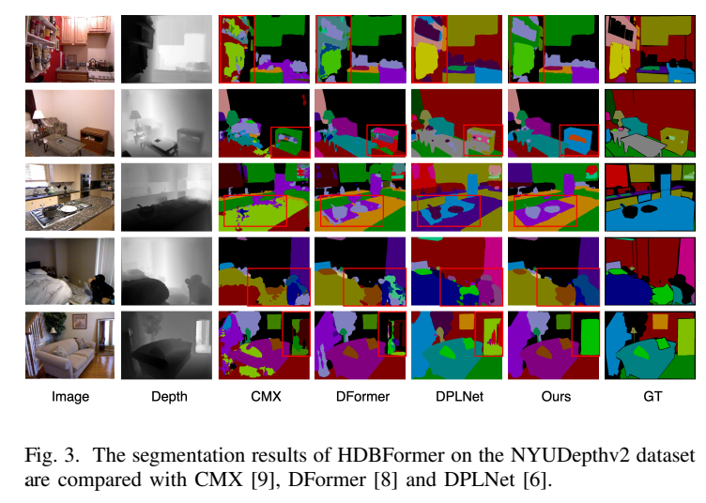
HDBFormer - Performance

Slide 47
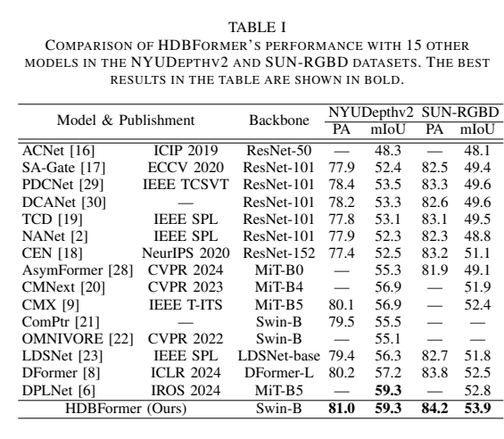


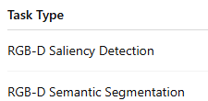
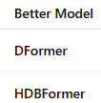
HDBFormer - Performance

Slide 48
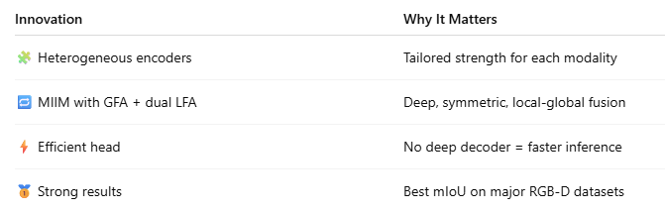
HDBFormer - Key Innovation

Slide 49

HDBFormer - Cons

Slide 50

HDBFormer - Preprocessing/alignment techniques

Slide 51
CEN
Heterogeneous Dual-Branch Framework

Slide 52
CEN - Source
Mid-Level Fusion with Interleaved Channel Exchange
GitHub repo: https://github.com/yikaiw/CEN
Article: https://arxiv.org/abs/2011.05005, 2020, NeurIPS

Slide 53

CEN – Architecture – Mid-level Fusion
Block inside Backbone

Slide 54



CEN – Architecture – Mid-level Fusion
The sparsity constraint in CEN is an ℓ₁ penalty on BatchNorm γ values.
It encourages certain feature channels to become inactive (γ ≈ 0), allowing those channels to be exchanged with more informative ones from the other modality.
Batch Normalization

Slide 55


CEN – Architecture – Mid-level Fusion

Slide 56

CEN - Loss
The total loss in CEN is a combination of the task loss (e.g., cross-entropy for segmentation) and an ℓ₁ regularization term applied to selected BatchNorm scaling factors. This promotes sparsity and enables dynamic channel exchange between modalities during training.

Slide 57

CEN - Loss

Slide 58

CEN - Performance

Slide 59

CEN - Key Innovation

Slide 60

CEN - Cons

Slide 61

CEN - Preprocessing/alignment techniques

