Slide 1
introducing
Drupal Development
What is it, and why?

Slide 2









Course Overview
What are we learning?
How will we learn it?
How will this benefit me?

Slide 3

What are we learning?
“Drupal is an open source content management platform powering millions of websites and applications. It’s built, used, and supported by an active and diverse community of people around the world.”
World’s busiest sites run on Drupal
Drupal is enterprise-ready for the world’s busiest websites. Drupal will scale with your business and your brands for your next-generation digital transformation and allow you to evolve down the road without skipping a beat.
weather.com | nbc.com | harvard | the white house | tesla | grammy.com | aljazeera…
Notes:
80% Research, 20% Programming
“Drupal is an open source content management platform powering millions of websites and applications. It’s built, used, and supported by an active and diverse community of people around the world.”
World’s busiest sites run on Drupal
Drupal is enterprise-ready for the world’s busiest websites like GRAMMY.com and The Olympics where failure is not an option. Drupal will scale with your business and your brands for your next-generation digital transformation and allow you to evolve down the road without skipping a beat.

Slide 4


How will we become Drupal Developers?
80% Research, 20% Programming
Learn the basics of programming
Best practices
Be part of a well-run dev team
Portfolio over credentials = build real-life projects
Contribute to Drupal Core
Notes:
If you are doing it right, Drupal is 80% research, 20% programming. Within a week or two, you will already be able to build most of the large websites. Without the last 20%, you will not be able to make small changes that make a big difference
Basics:
HTML, CSS, PHP. These are the basics. 80% of the training will be to develop your skills to be used in 20% of your work. Your level of knowledge here is what will set your salary and abilities.
Best practices:
Version control. Online viewable history. Code reviews. Best code practices. Updates in code. Software is an invisible product, many software projects fail. We will take the steps enterprise level teams use to have successful projects.
Dev team:
We will be following Agile methodologies. Same as enterprise software teams. Morning meeting, blockers/aftermeetings, lane owners, code review, evolving scope
Real-life projects:
#1) I believe that, within reason, school work should not be thrown away. We are spending our time, and our time is valuable – therefore we will work on real websites, and our code will remain on publically visible projects. A necessary component of
Contribute to drupal core:
80% of the time we will be using code that others have written for us. We are going to fix bugs in drupal core and contribute them back to the community. This will be a permanent plus on your record in the drupal community, and will give you credibility at job interviews. Also, core bugs are unsolved – it gives us problems that we will have to figure out and solve on our own.

Slide 5
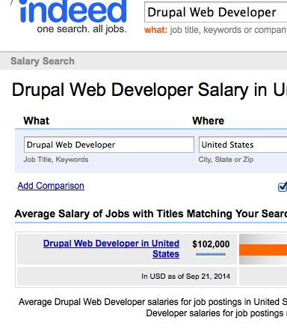
How will this benefit you?
Drupal’s downside is a Drupal dev’s upside
Drupal devs are in-demand
Non-dev Drupal roles also in-demand
‘Drupal Web Developer’ makes $102,000, on average (indeed.com)
Great freelance opportunities
Without guidance, steep learning curve

Slide 6

This class is the start of Debug Society, an effort to address issues with higher education first-hand.
Characteristics of Debug Society:
Nimble company with Agile curriculum
Affordable entry to lucrative careers
Assignments with a purpose
GPA = good at school. We grade for how ‘good at work’ you are
Opportunity to ‘do good’
Why does this class exist?

Slide 7


Experience
Ashraf Abed
571-215-0563
ashrafabed@gmail.com
Ashrafabed.com
Debugsociety.com
Senior Drupal Developer, Acquia Inc.
Acquia Certified Developer
Senior Drupal Developer
Acquia Inc. (2014)
Senior Software Engineer
Carr Systems (2012 – 2014)
Cyber Software Engineer
Northrop Grumman (2011)
Web Developer
Depthskins Design Studio (2009)
Freelance Web Developer
Self-employed (2003 – 2009)
Education:
M.S. Software Engineering
- GMU (2014 – TBD)
B.S. Electrical Engineering
- UMD (2007-2011)

Slide 8
Our curriculum is considered ‘Agile’. It is planned 2-3 weeks in advance, and adjusted as needed.
- General set up
- Git Github.com StackOverflow.com Acquia Dev Desktop DebugSociety.com
- Version control,Terminal/Command line/Editors
- Git, Vim/Nano/PHPStorm/Notepad++
- Agile, Kanban
- Project management, ’Crisis’ management, Disclosure,Waterfall,Deliverables
- HTML
- Primary tags (a href, #link, div, table, ul, li, span, 'style', )SEO-friendly templates
- CSS
- Common tags: float, display, position, Selector priority Fixed, fluid, responsive
- Responsive design: em, %, min-width, max-width Mobile-first SASS
- Drupal
- Templates Core Content Drupal.org Views Panels Panels Panes Mini panels View panes
- Features Site version control DB API Form API Hooks Security
- PHP
- Functional Easy to read Easy to modify Forms Efficient
- Object Oriented
- Your choice (MySQL (Imports{kanban,tickets},Queries) / Javascript / jQuery)
- Community integration (‘field trip’)
- Caching,Aggregation (Optimization)
- In-Drupal {Views Blocks Page Panels Panes}
- Out of Drupal {APC Memcache Varnish}
- Automated Testing
- Apache solr
Curriculum

Slide 9
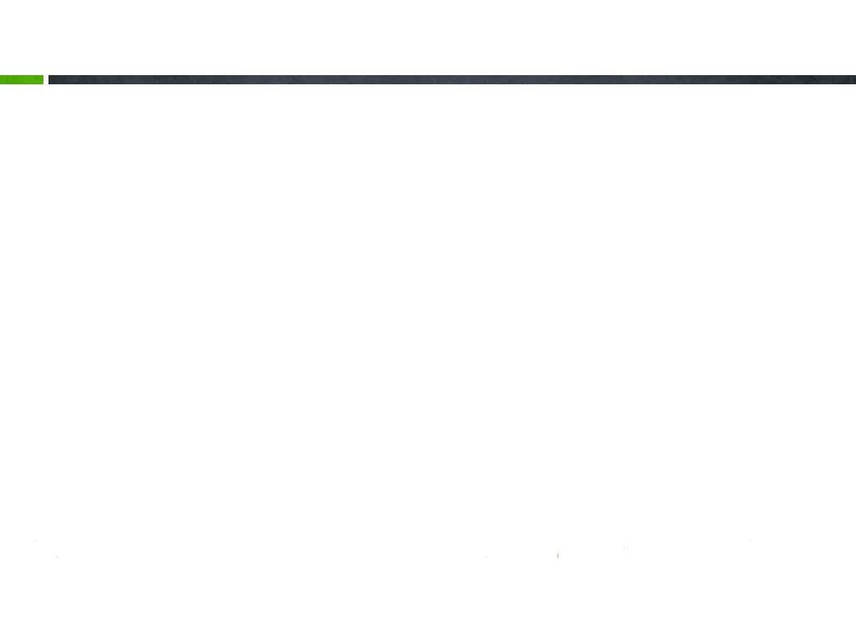
Day 1
Create account at Drupal.org
Create account at Github.com
Create account at StackOverflow.com
Download & install Acquia dev desktop or Vagrant
Get Git, set up our first website
Join ‘Slack’, our searchable chatroom
Use these tools + more on your homework
Windows: Download Notepad++
  And stop using windows.. You’re developers now.
Mac: Download SublimeText 2

