Slide 1
Development Tasks
Building a popular website
Notes:
This template can be used as a starter file for a photo album.

Slide 2
Review
Agile, Kanban: ‘unblock’ team daily, small task sizes, pick your task
HTML: Foundation / structure behind a page’s elements
CSS: Layout (position + style) of the page’s elements
Responsive Design: One flexible layout for many devices
Mobile-first: Design mobile site first, then add full-site elements
You only become a solid developer by coding, a lot.

Slide 3

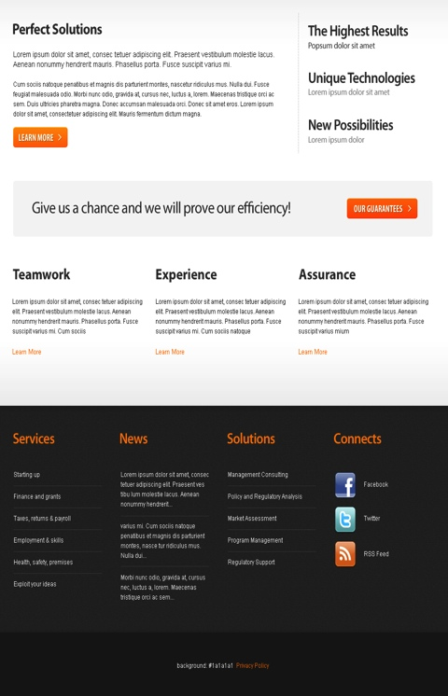
PSD to HTML/CSS
Before Before
After After
A client expects to see little to no difference between a picture of a layout and the implemented layout.

Slide 4
- Increase in quality
- Some increase in velocity
- Knowledge transfer of mentorship sorts
- Culturation amongst teams
- Team dynamics, developer relationships
- Talk through thought process
“Pair programming increases software quality without impacting time to deliver. […] 2 people working at a single computer will add as much functionality as two working separately except that it will be much higher in quality.”
- extremeprogramming.org
Pair programming
Notes:
First time we’re working on unanswered problems in class. Pair programming will facilitate. Take turns ‘driving’, one driver per task. Pair programming is not backseat driving. Driver says their thought process, pair programmer points out typos and answers questions, transfers knowledge. Does not say what to type.

Slide 5

Building Craigslist
Install Drupal
Plan Website
Brainstorm Features
Build Website
Style Website

