Slide 1
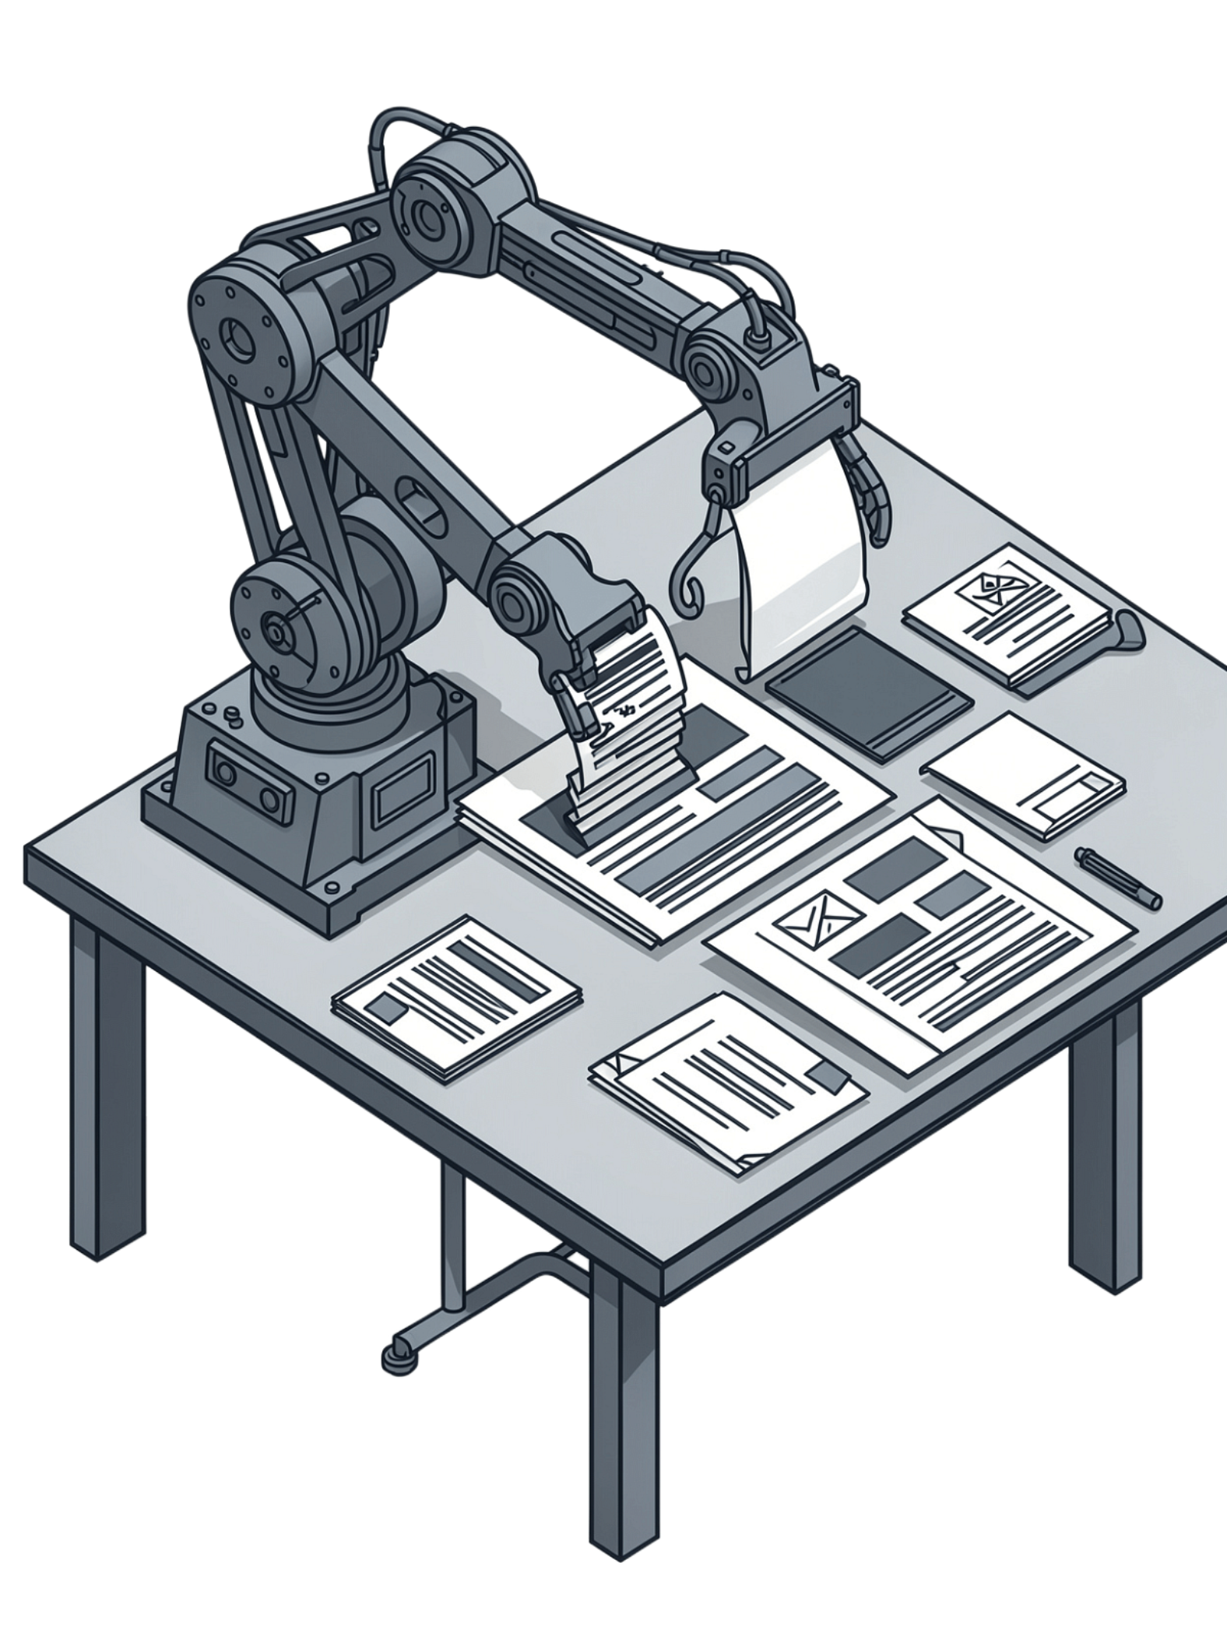
AI Resume Screening System Using Advanced DSA
Combining AI contextual understanding with algorithmic precision for faster, fairer, and more explainable candidate-job matching.
Team Members
2510030413 - B. Aparna
2510030174 - Anusha
2510030305 - N. Snikitha
2510030271 - Pavithra Boina
2510030252 - Lathika
2510030251 - Ananya

Slide 2


The Problem & Our Solution
Current Systems
Our Approach
Key Advantage
AI for contextual understanding + DSA algorithms for efficient, explainable matching — the best of both worlds.
Faster, structured searching with transparent algorithmic logic that justifies every match decision.
AI and NLP alone for resume-job matching — powerful for understanding language, but limited in search efficiency and transparency.

Slide 3

Current Systems Limitations & Research Gaps
Current Systems Limitations
Research Gaps
Slow at Scale — AI/NLP systems can struggle with large candidate pools.
Hard to Explain — Black-box models provide limited transparency.
Disconnected Flow — Extraction, matching and ranking are often separate.
Missed Duplicates — Duplicate resumes may not be reliably detected.
Scalability Issues — Performance decreases as data and complexity grow.
Unified Pipeline — Integrate extraction, matching and ranking end-to-end.
DSA-Based Processing — Use efficient searching, hashing, matching and sorting.
Duplicate Detection — Use hashing to identify repeated resumes.
Complete Workflow — Build a structured 7-stage screening process.

Slide 4







End-to-End System Workflow
Our integrated pipeline processes resumes through 7 sequential stages:
Upload
Extraction
Processing
Recruiter uploads job description and candidate resumes to the system.
AI extracts skills, experience, qualifications, and requirements from unstructured text.
DSA algorithms prepare and structure extracted data for matching.
Duplicate Detection
Matching
Ranking
Hashing identifies and filters duplicate resume submissions.
String matching algorithms (KMP, Aho-Corasick) find skill matches between candidates and job requirements.
Edit distance and bipartite matching algorithms score and rank candidates by fit.
Report Generation
Dashboard displays ranked candidates with matched skills, gaps, and recommendations for recruiter review.

Slide 5




DSA Algorithms in Action
KMP Algorithm
Aho-Corasick
Exact skill matching — find required skills within resume text efficiently in linear time.
Multiple skills at once — search for dozens of keywords simultaneously in a single pass.
Edit Distance
Bipartite Matching
Fuzzy matching — handle spelling variations and terminology differences gracefully.
Optimal assignment — assign candidates to job openings to maximize overall fit.

Slide 6
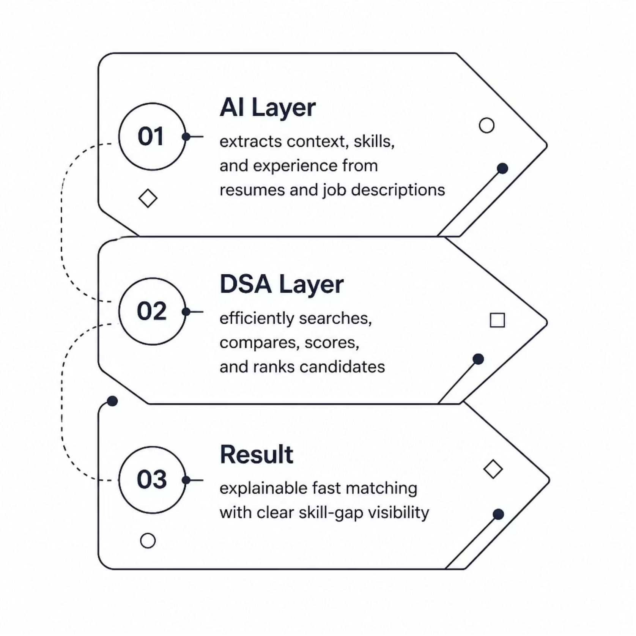
How AI & DSA Work Together
AI Layer
Understands context — extracts skills, experience levels, and intent from unstructured resume and job description text using natural language processing.
DSA Layer
Efficiently searches, compares, scores, and ranks candidates using structured algorithms — turning extracted data into precise, auditable decisions.
The Result
Explainable, fast matching with clear skill-gap visibility — every ranking score can be traced back to an algorithmic decision.

Slide 7
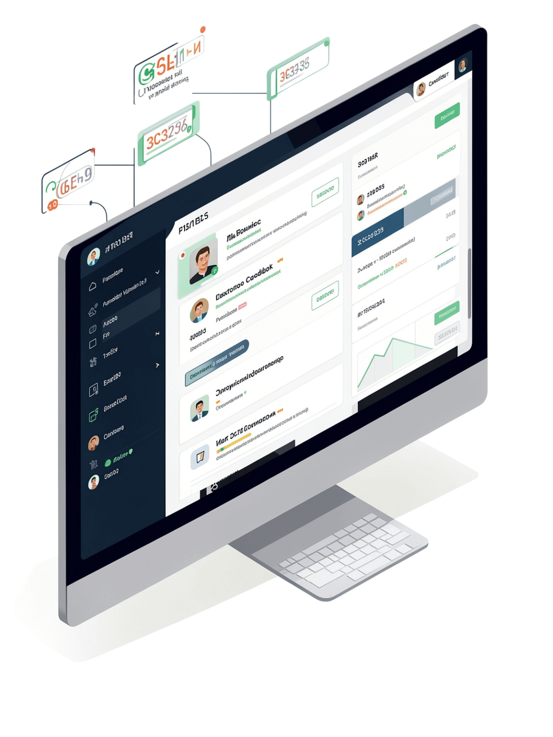




System Workflow & Output
Post & Extract
Recruiter posts job → AI extracts skill requirements from the description.
Screen & Score
DSA algorithms screen all resumes and rank candidates by match score (e.g., 92%, 87%, 74%).
Review & Decide
Dashboard shows matched skills, missing skills, and recommendations. Recruiter makes the final call.
The system assists the recruiter — it does not make the hiring decision. Human judgment remains at the center of the process.

