Slide 1
Matching models
Bill Evans
ECON 60303

Slide 2
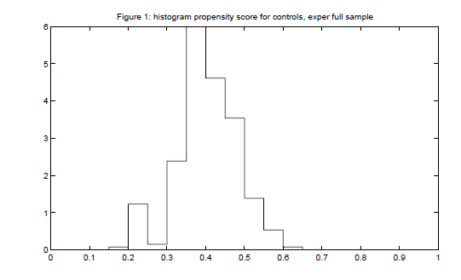
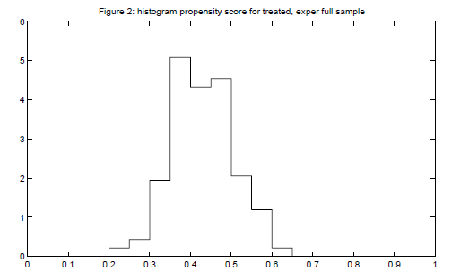

Slide 3
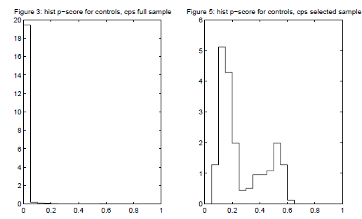

Slide 4
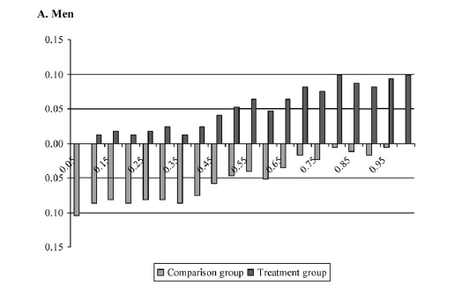
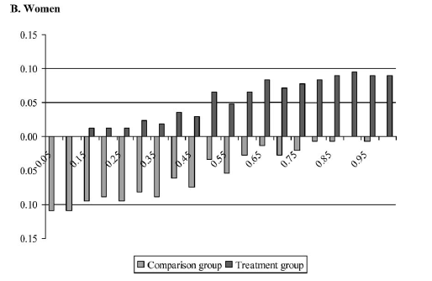
Treatment: private college
Control: public

Slide 5
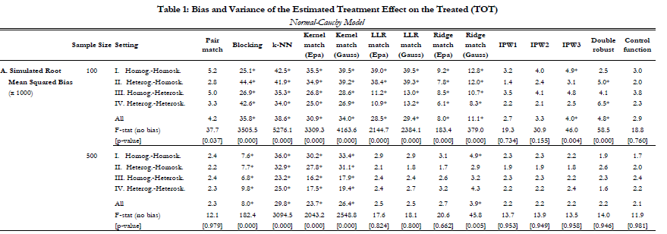
Busso et al.
Outcome: root MSE of
TOT across replications
Pair matching
Does well
But it is harder
To implement
IPW, even
without rescaling
of weights does
well, and is
easiest to estimate

Slide 6
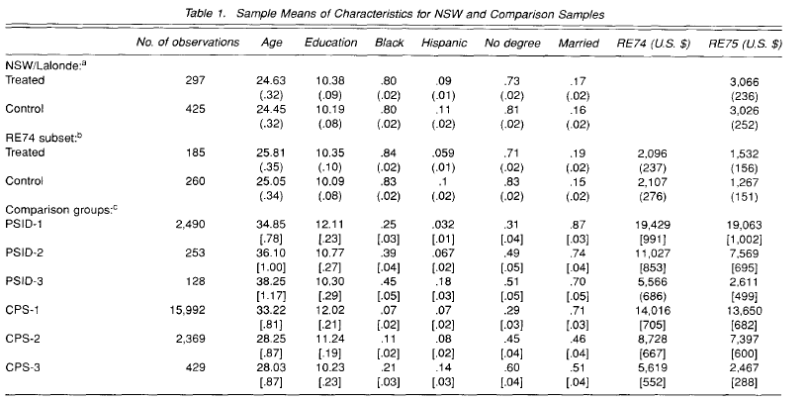
Dehejia and Wahba, 1999

Slide 7
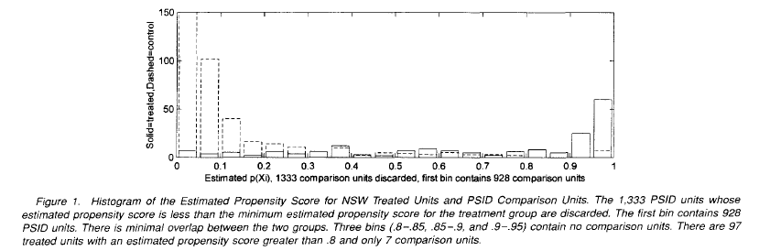
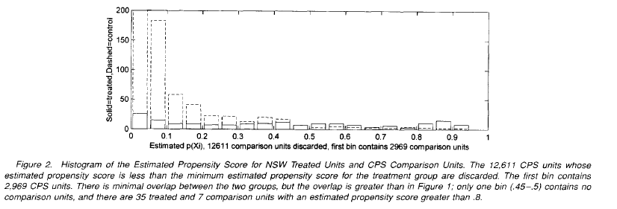

Slide 8
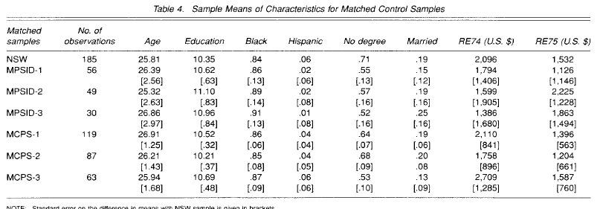
Not the easiest table to read. The numbers in brackets are std errors on the
Difference from the NSW treatment sample. So EDUCATION in NSW is 10.35.
The same value in MCPS3 is 10.69 for a difference of 0.34. The std error on the
Difference is 0.48

Slide 9
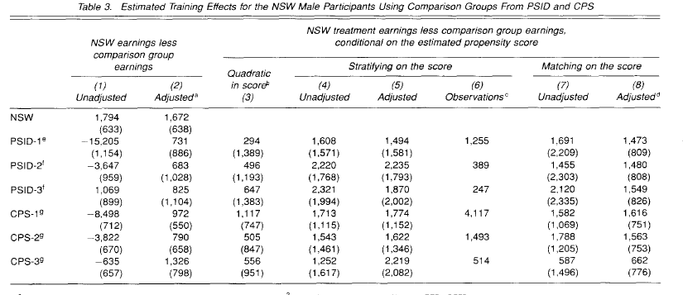
Treatment effect from RCT
Regression based adjustments
Propensity score
estimates

Slide 10
Differences in samples
NSW enrolled people April 75-April 77
DW – wanted two years of pre-program earnings
Survey asked for earnings in 1974 so they delete anyone enrolled after April 1976
But they also include people w. zero earnings 13-24 months prior to enrollment, for those enrolled after April 1976

Slide 11
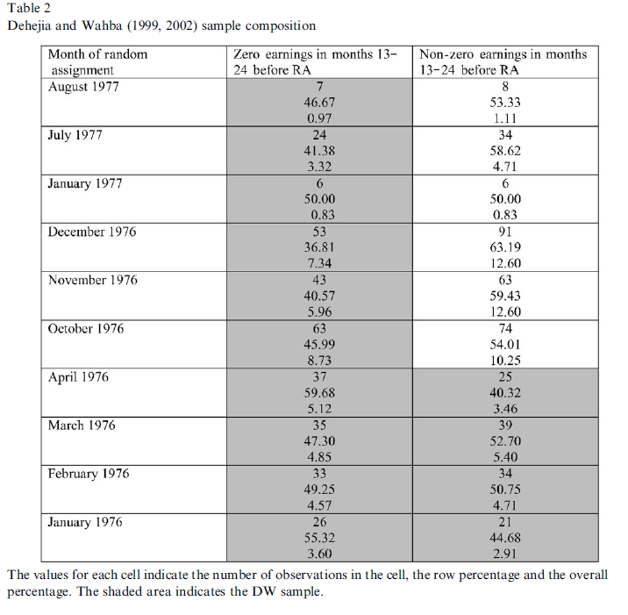

Slide 12
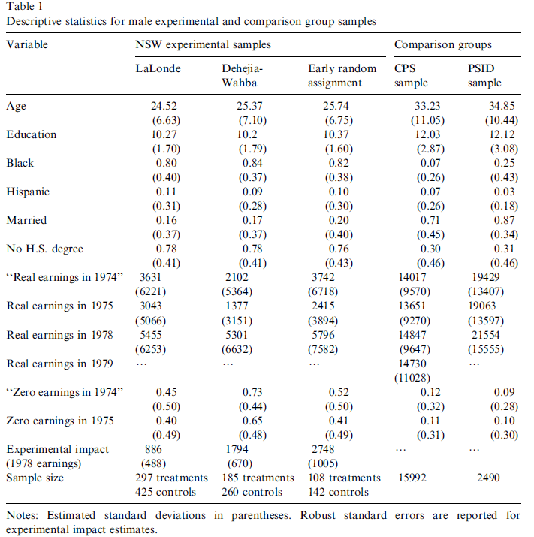

Slide 13
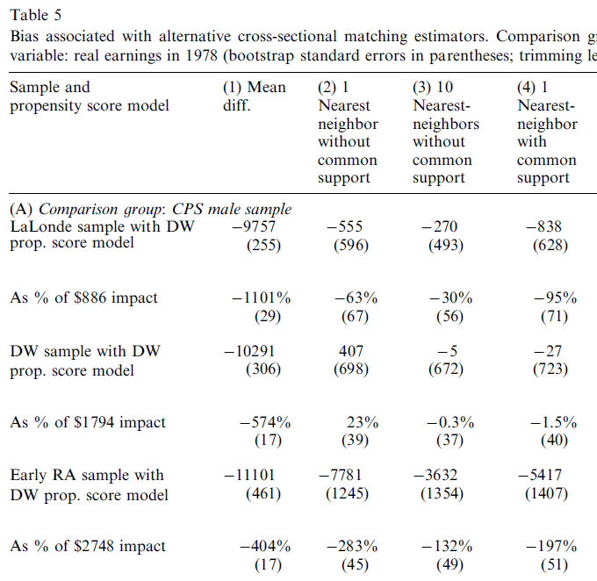
Lalonde Sample
DW methods—
Not even close
DW sample
Results from JASA
RA sample
DW methods
Looks awful

Slide 14
Example: matching1.do
workplace1.do: data on indoor workers, their smoking habits and whether they are subject to a workplace smoking ban
Y: smoker (=1 if yes, =0 if no)
D: worka (work area smoking ban, =1 if yes)
X: ln(income) and age plus dummies for male black, hispanic, hsgrad, somecol, college
Sparse set of controls – this is just to illustrate the procedure

Slide 15
Use a probit for the propensity score, use trimming
procedure from DW

Slide 18
Average weight of IPW2 should be 1 –
weights sum to number of observations in
the comparison sample.

Slide 20
Balancing Test
Variable | Mean | D=0 | Mean | D=1 | Diff (P-value)
Age | 38.54 | 38.61 | 0.07 (0.74)
Incomel | 10.43 | 10.43 | 0.005 (0.72)
Male | 0.366 | 0.368 | 0.002 (0.78)
Black | 0.121 | 0.118 | -0.004 (0.55)
Hispanic | 0.064 | 0.062 | -0.002 (0.69)
Hsgrad | 0.315 | 0.316 | 0.001 (0.90)
Somecol | 0.273 | 0.273 | 0.000 (0.98)
college | 0.353 | 0.350 | -0.002 (0.78)

Slide 22
How to use propensity scores

Slide 23
Early discharges
Recommended postpartum stay
2 days for normal vaginal birth
4 days for uncomplicated c-section
Rise of managed care reduced average length of postpartum stay
By mid 1990s, 80% of births were under recommended stay
“drive through deliveries”

Slide 24
Legislative response
States adopted mandatory minimum postpartum stays
Insurance must be offered
Patient can leave after 1 day
Federal law
Passed in 1996, effective January 1, 1998
Exempted Medicaid
CA state law
Passed and effective on Aug 17, 1997
Expanded to Medicaid January 1, 1999

Slide 25
Research question
Does more medical care generate better outcomes?
Problem: most births are uncomplicated so the law should have little impact on those
Is there a way to measure how complicated the birth is?
Different diagnoses – but there are many
Alternative – use PS as a measure of difficulty

Slide 26
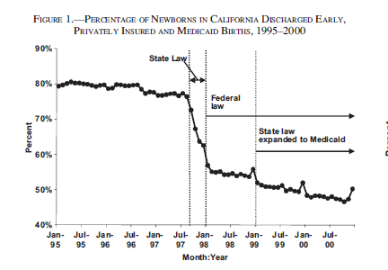

Slide 27
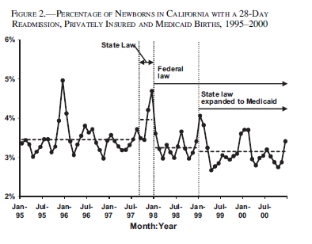

Slide 28
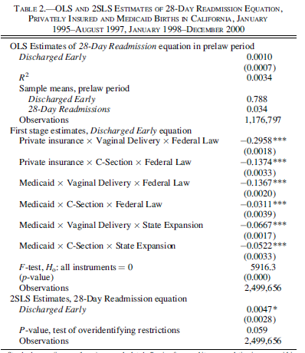

Slide 29
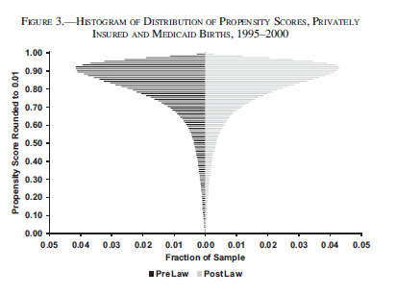

Slide 30
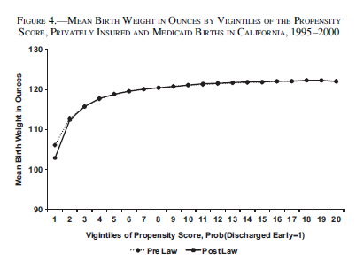

Slide 31
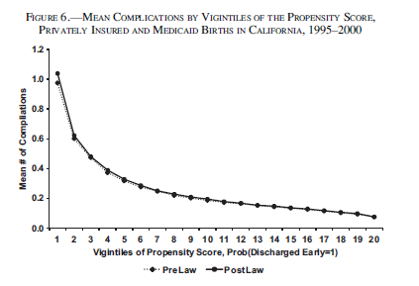

Slide 32
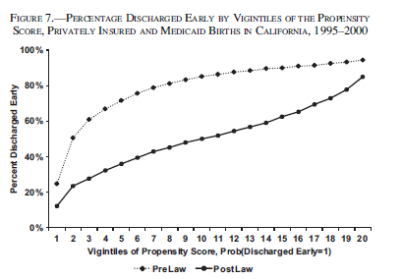

Slide 33
