Slide 1


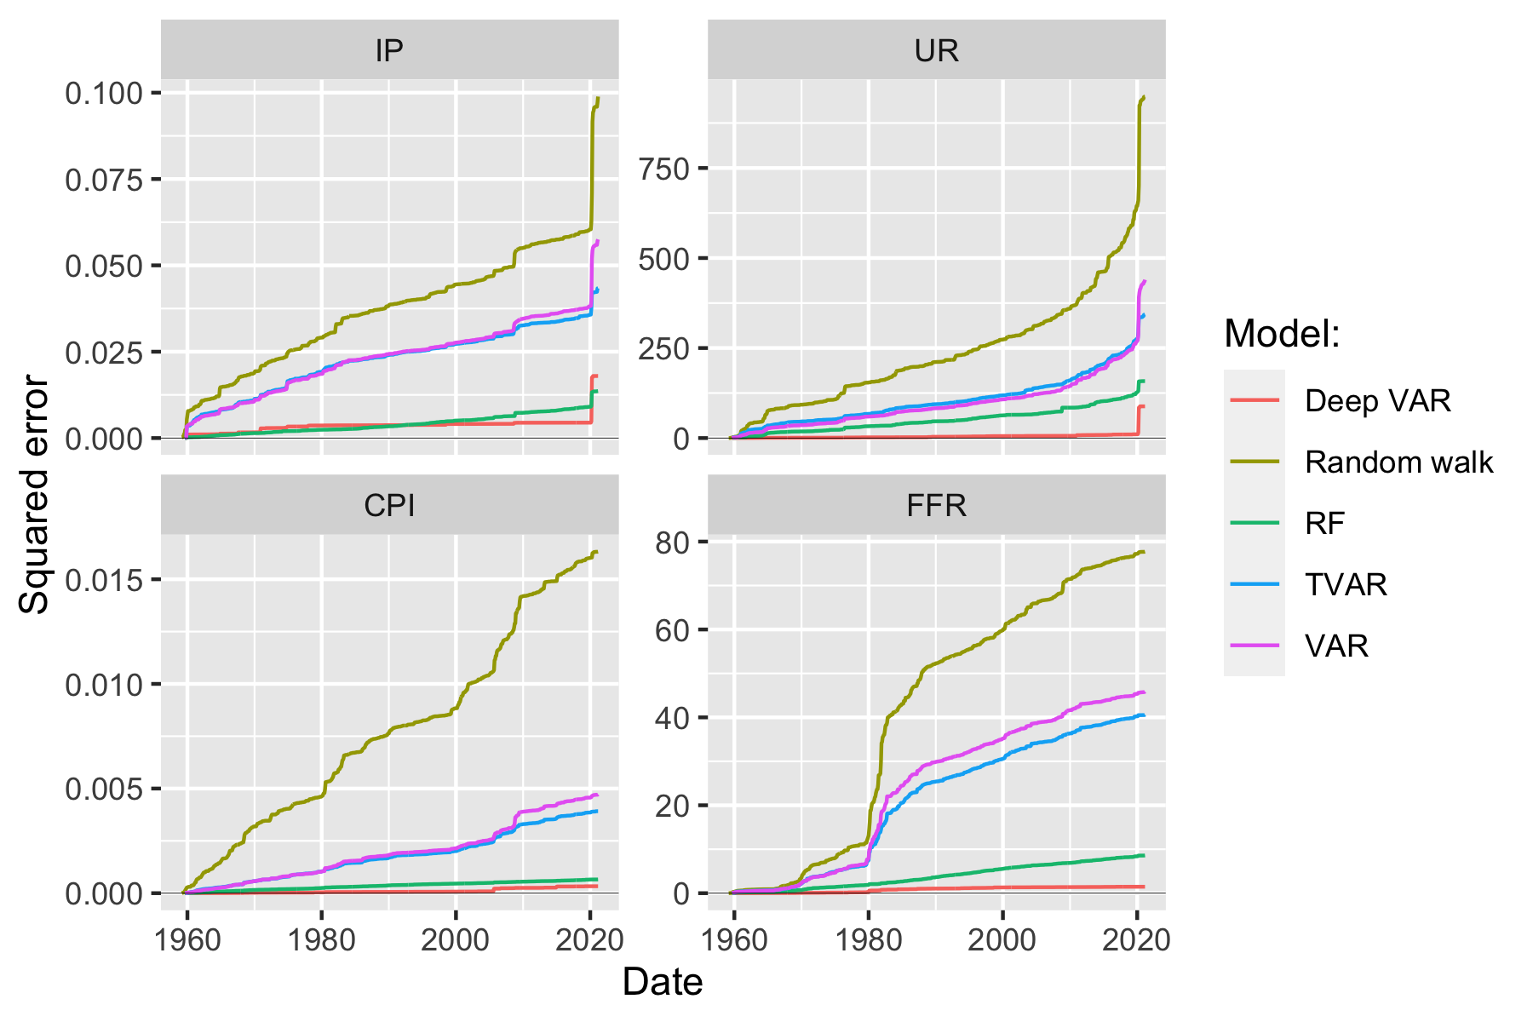
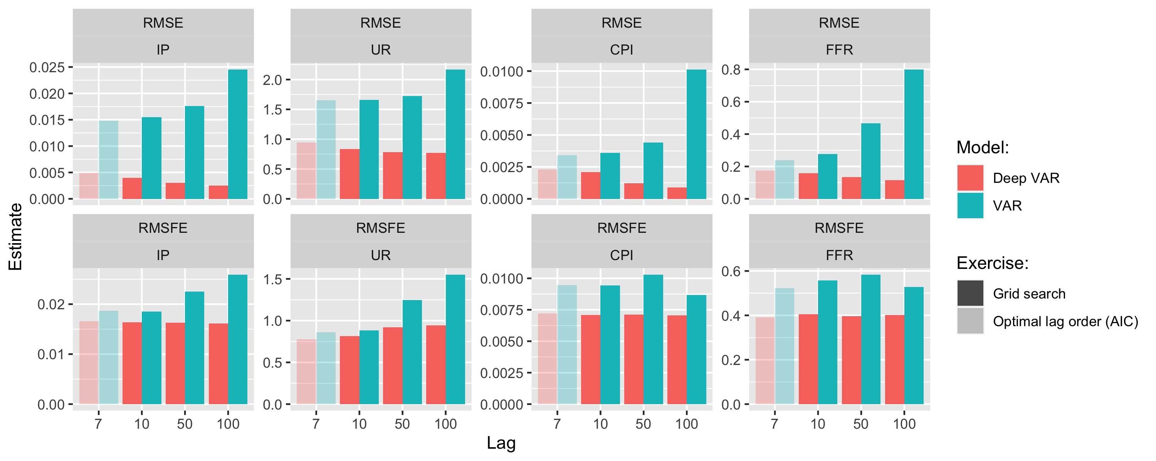
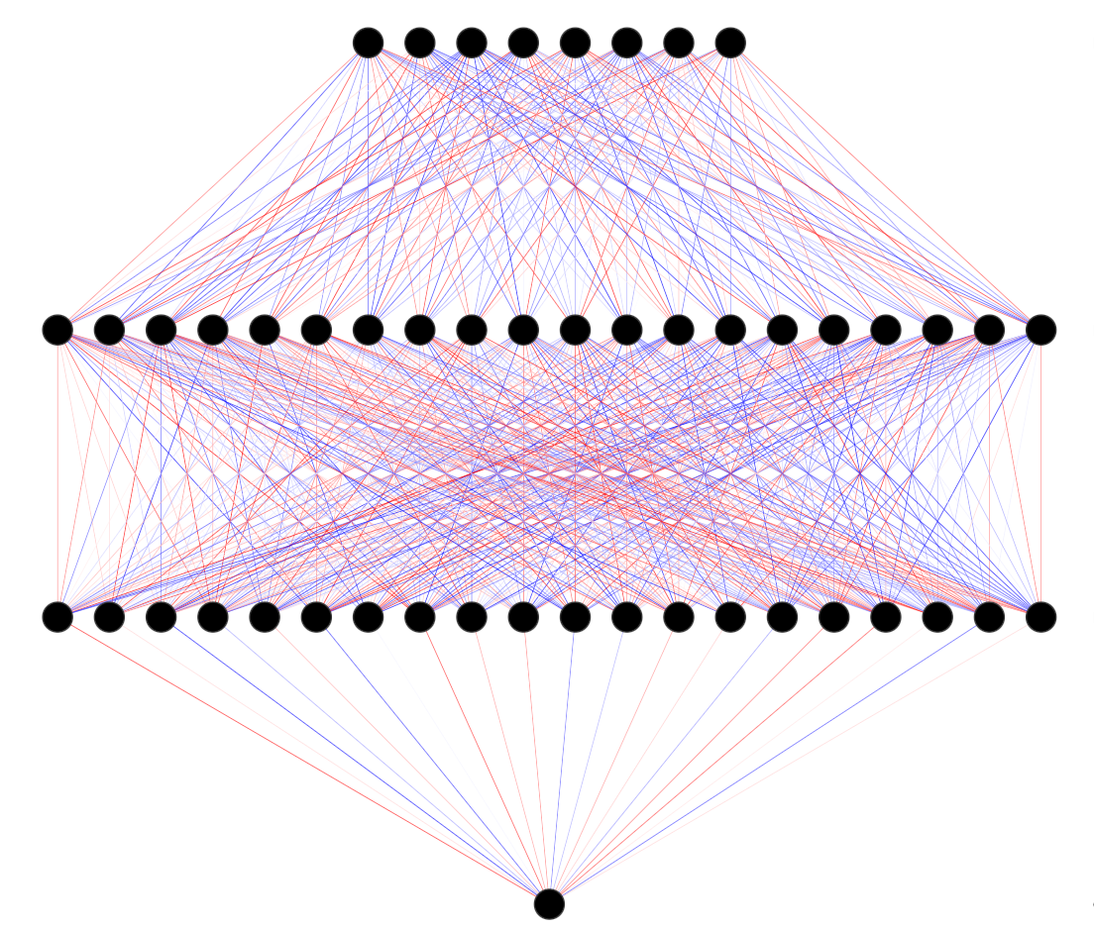
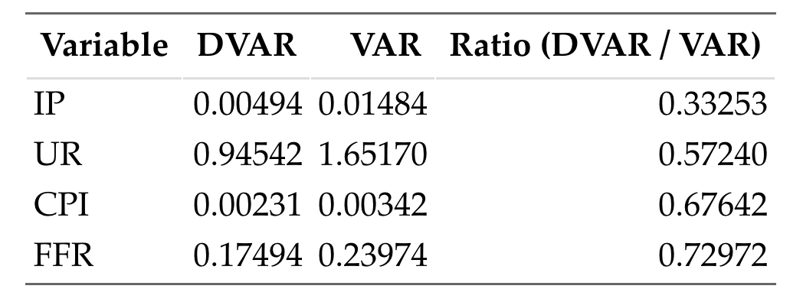
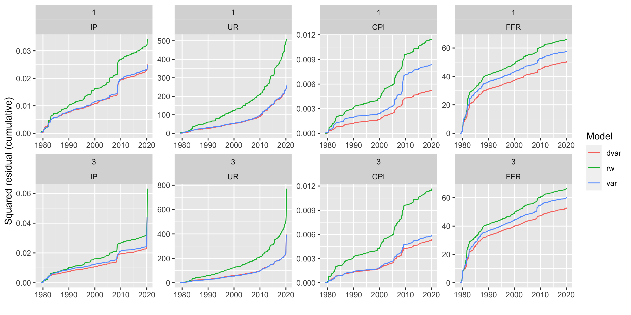

Deep Vector Autoregression for Macroeconomic Data
Patrick Altmeyer, Delft University of Technology
Marc Agusti, European Central Bank
Ignacio Vidal-Quadras Costa, European Central Bank
Can we leverage the power of deep learning in VAR models?
Significantly reduced in-sample error …
Have we merely scratched the surface?
Hyperparameter tuning
We propose Deep VAR: a novel approach towards VAR that leverages the power of deep learning in order to model non-linear relationships.
For a our baseline comparison we keep things simple: for example, we let the conventional VAR guide our search for optimal lag length. A short exercise in hyperparameter tuning demonstrates that the Deep VAR is less prone to overfitting with respect to the number of lags among other things.
Key contributions
Simple methodology close in spirit to conventional benchmark
Significant improvement in predictive performance
Open source R package to facilitate reproducibility
Less is more
A simple methodology
We developed our idea under the following premise: maximise performance of an existing and trusted framework under minimal intervention. We relax the assumption of linearity through one simple step: estimate each system equation through a recurrent neural network.
Figure 2: Comparison of cumulative loss over the entire sample period for Deep VAR and benchmarks.
Figure 4:: Pseudo out-of-sample RMSE and RMSFE for VAR and Deep VAR across different lag choices.
… out-of-sample error …
Where to go from here
Planned developments
From deterministic to Bayesian deep learning: this should aid with interpretability and uncertainty quantification.
Recent work by Daxberger et al. (2021) shows that Laplace Approximation is a promising way forward.
Can the existing toolbox (IRFs, variance decomposition, policy counterfactuals, …) be derived for Deep VAR?
Add other benchmark models.
Structural identification – how to proceed? Verstyuk (2020) works with Cholesky decomposition as in conventional VAR.
Deep VAR as a monitoring tool for detecting non-linearities?
Table 1: Test root mean squared error (RMSE) for the two models across variables.
… and multi-step-ahead forecasting error.
Figure 1: Neural Network Architecture. Inputs are lags of all variables. Output is variable of interest in time t.
Significant performance gains
References
Daxberger et al. (2021). “Laplace Redux-Effortless Bayesian Deep Learning.”. In: Advances in Neural Information Processing Systems 34
Kilian and Luetkepohl (2017). “Structural Vector Autoregressive Analysis.”. In: Cambridge University Press.
Verstyuk (2020). “Modeling Multivariate Time Series in Economics: From Auto-Regressions to Recurrent Neural Networks.”. In: Available at SSRN 3589337.
Empirical evidence
To evaluate our proposed methodology empirically we use the FRED-MD data base to collect a sample of monthly US data on output (IP), unemployment (UR), inflation (CPI) and interest rates (FFR). Our sample spans the period from January 1959 through March 2021.
Figure 3: Cumulative rolling-window forecasting error for the 1-month and 3-month horizon.

