Slide 1



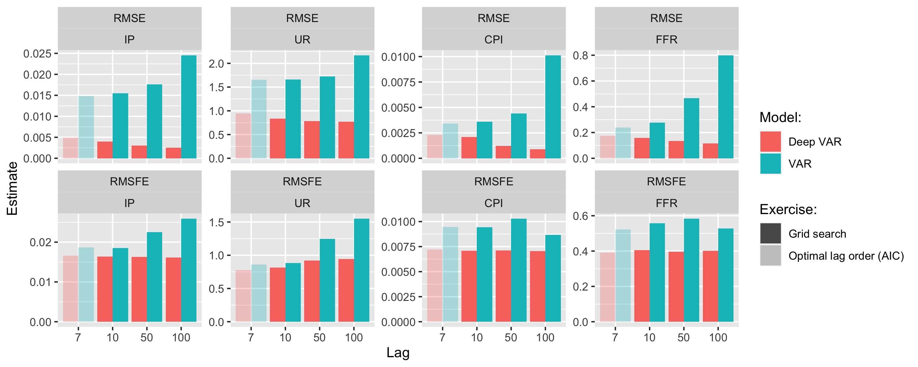
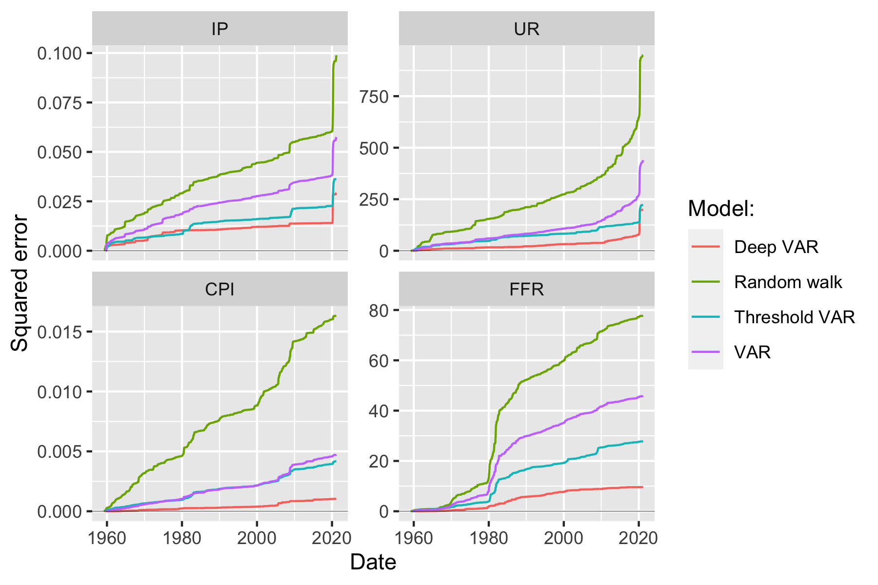
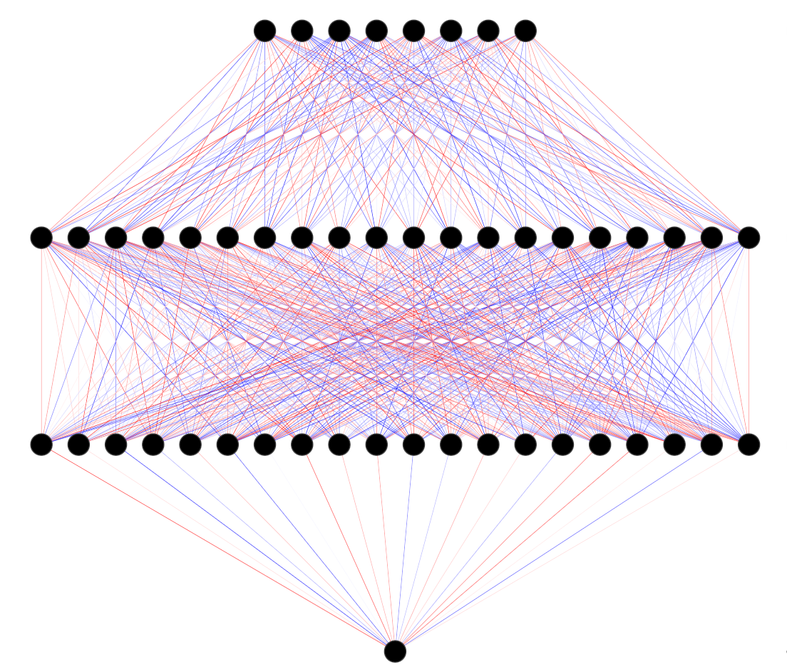
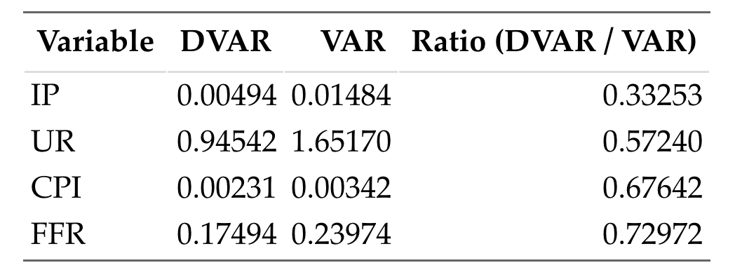

Deep Vector Autoregression for Macroeconomic Data
Patrick Altmeyer, Delft University of Technology
Marc Agusti, European Central Bank
Ignacio Vidal-Quadras Costa, European Central Bank
Can we leverage the power of deep learning in VAR models?
Significant performance gains
Have we merely scratched the surface?
Empirical evidence
Hyperparameter tuning
We propose Deep VAR: a novel approach towards VAR that leverages the power of deep learning in order to model non-linear relationships. By modelling each equation of the VAR system as a deep neural network, our proposed extension outperforms modern benchmarks in terms of in-sample fit, out-of- sample fit and point forecasting accuracy. In particular, we find that the Deep VAR is able to better capture the structural economic changes during periods of uncertainty and recession. By staying methodologically as close as possible to the original benchmark, we hope that our approach is more likely to find acceptance in the economics domain.
To evaluate our proposed methodology empirically we use the FRED-MD data base to collect a sample of monthly US data on output (IP), unemployment (UR), inflation (CPI) and interest rates (FFR). Our sample spans the period from January 1959 through March 2021.
Our findings show a consistent and significant improvement in predictive performance: the Deep VAR incurs much lower loss than the conventional benchmark. It also outperforms another popular approach towards VAR models that addresses non-linearity (Threshold VAR).
For a our baseline comparison we keep things simple: for example, we let the conventional VAR guide our search for optimal lag length. A short exercise in hyperparameter tuning demonstrates that the Deep VAR is less prone to overfitting with respect to the number of lags among other things.
Key contributions
Simple methodology close in spirit to conventional benchmark
Significant improvement in predictive performance
Open source R package to facilitate reproducibility
Figure 3: Pseudo out-of-sample RMSE and RMSFE for VAR and Deep VAR across different lag choices.
Less is more
Where to go from here
A simple methodology
Recent work
We developed our idea under the following premise: maximise performance of an existing and trusted framework under minimal intervention. VAR has become a standard tool for practitioners to construct economic forecasts, but the assumption of linearity through time and variables is restrictive. We relax that assumption through one simple step: estimate each system equation through a recurrent neural network.
We have added Threshold VAR for comparison (Figure 2).
Progress on uncertainty quantification through Bayesian deep learning – MC dropout (Gal and Ghahramani 2016). Recent work by Daxberger et al. (2021) shows that Laplace Approximation is a promising way forward.
Open questions
Figure 2: Comparison of cumulative loss over the entire sample period for Deep VAR and benchmarks.
What other benchmark models should we consider?
Structural identification – how to proceed? Verstyuk (2020) works with Cholesky decomposition as in conventional VAR.
Can the existing toolbox (IRFs, variance decomposition, policy counterfactuals, …) be derived for Deep VAR?
Deep VAR as a tool for detecting non-linearities?
We also test model performance with respect to a test sample: future realizations arrive and we compute 1-step ahead predictions without retraining (Table 1). In the paper, we also present evidence that the Deep VAR outperforms on n-step ahead forecasts.
References
Daxberger et al. (2021). “Laplace Redux-Effortless Bayesian Deep Learning.”. In: Advances in Neural Information Processing Systems 34
Gal and Ghaharamani (2016). “Dropout as a Bayesian Approximation: Representing Model Uncertainty in Deep Learning.”. In: International Conference on Machine Learning, 1050–59. PMLR.
Kilian and Luetkepohl (2017). “Structural Vector Autoregressive Analysis.”. In: Cambridge University Press.
Verstyuk (2020). “Modeling Multivariate Time Series in Economics: From Auto-Regressions to Recurrent Neural Networks.”. In: Available at SSRN 3589337.
Figure 1: Neural Network Architecture. Inputs are lags of all variables. Output is variable of interest in time t.
Table 1: Test root mean squared error (RMSE) for the two models across variables.

