Slide 1


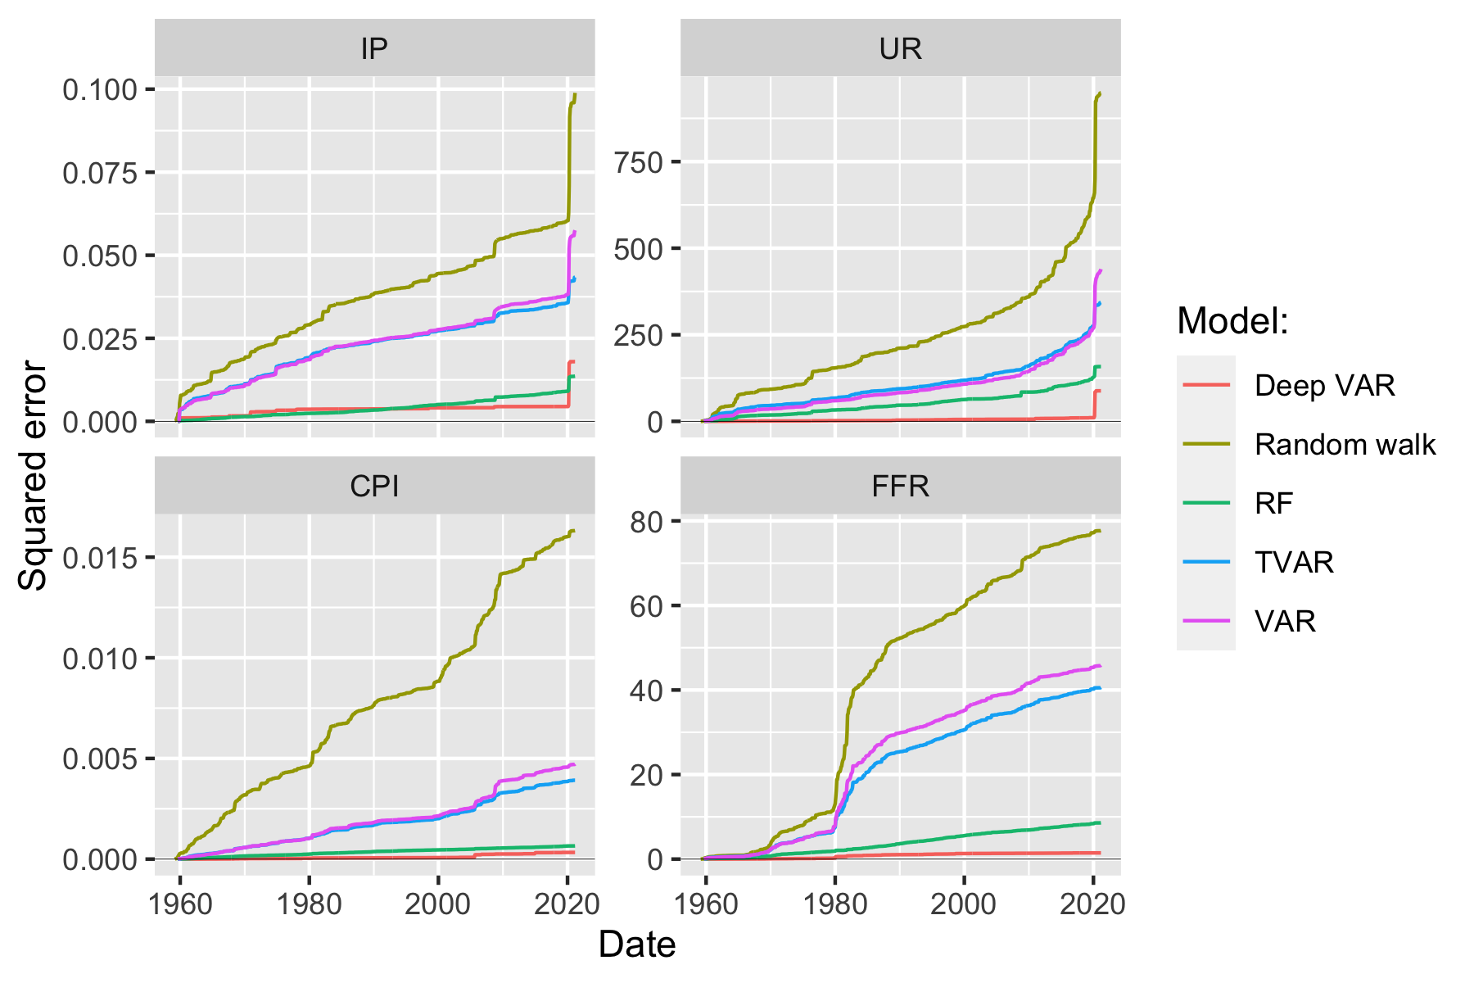
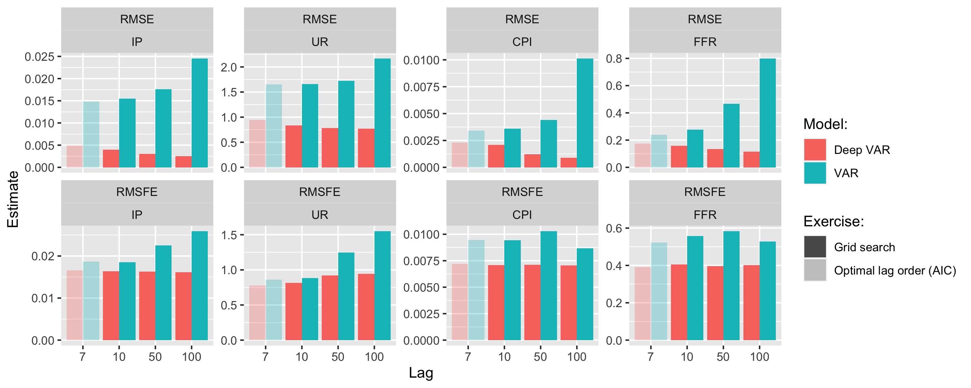
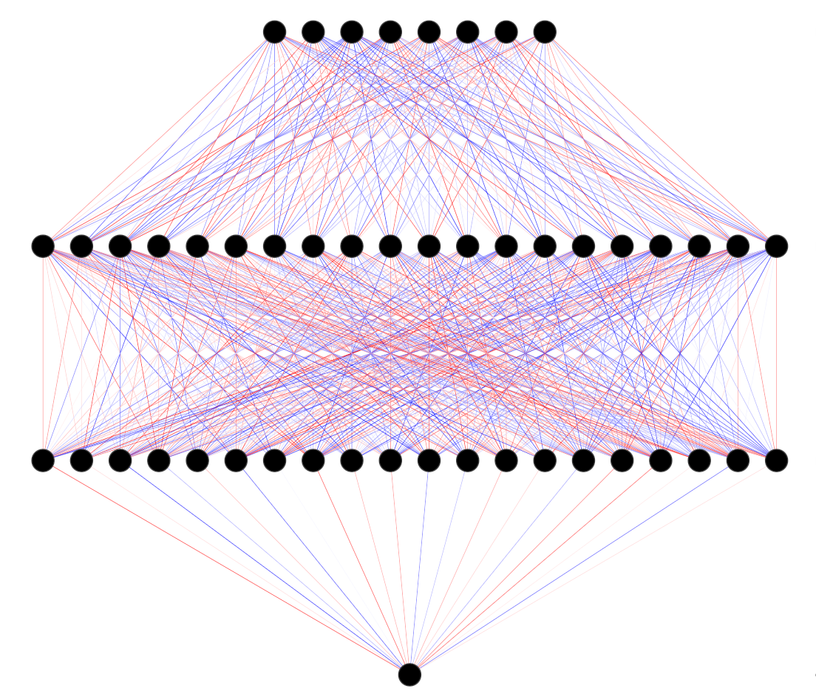
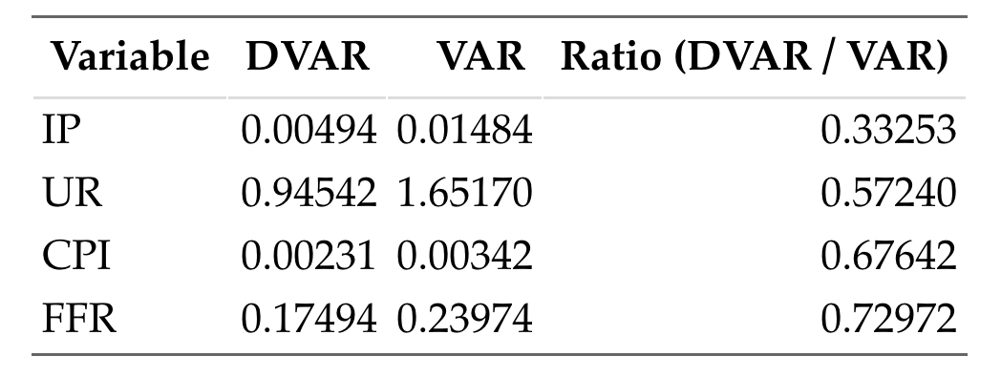
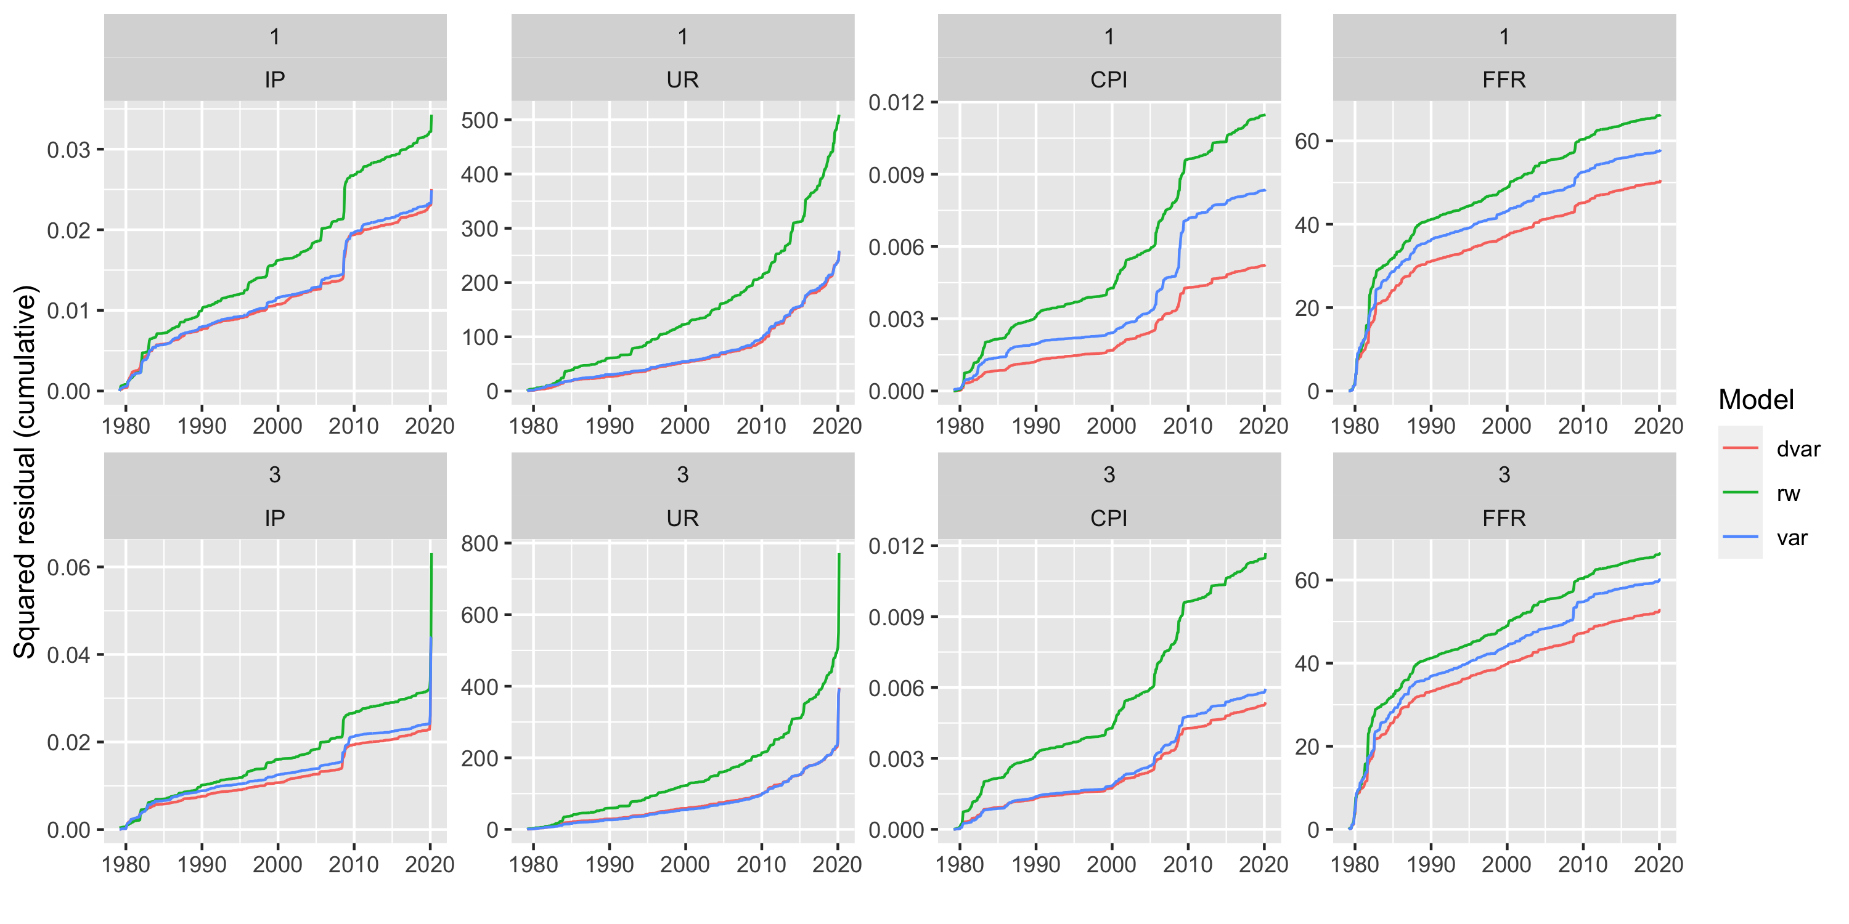

Deep Vector Autoregression for Macroeconomic Data
Patrick Altmeyer (p.altmeyer@tudelft.nl), Delft University of Technology
Marc Agusti, European Central Bank
Ignacio Vidal-Quadras Costa, European Central Bank
Can we leverage the power of deep learning in VAR models?
Significantly reduced in-sample error …
Have we merely scratched the surface?
Hyperparameter tuning
We propose Deep VAR: an approach towards VAR that leverages the power of deep learning in order to model non-linear relationships.
For a our baseline comparison we keep things simple: for example, we let the conventional VAR guide our search for optimal lag length. A short exercise in hyperparameter tuning demonstrates that the Deep VAR is less prone to overfitting with respect to the number of lags among other things.
Key contributions
Simple methodology close in spirit to conventional benchmark.
Significant improvement in predictive performance.
Open source R package to facilitate reproducibility.
Less is more
A simple methodology
We developed our idea under the following premise: maximise performance of an existing and trusted framework under minimal intervention. We relax the assumption of linearity through one simple step: estimate each system equation through a recurrent neural network.
Figure 2: Comparison of cumulative loss over the entire sample period for Deep VAR and benchmarks.
Figure 4:: Pseudo out-of-sample RMSE and RMSFE for VAR and Deep VAR across different lag choices.
… out-of-sample error …
Where to go from here
Avenues for future research
Verify if outperformance is robust through additional data & benchmarks.
Uncertainty quantification: can we just assume Gaussian residuals? Probably not. Bootstrap? Costly!
From deterministic to Bayesian deep learning: this enables uncertainty quantification and should aid with interpretability and robustness.
Recent work by Daxberger et al. (2021) shows that Laplace Approximation could be a promising way forward.
Can the existing inference toolbox (IRFs, variance decomposition, policy counterfactuals, …) be developed for Deep VAR?
Structural identification – how to proceed? Verstyuk (2020) works with Cholesky decomposition as in conventional VAR. What about GNN?
Table 1: Test root mean squared error (RMSE) for the two models across variables.
… and multi-step-ahead prediction error.
Figure 1: Neural Network Architecture. Inputs are lags of all variables. Output is variable of interest in time t.
Significant performance gains
References
Daxberger et al. (2021). “Laplace Redux-Effortless Bayesian Deep Learning.”. In: Advances in Neural Information Processing Systems 34
Kilian and Luetkepohl (2017). “Structural Vector Autoregressive Analysis.”. In: Cambridge University Press.
Verstyuk (2020). “Modeling Multivariate Time Series in Economics: From Auto-Regressions to Recurrent Neural Networks.”. In: Available at SSRN 3589337.
Empirical evidence
To evaluate our proposed methodology empirically we use the FRED-MD data base to collect a sample of monthly US data on output (IP), unemployment (UR), inflation (CPI) and interest rates (FFR). Our sample spans the period from January 1959 through March 2021.
Figure 3: Cumulative rolling-window prediction error for the 1-month and 3-month horizon. TVAR not shown here, since errors blew out by too much.

