Slide 2
#godatathon

Slide 3
TEAM NAME
Team member EDUARD GIMENEZ
Team member PATRICK ALTMEYER
Team member SIMON NEUMEYER
Team member JAKOB PÖRSCHMANN

Slide 4
Overview
Data exploration
Methodology
Forecasts
Interpretation of results

Slide 5
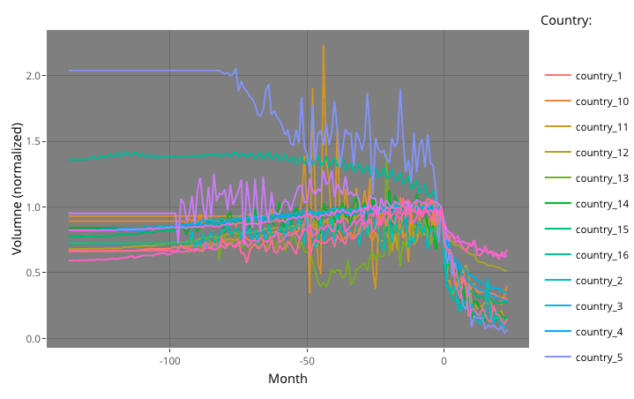
Time series (normalized)

Slide 6
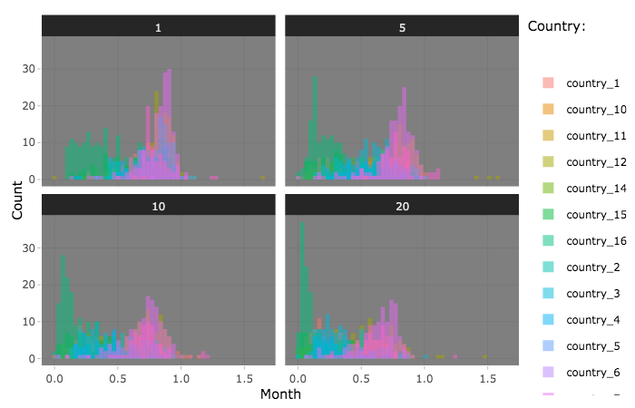
Country clusters

Slide 7
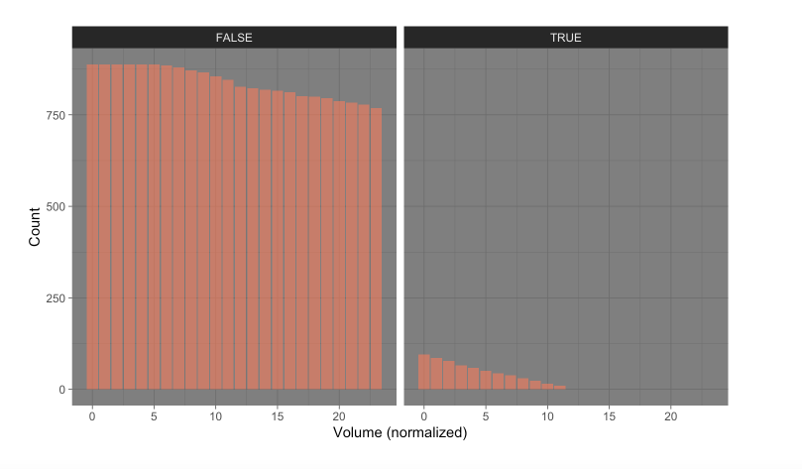
Existing observations

Slide 8
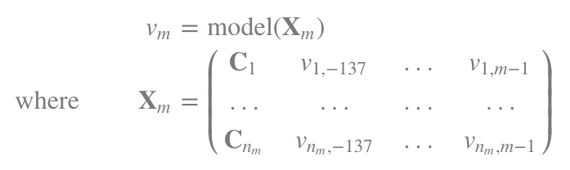
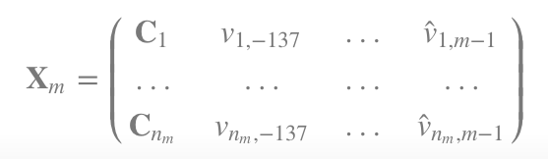
Framework
Fit classifier.fit(X,y) in parallel for all m∈[1,24]:
Predict classifier.predict(X) recursively for all m∈[1,24] where

Slide 9
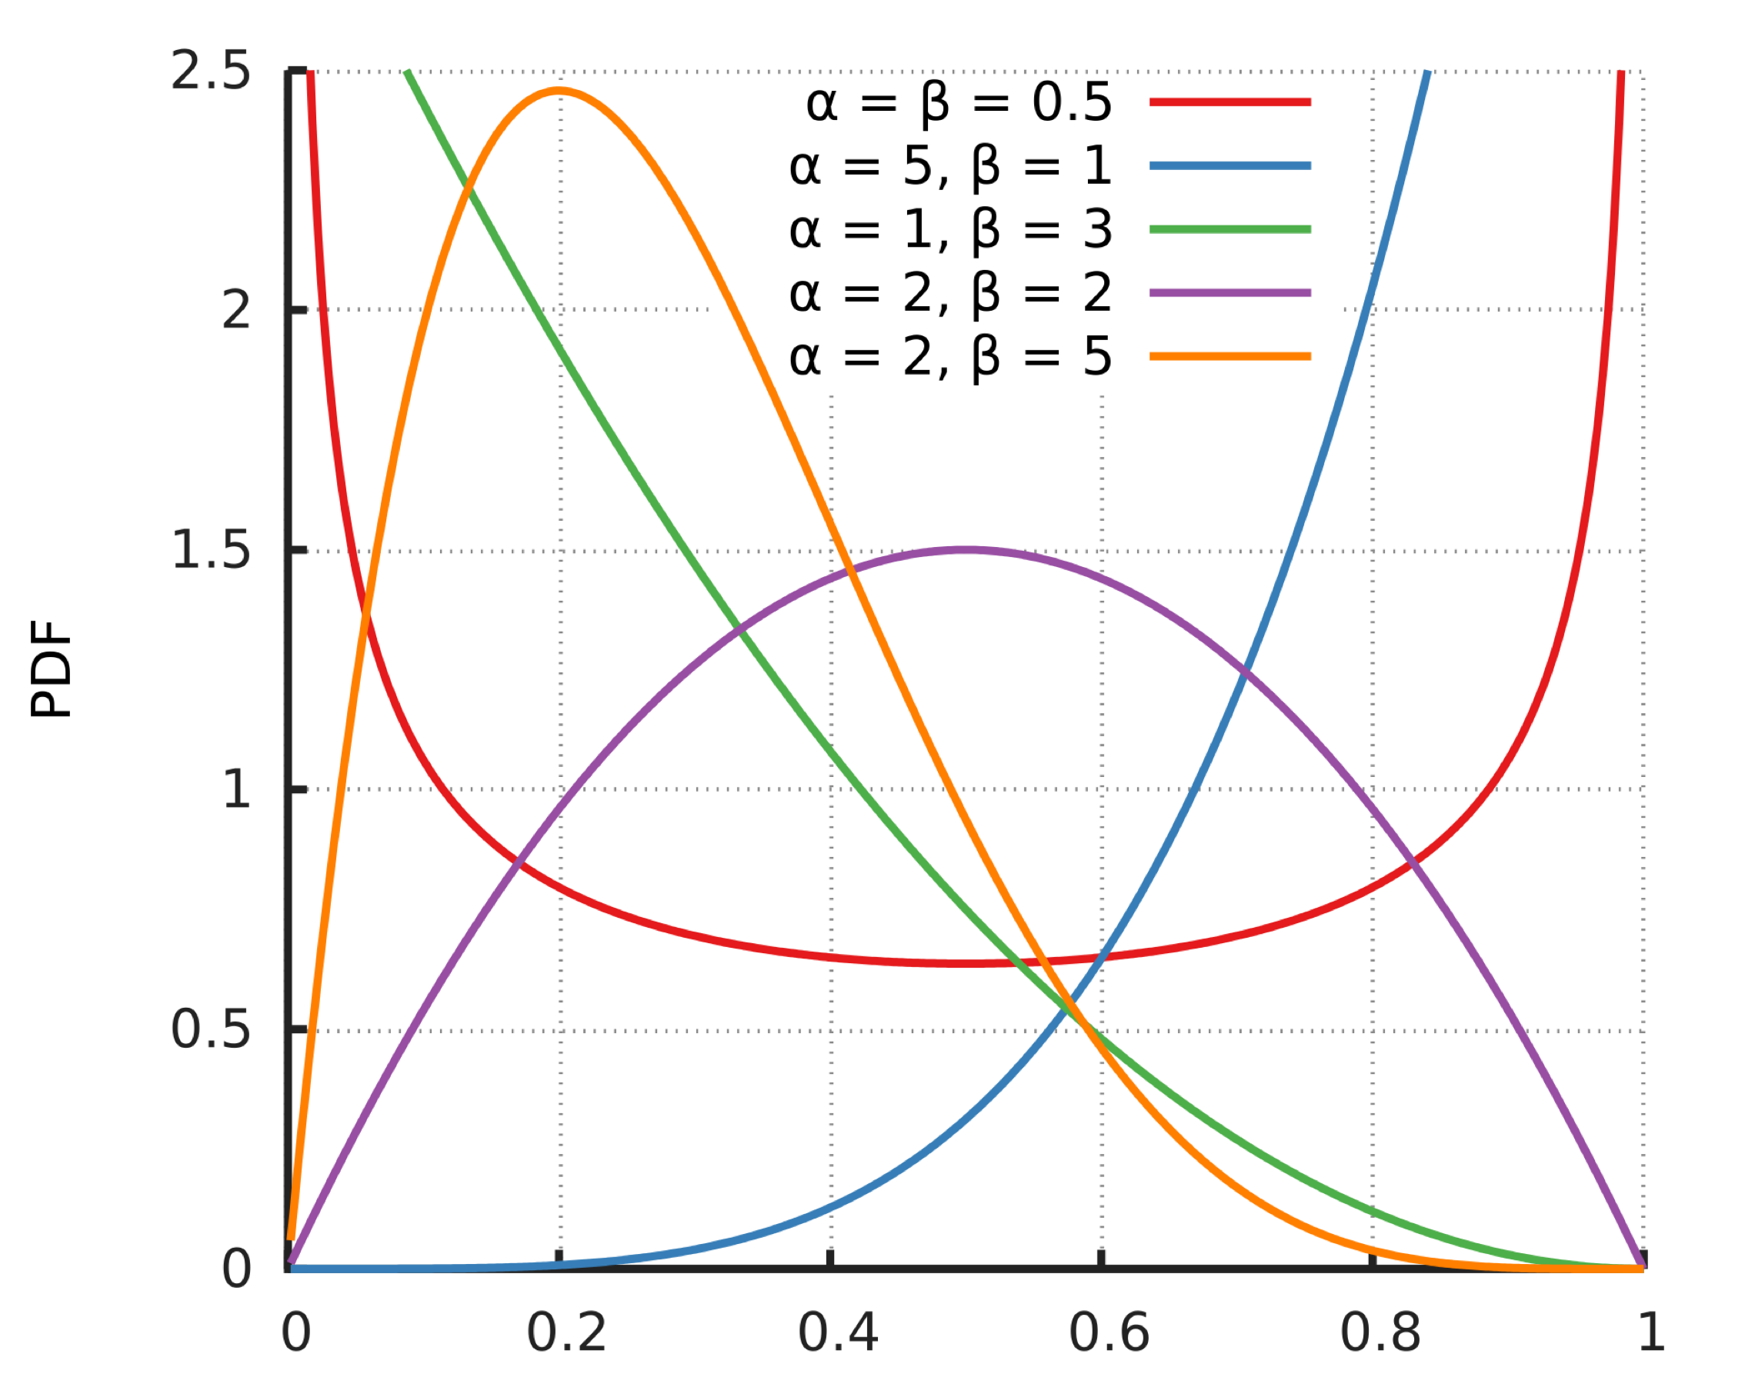
Confidence interval
Normalised predictions are (largely) v̂ ∈[0,1].
We aim for small bands near 1 and 0 and wider bands elsewhere.
Predictions can be thought of as being generated from a beta distribution with 𝔼(v)=α+β.
Fix β=5 and compute α=vβ(1−v).

Slide 10
Score function

Slide 11
Forecasts

Slide 12
Interpretation

