Slide 1



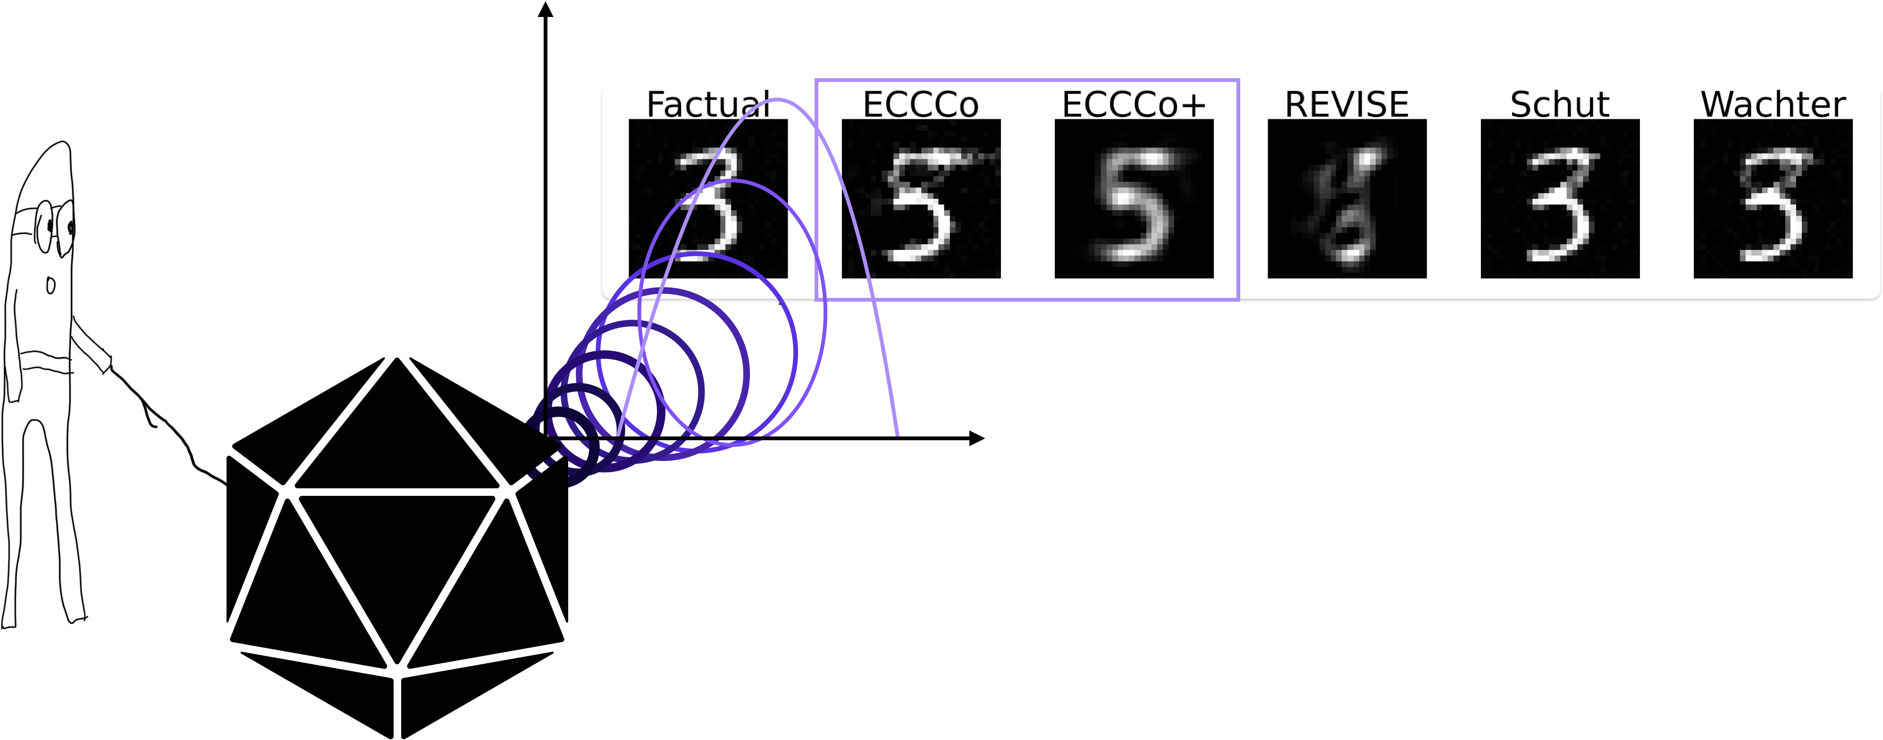
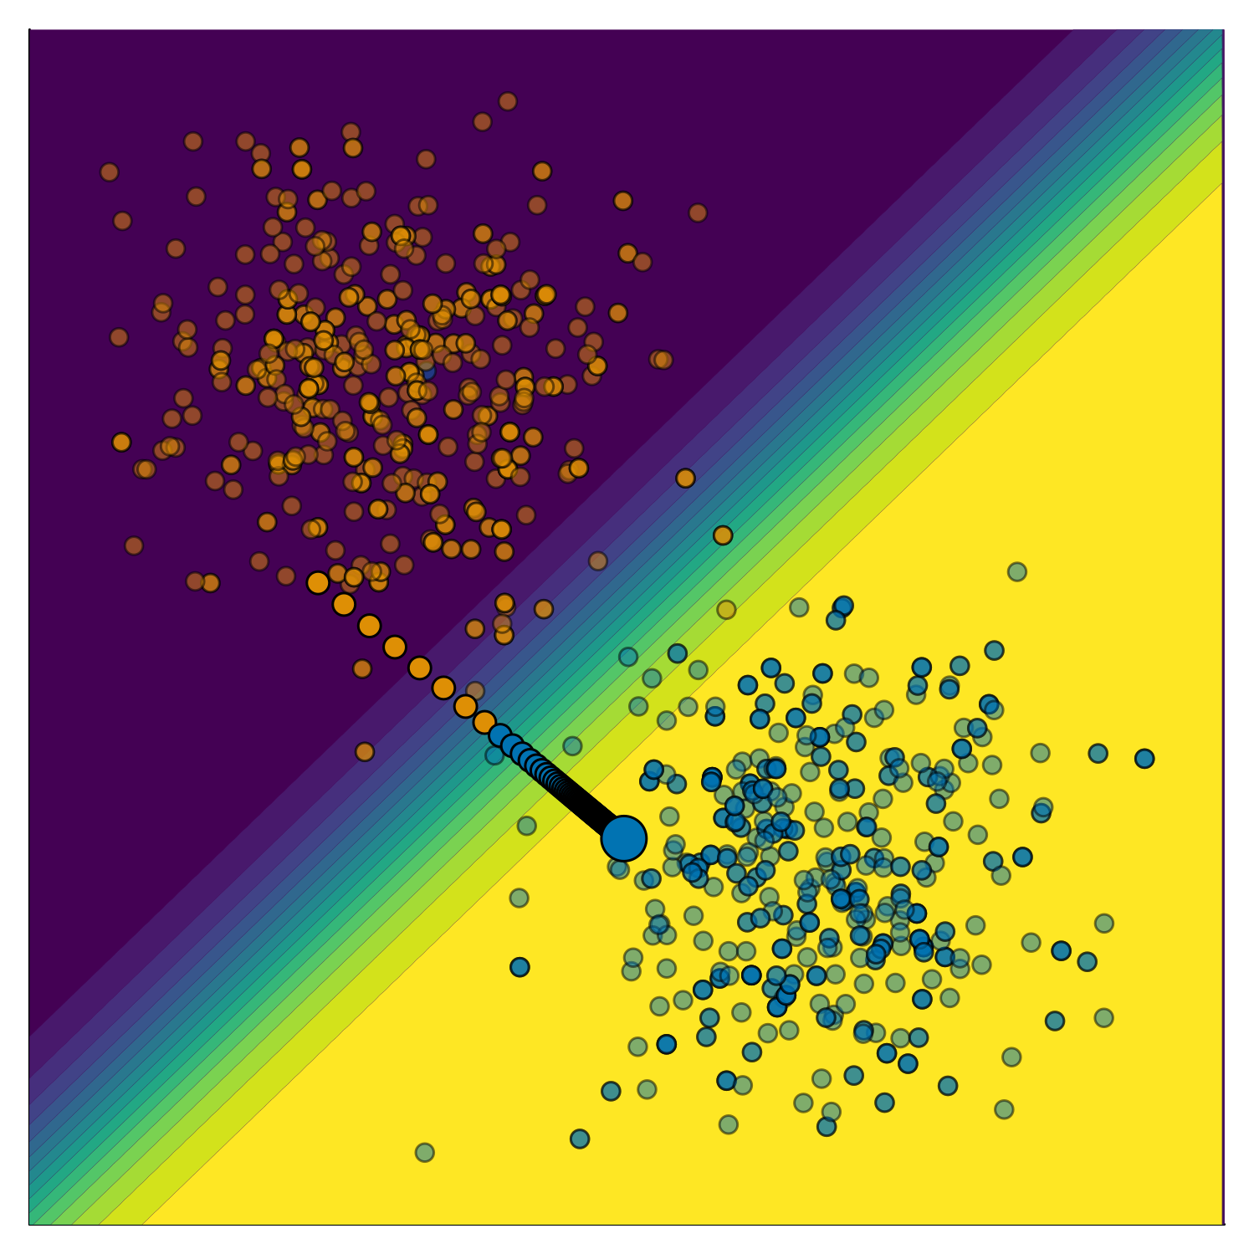


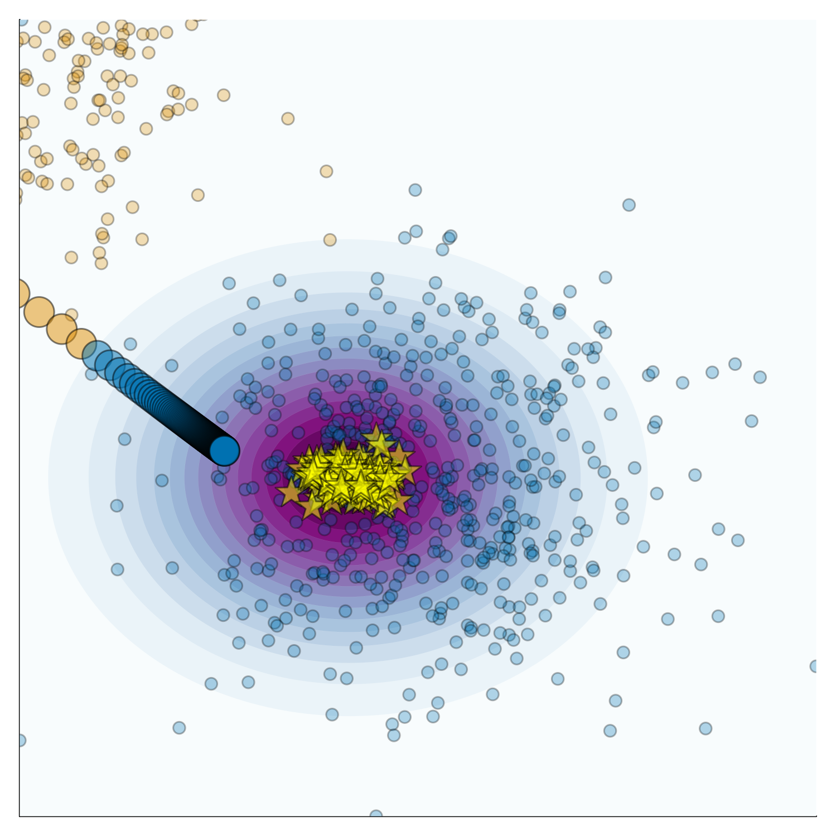
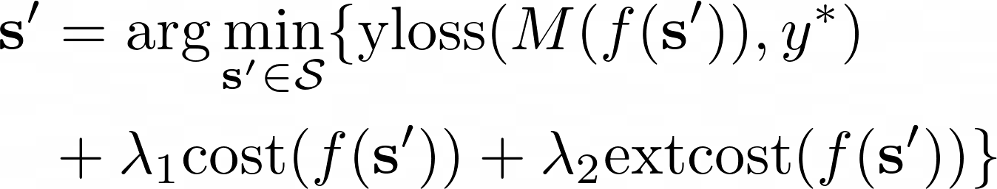
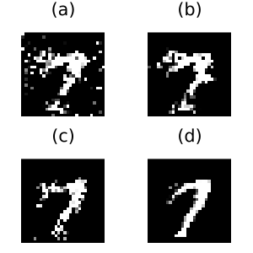
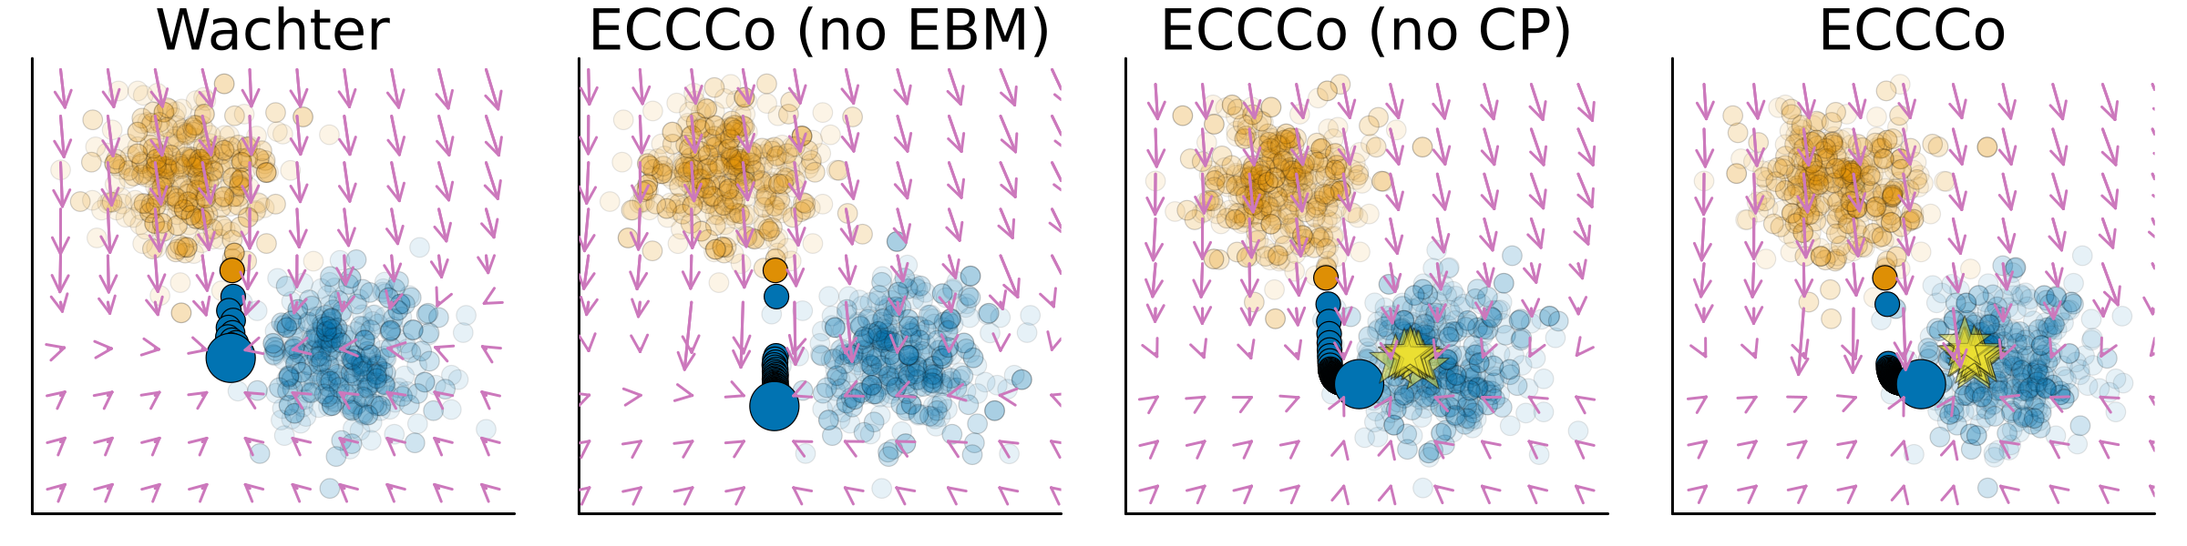
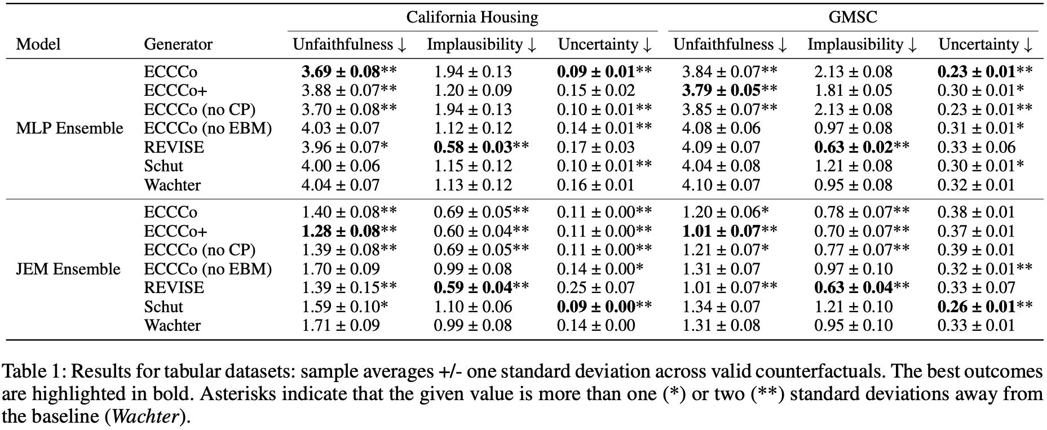





Faithful Model Explanations through Energy-Constrained Conformal Counterfactuals
The 38th Annual AAAI Conference on Artificial Intelligence
We propose ECCCo:
A new way to generate faithful model explanations that are as plausible as the underlying model permits.
Patrick Altmeyer (p.altmeyer@tudelft.nl)
Mojtaba Farmanbar, Arie van Deursen, Cynthia C. S. Liem
ECCCos from the Black Box
MOTIVATION
BACKGROUND
Reconciling Faithfulness and Plausibility
PLAUSIBILITY
FAITHFULNESS
Counterfactual Explanation (CE) explain how inputs into a model need to change for it to produce different outputs.
Counterfactual Explanations that involve realistic and actionable changes can be used for the purpose of Algorithmic Recourse (AR).
Counterfactual Explanation (CE) explain how inputs into a model need to change for it to produce different outputs.
Counterfactual Explanations that involve realistic and actionable changes can be used for the purpose of Algorithmic Recourse (AR).
Figure 2: Generating a counterfactual for 🐱 following Wachter et al. (2018). The contour shows the predictions of a simple multi-layer perceptron (MLP).
Figure 2: Generating a counterfactual for 🐱 following Wachter et al. (2018). The contour shows the predictions of a simple multi-layer perceptron (MLP).
ECCCo
RESULTS
By introducing a second penalty term, we can explicitly penalize external costs:
RESOURCES
Online Companion
GitHub Repository
Julia Package
Personal Website
Disclaimer: This poster was created by Patrick Altmeyer for the First IEEE Conference on Secure and Trustworthy Machine Learning. Images produced by author.

