Slide 1


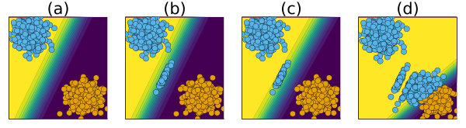
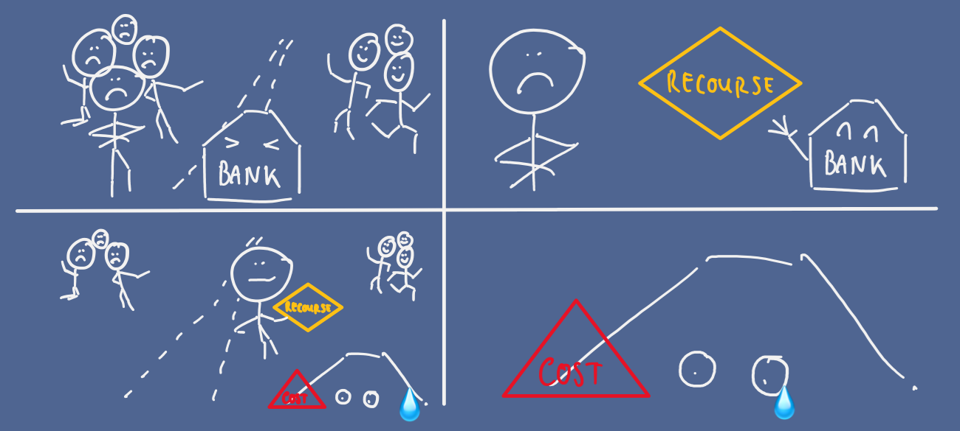
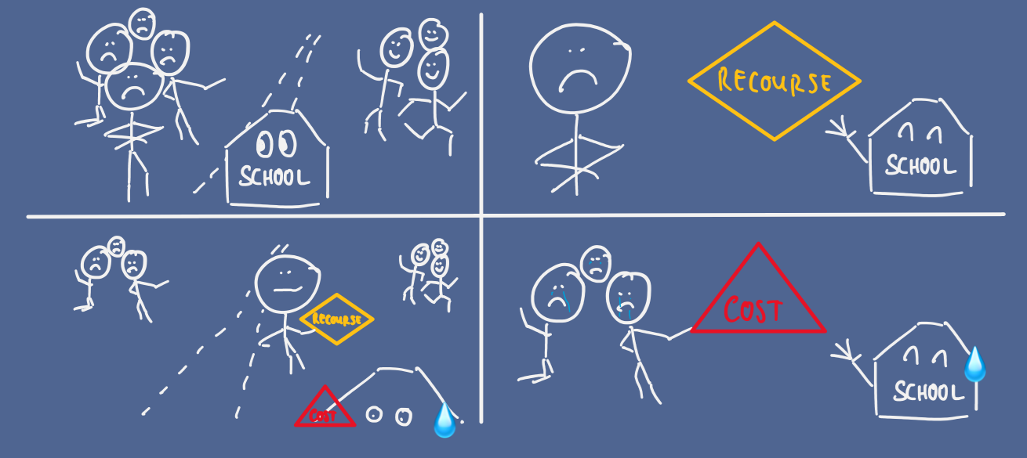
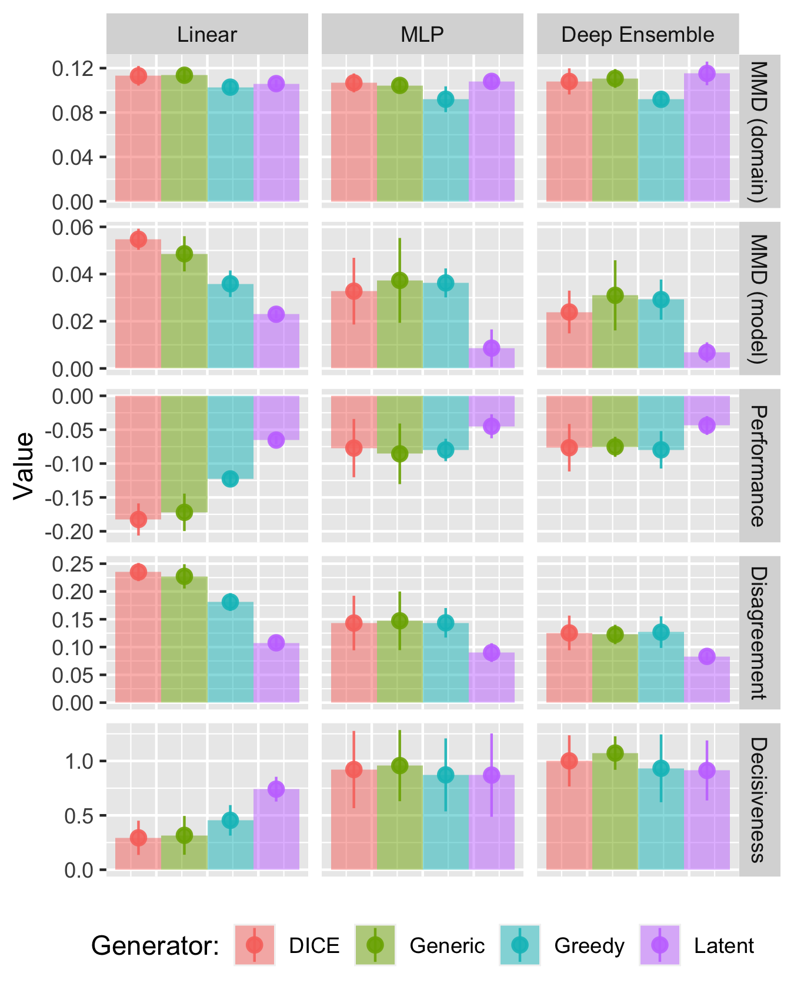
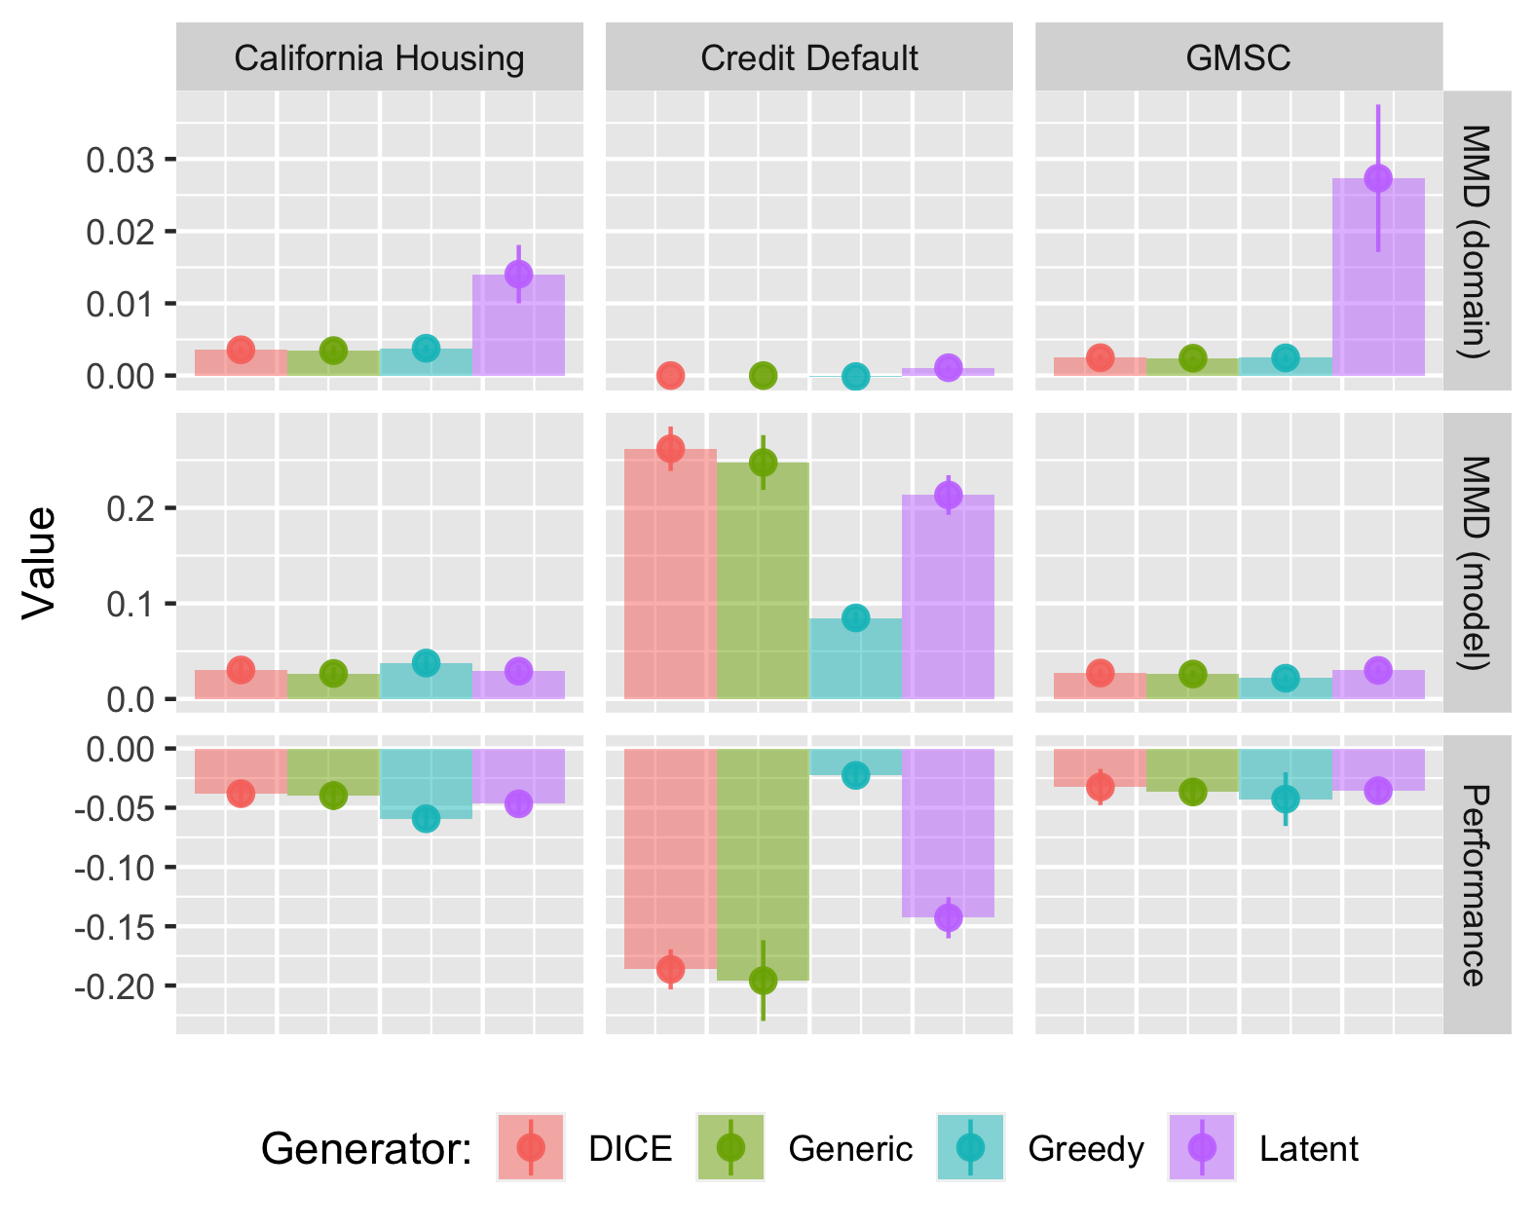
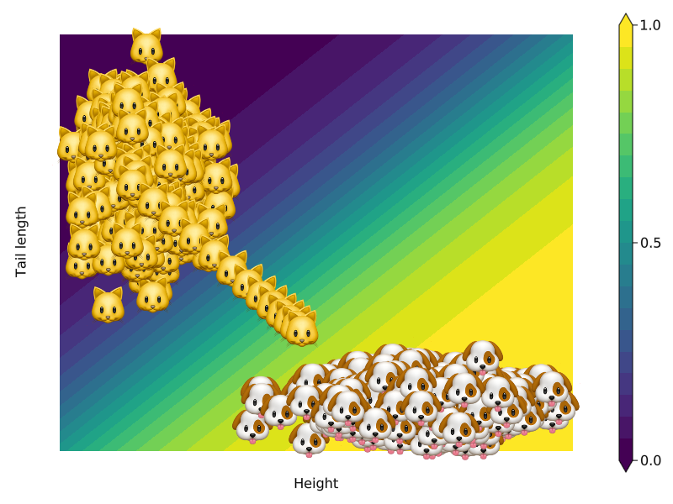
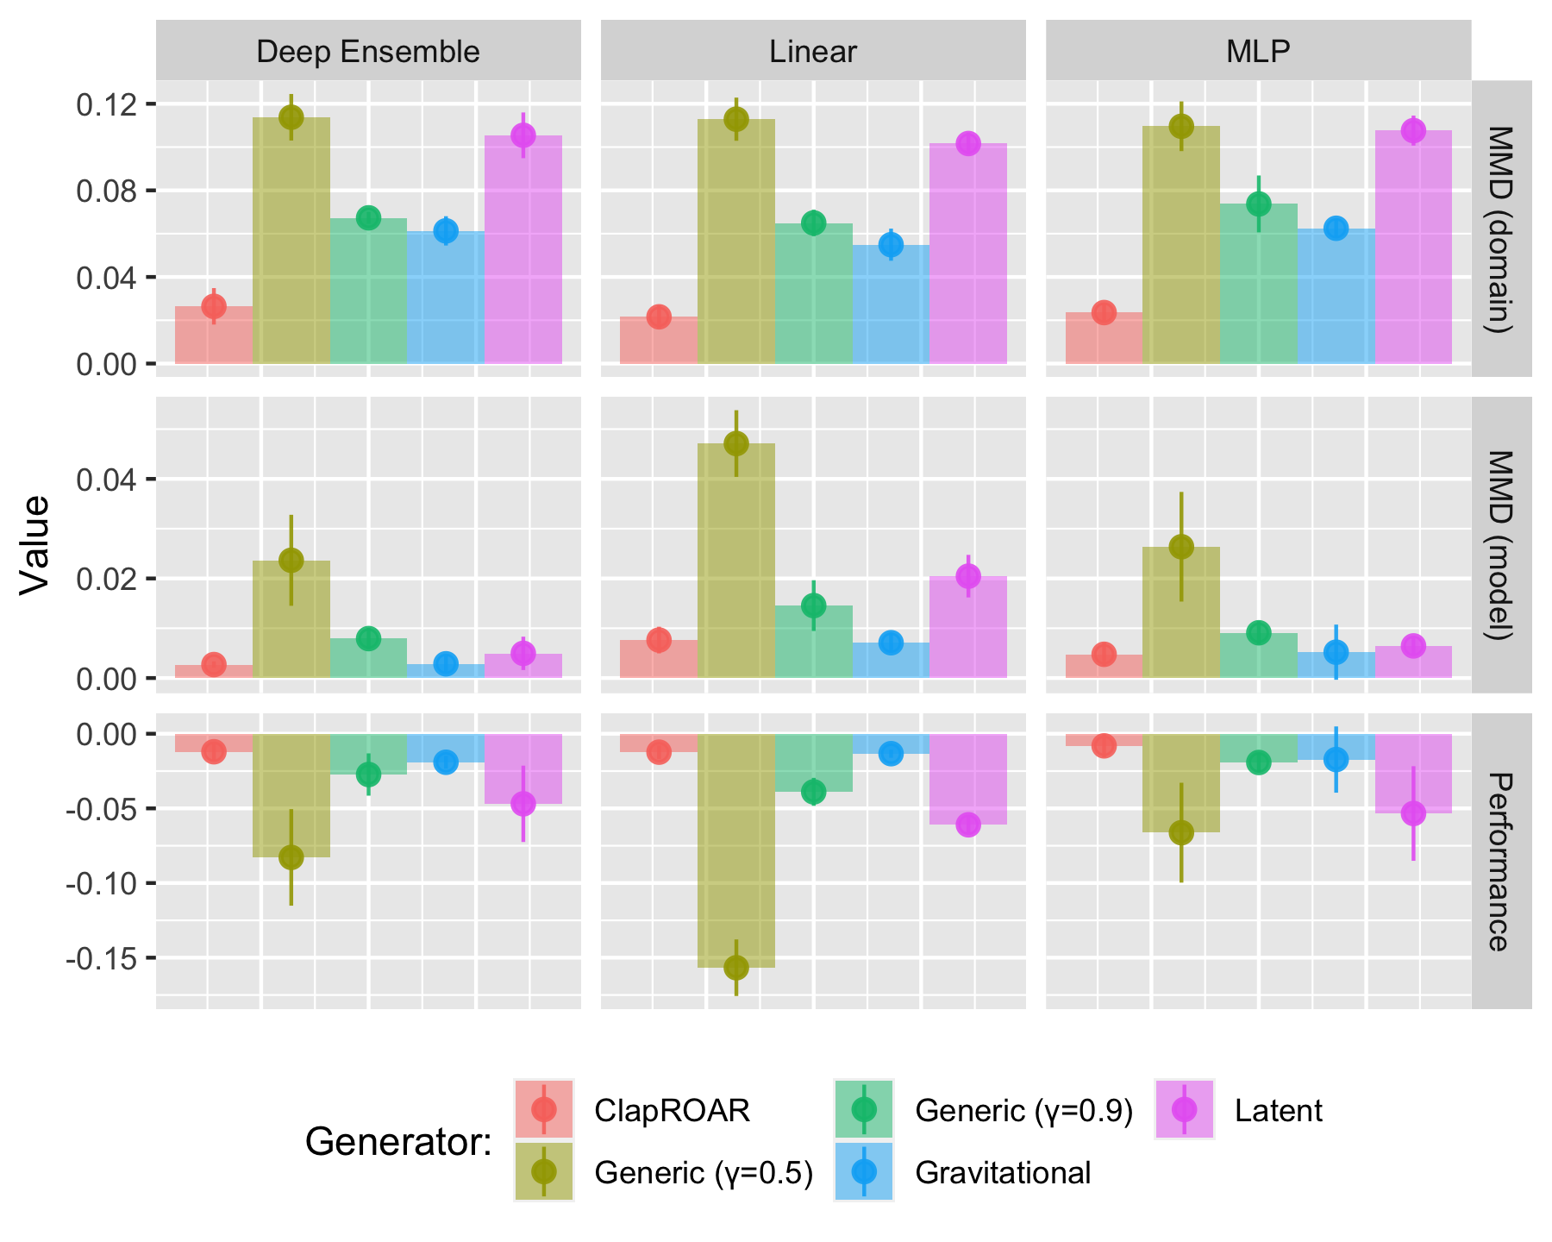
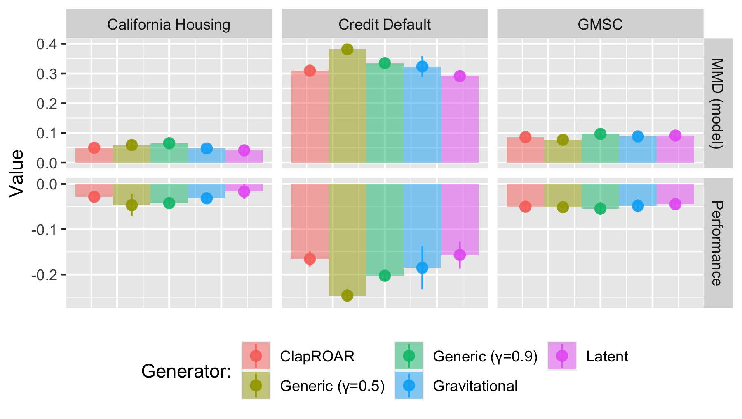
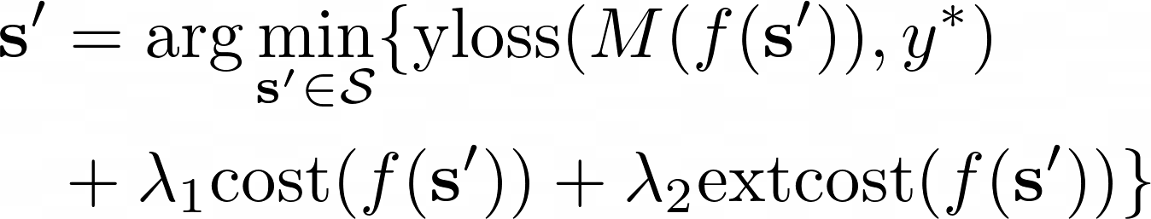
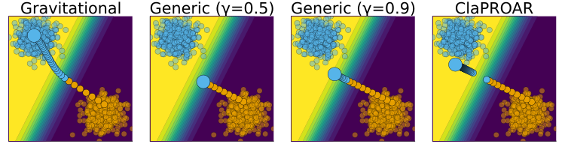







Endogenous Macrodynamics in Algorithmic Recourse
Patrick Altmeyer (p.altmeyer@tudelft.nl)
Giovan Angela (g.j.a.angela@student.tudelft.nl)
Aleksander Buszydlik (a.j.buszydlik@student.tudelft.nl)
Karol Dobiczek (k.t.dobiczek@student.tudelft.nl)
Arie van Deursen (arie.vandeursen@tudelft.nl)
Cynthia C. S. Liem (c.c.s.liem@tudelft.nl)
First IEEE Conference on Secure and Trustworthy Machine Learning
In a nutshell …
Proof-of-Concept
Key Takeaways
“[…] we run experiments that simulate the application of recourse in practice using various state-of-the-art counterfactual generators and find that [they] induce substantial domain and model shifts.”
－ Altmeyer et. al (2023)
Figure 1 illustrates the what we understand as Endogenous Macrodynamics in Algorithmic Recourse:
Simple linear classifier trained for binary classification.
Implementation of AR leads to a domain shift.
Classifier retraining leads to corresponding model shift.
Over time decision boundary moves away from target class (blue).
Our findings indicate that state-of-the-art approaches to Algorithmic Recourse induce substantial domain and model shifts.
We would argue that the expected external costs of individual recourse should be shared by all stakeholders.
A straightforward way to achieve this is to penalize external costs in the counterfactual search objective function.
Various simple strategies based on this notion can be effectively used to mitigate shifts.
Figure 1: Dynamics in Algorithmic Recourse. Individuals in target class marked in blue.
MOTIVATION
MODELLING RECOURSE DYNAMICS
Example 1 (Consumer Credit)
Research Questions
Endogenous Shifts
Does the repeated implementation of recourse provided by state-of-the-art generators lead to shifts in the domain and model?
Costs
If so, are these dynamics substantial enough to be considered costly to stakeholders involved in real-world automated decision-making processes?
Heterogeneity
Do different counterfactual generators yield significantly different outcomes in this context? Furthermore, is there any heterogeneity concerning the chosen classifier and dataset?
Drivers
What are the drivers of endogenous dynamics in Algorithmic Recourse?
Mitigation Strategies
What are potential mitigation strategies with respect to endogenous macrodynamics in AR?
Example 2 (Student Admission)
PRINCIPAL FINDINGS
BACKGROUND
Figure 5: Results for real-world data.
Counterfactual Explanation (CE) explain how inputs into a model need to change for it to produce different outputs.
Counterfactual Explanations that involve realistic and actionable changes can be used for the purpose of Algorithmic Recourse (AR).
Endogenous Shifts
Costs
Heterogeneity
Drivers
Minimizing private costs vs. complying with data generating process
Figure 4: Results for synthetic data.
SECONDARY FINDINGS
Figure 7: Results for real-world data using mitigation strategies.
Figure 2: Generating a counterfactual for 🐱 following Wachter et al. (2018). The contour shows the predictions of a simple multi-layer perceptron (MLP).
Figure 6: Results for synthetic data using mitigation strategies.
Mitigation Strategies
Can effectively mitigate shifts by penalizing external costs
TOWARDS COLLECTIVE RECOURSE
LIMITATIONS & FUTURE WORK
By introducing a second penalty term, we can explicitly penalize external costs:
Ad-hoc solution to tradeoff between private vs. external costs.
Experimental design is a vast over-simplification of potential real-world scenarios.
We have omitted recourse generators that incorporate causal knowledge.
Analysis limited to differentiable linear and non-linear classifiers, no trees.
RESOURCES
Figure 3: Mitigation strategies compared to the baseline approach, that is, Wachter (Generic) with γ = 0.5; choosing a higher decision threshold pushes the counterfactual a little further into the target domain; this effect is even stronger for ClaPROAR; finally, using the Gravitational generator the counterfactual ends up all the way inside the target domain.
Online Companion
GitHub Repository
Julia Package
Personal Website
Disclaimer: This poster was created by Patrick Altmeyer for the First IEEE Conference on Secure and Trustworthy Machine Learning. Images produced by author.

