Slide 1




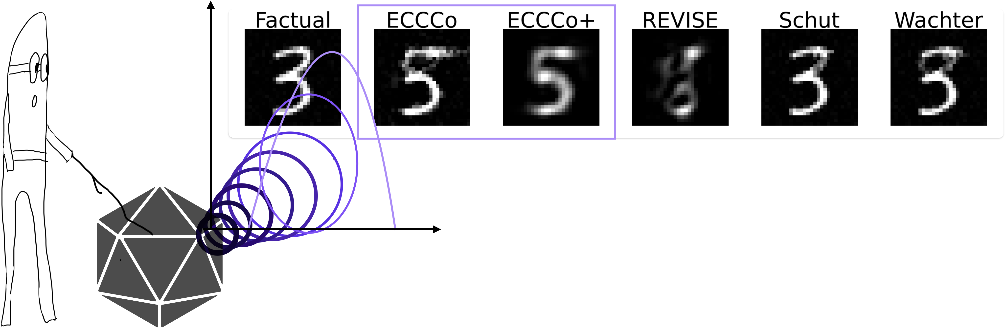
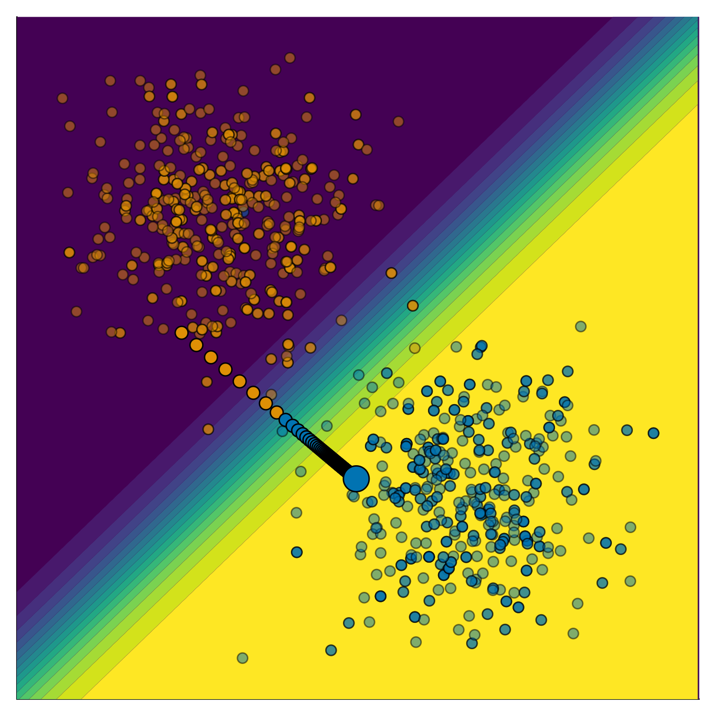

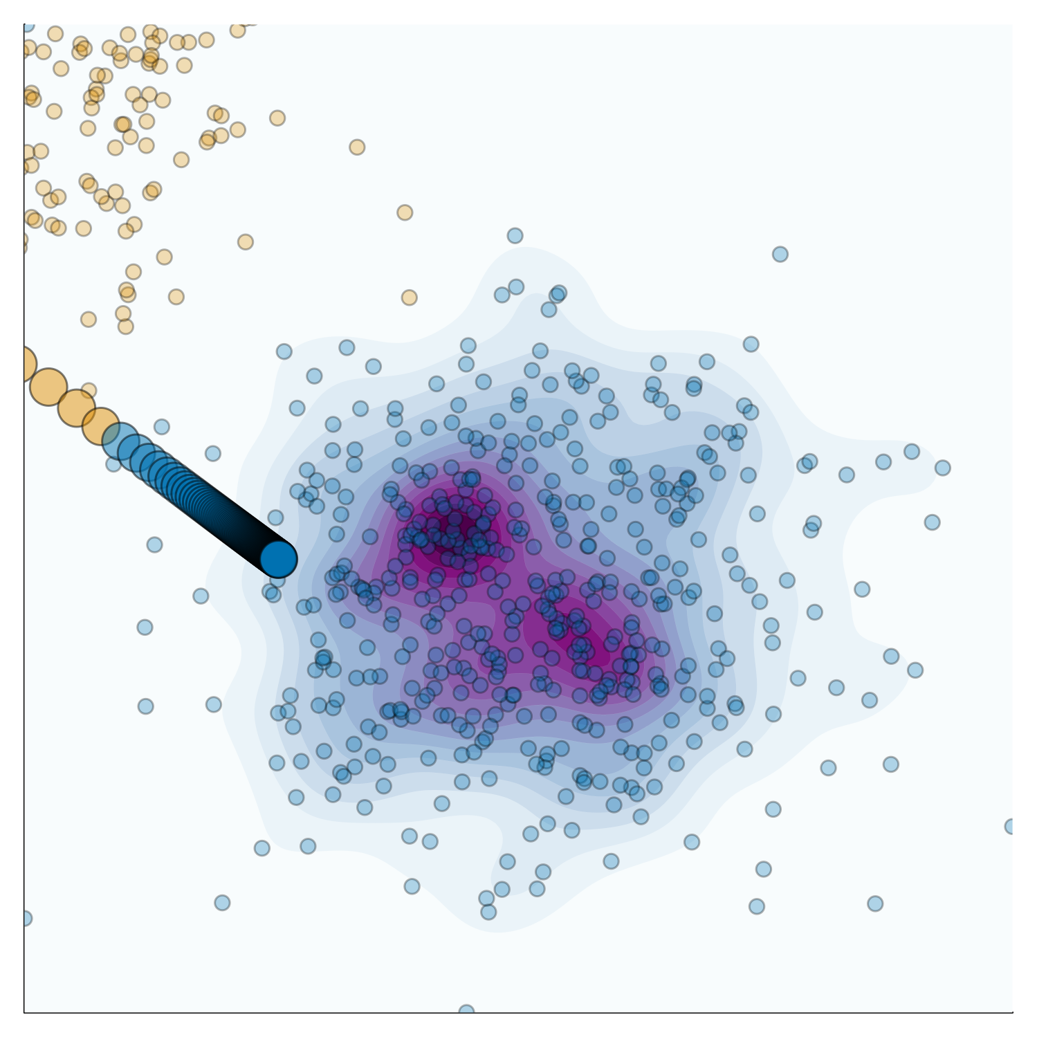
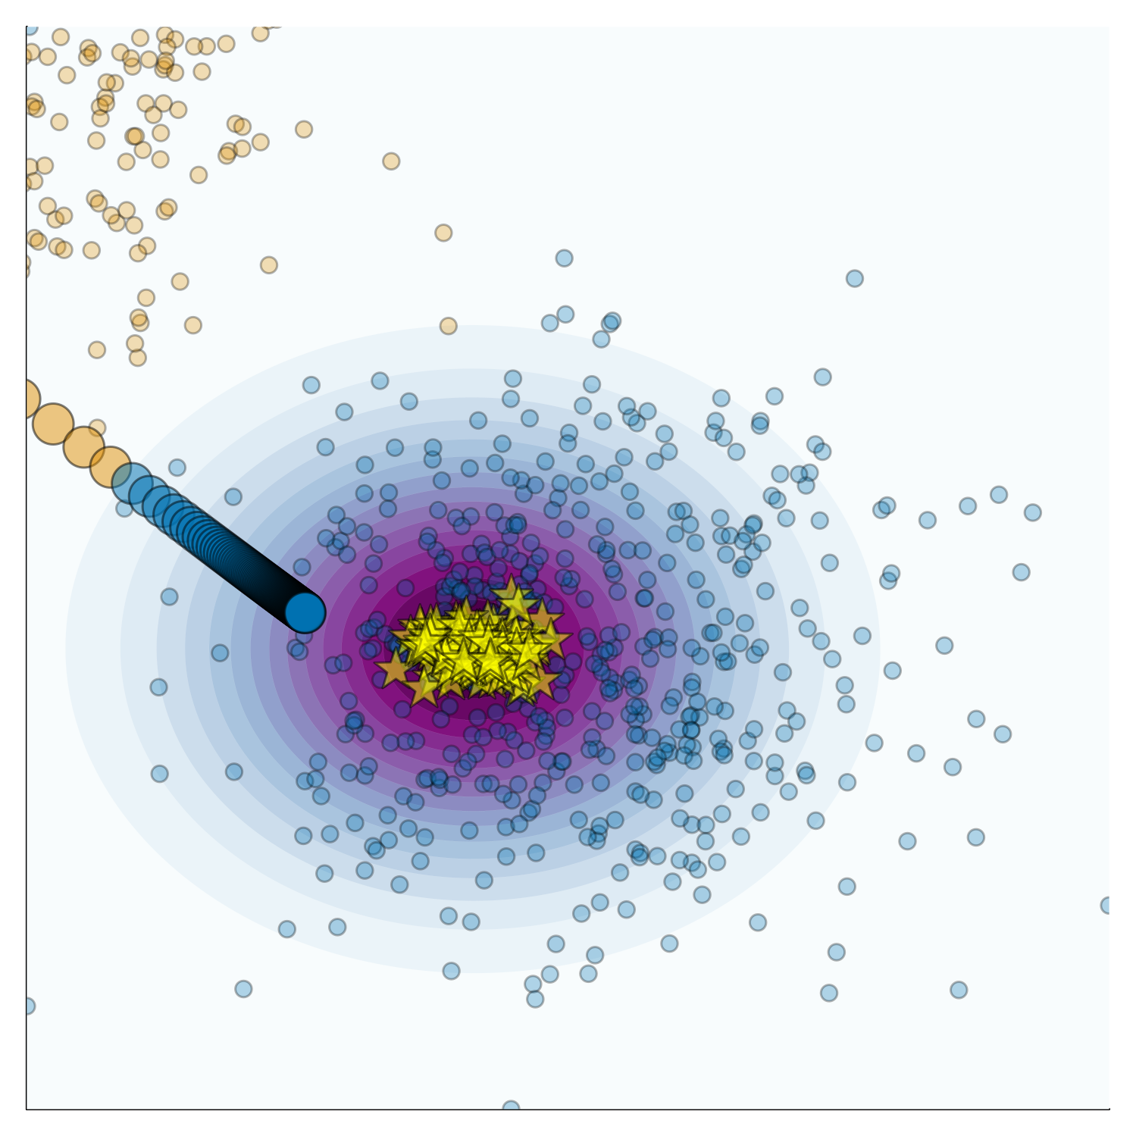
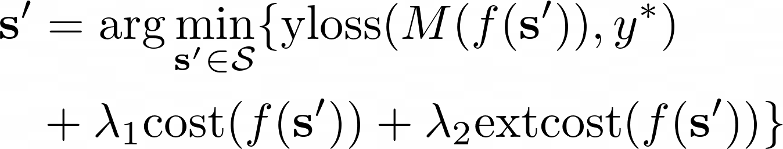
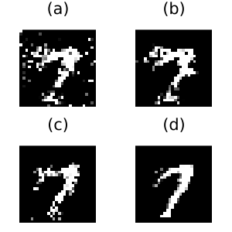
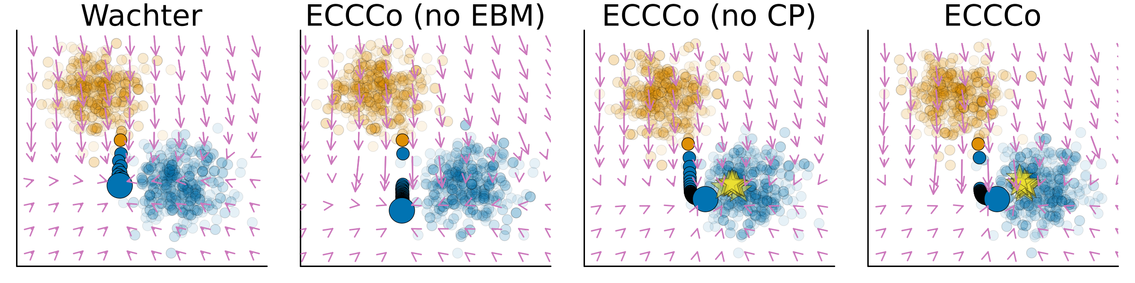
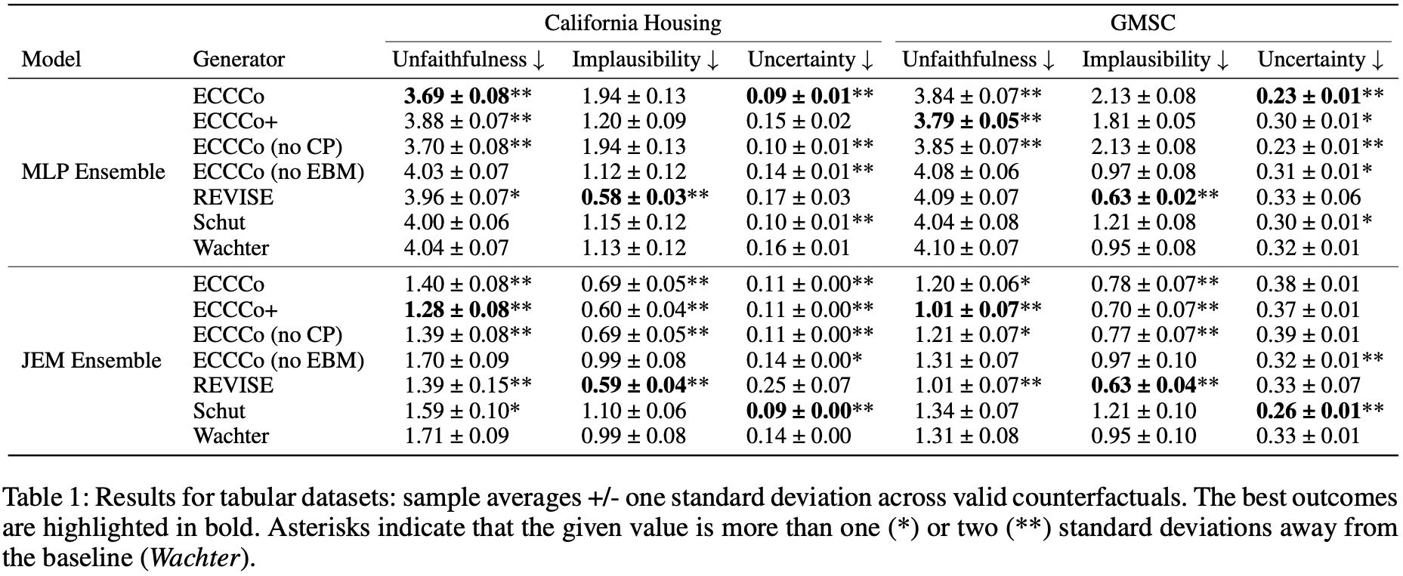





The 38th Annual AAAI Conference on Artificial Intelligence
ECCCos from the Black Box
Faithful Model Explanations through Energy-Constrained Conformal Counterfactuals
Patrick Altmeyer (p.altmeyer@tudelft.nl), Mojtaba Farmanbar, Arie van Deursen, Cynthia C. S. Liem
MOTIVATION
BACKGROUND
PLAUSIBILITY
FAITHFULNESS
Figure 2: Generating a counterfactual for 🐱 following Wachter et al. (2018). The contour shows the predictions of a simple multi-layer perceptron (MLP).
Figure 2: Generating a counterfactual for 🐱 following Wachter et al. (2018). The contour shows the predictions of a simple multi-layer perceptron (MLP).
METHOD
RESULTS
By introducing a second penalty term, we can explicitly penalize external costs:
RESOURCES
Online Companion
GitHub Repository
Julia Package
Personal Website
Disclaimer: This poster was created by Patrick Altmeyer for the 38th Annual AAAI Conference on Artificial Intelligence. Images produced by author.

