Slide 1


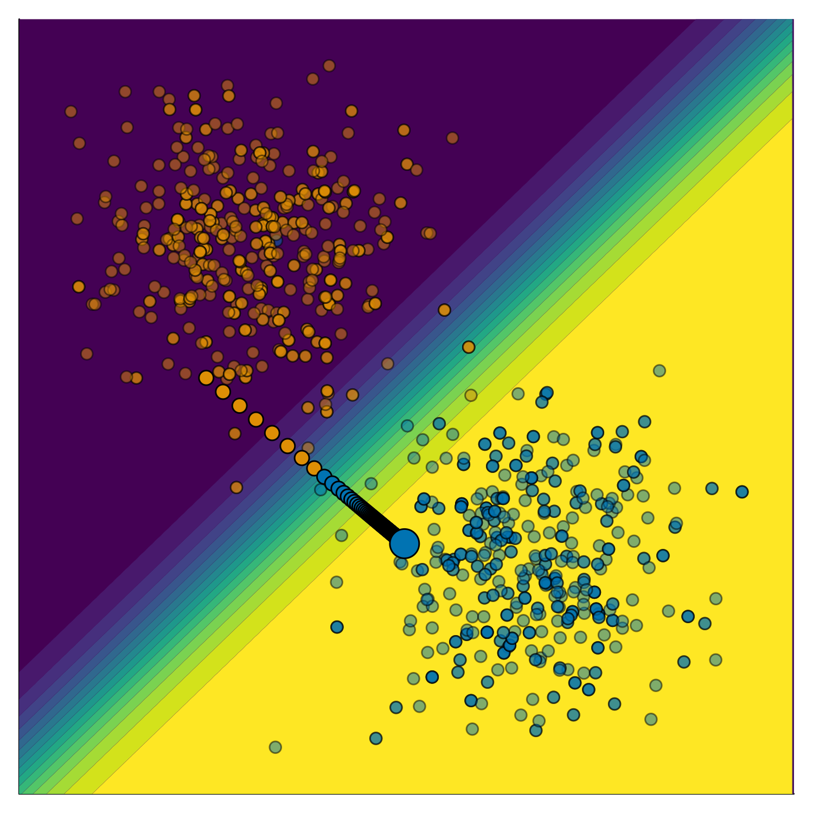





Stop Making Unscientific AGI Performance Claims
Patrick Altmeyer (p.altmeyer@tudelft.nl), Andrew M. Demetriou, Antony Bartlett, Cynthia C. S. Liem
BACKGROUND
Counterfactual Explanations (CE) explain
how inputs into a model need to change for it to produce different outputs
Figure 1: Gradient-based counterfactual search.
LEARN MORE
Disclaimer: This poster was created by Patrick Altmeyer for the ICML 2024 conference. Images produced by author.
Supplementary Appendix
GitHub Repository
Trustworthy AI in Julia - Taija
Personal Website

