Slide 1
Worksheet Formatting
CSC105
Prof. Earl

Slide 2
Table of Contents/Agenda
Labels
Annotations
Tooltips
Formatting Specific parts of the View
Editing & Formatting Axes
Slide 3
Slide 8
Slide 12
Slide 19
Slide 22

Slide 3
Labels

Slide 4
Labels
Start by making a line chart – Sales by month (continuous) of Order Date, Market onto color
Click the Label shelf to see the options:
Checking this box will turn labels on in the view, the same as clicking the “T” label button in the toolbar.
Drag Profit to the label shelf. This adds it to the label (turn it off with the toolbar). Click Label shelf, we can click on the ellipses here will bring up the full text editor to customize the label. (Only fields that have been added to the label shelf are available to use here.) Labels can be turned on for specific actions (such as highlighting) or for specific points (such as minimum/maximum), and other options here.

Slide 5
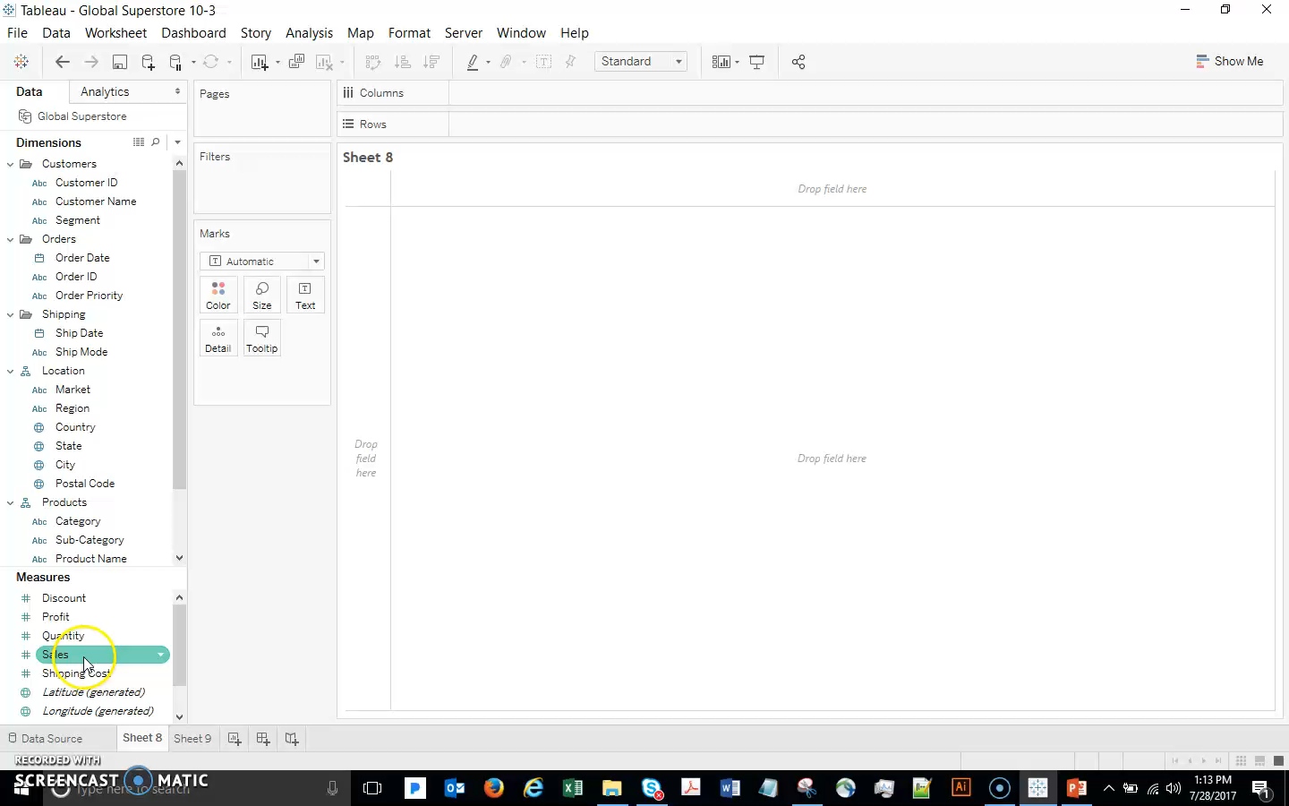
Labels

Slide 6
Labels
If you want to always (or never) see a specific label, just right click on the point, go to Mark Label, and choose the desired behavior, such as Always Show.
But you often don’t have much space in the view for labels. Often, the best way to add additional information is through the use of annotations or Tooltips.

Slide 7
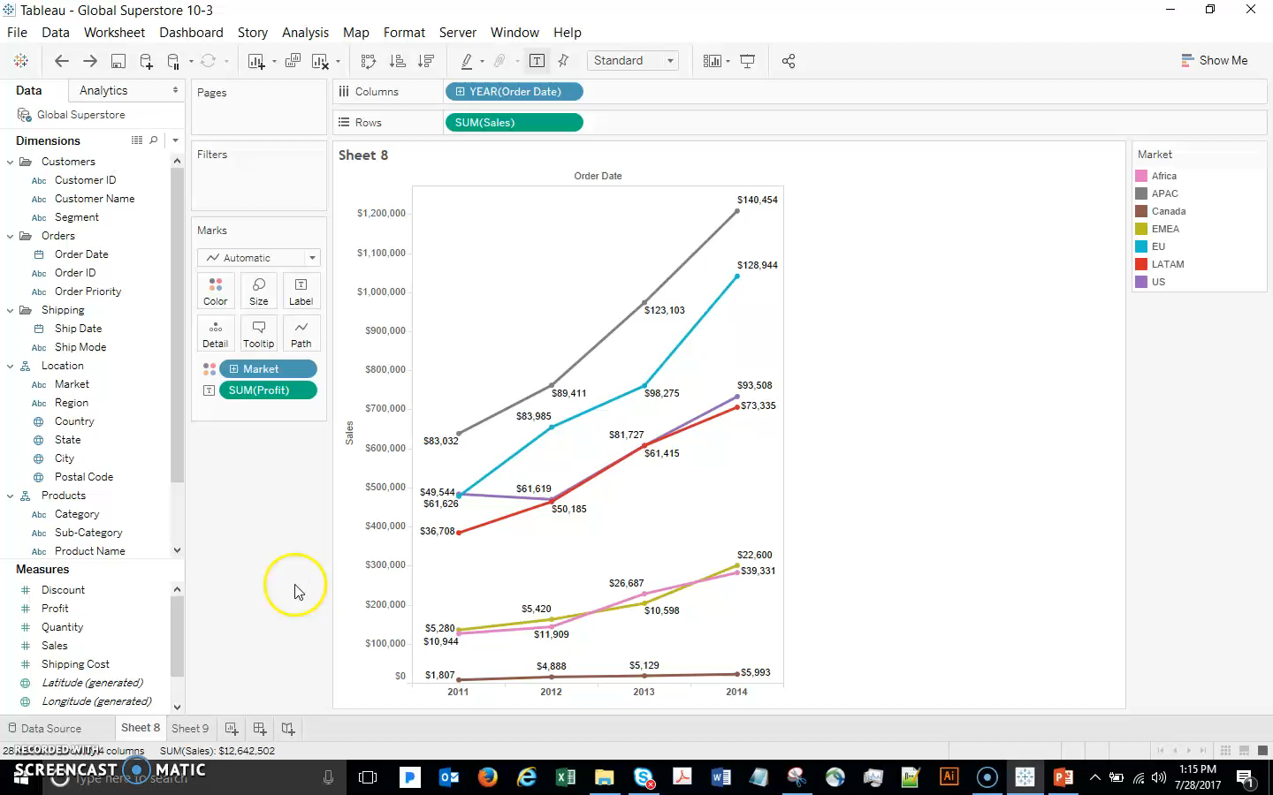
Labels

Slide 8
Annotations

Slide 9
Annotations
Annotations are text boxes used to call out something specific in the view.
A mark annotation stays with the mark itself, regardless of whatever changes are made on the view.
A point annotation stays in the same relative position on the view, independently of the mark, as does an area annotation.
Let’s start with a Mark annotation – right-click a mark select Annotate…Mark
These are not simple text boxes; like labels, annotations can have fields added to them as dynamic inputs.

Slide 10
Annotations
The appearance of annotations is easy to customize:
Single click to move or resize it.
Double click to format the text.
Right click and select Format to format the annotation box or line.
A point annotation is similar, but it will stay in a particular place in the view rather than be tied to a mark, which can move as you interact with the view.

Slide 11
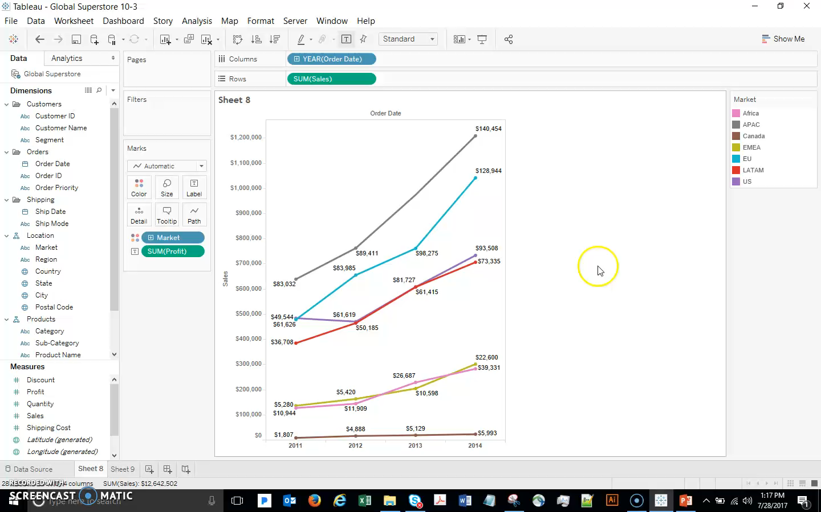
Annotations

Slide 12
Tooltips

Slide 13
Tooltips
To show Tooltips, let’s create a new worksheet:
Select Sales and Profit, choose Scatterplot from Show Me
Order Priority to Color, then Number of Records and Market to Detail.
Change the Mark to Circle, and increase the size.
Hover – the standard Tooltip here has a lot of information. But with just a little work we can make it more user-friendly and engaging:
Click Tooltip on the Marks card.

Slide 14
Tooltips
Change it to read something like (be sure to change the size and color of some words):
<Market> Market's <Order Priority> priority orders
total <SUM(Sales)> in sales
with <SUM(Profit)> overall profit.
This circle represents <SUM(Number of Records)> records

Slide 15
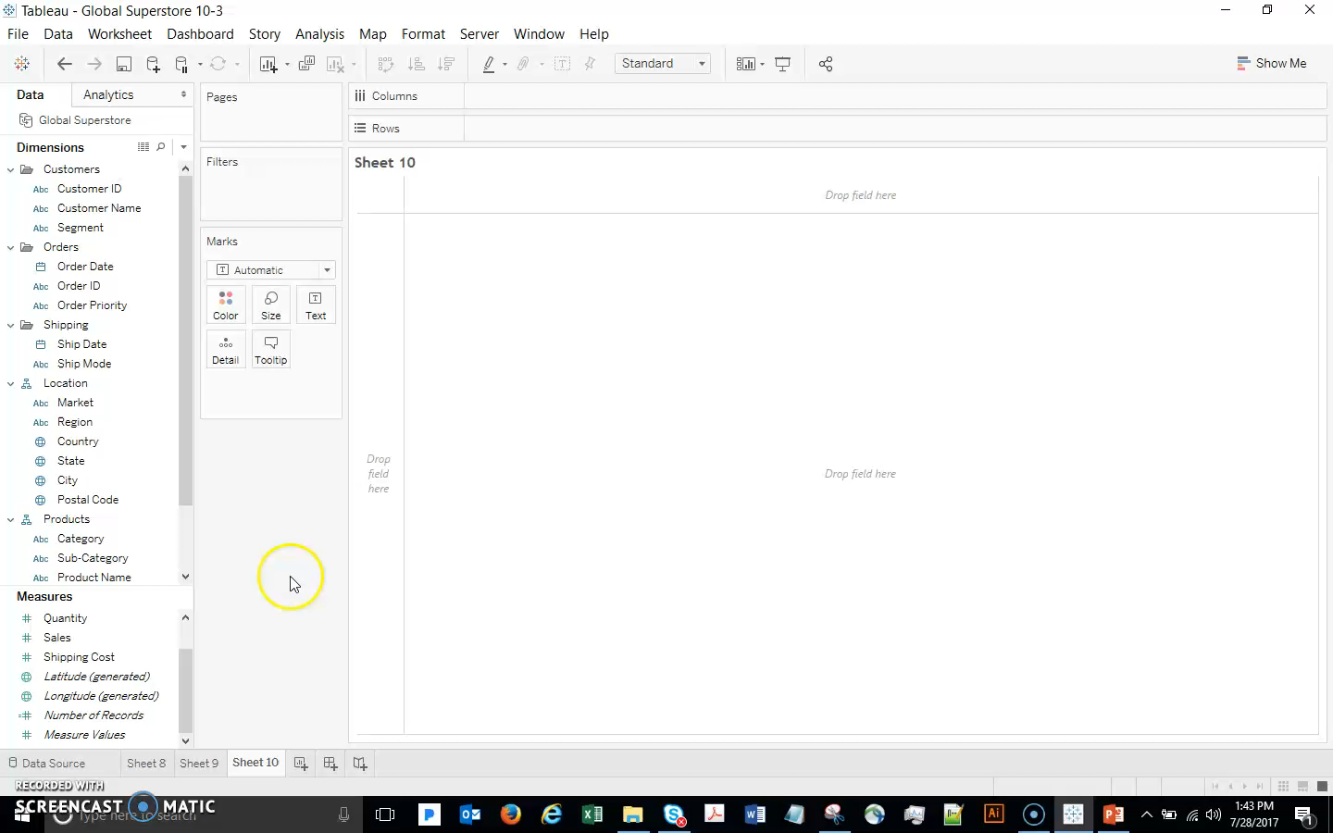
Tooltips

Slide 16
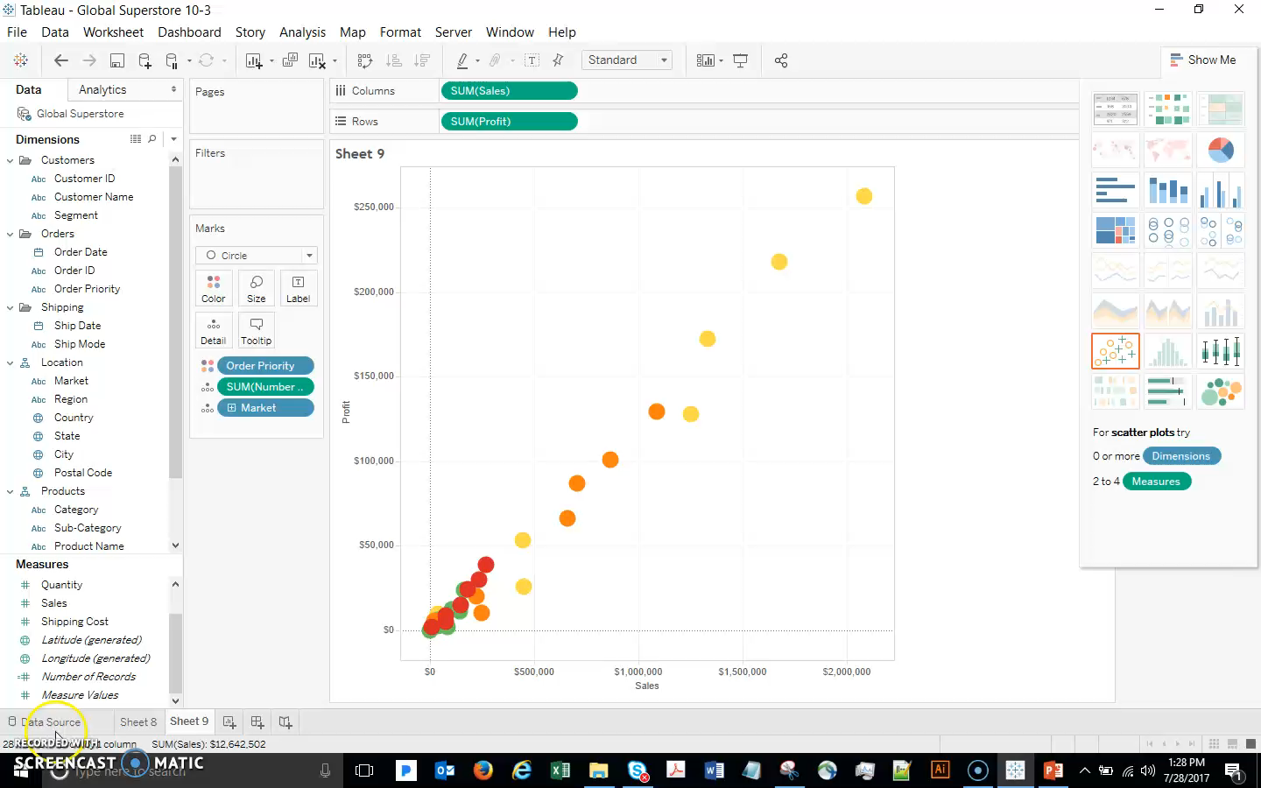
Tooltips
Remember that if you want to include a field in the tooltip that is not in your viz, just drag it to the Tooltip shelf
You can click Insert within the Tooltip window to bring up the list of fields available to the tooltip

Slide 17
Tooltips
In addition, if you prefer not to see the command buttons (keep only, group, view underlying data, etc), you can turn them off with a checkbox in the Tooltip window.
With every viz you make, don’t forget to pay attention to the Tooltips! They are often an important part of the user experience.

Slide 18
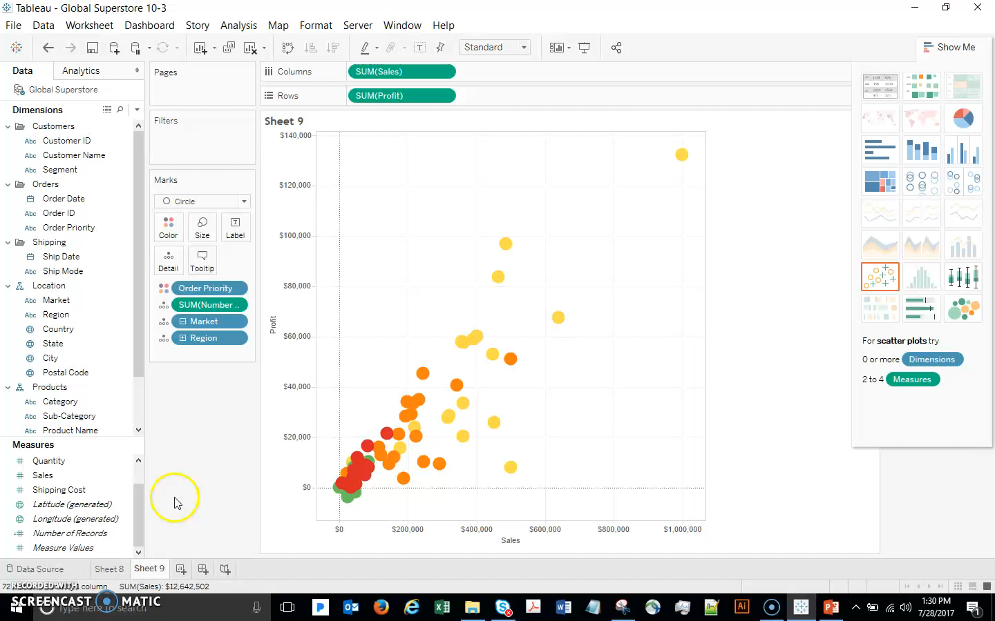
Tooltips

Slide 19
Formatting Specific Parts of the View

Slide 20
Formatting Specific Parts of the View
Many parts of the view can be independently formatted. To see if a field, number, legend, or other part of the view can be formatted, right click or bring up the menu to see if the format option is available.
For example, first create and show a Filter for Order Priority
Let’s format it. Click the drop down in the Filter and click Format Filters
The Format pane opens, offering us various options. Change the Font of the Body as an example. Just click the X to close the Format pane.

Slide 21
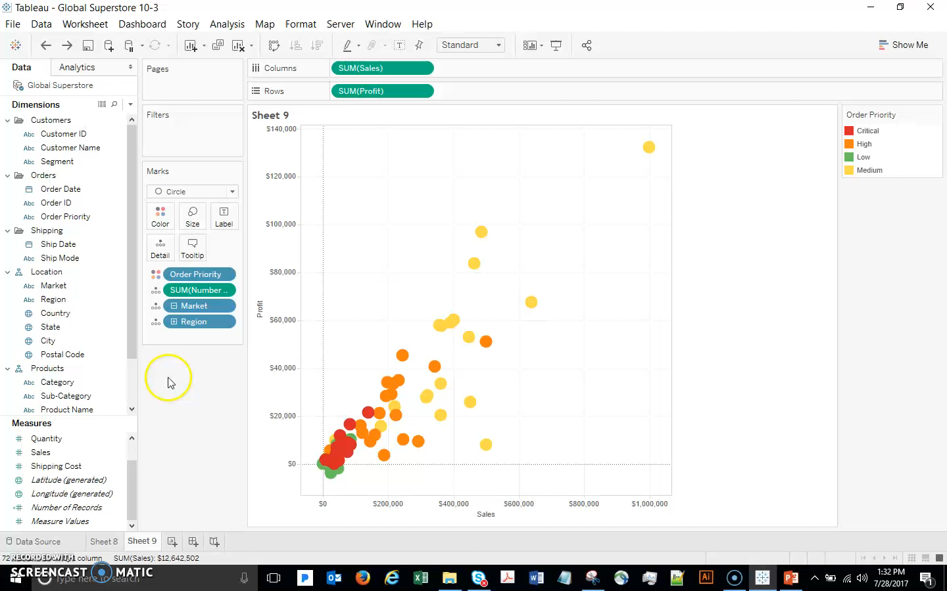
Formatting Specific Parts of the View

Slide 22
Editing & Formatting Axes

Slide 23
Editing & Formatting Axes
To adjust anything having to do with the layout of the axis, right click and select Edit Axis.
This dialog controls the range, tick marks, and the title.
We can edit the range, to a fixed range that we prefer. You can change the tick marks, axis title, etc. also
Additionally, this pin icon has appeared – this indicates the axis is no longer automatic.
Double click the pin and change it back to Automatic axis.
To hide an axis entirely, right click on the axis and uncheck Show Header.

Slide 24
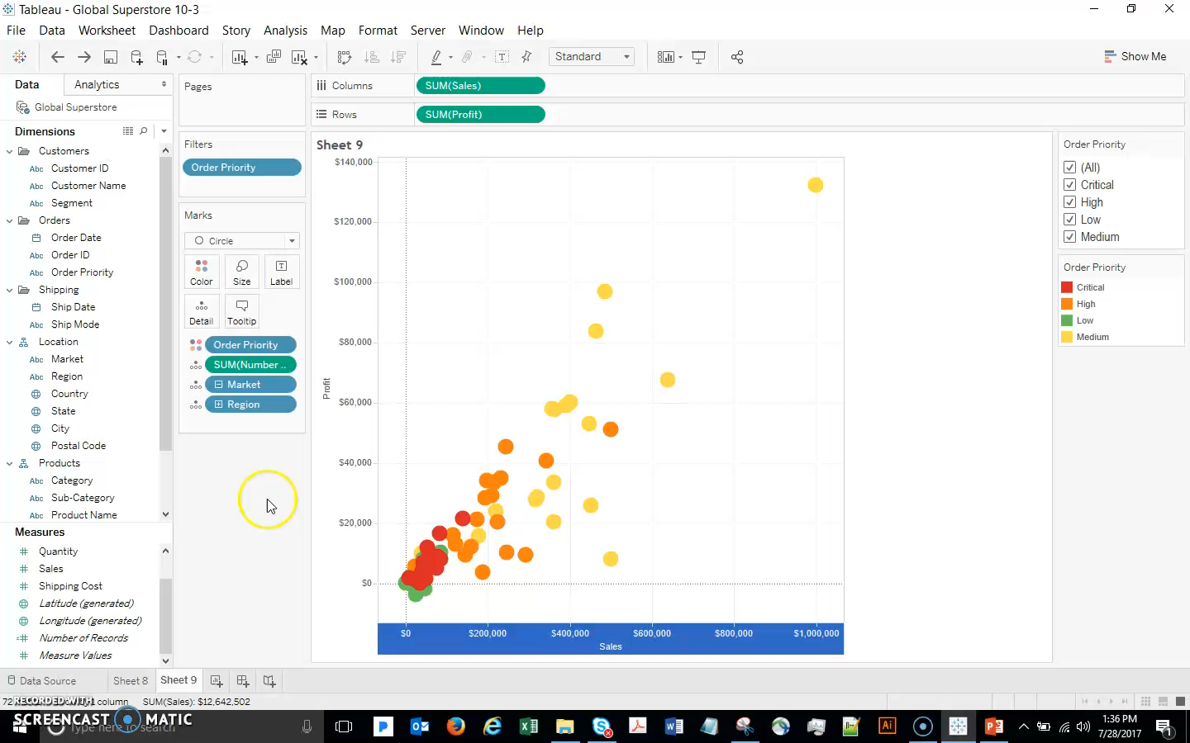
Editing & Formatting Axes

