Slide 1
Distributions
CSC105
Fall 2021
Prof. Earl

Slide 2
Table of Contents/Agenda
Distribution of Discrete Variables
Distribution of Continuous Variables
Histograms
Box Plots
Measuring Center
Slide 3
Slide 10
Slide 13
Slide 21
Slide 30

Slide 3
Distribution of Discrete Variables

Slide 4
Distribution of Discrete Variables
Frequency Table
See Online Stats, pages 40-42

Slide 5
Distribution of Discrete Variables
Bar chart of Frequency Distribution

Slide 6
Distribution of Discrete Variables
Bar chart of Distribution as proportion

Slide 7
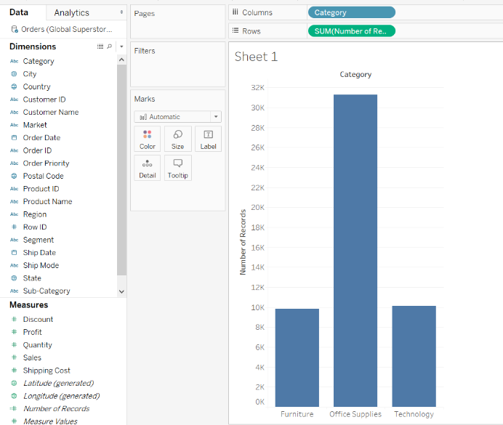
Distribution of Discrete Variables
Bar chart of Frequency Distribution
Click on Sheet 1
Drag Orders (Count) to Rows shelf
Drag Category to Columns shelf

Slide 8
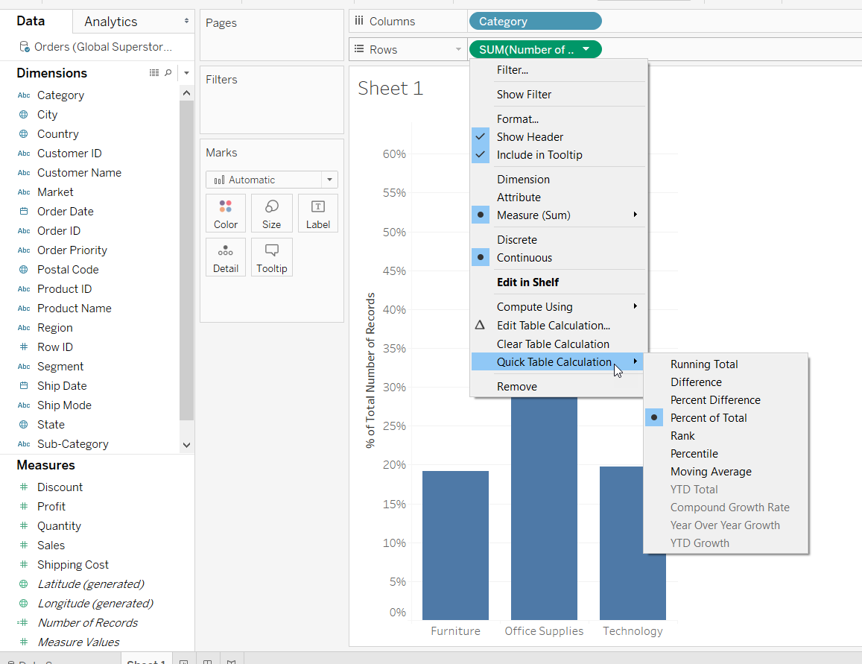
Distribution of Discrete Variables
Bar chart of Distribution as proportion (or percentage)
Click on Sheet 1
Drag Orders (Count) to Rows shelf
Drag Category to Columns shelf
Click arrow on Orders (Count) Pill
Select Quick Table Calculation
Select Percent of Total

Slide 9
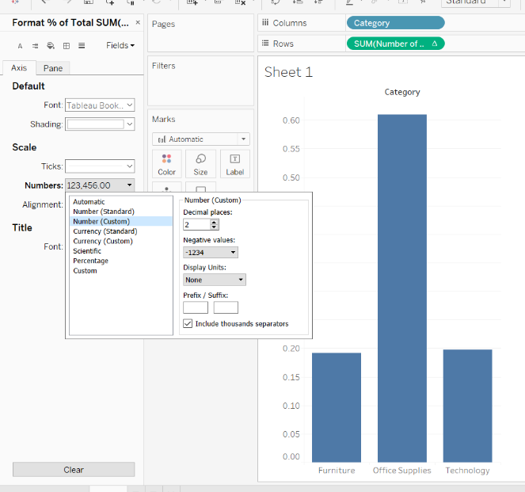
Distribution of Discrete Variables
Bar chart of Distribution as proportion (or percentage)
Click on Sheet 1
Drag Number of Records to Rows shelf
Drag Category to Columns shelf
Click arrow on Number of Records Pill
Select Quick Table Calculation
Select Percent of Total
Right-click on y-axis
Select format
Under Numbers, select format of numbering and pick 2 decimals

Slide 10
Distribution of Continuous Variables

Slide 11
Distribution of Continuous Variables
See Online Stats, pages 43-51

Slide 12
Distribution of Continuous Variables
See Online Stats, pages 43-51

Slide 13
Distribution of Continuous Variables
Histogram
See Online Stats, pages 43-51 and 82-85

Slide 14
Continuous Distributions
Represent all potential data points at once.
Also have the name “probability density curves”
The area under the curve is 100% or 1.0
The y-axis shows the chance of obtaining values near the corresponding points on the x-axis.
Special shape that we see often in nature is called the Normal Distribution
See Online Stats, pages 43-51

Slide 15
Distribution of Continuous Variables
Distributions of many shapes
See Online Stats, pages 43-51

Slide 16
Distributions of many shapes
Positive Skew
See Online Stats, pages 43-51

Slide 17
Distributions of many shapes
Negative Skew
See Online Stats, pages 43-51

Slide 18
Distributions of many shapes
Continuous Distribution of
Negative skew
See Online Stats, pages 43-51

Slide 19
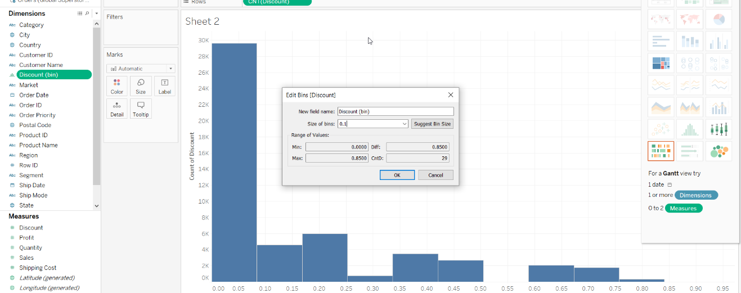
Histograms in Tableau

Slide 20
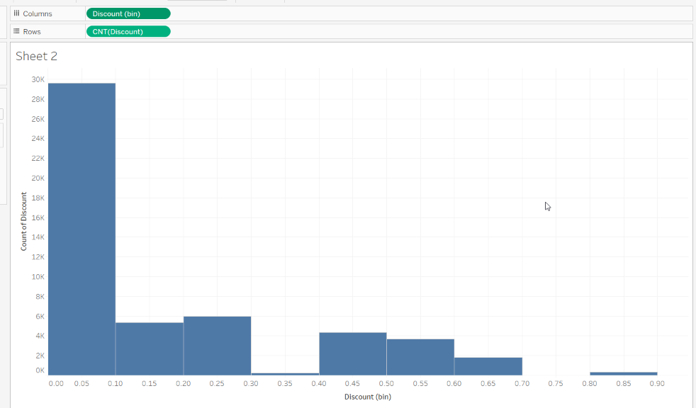
Histograms in Tableau

Slide 21
Graphing Distributions
Box Plots

Slide 22
Box Plots
Useful for identifying Outliers and comparing distributions
Other name: Box and Whiskers Plot
Introduced by John Tukey in 1970’s
See Online Stats, pages 92-100

Slide 23
Outliers
Atypical and infrequent observations
Values that have an extreme deviation from the center of the distribution.
No universally-agreed on criterion for defining an outlier
Outliers should only be discarded with extreme caution.
One should always assess the effects of outliers on the statistical conclusions.

Slide 24
Box Plots
Calculate Percentiles
14 15 16 16 17 17 17 17 17 18 18 18 18 18 18 19 19 19 20 20 20 20 20 20 21 21 22 23 24 24 29
25 percentile or lower hinge (Q1)
50 percentile or median (Q2)
75 percentile or upper hinge (Q3)
See Online Stats, pages 92-100

Slide 25
Box Plots
First step, plot 25th, 50th and 75th percentiles
Women’s scores: 25th = 17, 50th= 19, 75th = 20
See Online Stats, pages 92-100

Slide 26
Box Plots
Another name for H-spread is Interquartile Range or IQR. 50% of the values are found in the IQR.
To determine where potential outliers may be, we ask if we have any values greater than 1.5 * H-spread (or IQR) above the 75th percentile or any values less than 1.5* H-spread below the 25th percentile.
See Online Stats, pages 92-100

Slide 27
Box Plots
Fences are not shown in the final plot
The mean is sometimes added to a box plot to compare with the median
‘Whiskers’ are placed at upper and lower adjacent values to the inner fences.
Outliers are given symbols.
See Online Stats, pages 92-100

Slide 28
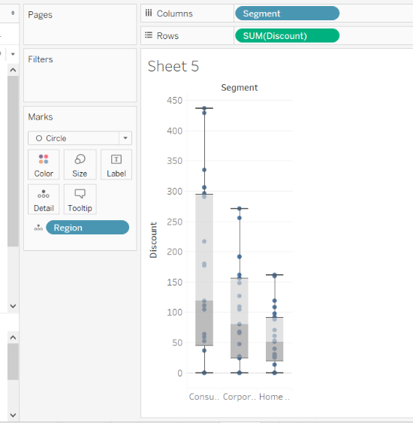
Make a Box Plot in Tableau
Segment to Columns
Discount to Rows
Region to Columns (right of Segment
Select box-and-whisker plot from Show Me

Slide 29
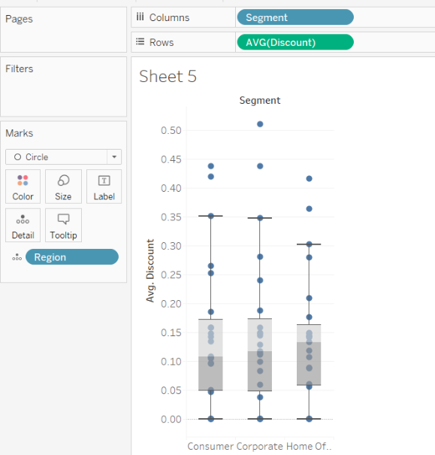
Make a Box Plot in Tableau
Segment to Columns
Discount to Rows
Region to Columns (right of Segment
Select box-and-whisker plot from Show Me
Change Discount Aggregation to AVG

Slide 30
Measuring Center
Mean, Median, and Mode

Slide 31
Measuring Center
Mean
Arithmetic average
Median
The middle of the data points (½ above, ½ below)
Mode
The most frequent value

Slide 32
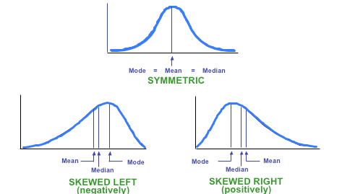
Means and Medians differ when distributions are skewed

Slide 33
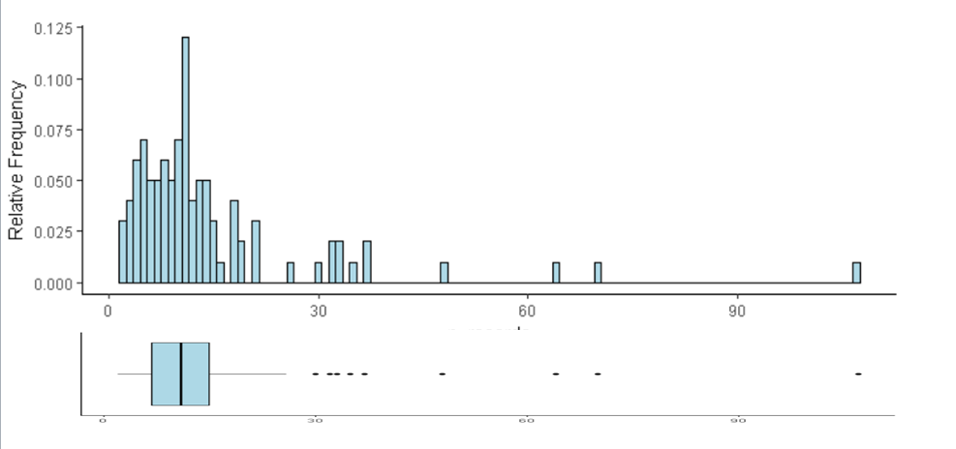
Comparing Boxplots and Histograms

