Slide 1
Fields and Variables in Tableau
Prof. Earl
CSC105

Slide 2
Dimensions and Measures

Slide 3


Dimensions vs. Measures
DIMENSIONS | MEASURES
Categorical Data | Quantitative (numerical) Data
Independent/Explanatory Variable | Dependent/Response Variable
Organize Data into groups | Are used in calculations, (Sum, Average, Count)
Answers: Who? What? Where? When? | Answers: How much? How many? How long?
Dimensions group or slice Measures | Measures aggregate and recalculate with every Dimension brought into a visualization
Not typically aggregated | Most often are aggregations
Shown as its field name in Tableau | Display the aggregation and field name

Slide 4
Dimensions in Tableau
Dimensions set the granularity or the level of detail in the view
Things you group by or drill down by
Usually (but not always) categorical fields
E.G. City or Order Priority
It doesn't make sense to compute an average City or average Order Priority (these are words). It makes sense to slice or group the data using these fields instead. We want to view our data by some combination of these categories.
The dimensions we use will determine how many 'marks' we have – Order Priority has 3 categories, so it would give us 3 marks.

Slide 5
Measures in Tableau
Measures are aggregations – they’re aggregated up to the granularity set by the dimensions in the view
Measures are usually numerical data like Shipping Cost or Sales
Think of them as the data elements that you can calculate
The value of a measure depends on the context of the dimensions.

Slide 6
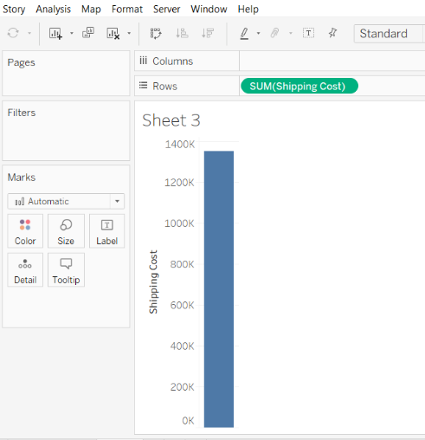
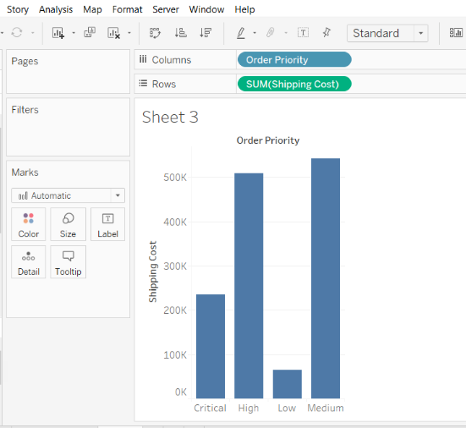
Dimensions and Measures in Tableau
Sum of Shipping Cost (Measure)
Sum of Shipping Cost with added Dimension

Slide 7

When our Dimension is Ordinal
We want categories order by ranking order
Low and Medium should be re-ordered

Slide 8
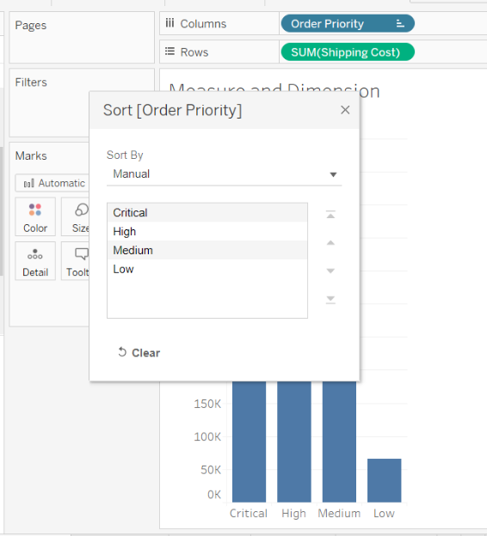
When our Dimension is Ordinal
Click on sort symbol on Order Priority pill
Select Sort
Select Manual
Reorder categories

Slide 9
Data Types

Slide 10






Data types
Think of data types as the data elements that you want to perform calculations on
Icon | Data type
 | Text (string) values
 | Date values
 | Date & time values
 | Numerical values
 | Boolean values (relational only)
 | Geographic values (used with maps)

Slide 11
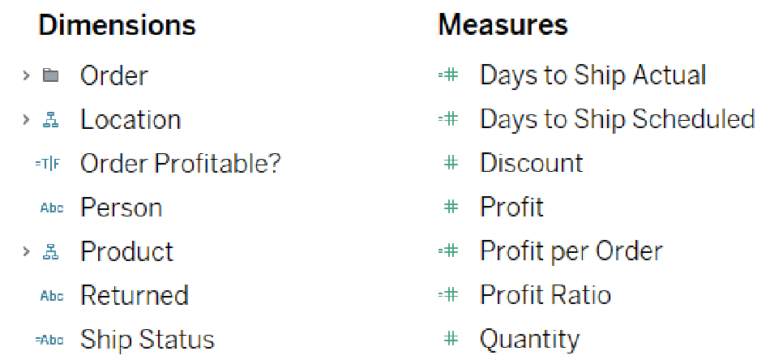
Data types
An equal sign preceding an icon indicates a calculated value field or a copy of another field

Slide 12
Discrete and Continuous

Slide 13
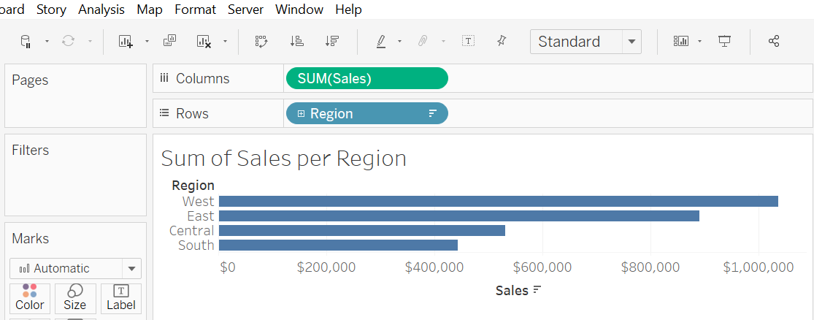
Discrete and Continuous pill color
When we bring a field into the view from the Data Window, Tableau creates a pill.
Continuous pills are GREEN
Discrete pills are BLUE
Continuous
Discrete

Slide 14
Continuous Axis vs. Category Labels

Slide 15
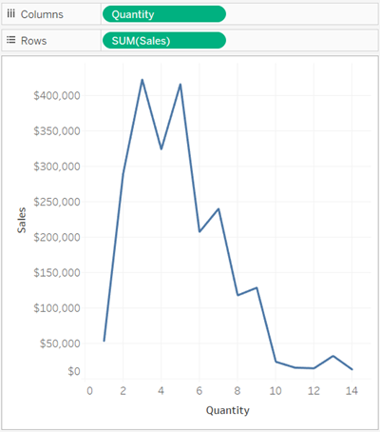
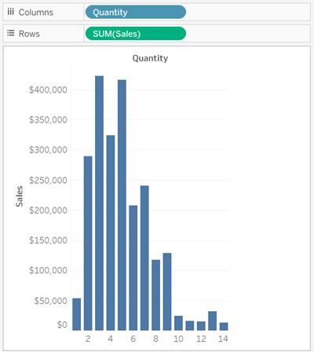
Continuous Axis vs. Category Labels
Continuous
Discrete

Slide 16
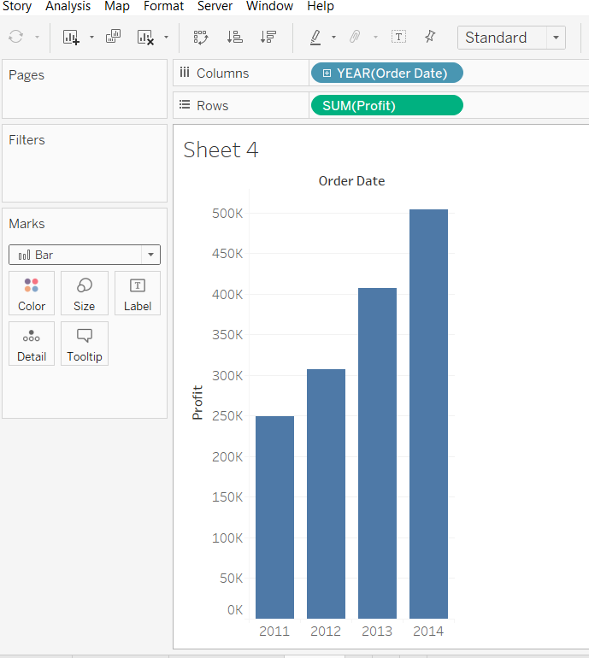
Continuous Axis vs. Category Labels
Practice in Tableau
Click on New Worksheet
Drag Order Date to Columns shelf
Drag Profit to Rows shelf
Change to bar chart in the marks card

Slide 17
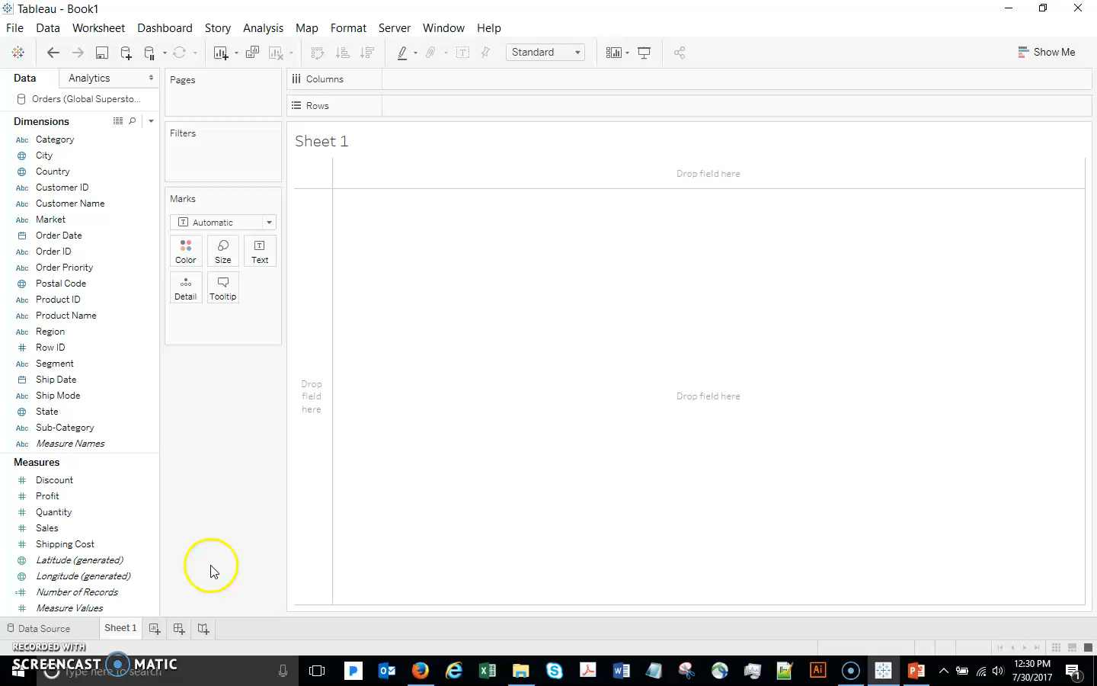
Continuous Axis vs. Category Labels
Click on New Worksheet
Drag Order Date to Columns shelf
Drag Profit to Rows shelf
Change to bar chart in the marks card

Slide 18
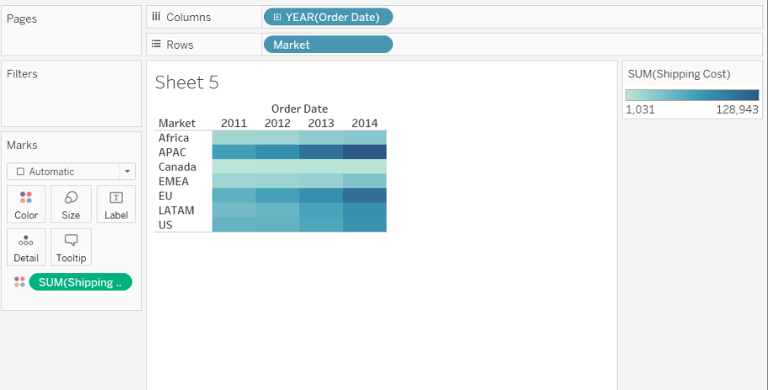
Continuous Axis vs. Category Labels
Open a new worksheet
Drag Order Date to Columns
Drag Market to Rows
Drag Shipping Cost to Color

Slide 19
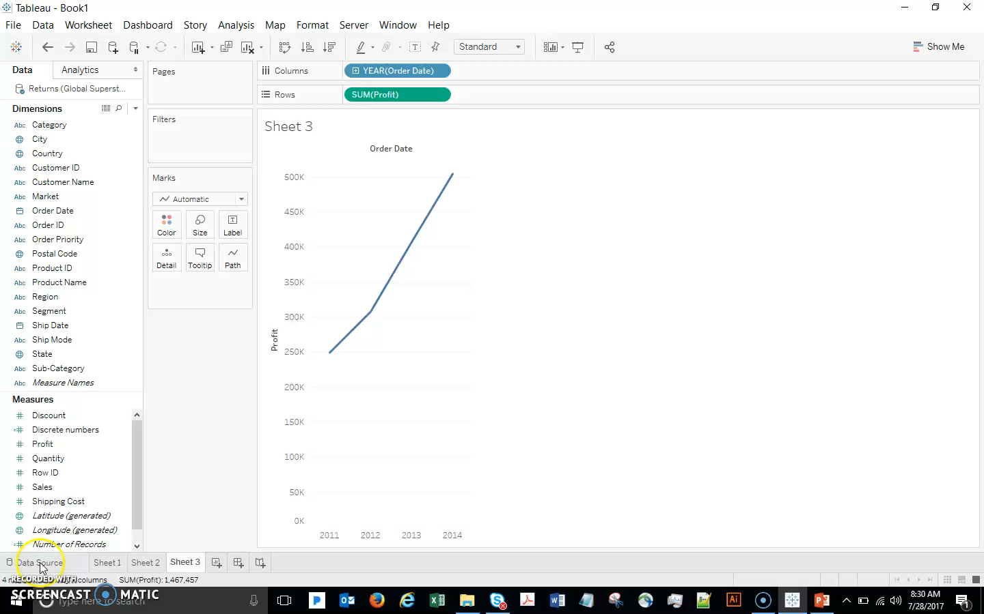
Continuous Axis vs. Category Labels
Open a new worksheet
Drag Order Date to Columns
Drag Market to Rows
Drag Shipping Cost to Color

Slide 20
Working With Dates

Slide 21
Working with Dates
Dates can be brought into the view either as discrete (blue) or continuous (green).
By default, date dimensions are discrete fields for which Tableau automatically selects a date level when it is placed on a shelf.
To make a date dimension continuous by default, right-click (control-click on Mac) the field in the Data pane and select Convert to Continuous.
Once a date is in the viz we can easily change its data type in the pill’s menu – you need to remember that the options on top are discrete dates, the lower section are continuous dates.

Slide 22
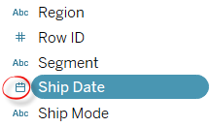
Working with Dates
Dates are automatically placed in the dimensions area of the data pane:
Date/time fields are identified by the calendar icon.
Automatic hierarchy is created for dates:
Begins at the highest level in the data, usually year.
Right-click on the field to change the hierarchy.
The standard Gregorian calendar is used by default:
The ISO-8601 week-based calendar can be selected for any data source.

Slide 23
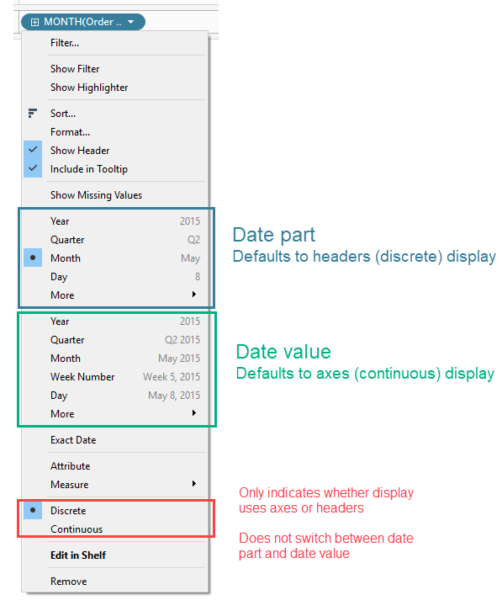
Discrete Date Parts and Continuous Date Values
Discrete dates are organized as discrete
date parts, independent of linear time
Organized by date units, such as aggregated data for all for all Novembers over several years.
Continuous date values represent the chronological progression of time
Create an axis as a timeline.

Slide 24
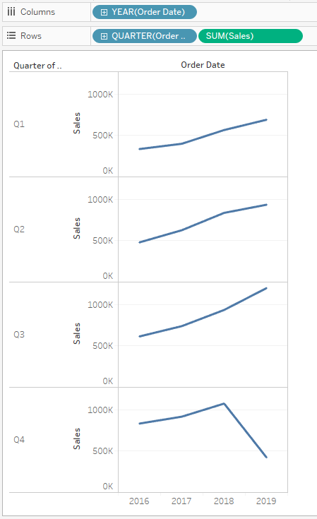
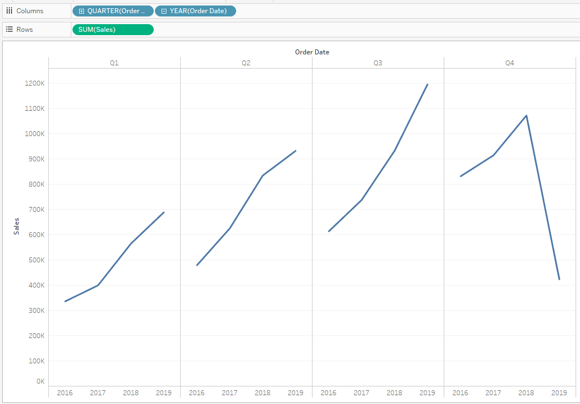
Using Discrete Date Parts
Reorder date hierarchy:
Place quarter before year
Place date parts on different shelves:
Year on columns
Quarter on rows

Slide 25
Creating Custom Dates
Custom dates are calculated date parts that you can save.
Example: reuse the custom date part or value without having to override the default behavior for each use.
Can be used to “break” the automatic date hierarchy or to create elements to use in defining a new one.
Example: new dimension for just the month of order data
Allow for each field to represent just itself.
Can be continuous date values or discrete date parts.

Slide 26
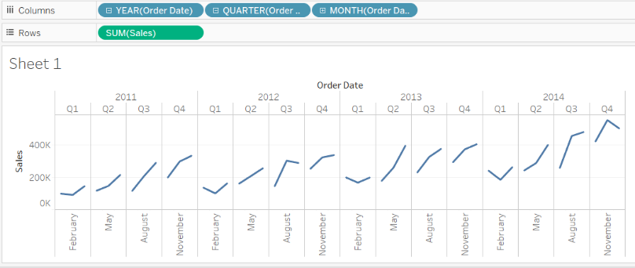
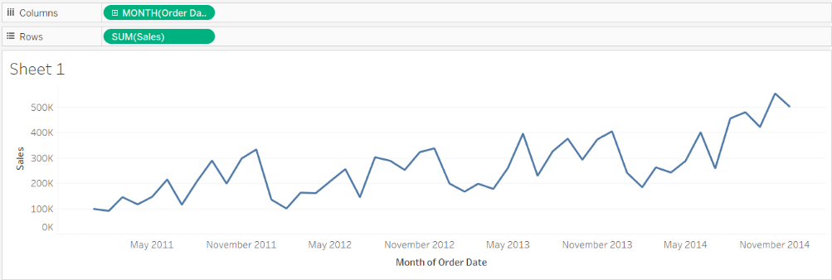
Continuous vs. Discrete dates
Discrete dates
Continuous dates

Slide 27
Color & Maps

Slide 28
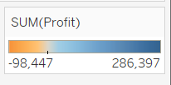
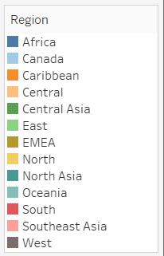
Color and Maps
A measure on color defaults to a filled map
A dimension on color defaults to a symbol map
If the pill is continuous Tableau will show a color gradient
If it is discrete Tableau will show a palette of distinct colors

Slide 29
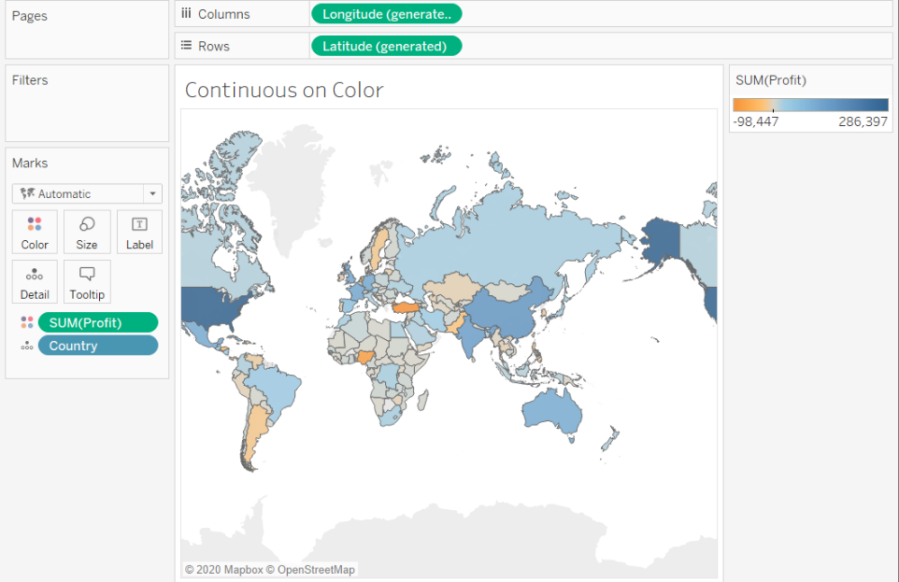
Color and maps
Open a new sheet
Double click Country
Drag Profit to Color

Slide 30
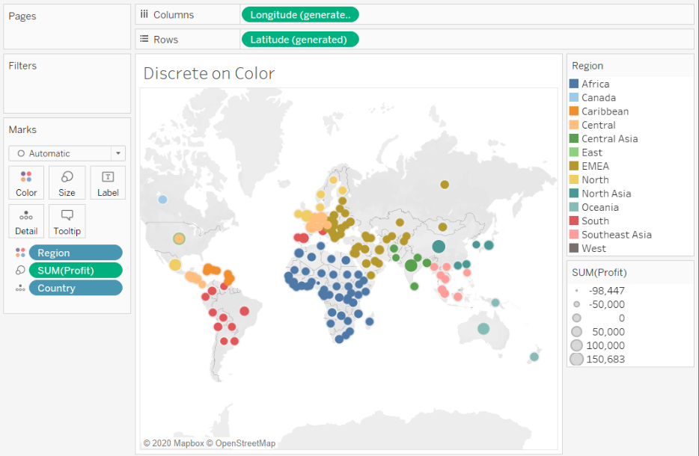
Color and maps
Undo Profit from color
Drag Region to color
Drag Discount to Size

Slide 31
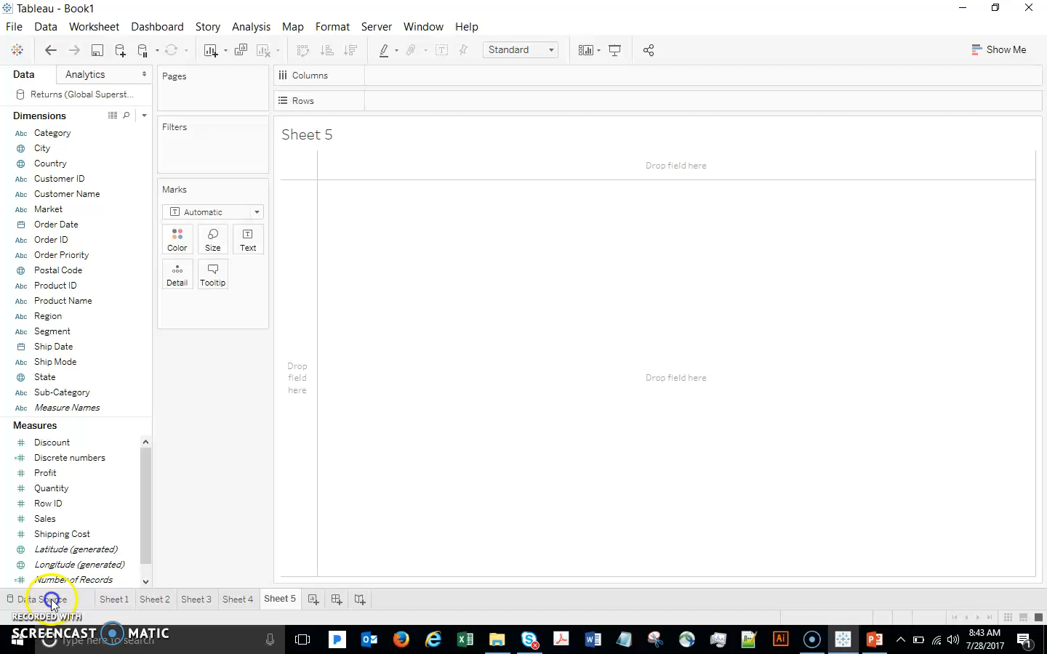
Color & Maps
Open a new sheet
Double click Country
Drag Profit to Color
Undo Profit from color
Drag Region to color
Drag Discount to Size

