Slide 1
System Administration Tasks
CSC252
Prof. Earl
Slides sourced from Dr. Lisa Frye and Dr. John Carelli

Slide 2
Accounts
Files
/etc/passwd – User information
ID, group ID, home dir, shell, ...
/etc/shadow
Encrypted user password
NIS, NIS+
Network Information Service (Originally called: yellow pages)
Allowed for distribution of system configuration data
Included user accounts, hostnames.
Sun Microsystems developed NIS+ to replace it
Completely different design, but achieves the same goal
Both have been replaced at this point – The protocols were designed to be replaced

Slide 3
Accounts (cont.)
Lightweight Directory Access Protocol (LDAP)
Distribute information across the network
Managed from a central server (Can be multiple for redundancy)
RedHat Documentation
Active Directory
Microsoft’s implementation
Meant for managing Windows Environments
Can be used across platforms

Slide 4
Adding local users
useradd [-u uid] [-o] [-g group] [-G group [, group, …] [-d home] [-m] [-k template] [-f inactive] [-r] [-p passwd] [-s shell] [-e expire] [-c comment] login
Default Settings
useradd –D [-g group] [-b base] [-f inactive] [-e expire] login
useradd –D
Look at default settings

Slide 5
User Management
usermod [-u uid] [-o] [-g group] [-G group (, group, …)] [-d home] [-m] [-l new_login] [-f inactive] [-r] [-p passwd] [-s shell] [-e expire] [-c comment] login
userdel [-r] login
passwd <login>
Change the password for a specific user (must be root)

Slide 6
System Accounts
root (superuser)
daemon (system server processes/files)
bin (owns system executables and files)
sys (for Distributed File Services, DFS)
lp (managing printers)
adm (basic system functions)
nobody (default for unprivileged operations)
Viewing system accounts: https://www.cyberciti.biz/faq/linux-list-users-command/

Slide 7
Groups
Primary Group
Secondary Groups
/etc/group - Holds the groups available on the system
groups command
get a list of groups
user can change current group with newgrp

Slide 8
System Groups
root
daemon
sys
tty
bin
adm
lp
mail
uucp/nuucp
nobody
noaccess

Slide 9
Backing up
backup from one machine
label all tapes
Three generations
Grandparent / Parent / Child
3 Backup cycle (Daily, Weekly, Monthly)
avoids propagating an error
secure backup tapes
keep tapes off site
backup appropriately
Always check your backup procedure
Attempt a restore
Tape life Cycle – How often should tapes be replaced?

Slide 10
Backup Schedule Depends on
activity on filesystem
capacity of dump device
length of “dump window”
amount of redundancy
number of tapes available
how far back you must be able to recover

Slide 11
Linux Device Names
Linux Naming Convention
/dev directory
fd0 – Floppy Drives (if you know what those are)
sda (First SCSI or SATA Hard Disk)
sdb (Second SCSI or SATA Hard Disk)
scd0/sr0 – CD-ROM
mmcblk0 – SDHC/PCMCIA – mvne ssds
Partitions are represented by appending a decimal number:
sda1 and sda2 represent the first and second partitions of the first SCSI disk drive

Slide 12
Disk Information
Get information about available disks:
df command
Disk space usage
lsblk command
List the block devices connected
lsusb command
fdisk
Used to partition disks

Slide 13
Adding new drives
Physically add drives
Create entries in /dev
mknod command
format the drive
mkfs (make the file system)
Add entry to /etc/fstab (optional)
Allows for mounting devices at start time

Slide 14
Mounting Filesystem
mount [-r] [device] <directory>
uses /etc/fstab
-r for read only
mount –t type [device] <directory>
specify the type of device
mount [-f filesystem_types]
“Fake” don’t actually mount anything
See what mount is trying to do,
Add an entries to /etc/mtab
mountall
called during boot process
uses /etc/fstab to get disk info

Slide 15
Unmount Filesystems
umount <filesystem>
umountall

Slide 16
Filesystem Commands
Who is using a file a directory or a socket?
fuser [-u] [-k] <device>
-u for user
-k kills the process using the device
-v is verbose
Checking a filesystem
fsck

Slide 17
fsck tasks
Fixes damaged or inconsistent indoes
unreferenced inodes
large link counts
unused data blocks not recorded in block maps
data blocks listed as free but also used in a file
incorrect summary info in a superblock

Slide 18
quotas
Set up user quotas (Place a limit on disk space usage available to user(s))
rq in /etc/fstab
create a quotas file in the affected filesystem
edquotea
Allows for editing of quotas
quota
display quotas

Slide 19
Network File Systems - NFS
Allows access to storage devices over a network
Appears to be connected locally
Runs on RPC protocol (Remote Procedure Call)
daemons
nfsd, mountd, statd, lockd, nfslogd
start when system enters multiuser mode
/etc/exports
Specifies exported file systems and hosts permitted to access them

Slide 20
Boot Process
Loading and initialization of the kernel
Device detection and configuration
Creation of system processes
Operator intervention (manual boot only)
Execution of startup scripts (by init)
Multiuser operation (init spawns getty process)

Slide 21
init states
(Run Levels)
0 system is completely shut down
1 single-user mode (administration)
2 multi-user mode without NFS (networking)
3 full multi-user mode with networking
4 unused
5 full multi-user mode with networking and X11 (GUI)
6 reboot
startup scripts are defined in /etc/rc#.d
commands in /etc/rc.local will execute on a runlevel change

Slide 22
Startup Script Tasks
setting the name of the computer
setting the timezone
checking the disks with fsck
mounting the system’s disks
removing old files in /tmp
configuring network interfaces
starting up daemons and network services

Slide 23
Shutdown Steps
logs shutdown
kills nonessential processes
executes sync
waits for filesystem writes to complete
halts the kernel

Slide 24
Shutdown Commands
shutdown [TIME] [message]
halt
reboot [-p] (-p for poweroff)
init <run_level>
Usually a command ran by the kernel
Can be used by root to restart at the given run_level

Slide 25
sync
flushes cached superblocks to disk
flushes modified inodes and cached data blocks

Slide 26
Patches
Updates the system files
Correct errors or provide security fix
patch

Slide 27
Software
CD
Source Code
Download Packages
deb → tar file with information to install a system
System Package Managers

Slide 28
Maintaining Software Packages
yum
apt-get

Slide 29
yum
yum install <packageName> | Allows for installing a package and any dependencies (Required Packages)
yum update <packageName> | Update a specific package or all packages
yum check-update | List packages that have updates available to them
yum clean all | Remove all header files used for resolving dependencies and cached packages
yum list available | List all available packages
yum search <word> | Search's for words in a package name, description
Groups of packages
yum grouplist
yum groupinfo
Configuration File: yum.conf

Slide 30
apt-get (apt)
apt update | Update local package list
apt check
apt install package
apt remove package
apt upgrade | Upgrade all packages on the system that don’t require any new packages
apt dist-upgrade | Upgrade all packages on the system and install any new packages necessary

Slide 31
Daemon
A background process that performs a specific function or system-related task

Slide 32
SYSLOGD – System Logging
Syslog – Standardized System for managing system log files
Programs write to special file (/dev/log)
syslogd reads messages from the file
consults configuration file syslog.conf
dispatches each message to appropriate destination
sysadmins should back up and maintain log files
More Information

Slide 33
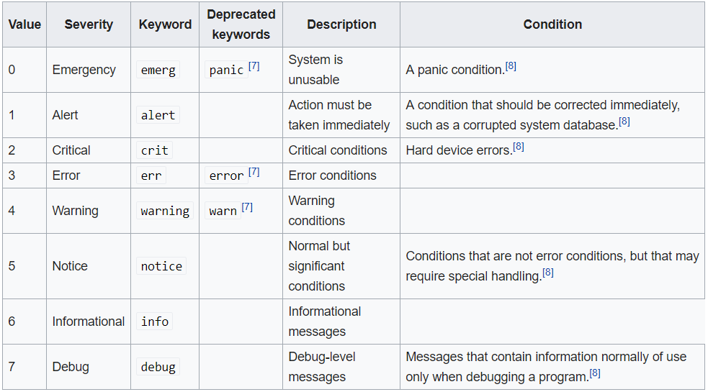
SYSLOGD – Message Severity Levels
The meaning of severity levels other than Emergency and Debug are relative to the application. (Wikipedia)

Slide 34
inetd
“super-server” daemon that manages other daemons
provides internet services
listens for traffic on designated ports
Consults /etc/inetd.conf to determine which network ports to listen to
Uses /etc/services or portmap daemon to map service names to port numbers

Slide 35
inetd.conf
1 service name
2 type of socket service uses (stream or dgram)
3 communication protocol uses (tcp or udp)
4 wait: service can process multiple request at one time
nowait – fork a new copy of daemon for each request
5 username under which daemon should run
6 fully qualified pathname of the daemon and its command-line arguments

Slide 36
vmstat
Report on virtual memory usage
Two arguments
number of seconds between measuring and reporting values
number of times to measure and report values
Report
First line is the average values since last system reboot
Other lines represents current values
man vmstat

Slide 37
netstat
Report on network connection information
Common Options
netstat –v
netstat –nt
netstat –nl
netstat –I
netstat –rn
netstat –s
More Options

