Slide 1
Files and Directories
CSC252 – UNIX Scripting and Administration
Prof. Earl

Slide 2
The Filesystem
A set of data structures that:
store user and system data
store that data as files on, usually, a disk
Summary:
Organization & Terminology of the Linux Filesystem
Moving through the filesystem
Ordinary and Directory files
Absolute and Relative Paths
Important Files and Paths
File Access Permissions

Slide 3
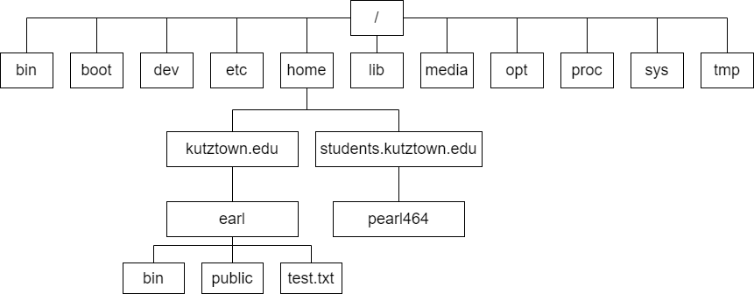
Hierarchical System

Slide 4
Terminology
Directory Tree
Directory Files
Ordinary Files
Root
Directories are connected by a path
Parent
Child

Slide 5
Filenames
Should use these characters:
Uppercase Letters (A-Z)
Lowercase Letters (a-z)
Numbers (0-9)
Underscore (_)
Period (.)
Comma (,)
Two files of the same name can’t exist in the same directory
Files can have the same name in different directories

Slide 6
Filenames (continued)
Filename Extensions
Hidden Filenames - begin with a dot (.)

Slide 7
The Working Directory (Current Directory)
The directory your session is currently associated with
pwd
The working or current directory

Slide 8
Home Directory
When logging in, this is your working directory
Startup Files are usually located here
Used to set configuration options for your shell and other programs

Slide 9
Pathnames
All files have a pathname
Absolute Pathnames
/ (root)
~ (Tilde)
Relative Pathnames
Relative to your working directory
. & ..
Refer to this and parent directories respectively

Slide 10
Standard Directories and Files
FHS – Filesystem Hierarchy Standard
/ - root
/bin – Command binaries
/boot – Static files of the boot loader
/dev - Device Files
/etc – Machine-local system configuration files
/home – User directories
/sbin – Essential system binaries (Used for system administration tasks)
/sys – Device pseudo filesystem
/usr/bin – Most user commands

Slide 11
ls
List contents of a directory
With –l option
Type of File
File Access Permissions
ACL Flag Links
Owner
Group
Size
Date (and time) of last Modification
Filename
File Types:
- Regular File
d Directory
l Symbolic Link
c Character (Device File)
b Block (Device File)
p Pipe
s Socket

Slide 12
Permissions
Files are owned by
User – Real and Effective User ID
Group – Real and Effective Group ID
Other
Relevant commands
chown
chgrp
chmod
umask

Slide 13
Permission Settings
(U)ser, (G)roup, (O)ther, (A)ll
Set using octal
Read = 4, Write = 2, Execute = 1, No Permission = 0
Add them up to set permission
7 - Gives all permissions, 5 – Gives Read and Write, etc.
755 → User has (R)ead, (W)rite, and (E)xecute, Group and Other have R, X
777 → All users have all permissions
Set using alphanumeric characters
Syntax:
<option>=<permissions> (u=rwx,g=rx,o=rx)
ugo=rwx (Same as 777) OR a=rwx

Slide 14
Special Permissions
setuid
Value 4 or u+s
setgid
Value 2 or g+s
Sticky bit
Value 1 or o+t
Using the value is a 4th octal option
chmod 4777
umask

Slide 15
Links
A pointer to another file
Clone of a file that points to one original file.
Can have the same or different names
Symbolic Links
Aka Soft Links
Commands
ln
ls -il

Slide 16
Dereference Links
Follow link to target file
Pointer to file

Slide 17
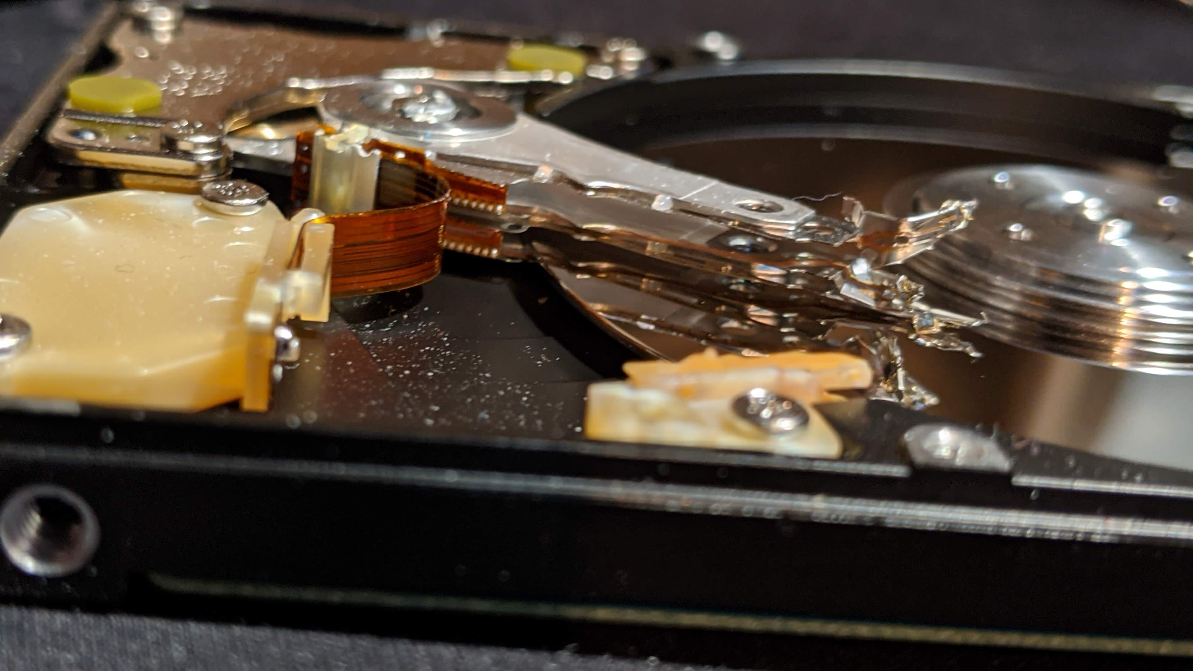
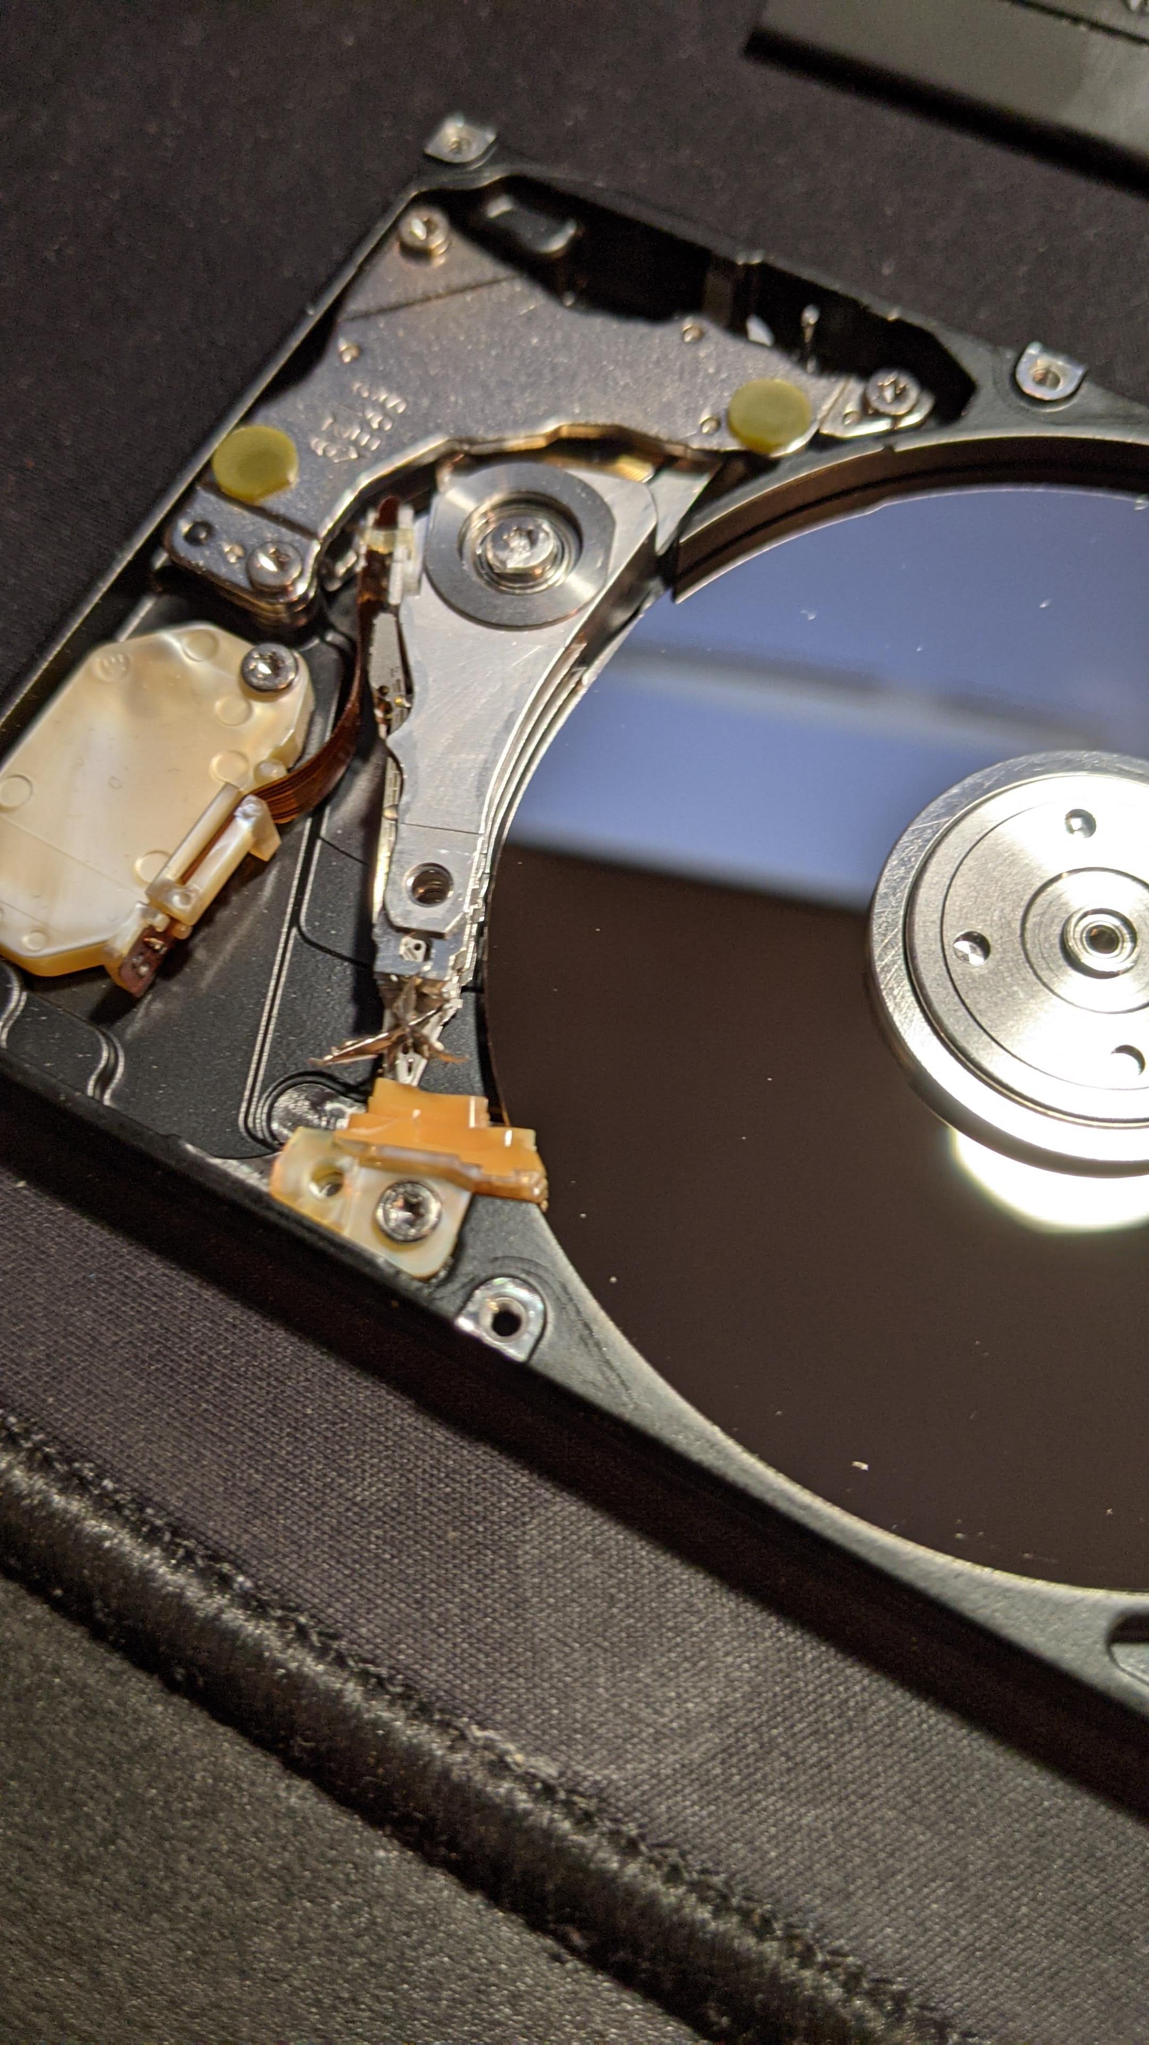
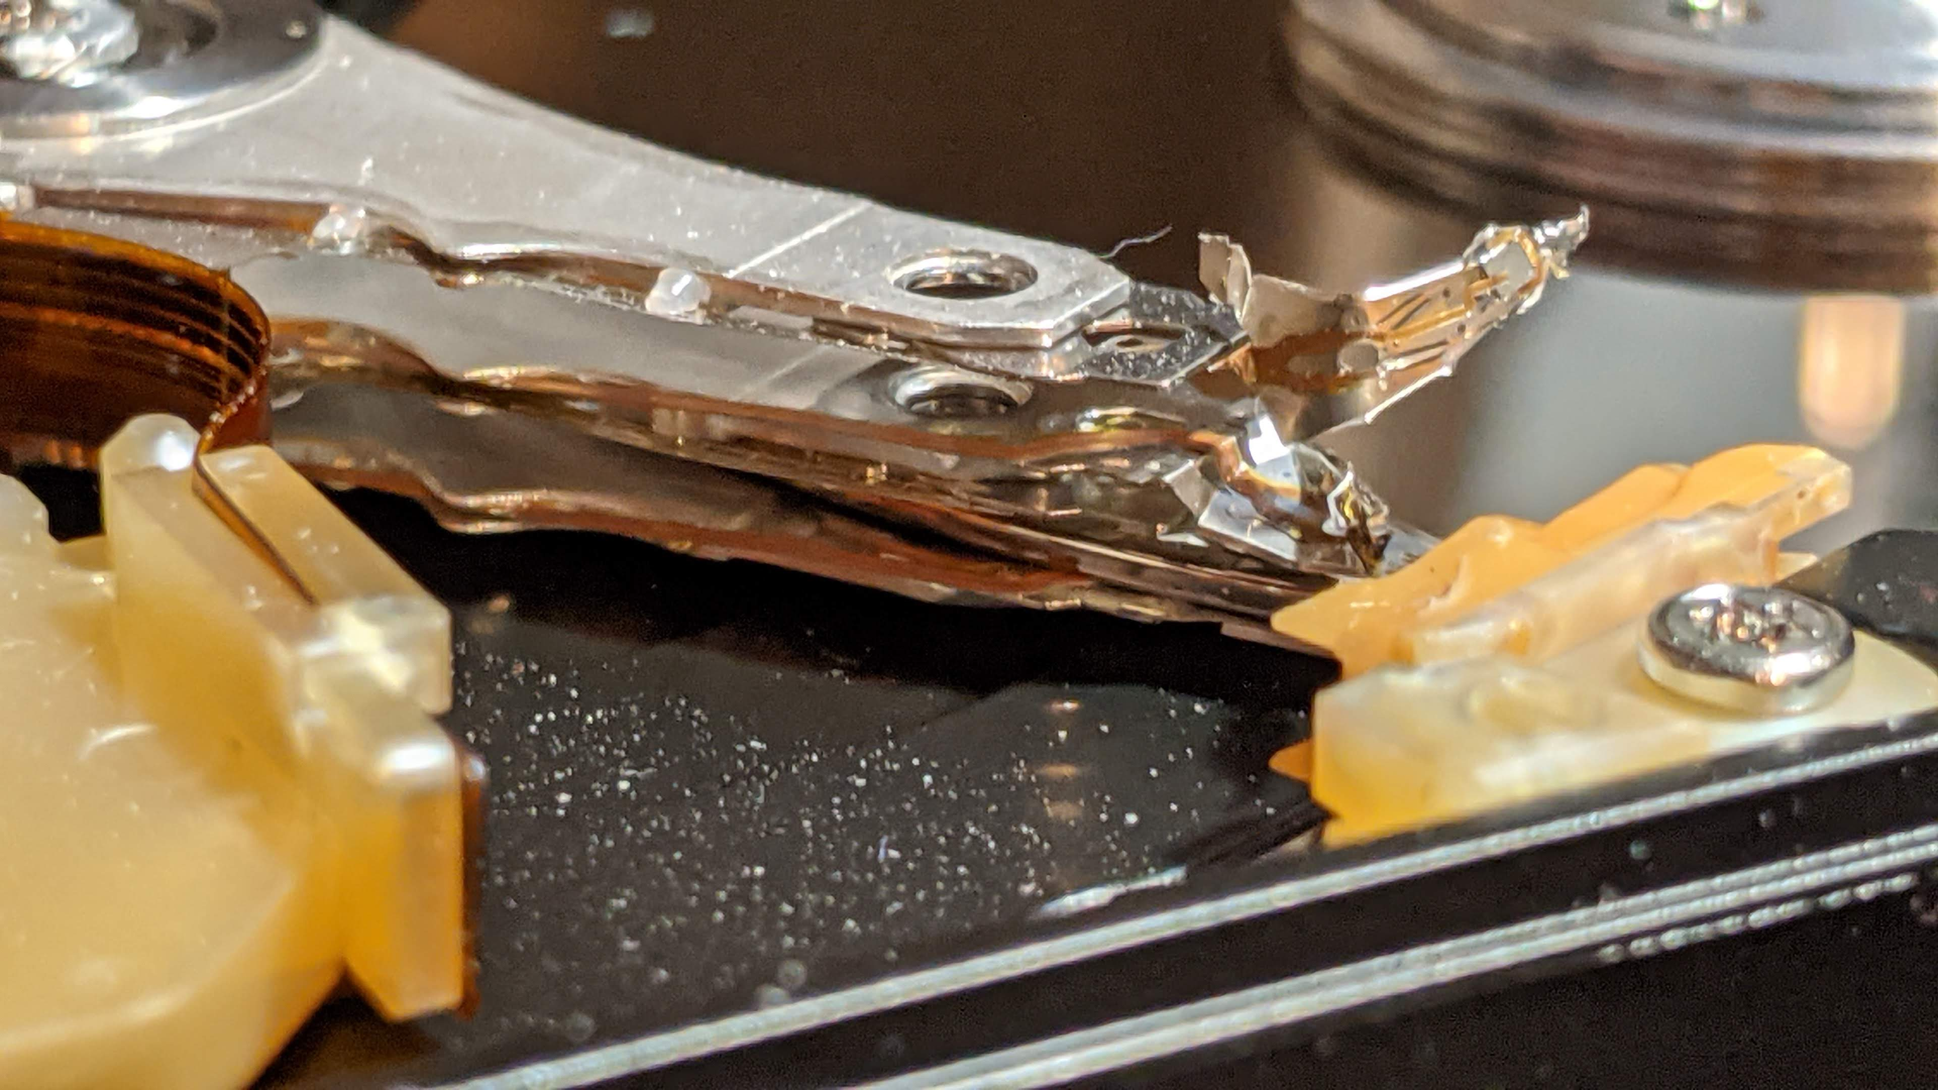
Data Storage – Magnetic Hard Disks
2.5in Laptop Hard Drive (500GB?)
Photo Credit: Patrick Earl

Slide 18
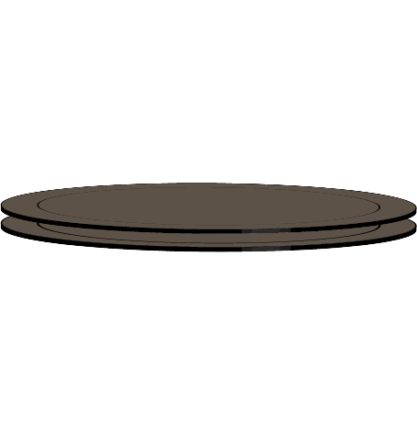

Data Storage – Magnetic Hard Disks
Data Stored on Magnetic Hard Disks
Platters
Tracks (Cylinders)
Sectors
Blocks (Clusters)
OS controls sector size
Usually, 512 bytes on UNIX

Slide 19
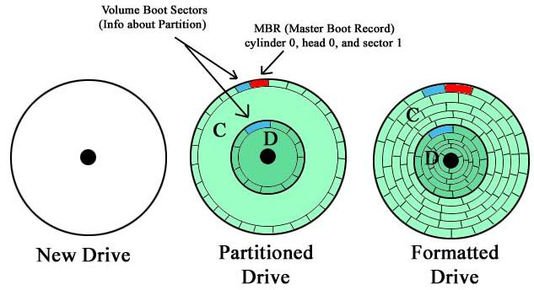
Storage Partitions
One Physical drive can be split into multiple logical drives (Partitioned)
A partition contains a file system
Disk Formatting
Also known as Partition Schemes (File Systems)
Common Ones:
ext3/ext4
ntfs (Windows)
apfs (macOS)
Commands:
fdisk
lsblk
Image Source: https://www.minitool.com/lib/hard-disk-partition.html
Notes:
* Partition schemes manage how this information is stored on a device.

Slide 20
inode and Data Blocks
A file is a collection of data blocks
Data Blocks contain the contents of a file. Files are collections of data blocks.
Inodes
A unique integer number.
Contain information about a given file
The Mode/Permissions
Owner ID, Group ID
Size of the File
Number of Hard Links
Time last Accessed and Modified
Time inode was last modified
Contains a list of the data blocks spread across a drive

Slide 21
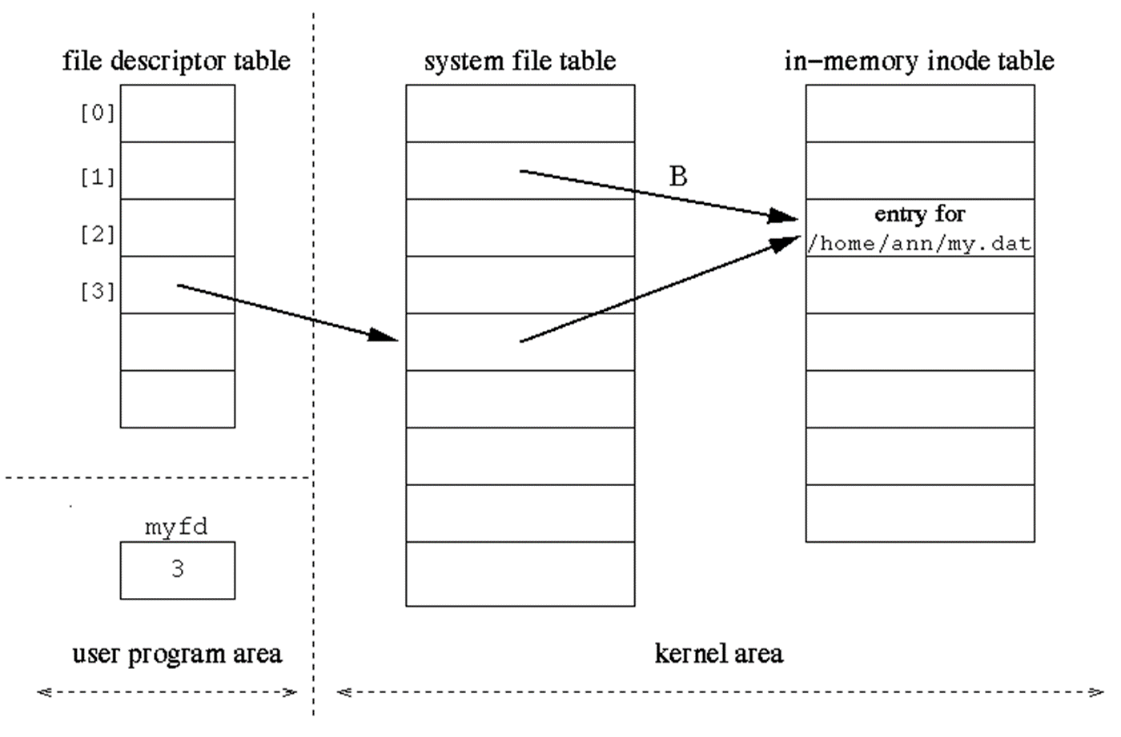
File Table
myfd = open(“~/user/text.txt”, O_RDONLY);
Source: Dr. Lisa Frye

Slide 22
Character/Block Devices
Character Devices
Accessed as a stream of sequential data
No buffering is required
Keyboard Devices, Serial Ports
Block Device
Hardware device that contains chunks/blocks of data
Buffering is required
Can seek through the file
Hard disks, USB Flash Drives, CDs, etc.

Slide 23
ext4 Data Structures – More Info
https://www.kernel.org/doc/html/latest/filesystems/ext4/index.html

