Slide 1
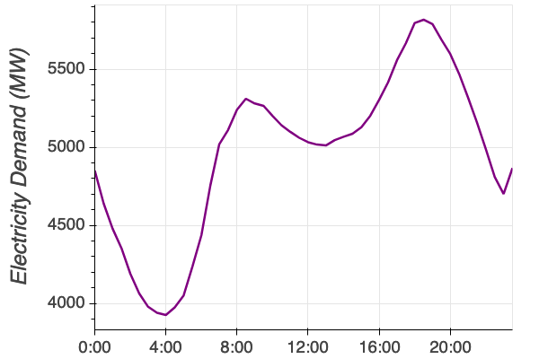
Forecasting Electricity Demand
Notes:
This the average daily pattern of electricity demand in Victoria in 2018. Note the two peaks in morning and evening.

Slide 2
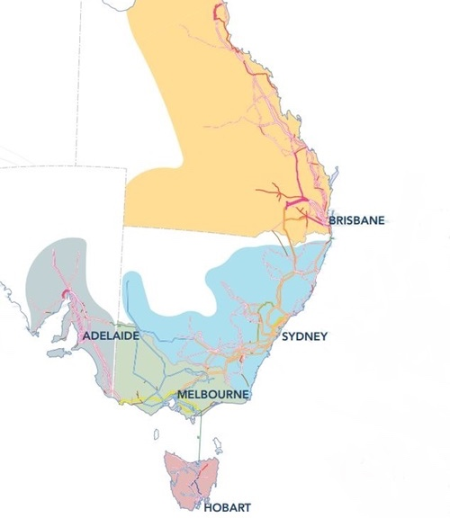

National Electricity Market (NEM)
Patrick Hearps
Notes:
The NEM is made up of 5 regions, essentially the eastern seaboard states, with ACT lumped into NSW

Slide 3
Why?
NEM value
$45 million / day
$16.6 billion / year
New smaller data-driven companies entering market (solar, batteries, smartgrid)
Notes:
A simple, understandable model would likely be of value to smaller companies operating in the energy market space.

Slide 4
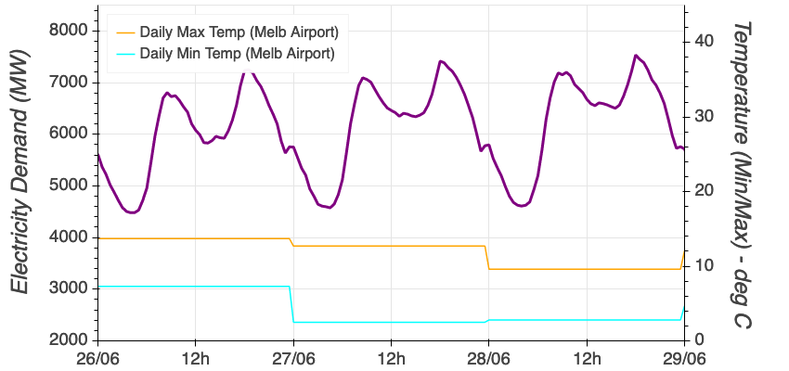
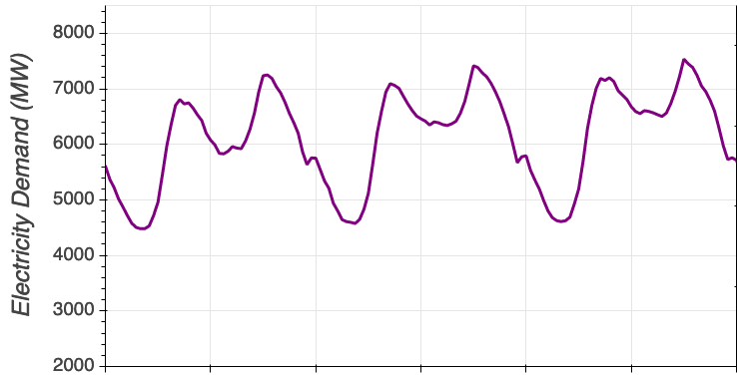
Notes:
Lower temperatures in winter leading to higher electricity demand

Slide 5
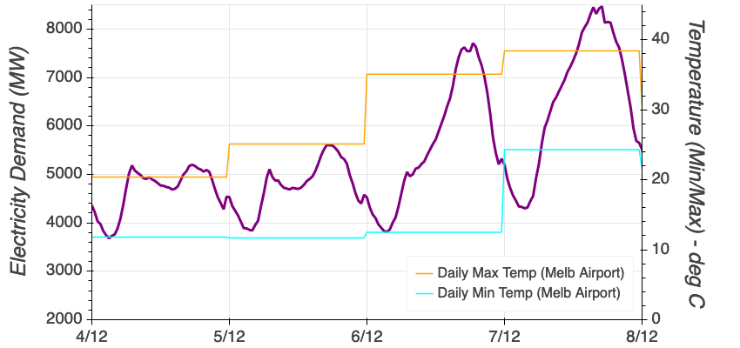
December – hot days
Notes:
Higher temperatures in summer leading to radically higher afternoon electricity demand

Slide 6
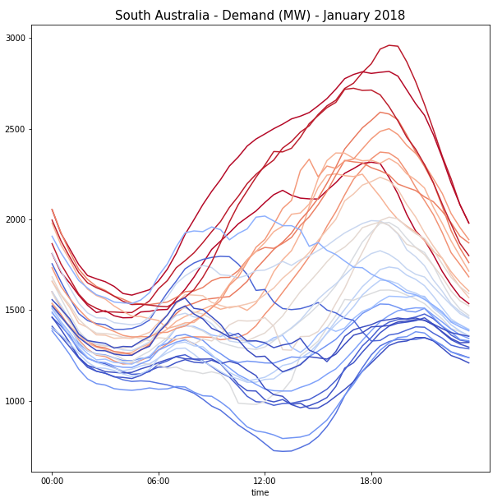
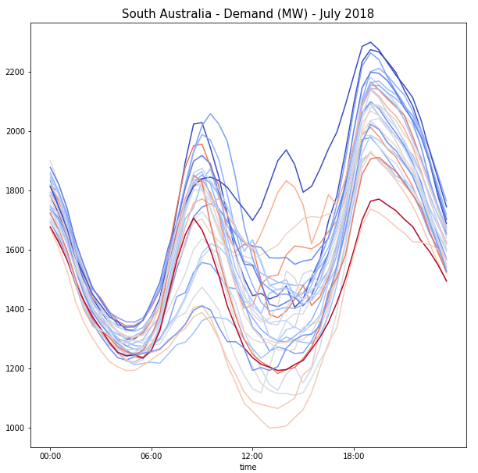
Relationship with temperature
Notes:
Extra slides, each daily demand profile for month of Jan & July 2018, colour coded by temperature, for South Australia

Slide 7
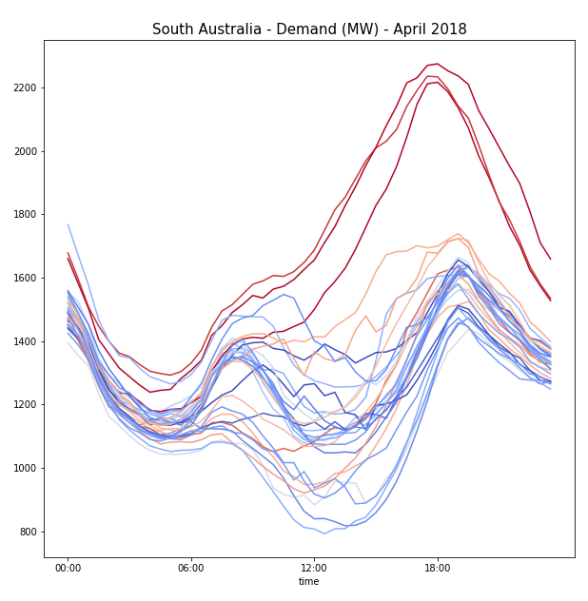
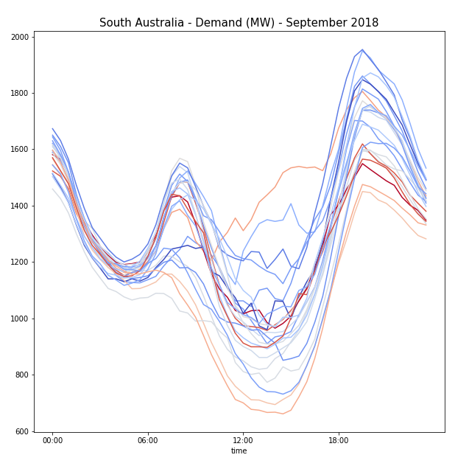
Relationship with temperature

Slide 8

Temperature ~ electricity?
Notes:
How/why is temperature a significant driver of electricity demand? Air-conditioning is the first thing that comes to mind, but it is more than just this.
Family aircon: https://www.colbycool.com.au/
Cooling towers: http://h2ocooling.com/content/uploads/ICS_CoolingTowerDisasterRecoveryProject_LeyteTower-After.jpg

Slide 9

Notes:
Heating & Cooling for commercial buildings is large

Slide 10
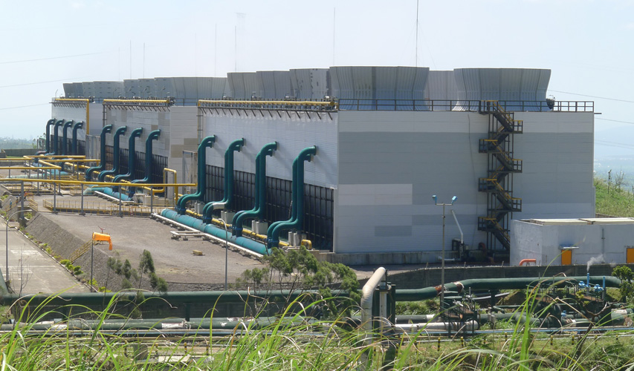
Notes:
Industrial sites have huge heating and cooling loads which get worked harder during temperature extremes

Slide 11
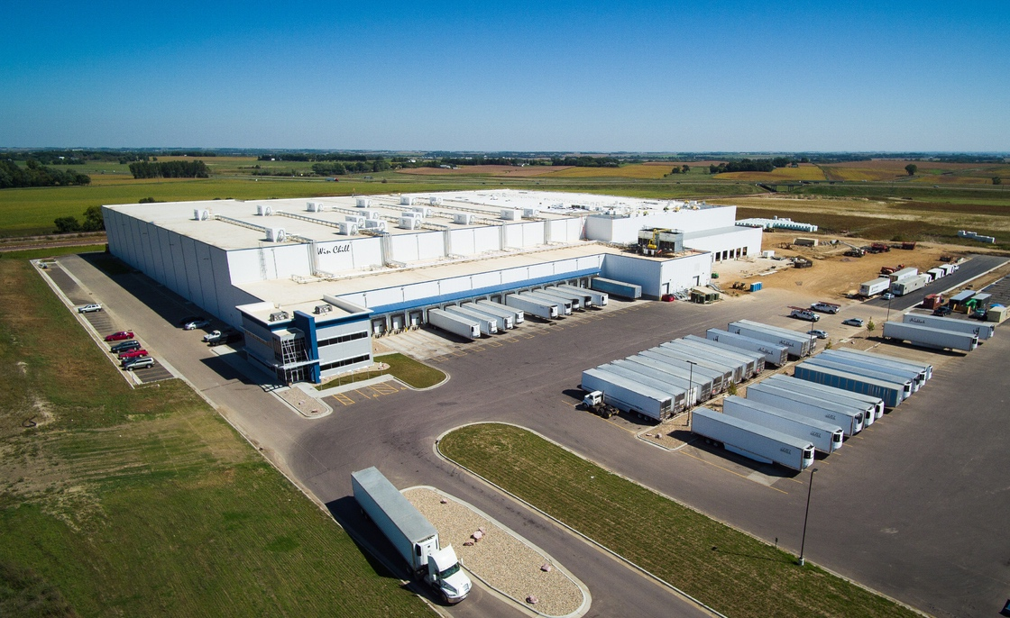
Notes:
Industrial and commercial refrigeration

Slide 12
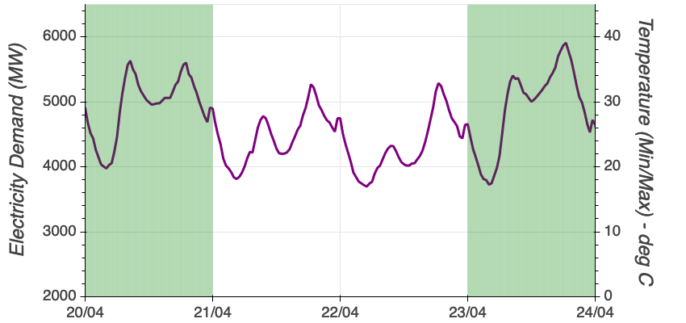
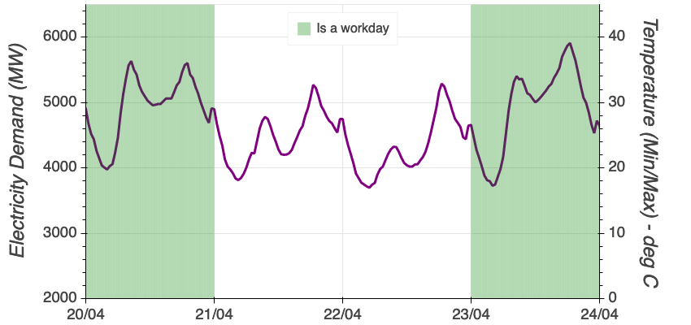
Notes:
Weekends vs weekdays exhibit a noticeable impact on demand as well

Slide 13
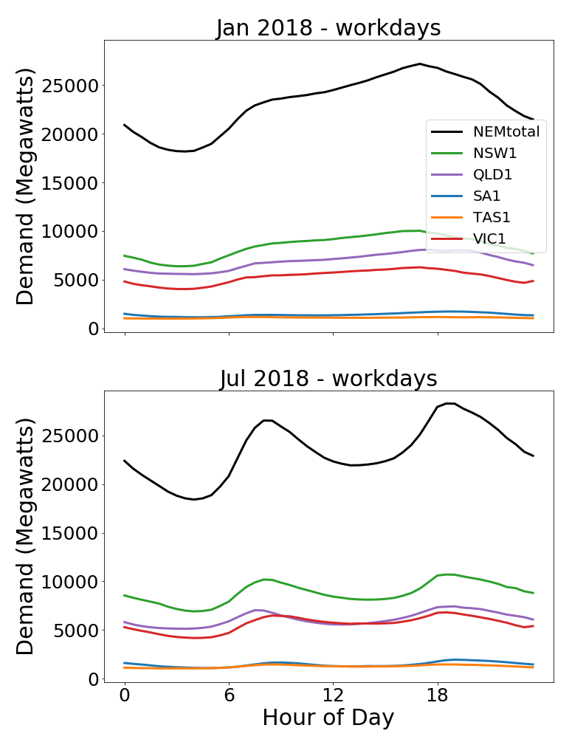
Target = electricity demand by region and total
Notes:
Training dataset 2009 - 2017

Slide 14
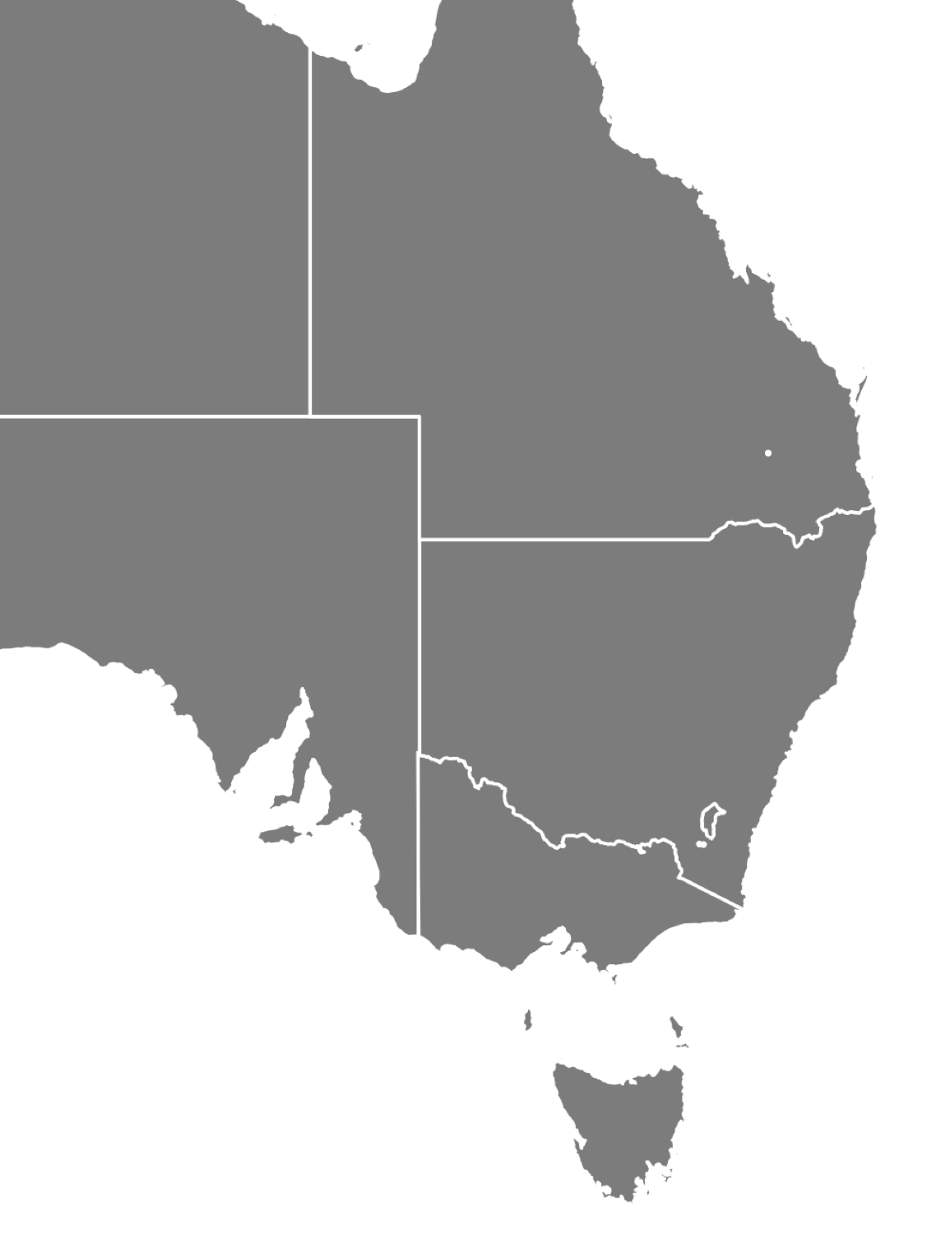
Weather Stations
Townsville
Rockhampton
Gladstone
Min/Max Daily Temp
QLD - 7
NSW - 9
SA - 4
VIC - 4
TAS - 2
Bundaberg
Toowoomba
Brisbane
Gold Coast
Grafton
Armidale
Broken Hill
Port Augusta
Dubbo
Newcastle
Sydney
Mildura
Wollongong
Adelaide
Canberra
Murray Bridge
Mt Gambier
Melbourne
Morwell
Portland
Launceston
Hobart
Notes:
Temperature stations used as inputs
Base map from https://simplemaps.com/resources/svg-au

Slide 15
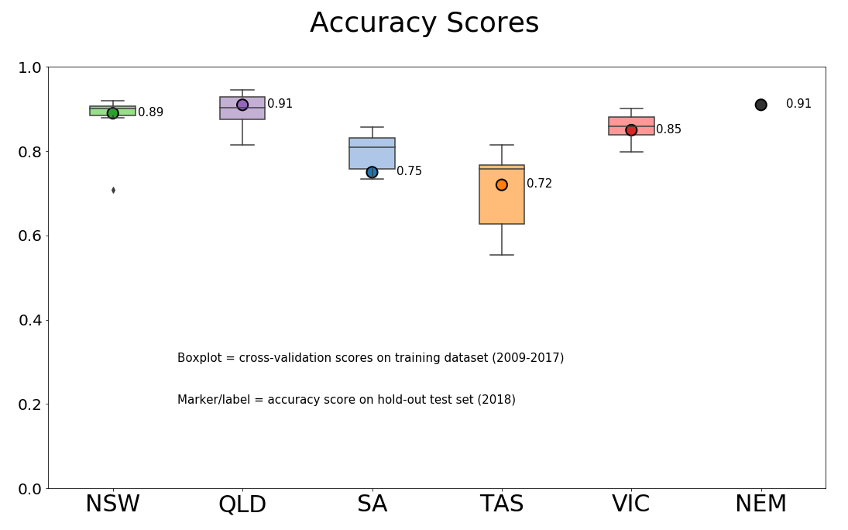
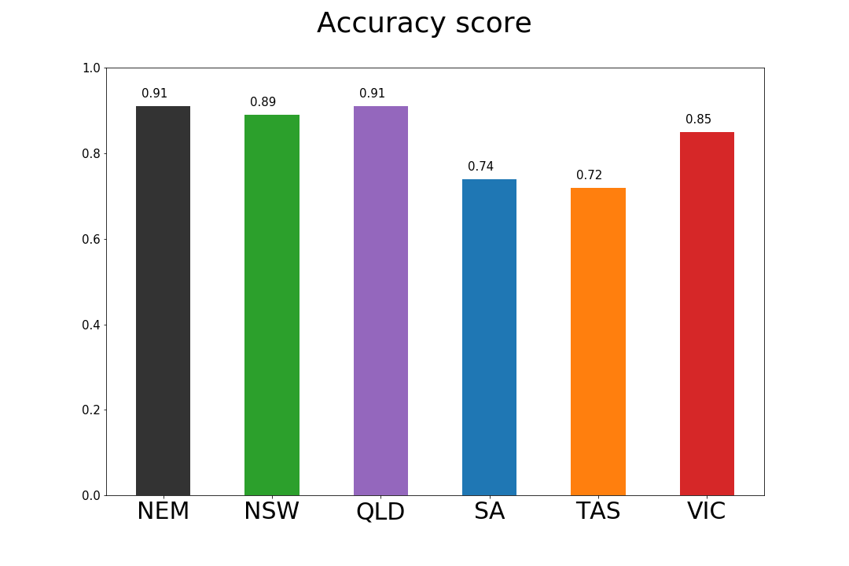
Notes:
5 individual models created, one for each NEM region. NEM total (black) is simple sum of each of these. Overall accuracy (R-squared score) is highest for QLD, and NEM total – errors averaging out?

Slide 16
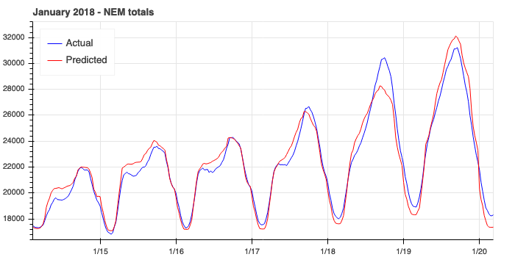
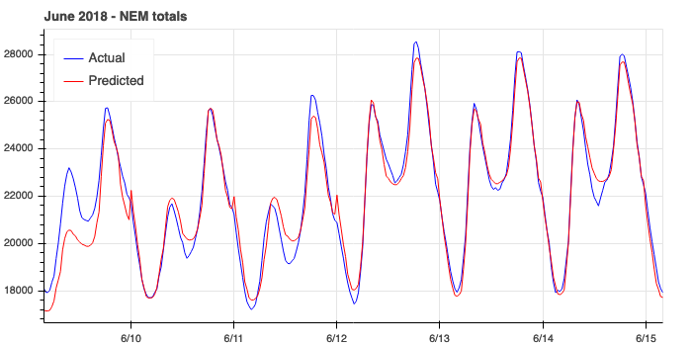
Notes:
Examples of particularly good prediction period

Slide 17
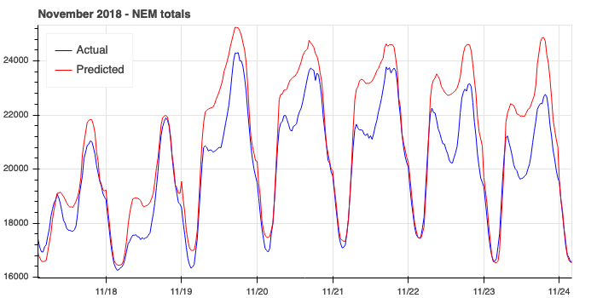
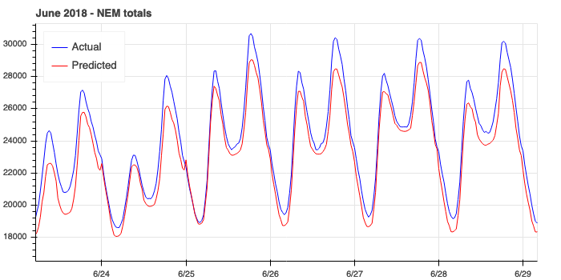
Notes:
Example of more inaccurate prediction period – more investigation required to understand this

Slide 18
Questions?

