Slide 1
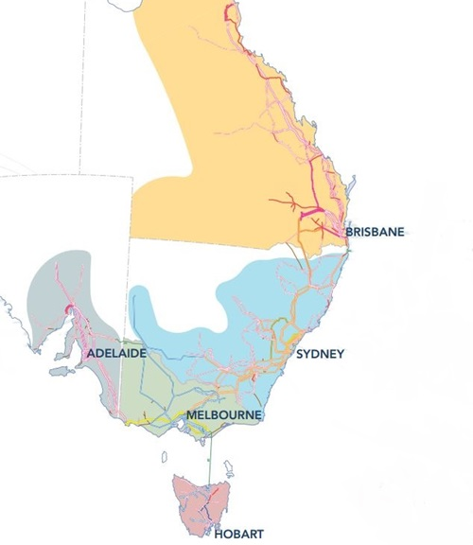

National Electricity Market (NEM)
Patrick Hearps
Notes:
Technical presentation on modelling electricity demand in the Australian National Electricity Market, Patrick Hearps, April 2019

Slide 2
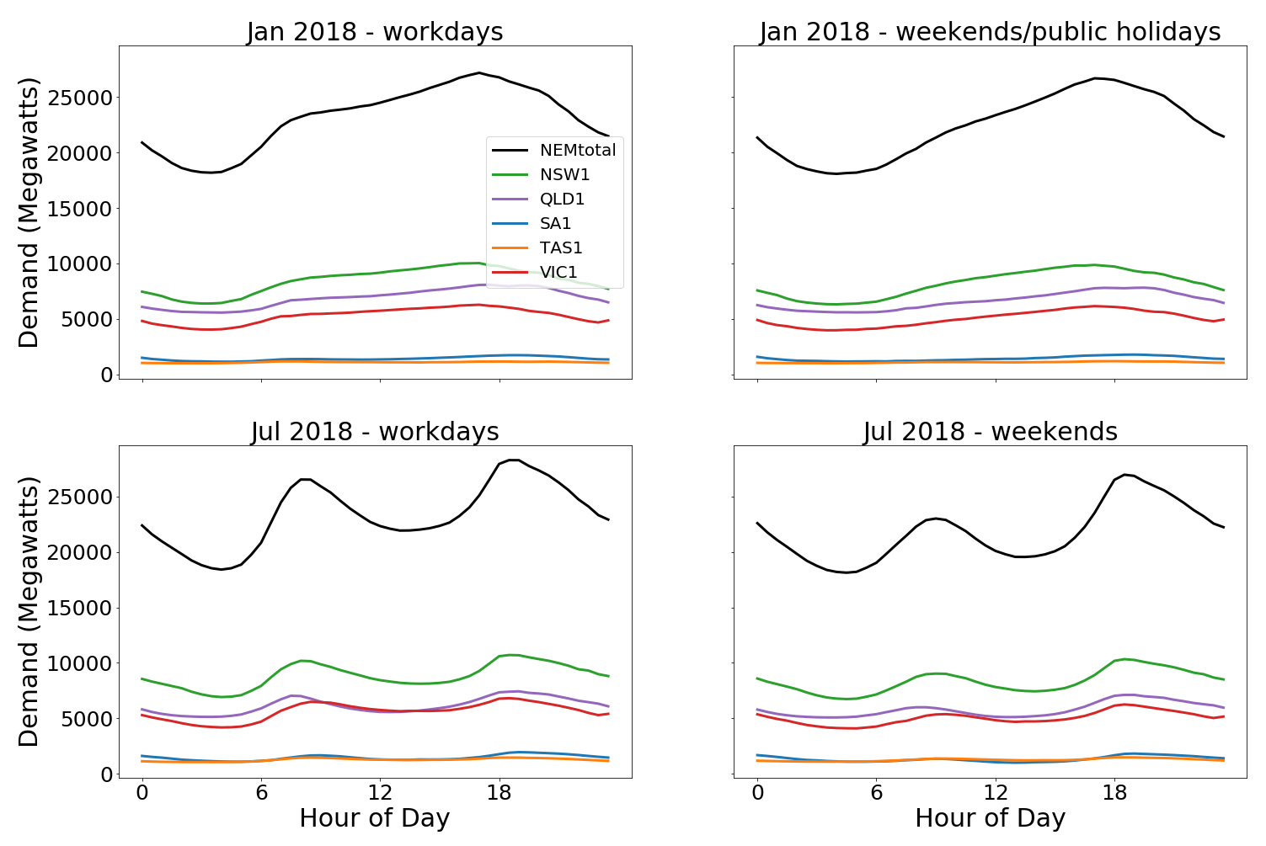
Target = electricity demand by region and total
Notes:
Electricity demand is the aggregate result of millions of people’s behavior controlling tens of millions of machines.
Large factors affecting demand considered in this project include
temperature, both at the daily/hourly and seasonal timescale,
weekends/holidays affecting work behavior
Graph shown displays average demand for each hour over one month (month labelled), filtered by workdays, for all 5 NEM regions and sum

Slide 3
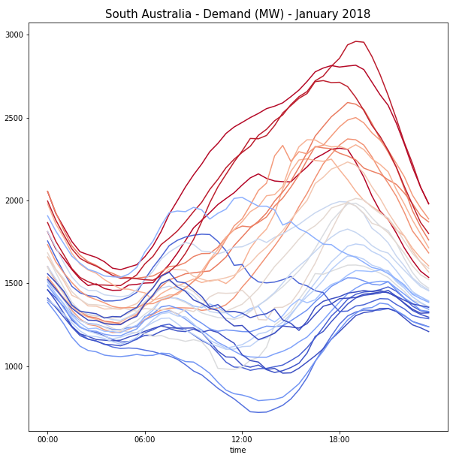
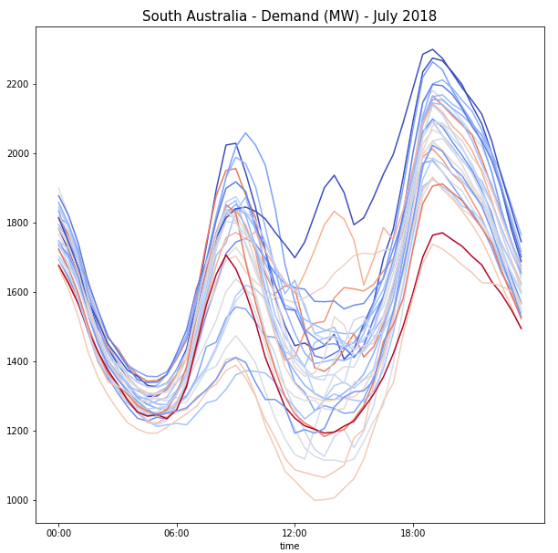
Relationship with temperature
Notes:
Graphs displays actual demand profiles for each day in a single month for SA1 (South Australian NEM region), month as labelled. Colour-coded cool to warm by max temperature for Adelaide on each day. Relationship is clearest for hot summer days, and some relationship with colder days in winter.

Slide 4
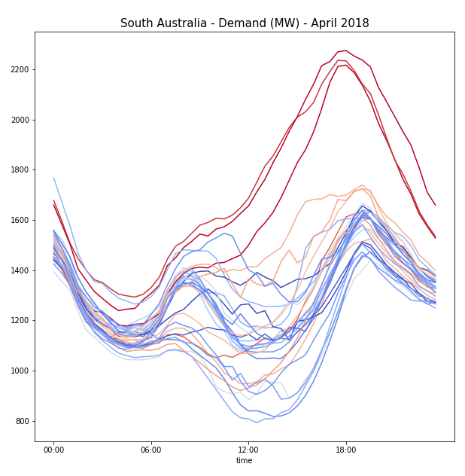
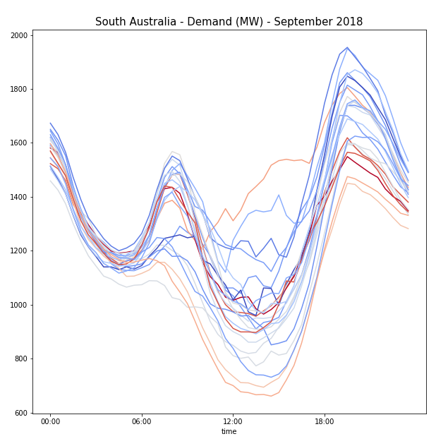
Relationship with temperature
Notes:
Same graphs as previous page but for different months. Still noticeable relationship with temperature in shoulder seasons (autumn/spring) but less clear.

Slide 5
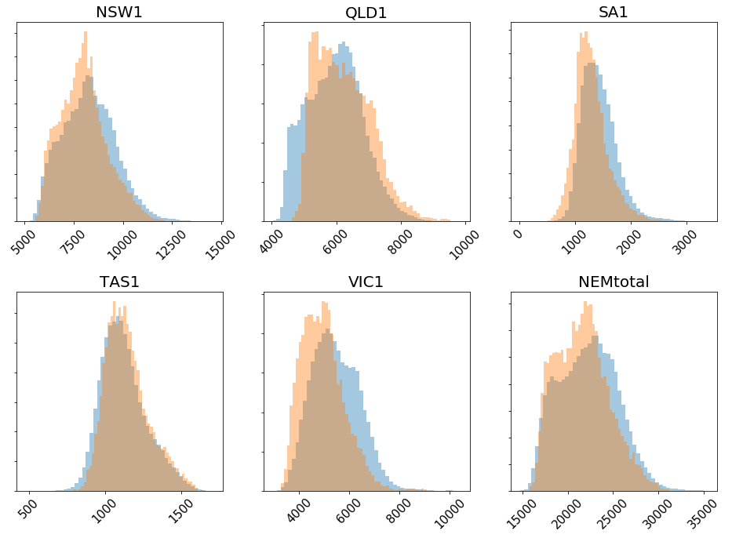
Target = electricity demand by region and total
Train: 9 years 2009 – 2017 Test: 1 year 2018
Notes:
Target was to model and predict half-hourly electricity demand for each of the 5 NEM regions (and summed total by summing outputs of 5 region models), training and cross-validating on 9 years of data, final testing on hold-out dataset for 2018. Histograms show distribution for training set in blue, test set (2018) in orange. Note somewhat different distributions, but overall similar range between training/test.

Slide 6
Date-time dependent features
Time of day (half-hourly intervals)
Workday/Holiday (weekends + public holidays)
Season (Summer/Winter/Shoulder)
Year
Notes:
Input features, public holidays were defined for each NEM region.

Slide 7
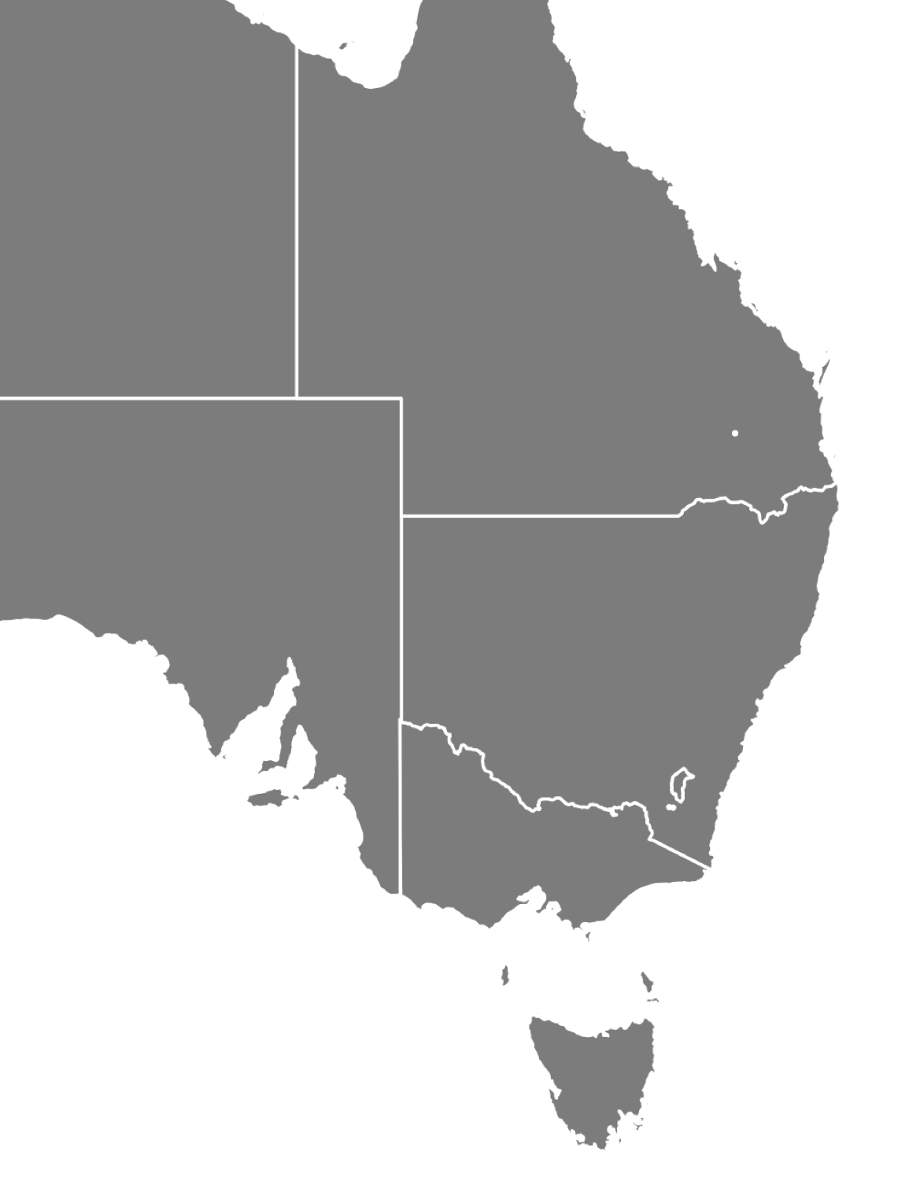
Weather Stations
Townsville
Rockhampton
Gladstone
Min/Max Daily Temp
QLD - 7
NSW - 9
SA - 4
VIC - 4
TAS - 2
Bundaberg
Toowoomba
Brisbane
Gold Coast
Grafton
Armidale
Broken Hill
Port Augusta
Dubbo
Newcastle
Mildura
Sydney
Adelaide
Wollongong
Canberra
Murray Bridge
Mt Gambier
Melbourne
Morwell
Portland
Launceston
Hobart
Notes:
Daily min/max temperature historical observation data from BoM for each of these 26 locations, hand chosen for population/industrial centres and geographical dispersion.
Daily min/max (as opposed to finer timescale) was used for ease of applying to actual daily forecasts in practical applications. Historical forecast data was requested from BoM but would have been expensive ($5K) to obtain, whereas observation history was free.
Base map from https://simplemaps.com/resources/svg-au

Slide 8
Models
ARIMA?
KNN Regressor
Random Forest Regressor
Grid-searched
Notes:
ARIMA was not used but will be explored in future.
KNN and Random Forest applied to explore comparisons of complex past behavior to current patterns of temperature and other factors– Decision Tree was also included in early stages but found to consistently underperform versus Random Forest.
Due to number of branches and leaf nodes of trees in DT/RF regressors, visualization of even one Decision Tree is impractical, unfortunately, but further options exist for interactive web-based visualisations allowing easy zooming in/out that could be explored in future.
Due to time required for grid-search (particularly for RF), grid-searching was mainly done for one NEM region model (VIC1) and same parameters applied to rest of regions. Not ideal, but grid-search solution space was fairly flat, not expecting that this would significantly affect results.

Slide 9
Preprocessing
Round up target to nearest multiple of 5, go from 137,000 to 1,337 possible results. (~x100 reduction)
Standardisation pipeline for KNN, to avoid cross-val leakage
Plain K-fold stratification for CV, ShuffleCV ended up with leakage? Giving too high cross-val results (0.95)
Notes:
Cross-validation and testing in early stages found multiple steps of data leakage causing results far too good – consistently ~0.95 with essentially zero variance. Good learning.

Slide 10
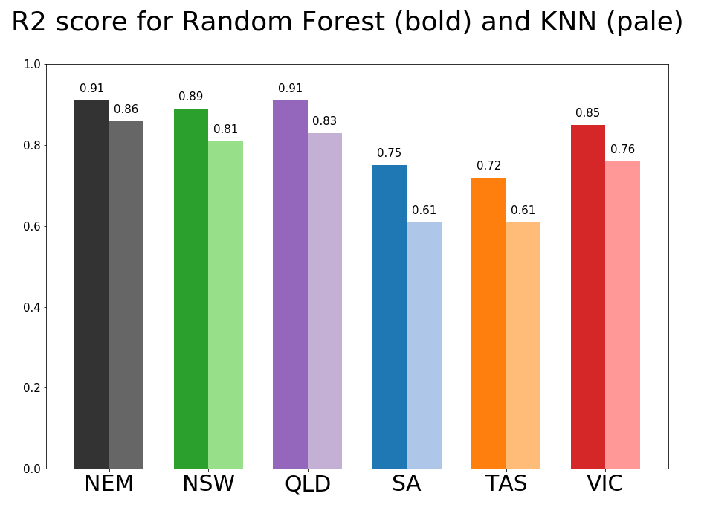
Notes:
R-squared accuracy score for 2018 hold-out test data set.
Random Forest consistently better than KNN.
Satisfying results for NSW, QLD & VIC.
Note high score for NEM total – which is not a sixth model but simply the sum of the 5 region models, compared against sum of actual data for 5 NEM regions. Errors averaging/cancelling out?
Further investigation to be done on why lower scores for SA & TAS. Some ideas include:
These two states have much lower demand than other 3, could introduce more variability in actual data as less scale for smoothing random behavior
SA having highest penetration of wind and solar power in the NEM
TAS having quite different climate patterns from rest of Australia
EDA to look for whether low accuracy is concentrated on particular periods or spread across 2018 data set

Slide 11
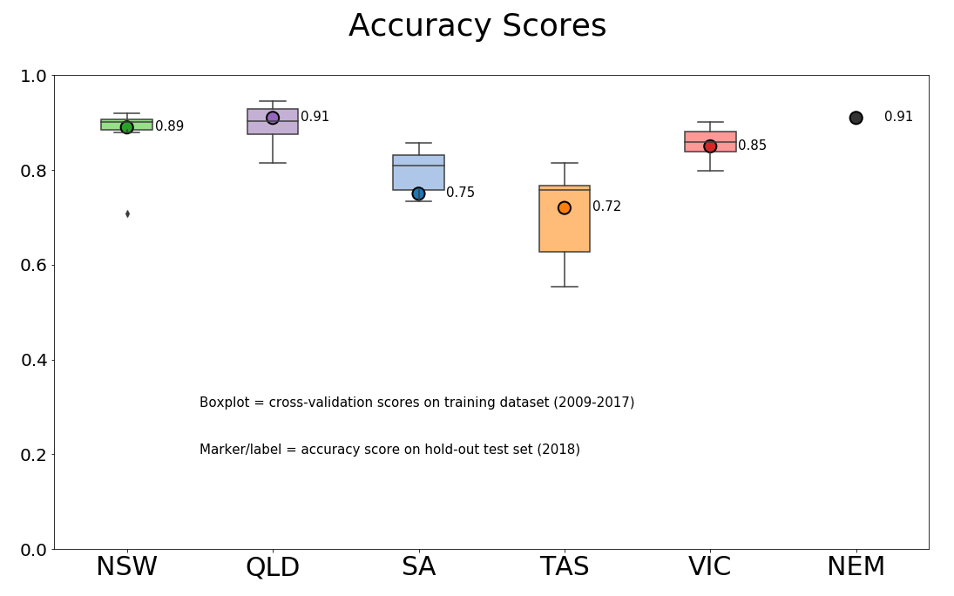
Cross-Validation: Random Forest
Notes:
Further dive into accuracy of Random Forest – boxplot shows cross-validation accuracy, CV was done by each year 2009-2017, vs hold-out test accuracy (same as previous page)

Slide 12
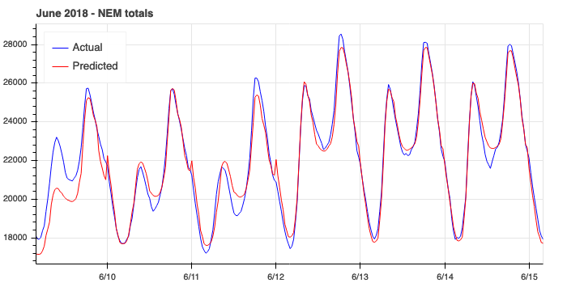
Notes:
Example of good result period - winter

Slide 13
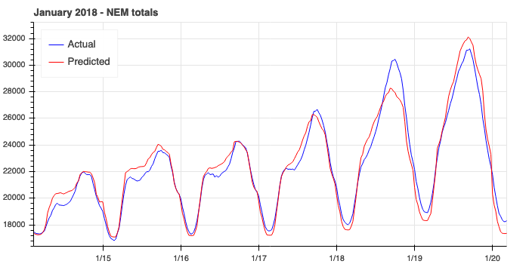
Notes:
Example of good result period - summer

Slide 14
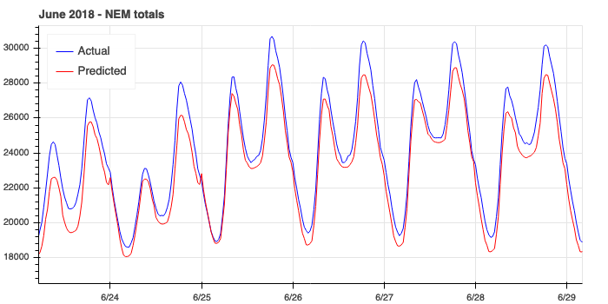
Notes:
Example of poor accuracy period - winter

Slide 15
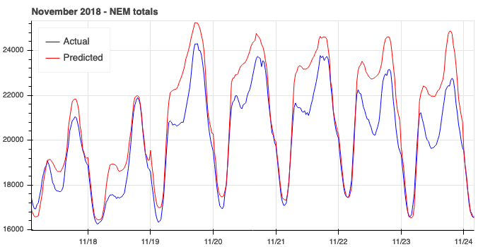
Notes:
Example of poor accuracy period - spring

Slide 16
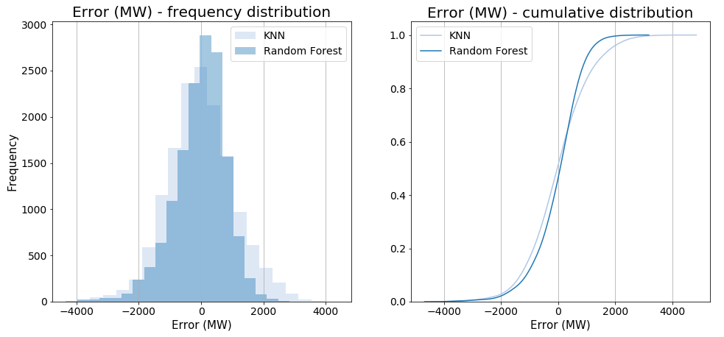
Distribution of Errors (NEM total)
Notes:
Graphs show error values for each half-hour period in 2018 hold-out test set for NEM total sum, frequency and cumulative distribution. Slight tendency to underestimate more than overestimate but is close to normal distribution.

Slide 17
Further work
Focus on periods of greatest error
More weather stations? Other weather data (pressure, humidity etc)?
Solar power production?
LSTM Neural Network
Improve time-dependent variables
ARIMA (SARIMAX) model

